Slide 1

Department of Veterans Affairs
Network Contracting Office (NCO) 21
VA Palo Alto Building 6
Wet Labs Renovation/Addition and Administrative Expansion
Scope Overview
May 8, 2014

Slide 2
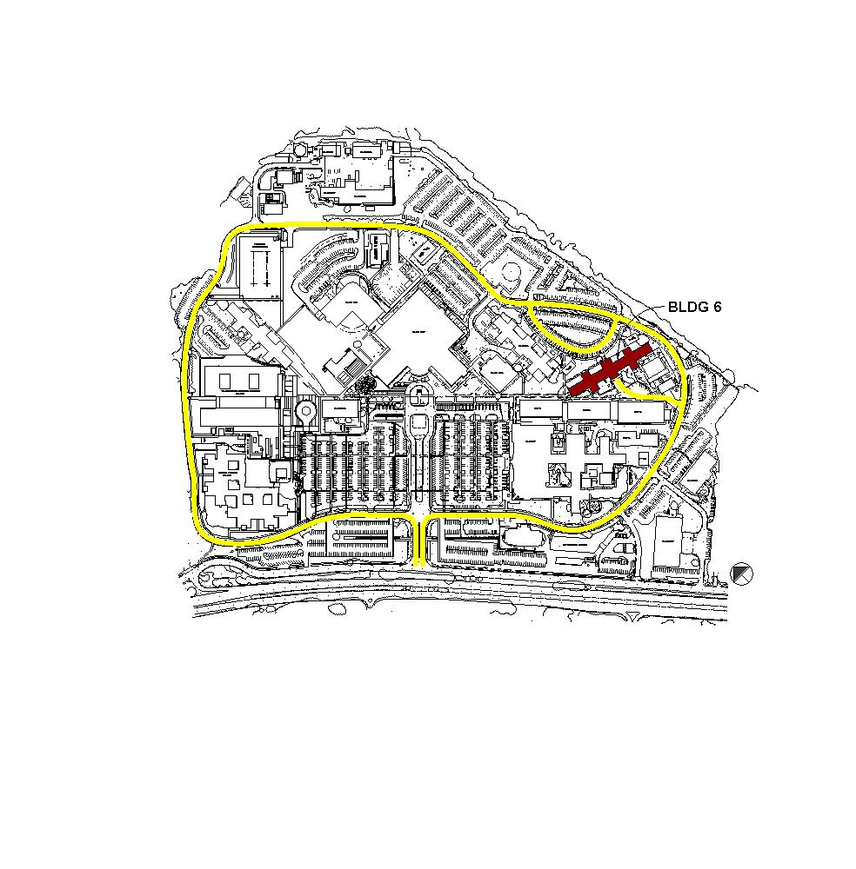
CAMPUS PLAN

Slide 3
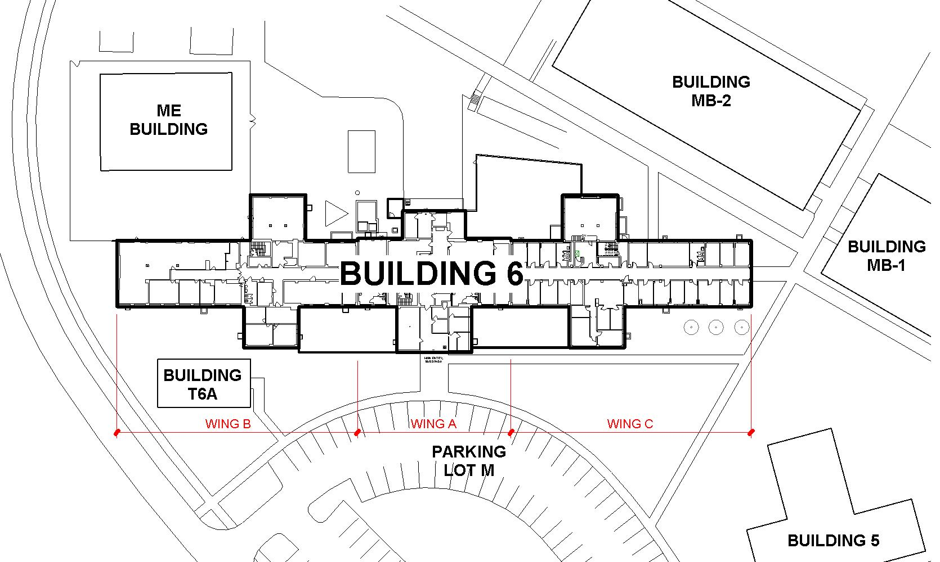
EXISTING SITE PLAN

Slide 4
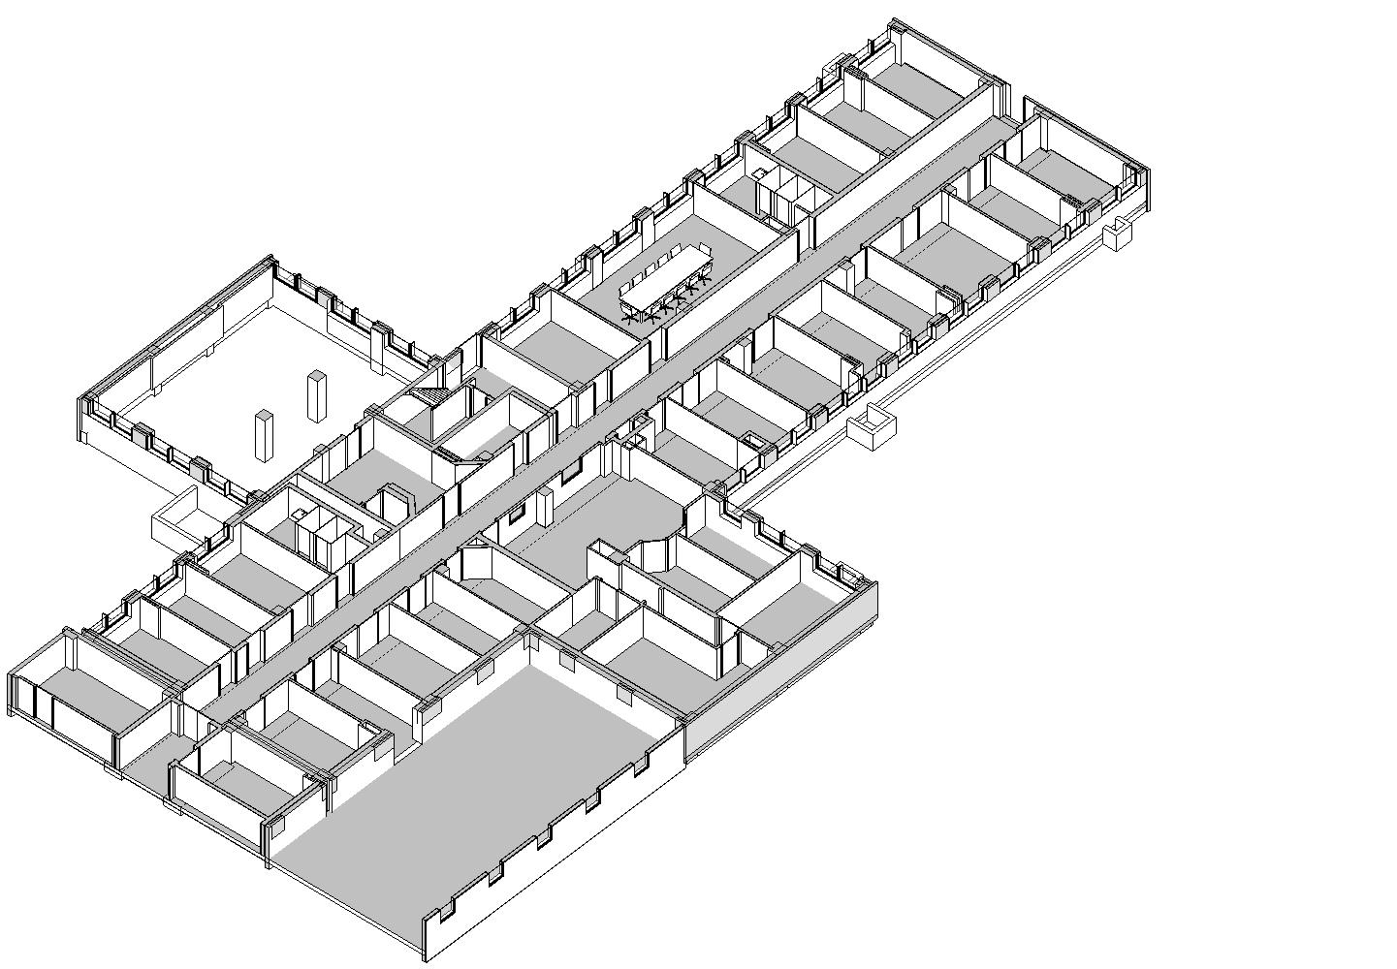
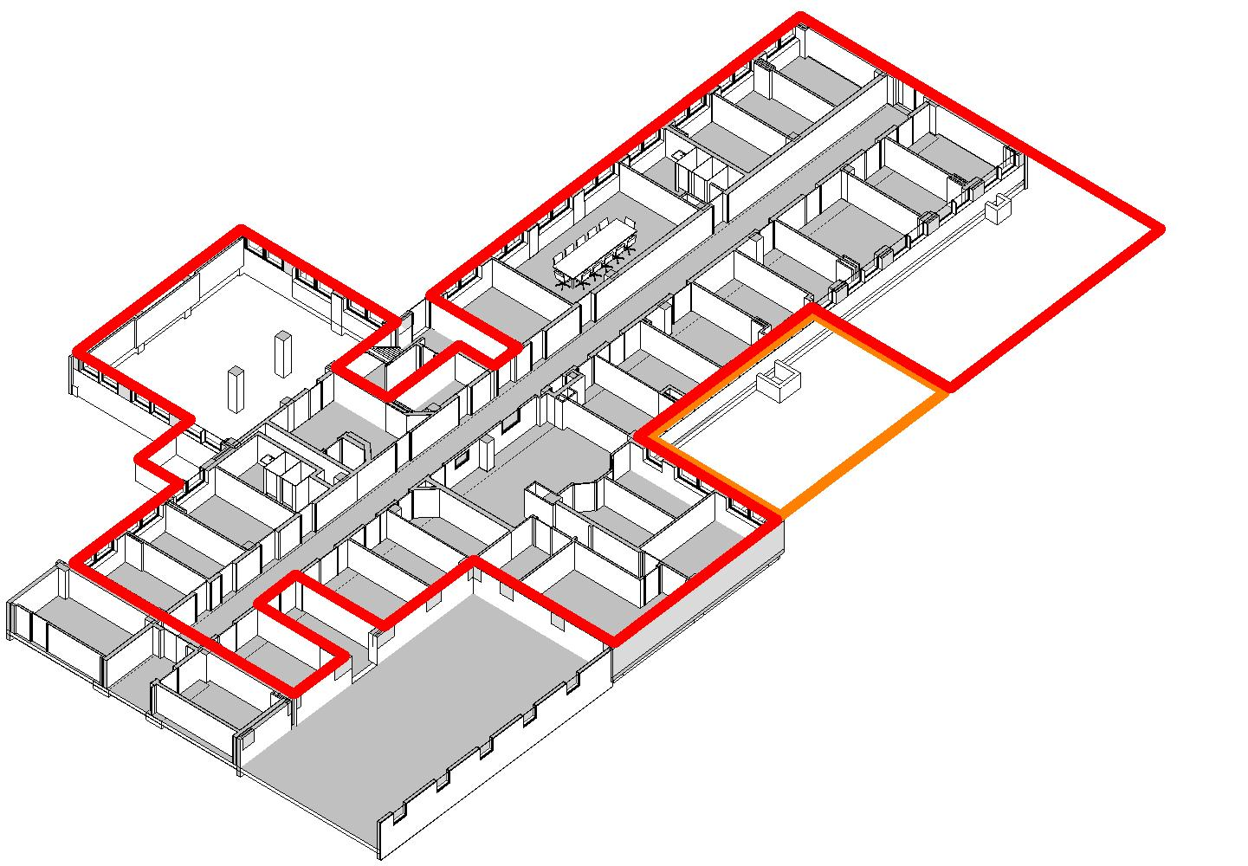
EXISTING FIRST FLOOR

Slide 5
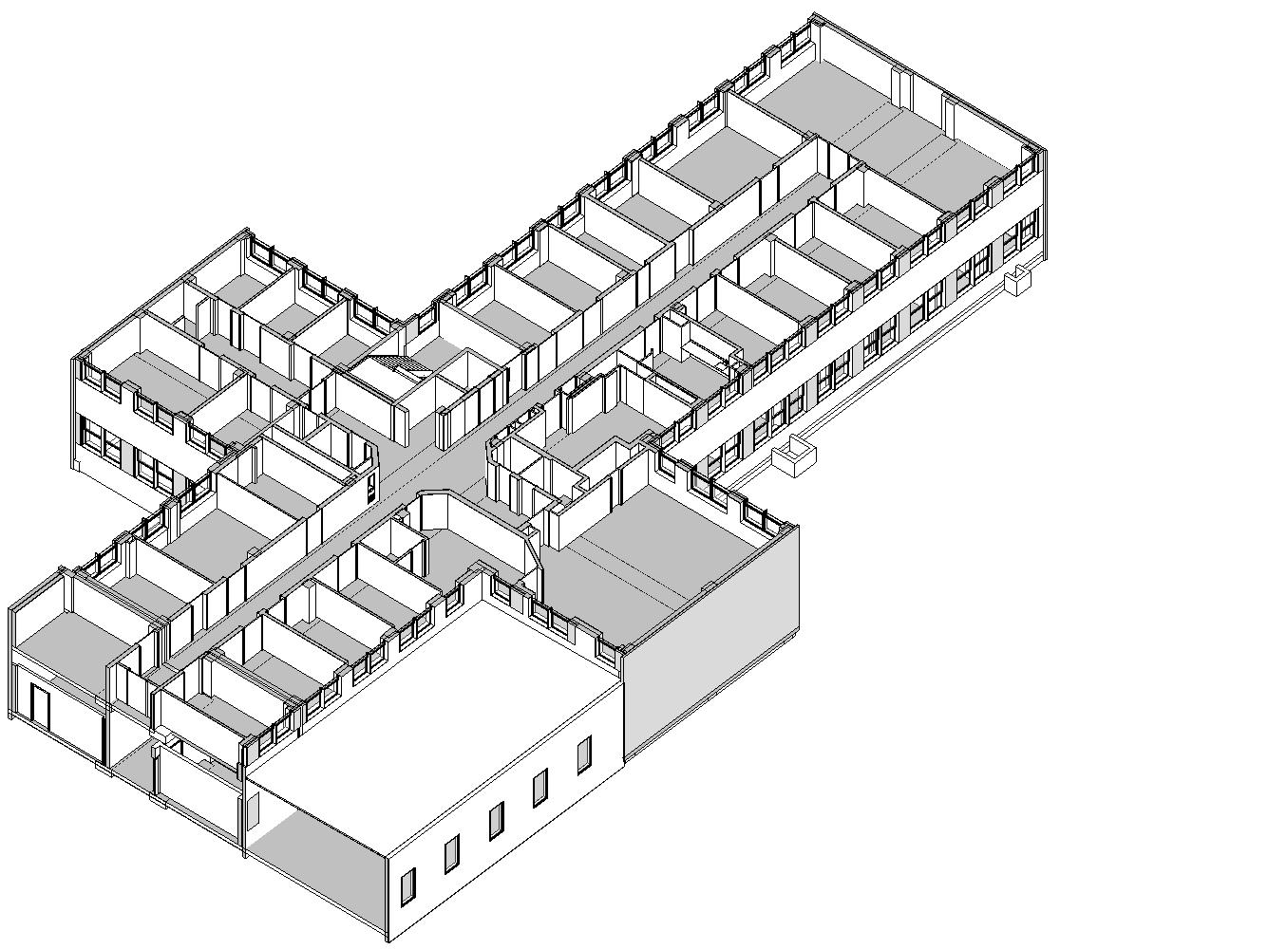
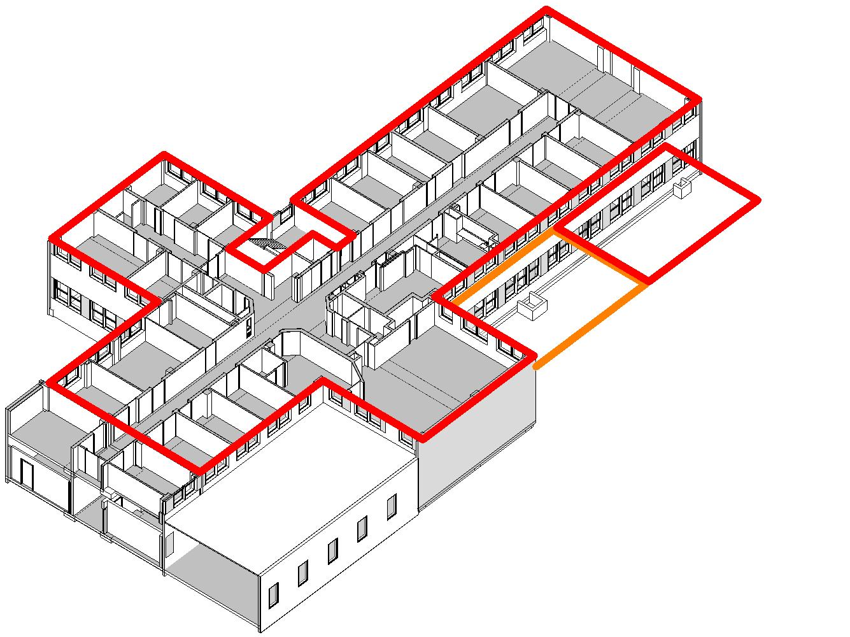
EXISTING SECOND FLOOR

Slide 6
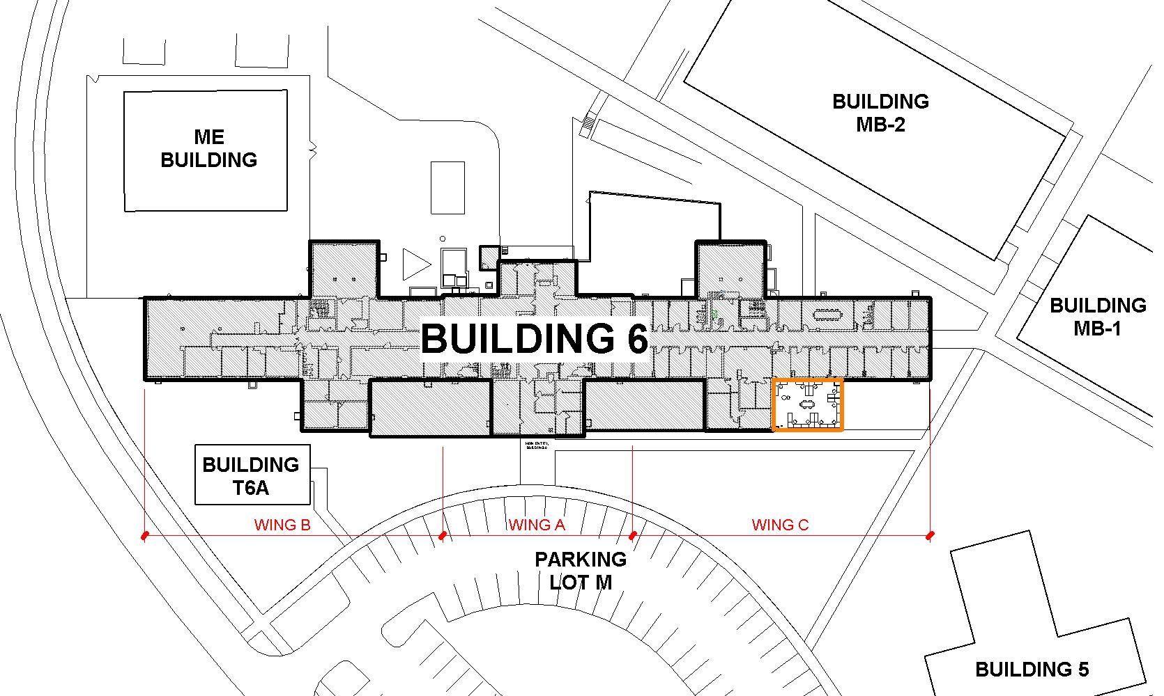
ADMIN SCOPE SITE PLAN

Slide 7
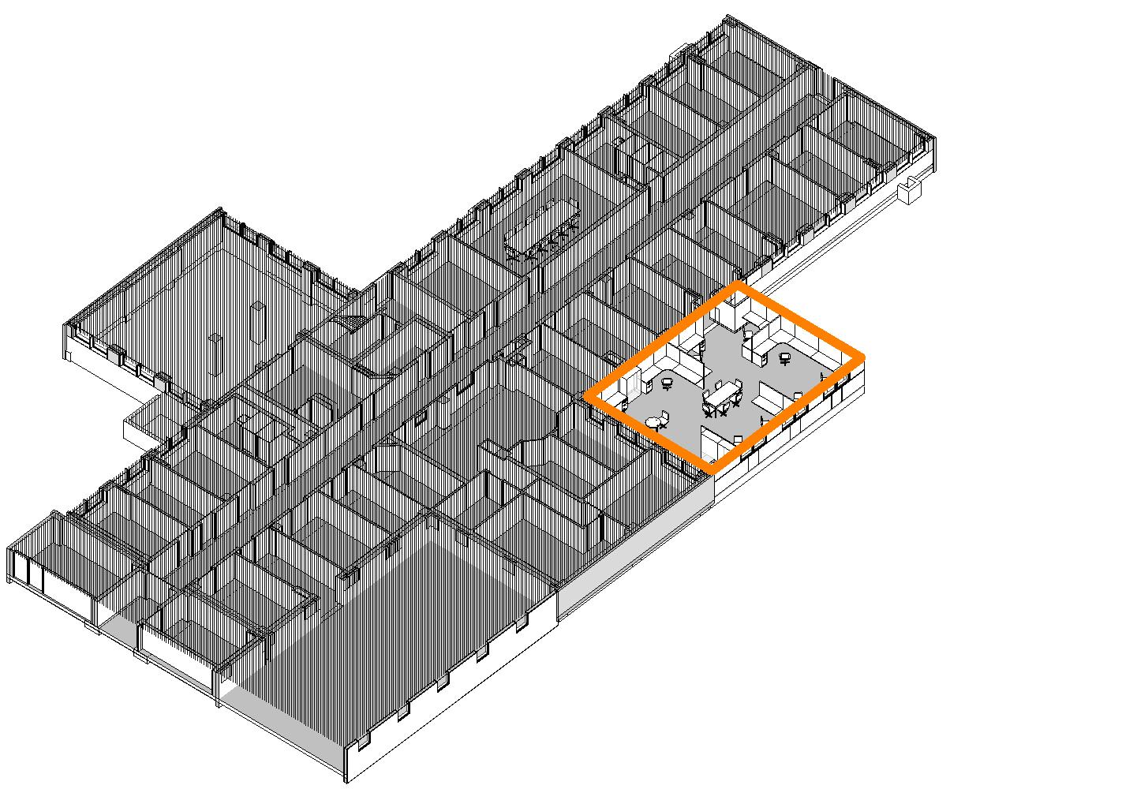
ADMIN SCOPE FIRST FLOOR

Slide 8
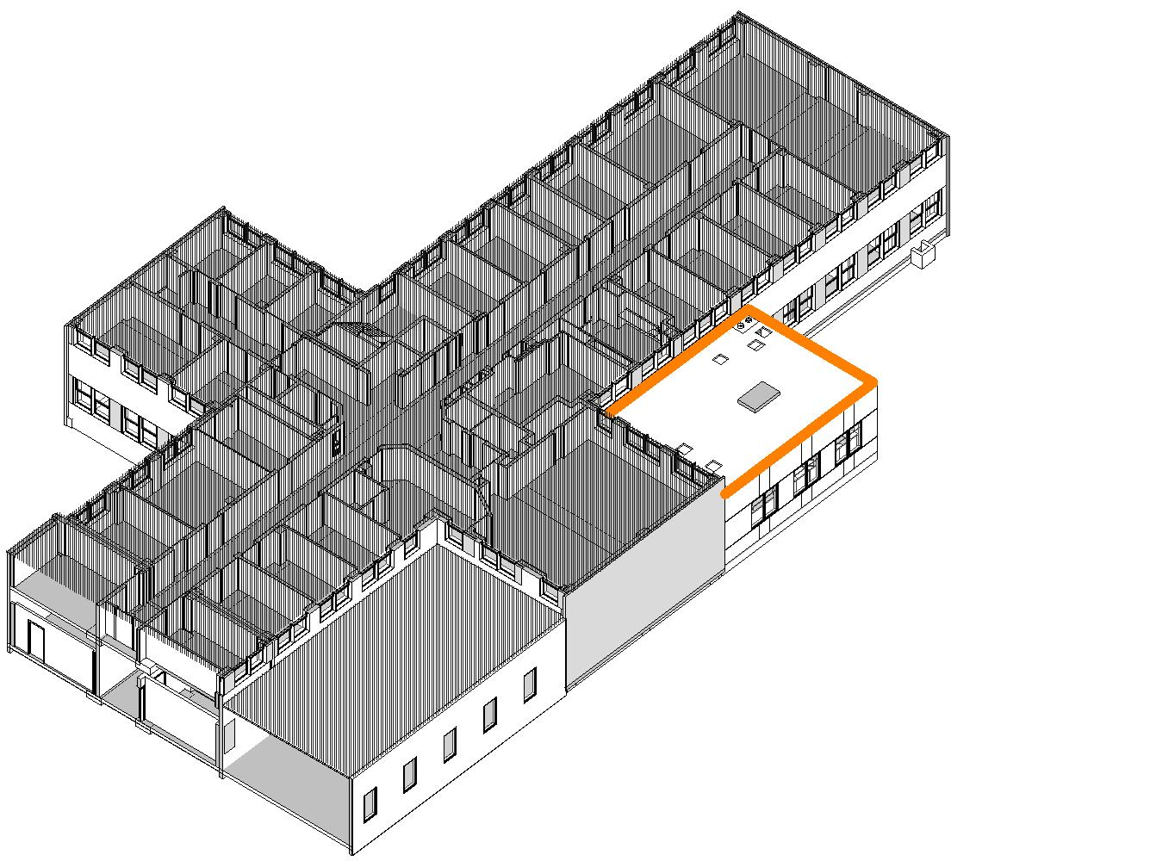
ADMIN SCOPE SECOND FLOOR

Slide 9
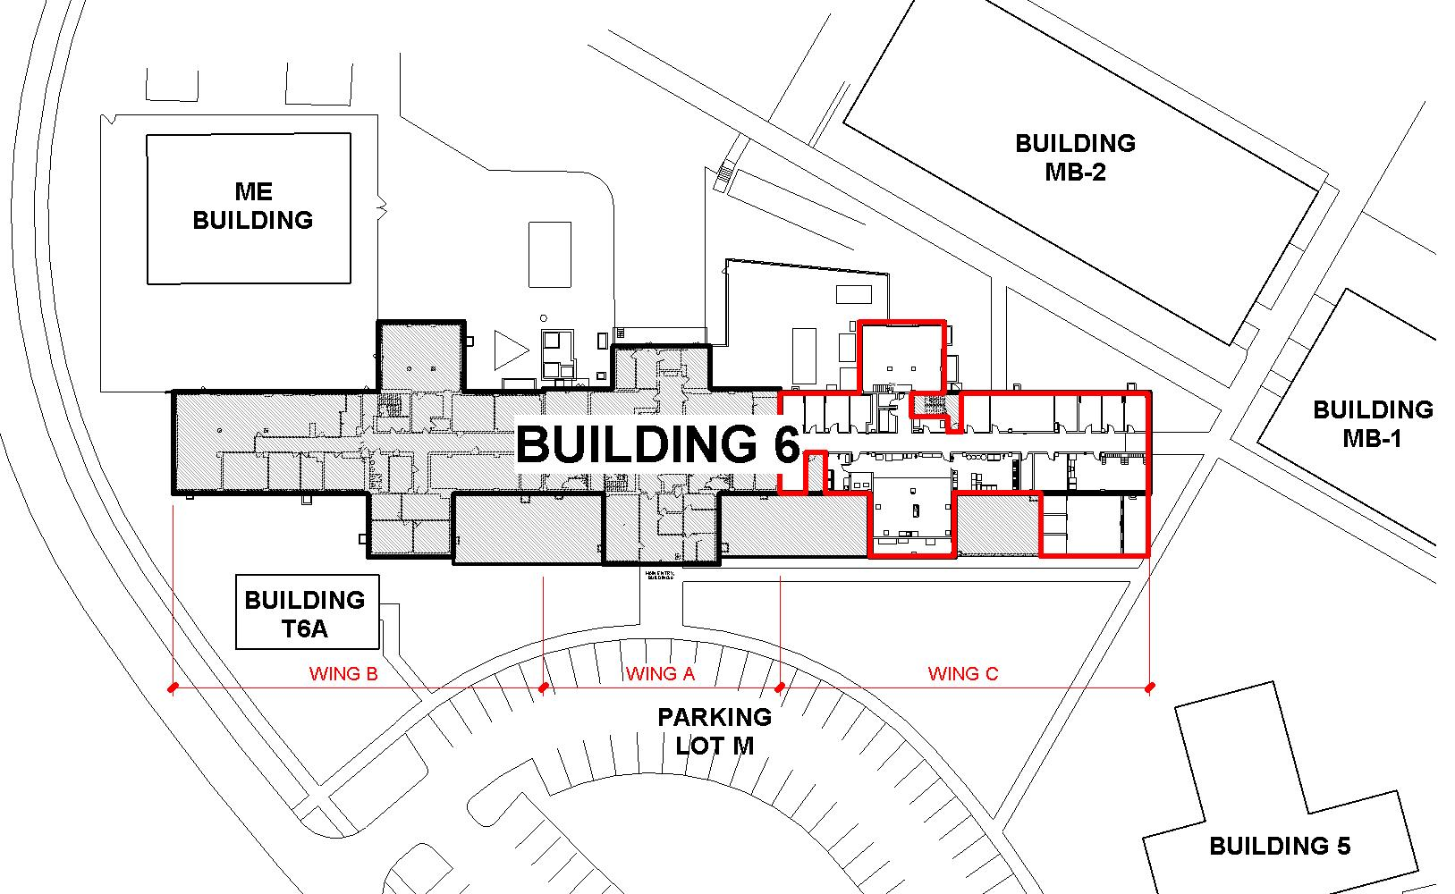
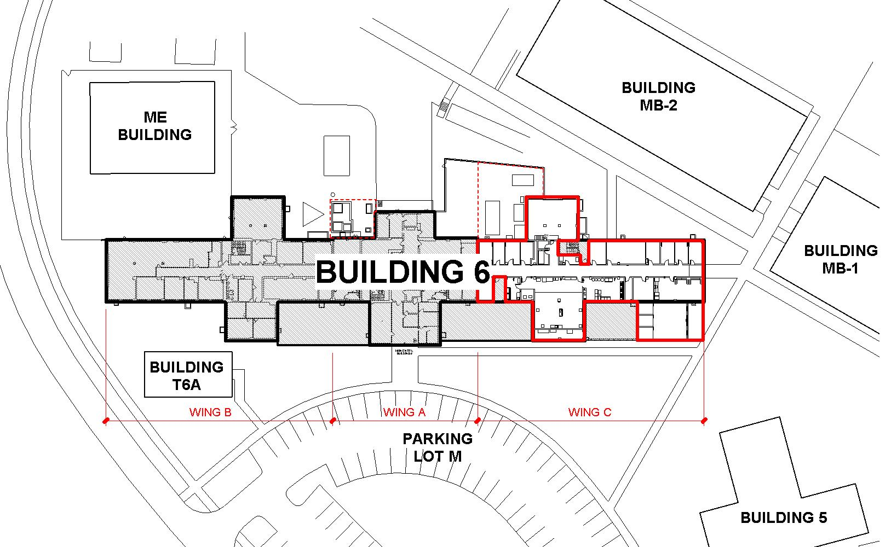
LAB SCOPE SITE PLAN

Slide 10
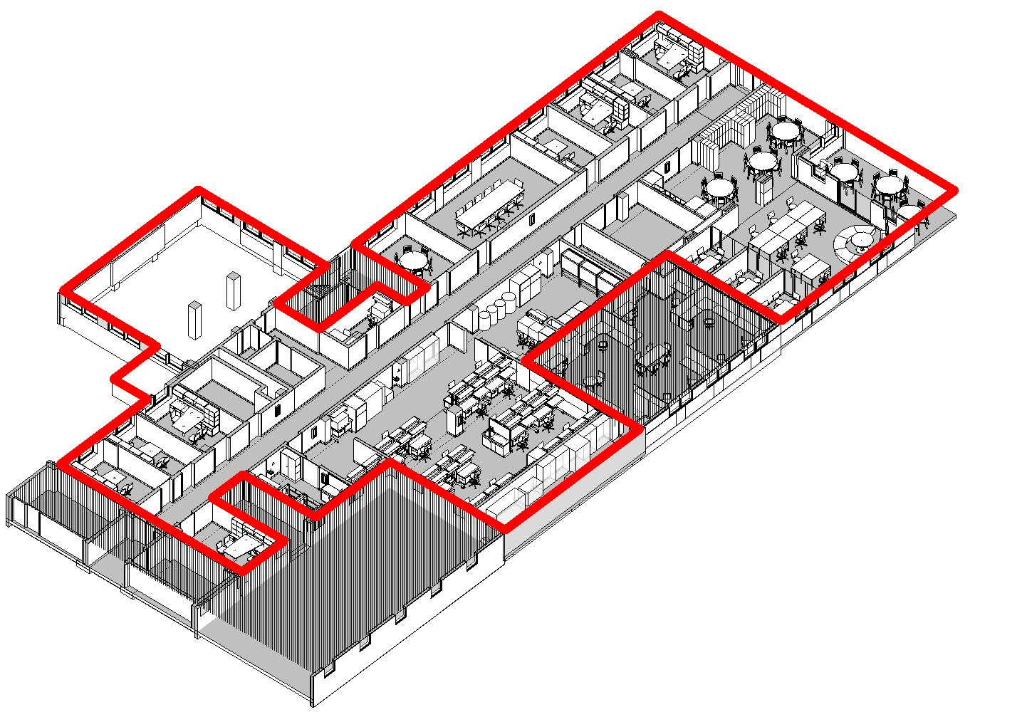
LAB SCOPE FIRST FLOOR

Slide 11
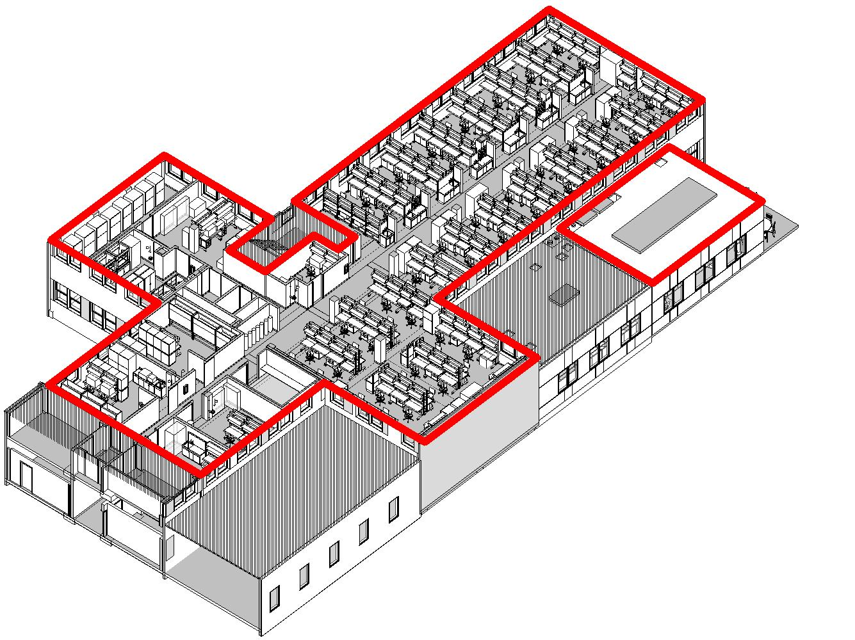
LAB SCOPE SECOND FLOOR

Slide 12
Questions??
Notes:
12

