Slide 1
VALU Monthly Project Review (VMPR)
Project Name/IN #
Vendor Date

Slide 2
Agenda
Executive Summary
Project Overview
Review of Action Items
Contract Status
Initiative Summary Status
Schedule
Task Details
Training Delivery Task – Course Status and Student Status
Rescheduled Courses (with cost impact)
Training Delivery Task – Student Status
Financial Status
Issues
Risks
Lessons Learned

Slide 3
Executive Summary
Key Task Status:
Top Issue/Decisions Needed:
Key Upcoming Milestones/Activities/Contract Actions:

Slide 4
Project Overview
GOAL
Key Milestones
Indicate key milestones per Statement of Requirements
POCs
Vendor PM:
Provide a short description of the project goal
POP
Management Plan POP:
Client Agency PM:
OPM PM:
Task Order POP:

Slide 5
Review of Action Items
# | Action Item | Owner | Due Date | Status | Comments
0
1
2
3
4
5
6
Note: This slide should include the status of all action items from previous VMPRs. Once the action is briefed as closed during the VMPR, it can be removed from this list for the next VMPR.

Slide 6
See note pages for descriptions of column headings.
Contract Status IN #
Event/Date | Change Request | PoP | Line Items Affected | Status
Contract Award |  | 6/1/2010 -5/31/11 | 1, 2, 3, 4, 6, 7 | Complete
Mod 1 - 8/16/10 | Increase funds for surge training | – | 3 & 4 | Complete
Mod 2 - 12/21/10 | Add portal development | - | 5 | Complete
Mod 3 - 2/7/11 | Remove Communication Support task | - | 6 | Complete
Mod 4 – 3/4/11 | No-cost Pop extension |  | 3, 4, 5 & 7 | Submitted
Contract Issues: | 1) awaiting finalization of which courses will be included 2) invoices over 90 days
Requests that have been submitted, but not yet approved should be highlighted using red italics text.

Slide 7




UPDATED SLIDE New
Initiative Summary Status
 | Task Title (include PoP) | Key Deliverable(s) | % Task Complete | Schedule Status | Total Funded Amount | Cumulative Planned Expenditures | Cumulative Actual/Expended Amount | Pending Deliverables Received Forms (DFRs) Amount | Financial Status
0
1
2
3
4
5
6
7
 |  |  | TOTAL
PENDING FURTHER REVIEW
Schedule Status
High likelihood for on-time task completion
Potential for delay to task completion (corrective actions have been implemented)
Strong likelihood for delayed task completion OR corrective actions have no
Financial Status
Spending is within 5% (+/-) of planned expenditures
Spending is between 5% and 10% (+/-) of planned expenditures
Spending has exceeded planned expenditures by 10% (+/-)
New

Slide 8
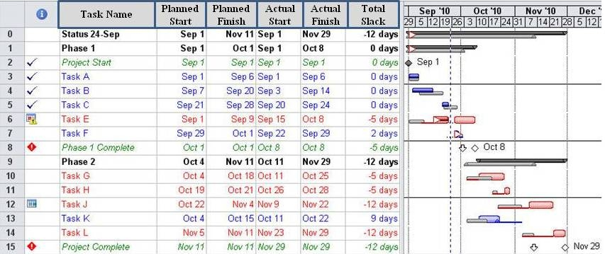
IN# Schedule
Please make sure that planned start & finish and actual start & finish dates are included on your schedule
Note: Provide MS Project-based summary schedule that displays all major tasks with milestones and deliverables. Provide roll-ups to level 3 or 4, but the schedule should not exceed 1 PowerPoint slide. However, extra schedule slides can be included as back-ups to address particular areas of concern if necessary. (Note: Initial schedule should remain constant – with all future deviations shown from that point)

Slide 9

Task Details (1 of 2)
(VALU: Jane Doe/Vendor: John Doe)
Include the names of the VALU and Vendor POCs for each task.
Each task will have its own set of the following information:
Task # (Name):
Objectives
  List the objectives for the task
Execution Plan
  Indicate how this task will be completed
  For training vendors only, include the number of planned courses; and if using the same resources, include the number of additional courses that you could conduct.
Dependencies
  List any dependencies for the task (ex. cross projects, critical path, IT Component, etc)
Assumptions
  List any assumptions for the task
Resources
  List any resources that may be needed to complete this task (ex. travel, SPI, etc)

Slide 10
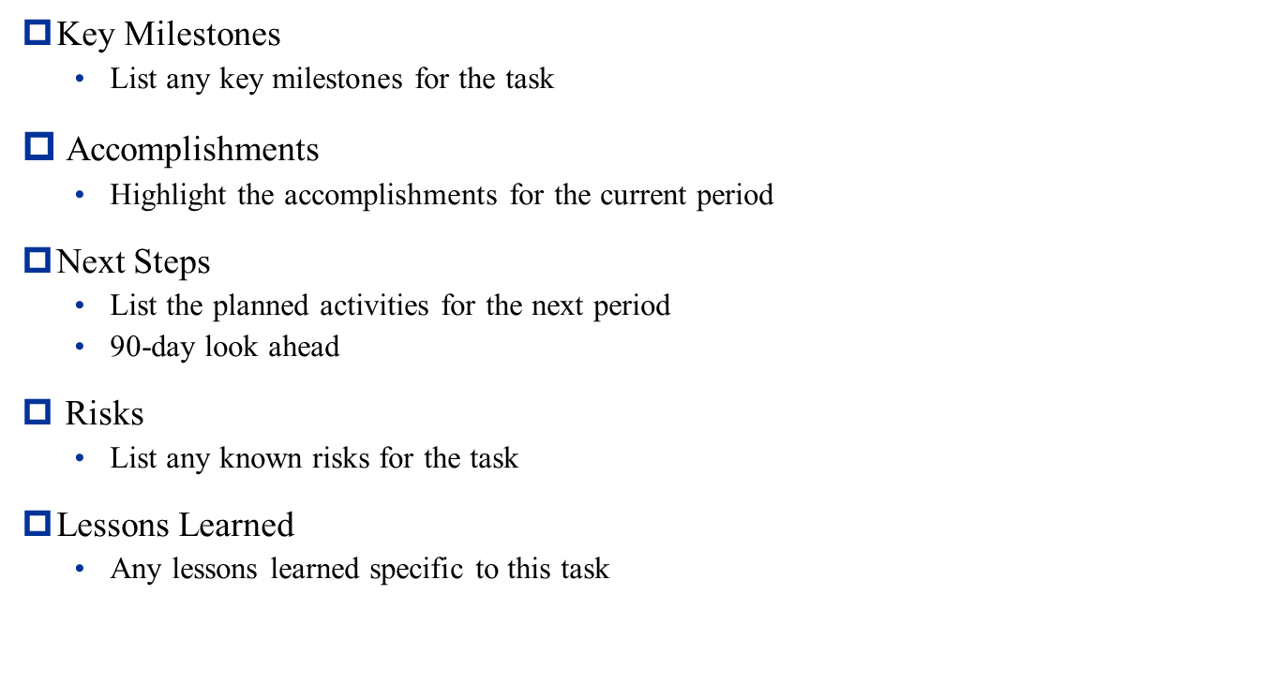
Task Details (2 of 2)

Slide 11
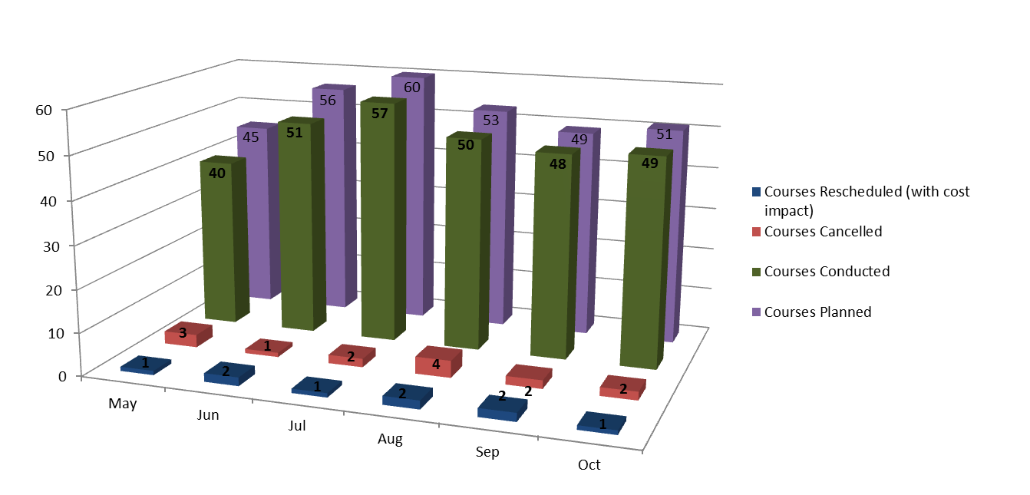
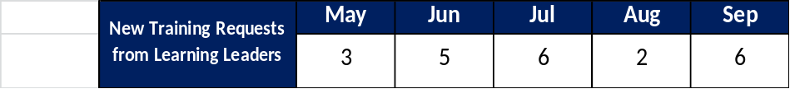
Training Delivery Task –Course Status
Planned vs. Actual
PENDING FURTHER REVIEW
Note: (To be completed by training vendors ONLY.) For each training delivery task, provide a graph showing
planned vs. actual course delivery for the duration of the PoP similar to the Advance graph shown above. Show
Courses rescheduled (only those that resulted in a cost impact),courses planned, actual courses completed,
and cancellations. Include the number of new training requests from Learning Leaders per month.

Slide 12
Rescheduled Courses
(with cost impact)
List rescheduled courses since the last review.
  Course Name
  Reason for rescheduling
  Name of facility that made the request
  Total Cost
Note: (To be completed by training vendors ONLY.) . Provide details for rescheduled courses that resulted in a cost impact ONLY.

Slide 13
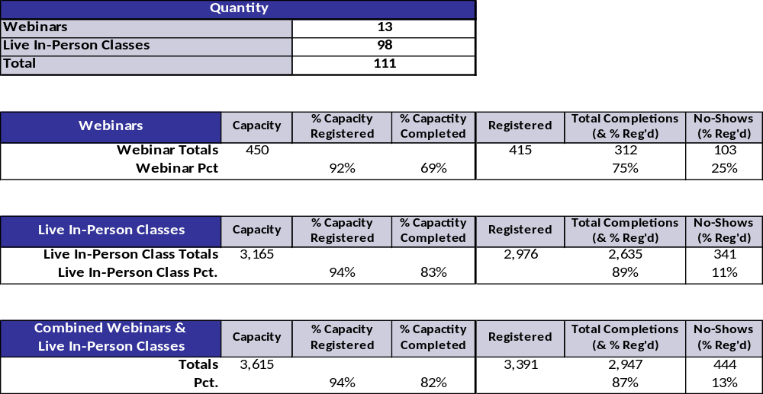
Training Delivery Task – Student Status
Planned vs. Actual
PENDING FURTHER REVIEW
Note: (To be completed by training vendors ONLY.) Optional, but recommended for each training delivery task. Provide metrics for lecture style classes, webinars, keynotes. Provide attendance metrics, if available (i.e., registered, complete, no-shows).

Slide 14
Financial Status
Financial Planned vs. Actual ($ thousands) – MM/DD
1
PENDING FURTHER REVIEW
New
IMPORTANT NOTE: Add footnotes for providing explanations for significant variations in the data shown on the graph.
Example: Underburned in March 2010 due to delays in obtaining data from SMEs
1

Slide 15
See note pages for descriptions of column headings.
Issues
# | Task # | Issue Name | Issue Description | Proposed Resolution | Resolution Date | Status
1 |  | Brief descriptive name | Clear and concise description of the issue
2 |  | Example: Limited availability of SMEs | Conducting interviews with SMEs has not been completed as scheduled due to limited availability of SMEs which will delay the delivery of the quarterly report.
3
4
5
Note: This table should be a cumulative list of all issues through the current VMPR reporting period. Issues that have been closed should be moved to the end of the list.

Slide 16
See note pages for descriptions of column headings
Risks
# | Task # | Risk Name | Risk Statement | Risk Level |  | Proposed Mitigation Strategy | Impact Date | Status
 |  |  |  | Prob | Impact
1 |  | Brief descriptive name | Risk Event (“if” statement), Impact (“then” statement)
2 |  | Example: Extended coding duration | If developers cannot complete the code by March 5, 2007, then the start of testing and the project itself may be delayed by up to three weeks.
3
Impact | LOW (L) | MED (M) | HIGH (H)
Cost
Schedule | Minimal schedule slippage | Moderate schedule slippage | Significant schedule slippage, recovery impossible
Performance
Probability
LOW (L) 1% - 40% - Highly Improbable/Unlikely
MED (M) 41% - 60% - Possible
HIGH (H) 61% - 99% - Probable/Extremely Likely
Note: This table should be a cumulative list of all Risks identified through the current VMPR reporting period.

Slide 17
Lessons Learned
List any lessons learned from the overall project, not task specific.
Note: Should be for the current VMPR reporting period.

Slide 18

Questions?

