Slide 1
Investigations Processing
Jessica Roberts
Personnel Security Lead
VHA Service Center
Notes:
My presentation today reflects some of the most asked questions about investigations processing specific to contractor personnel.
If I do not cover a topic you would like more information on, please email VSCSecurity@va.gov

Slide 2
Personnel Security @ the VSC
Handles Security processing needs for:
  @ 5000 federal positions
  VHA Contractors
  Students
  WOCs
  Volunteers
  All within the VHA
  Soon VBA
  Detailed to SIC

Slide 3
Personnel Security/VSC Benefits
Customer Service!
Expertly trained personnel
No help desk – personal attention
SAC Adjudication
Standard Process

Slide 4
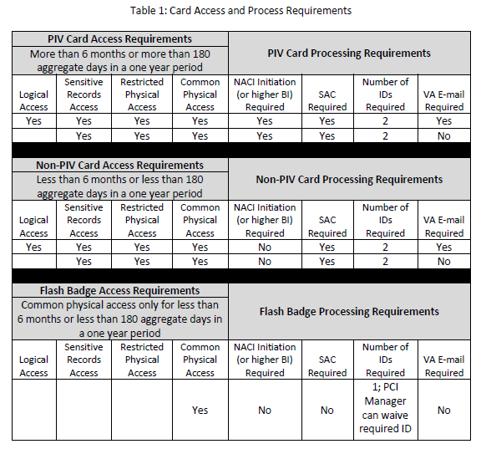
PIV Badge
Notice the 180 days theme
Badge Type vs. Risk
Contract may require multiple badge types
Notes:
The 180 days is the magic number to immediately try and establish badge type. Badge type should be completed prior to risk designation. You may have multiple badge types on each contract.
For example: an IT contract may have technicians running wire in an area where no IT is connected for 3 months in a building that has not been released to the government yet;
it may also have a Project Manager that knows all the IT architecture information and has unlimited server access for the duration of the two year contract;
then you may have IT specialists that set up machines but do not have any VA intranet access for the duration of their phase, 5 months beginning after the building has been released to the government and server rooms have been secured.
The Wire Techs need a Flash badge; the project manager needs a full PIV with a High Risk BI, and the IT Specialists need a Non-PIV unless they will continue work past the 180 day mark.
Once a badge type has been established, position risk needs to be identified for all Contractors requiring Full PIV.

Slide 5
Flash Badge
No Security Process
Local credential that requires one form of ID federally – facility may add to that
VSC does not process for most cases

Slide 6
Non-PIV
Requires 2 forms of ID
Requires a favorably screened SAC
Must be less than 180 total days in a one year period

Slide 7
PIV
Anything greater than 180 total days in a one year period regardless of the duties
Needs 2 forms of ID
Needs SAC
Risk Assessment must be conducted to establish investigation type
Investigation must be in schedule at OPM with a favorably screened SAC

Slide 8
Position Risk
PDAT Tool
Regulation: VA 0710 Para. 2e4
Helpful Hints:
  High Risk
  Moderate Risk
  Low
Notes:
The PDAT Tool that was downloadable is now superseded by the online version.
VA 0710 Para 2e4 says: The PDAT will be used by the CO and COTR to designate the statement of work or written description for contract employees.
High Risk indicators are:
~Policy or Program authority
~Higher level managerial assignments
Authority for Independent Action
Responsibility for planning, directing, controlling, implementing, developing, designing, and/or administering: IT systems, Agency IT security, IT risk analysis and threat assessments, computer security, conducting investigations
System access for causing: grave damage, very serious adverse impact, significant personal gain
~Privileged access to IT systems and infrastructure
~Assignments involving accounting, disbursement, or authorization of $10 million or more per year
Access to systems that interconnect with VA network in such a way as to enable a user to bypass firewalls or systems operated by any VA contractor, or another contractor whose function and data has substantial value.
Moderate Risk indicators are:
Assists in policy development and implementation
~Mid-level managerial assignments
~Non-management positions with authority for independent or semi-independent actions
Responsible for direction, planning, designing, operating, or maintaining IT systems and whose work is technically reviewed by a higher authority to insure the integrity of the system.
System design, operation, testing, maintenance, or monitoring which is under technical review of IT High Risk includes:Systems that contain the primary copy of data whose cost to replace exceeds $1 million.
Control system which affect personal safety and/or physical security, fire, or Hazmat warning safety systems
~Priveleged information on contract awards in excess of $10 million
Accouting disbursement or authorization of more than $1 million, but less than $10 million per year
~Access to data or system whose misuse can cause serious adverse impact or result in personal gain: Proprietary data (VA and/or Contractor), Privacy Act
Limited privileged access to any IT systems whose misuse can cause adverse impact to the VA
Low Risk indicators are:
Position has little effect on the efficiency of the Agency’s programs and operations
Non-sensitive positions and all other positions involving IT systems whose misuse has limited potential for adverse impact to sensitive data, which is protected with a password and encryption.

Slide 9
Forms and Website links
VSC PerSec Services Packet
Reissuance Form
Website – Scroll to Security Section
New
  Signature
  Email vs snail mail
  Supplemental form
  SOP- Release date is TBD but soon!
Notes:
Signature = Verification from the CO that the contract has officially been awarded and individuals listed have a vetted contractual relationship with the government and delegation of responsibility to sponsor the contractors.
Email address for employee is listed to expedite individual requests
Supplemental form leaves more room for larger contracts
The SOP is finished and should be released soon….easier to understand…more consistency with VA policy and federal regulations.

Slide 10
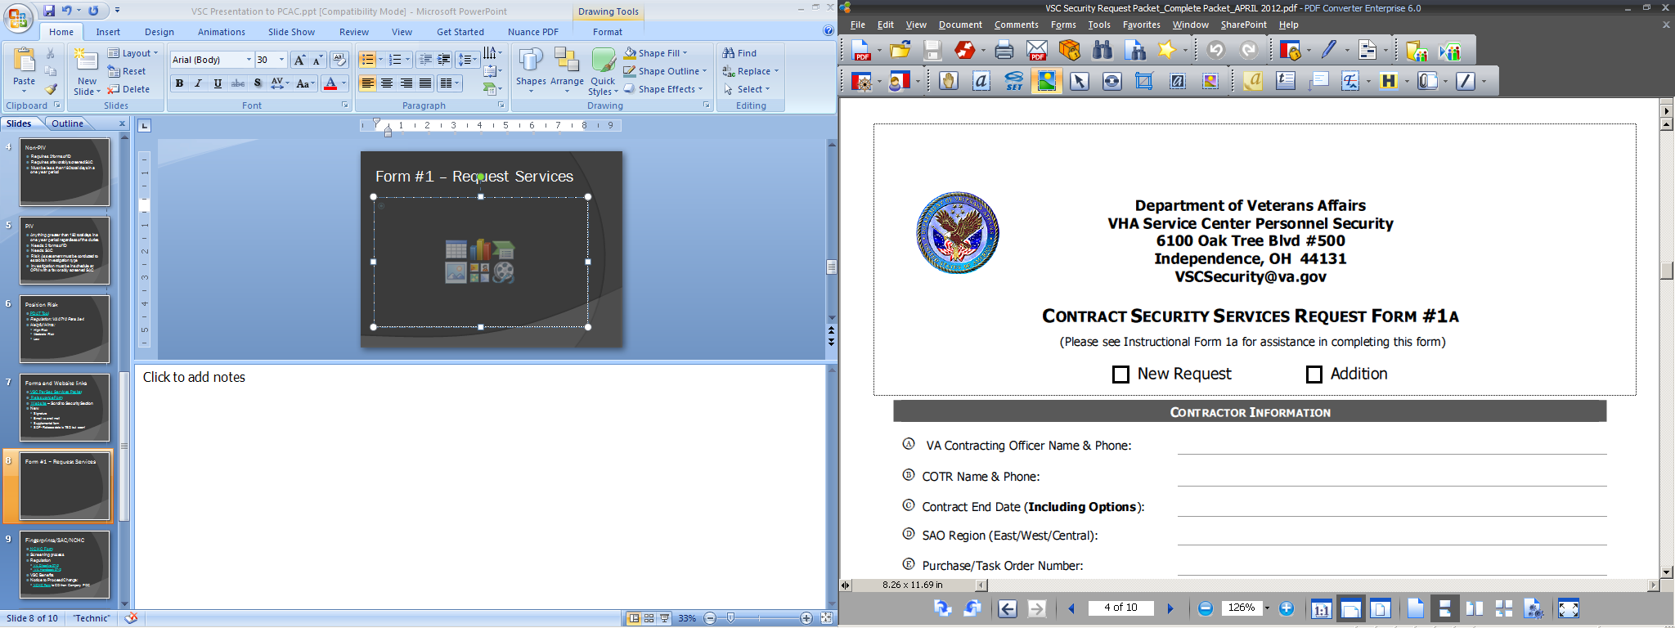
Form #1 – Request Services
New Request vs. Add-on
Note: email address

Slide 11
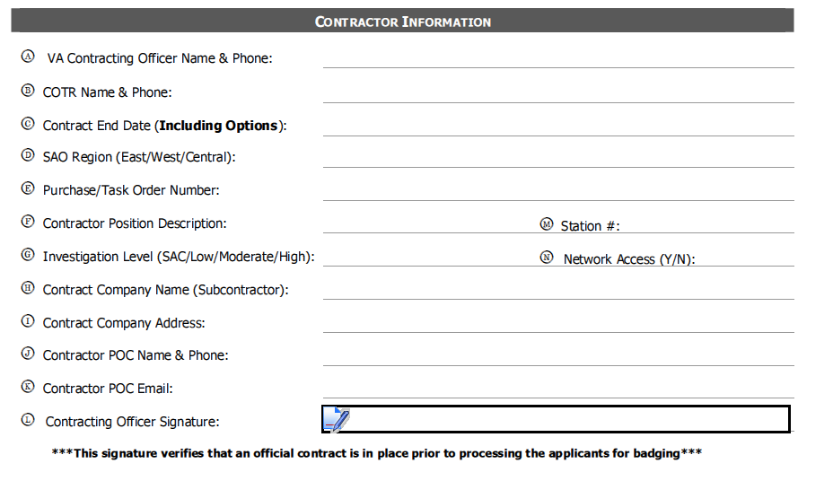
Form #1 – Request Services
Notes:
All blocks must be completed
Contract End date: Annotate latest end date to ensure proper processing for badges.
SAO Region: East West Central are the only answers here; used for billing.
Signature: If form is sent electronically by the CO or COR, a signed email including the form will be accepted in lieu of wet signature or signature through Adobe.
Signature provides us the authority to proceed and assigns us the responsibilities indicated of the CO or COR in the regulations.

Slide 12
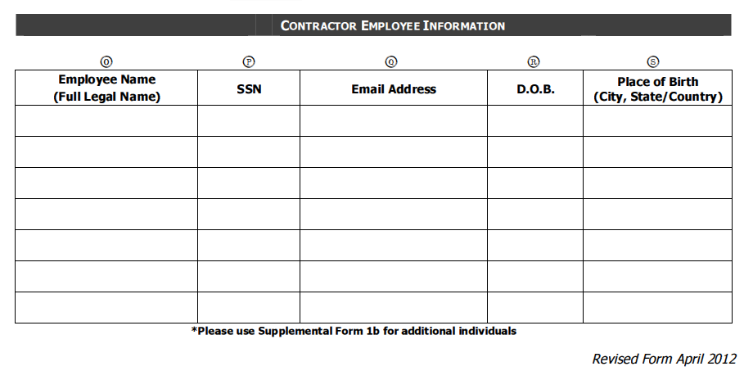
Form #1 – Request Services
Notes:
Only optional field is email.
4 data elements form should be encrypted or password protected if sent electronically.
For Password Protection:
Select Document/Document Properties/Security (tab)
Security Method: Password Security
Indicate: “Allow document opening by password”
Key in a ‘Document Open Password’
Send password in a separate email.

Slide 13
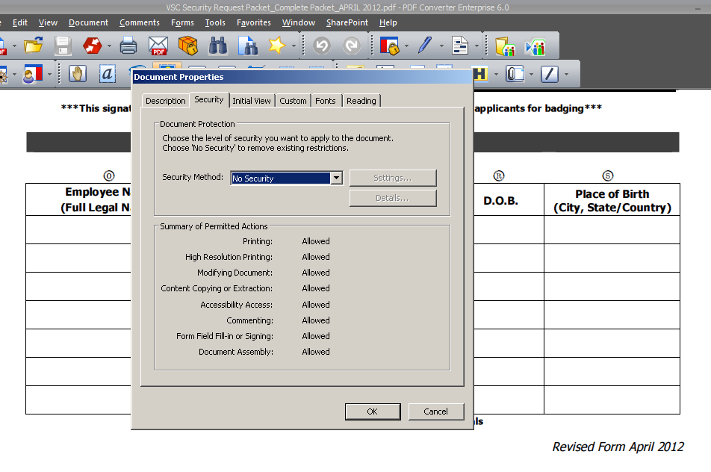
Password Protection in Adobe
Notes:
For Password Protection:
Select Document/Document Properties/Security (tab)
Security Method: Password Security
Indicate: “Allow document opening by password”
Key in a ‘Document Open Password’
Send password in a separate email.

Slide 14
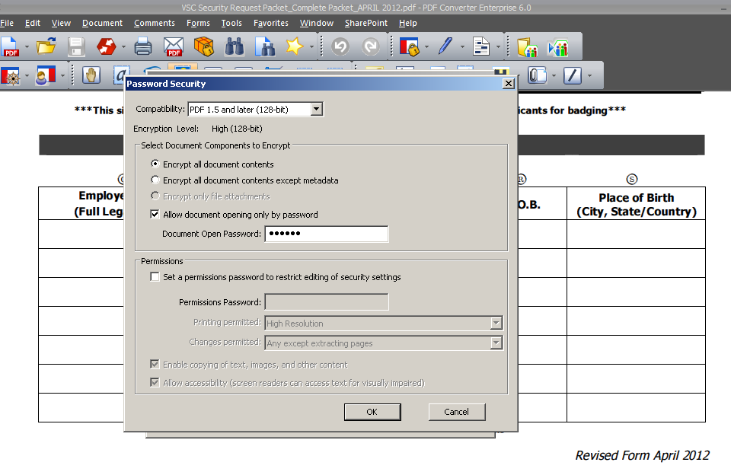
Password Protection in Adobe
Notes:
For Password Protection:
Select Document/Document Properties/Security (tab)
Security Method: Password Security
Indicate: “Allow document opening by password”
Key in a ‘Document Open Password’
Send password in a separate email.

Slide 15
Fingerprints/SAC/NCHC
NCHC Form
Screening process
Regulation
  VA Directive 0710
  VA Handbook 0710
VSC Benefits
Notice to Proceed Change:
  NCHC Form to CO then Company POC
Notes:
The NCHC form is used to communicate fingerprint screening. This documentation is usually accepted by most ISOs. If it is not accepted, sometimes all that is needed is a phone call to the ISO to instruct them on what work goes into completing the form.
VSC Benefits:
The SIC does not screen Fingerprint checks, only at the VSC will your contracts receive a screening verification.
Work begins much earlier for contractor personnel.
No help desk; an individual is assigned to the contract for the entire duration.
Customer Service!
SOP will state that the NCHC form will be forwarded from the CO/COTR to the Contractor POC as the “Notice to Proceed” for the individuals that have a favorable screening.

Slide 16
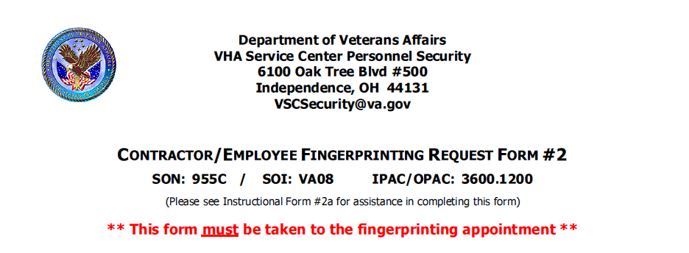
Form #2 – Fingerprint Request
Any facility
Be sure to change SON/SOI

Slide 17
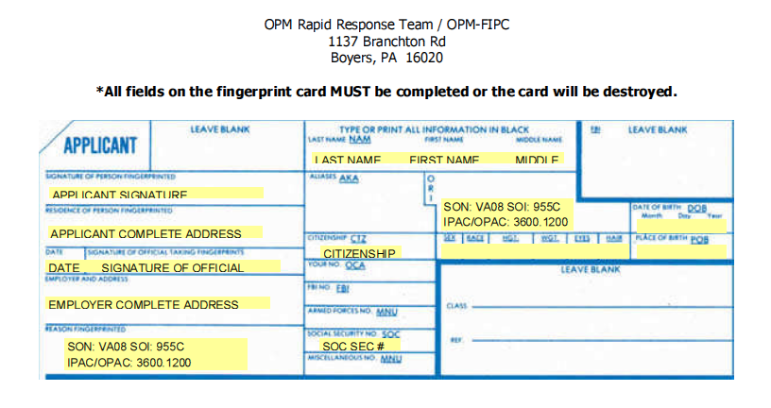
Form #2 – Hard Copy
Not Recommended

Slide 18
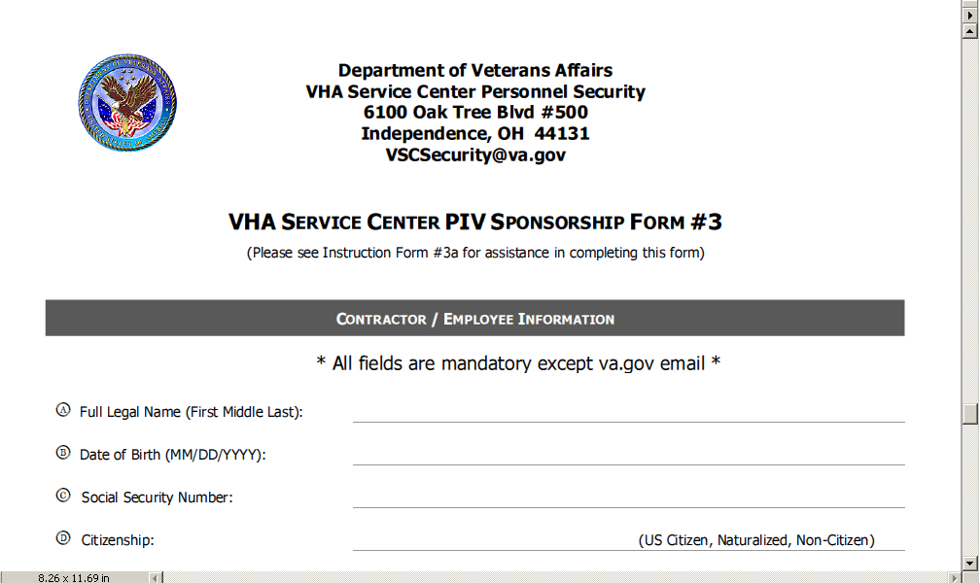
Form #3 – PIV Sponsorship
All fields are mandatory

Slide 19
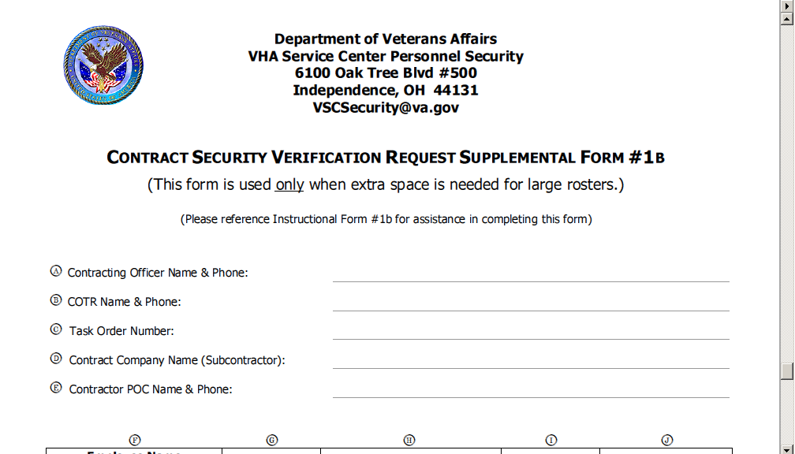
Form #1b – Supplement
Notes:
Only needed for larger contracts.

Slide 20
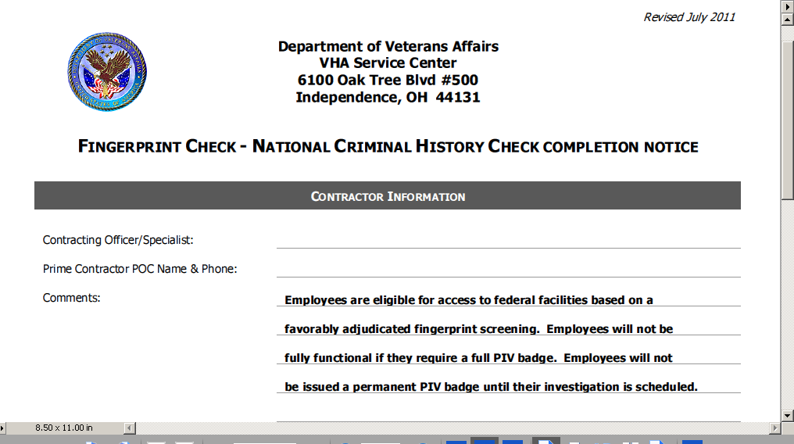
NCHC Form – Screening Notification

Slide 21
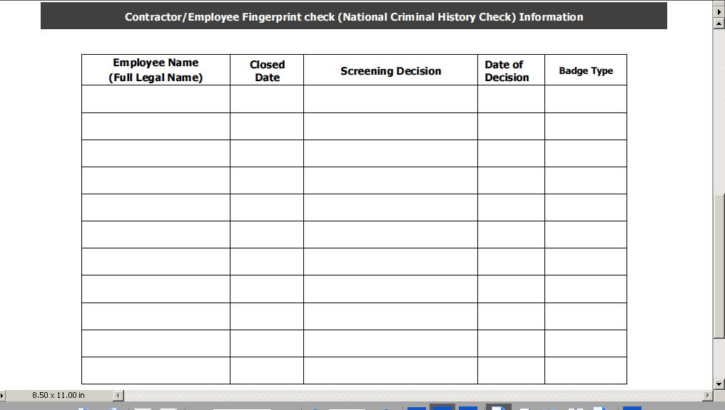
NCHC Form – Screening Notification

Slide 22
Timelines
Initial Communication – 5 days of award date
NCHC Form/Notice to Proceed – 5 days of assignment/fingerprint completion date of last individual printed
Investigation Request – Parallel within 10 days of assignment
**All timelines are dependent upon Contracting staff and Company staff cooperation.

Slide 23
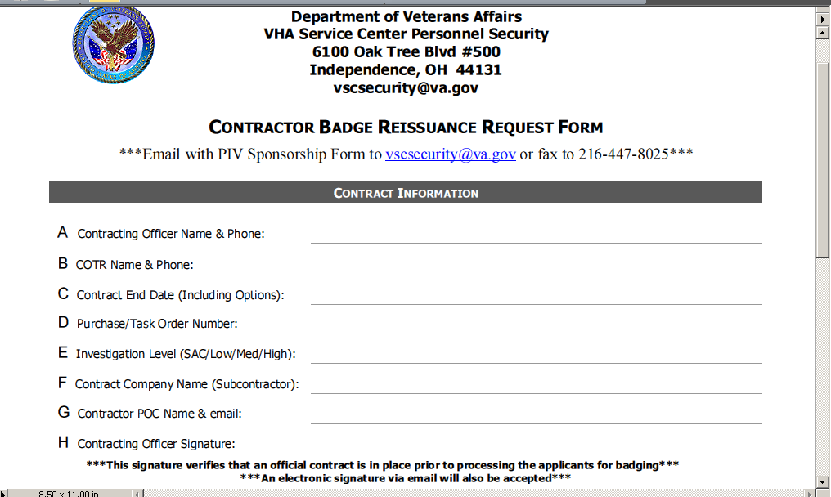
Badge Reissuance

Slide 24
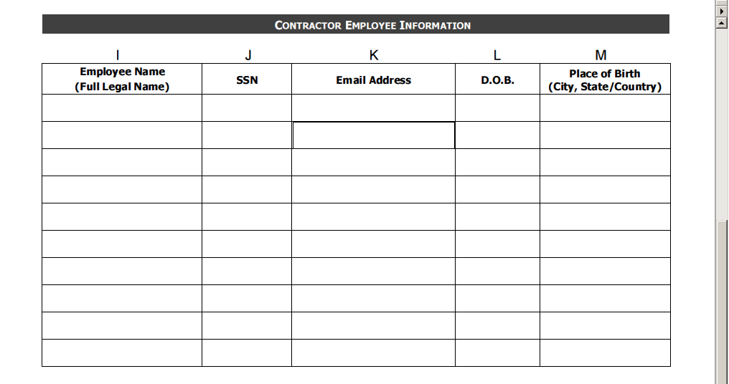
Badge Reissuance

Slide 25
Questions?
VSCSecurity@va.gov
Fax: 216-447-8025/8032

