Slide 1


CAPE CANAVERAL NATIONAL CEMETERY
CONSTRUCTION of a NEW NATIONAL CEMETERY
CAPE CANAVERAL, FL
PRE-PROPOSAL CONFERENCE
AUGUST 21, 2014
IAS
Notes:
I would like to welcome all of you to this Pre-proposal Conference regarding RFP VA-101-14-R- 0113, entitled, Tallahassee National Cemetery
Please be sure that everyone has signed-in
Hold all questions to the end

Slide 2
Agenda
Opening Remarks – Housekeeping items
New Acquisition: RFP VA101-14-R-0105
Submission Requirements
Milestones
Project Scope and Overview
Site Visit
Notes:
I would like to make clear that anything said should not be interpreted as a change to the solicitation/contract documents as posted. If a statement is made that is inconsistent with the solicitation requirements, you should not submit your proposal based on the statements, only submit based on the posted solicitation and all amendments.

Slide 3
Opening Remarks
Introductions
  VA Representatives
    VA CFM: Derek Underwood, Senior Contracting Officer
    VA CFM: Elyse Kennedy, Contracting Officer
    VA CFM: Kevin Dix, Project Manager
    VA CFM: Dana Quel, Senior Resident Engineer
Architect of Record – Foster Conant & Associates, Inc.
  Rene’ Ramos, Principal

Slide 4
NCA Mission
The National Cemetery Administration
honors Veterans and their families
with final resting places
in national shrines and
lasting tributes that commemorate their service and sacrifice to our Nation.
President Abraham Lincoln pledged the nation:
“To care for him who shall have borne the battle and for his widow and his orphan.” That remains VA’s motto today.

Slide 5
National Shrine
To meet this National Shrine standard, VA is using Source Selection with Trade Offs as an Acquisition Strategy
RFP specifies the selection criteria used to select Best Value for the Government

Slide 6
New Acquisition Requirements
VA101-14-R-0105
  Pre-Solicitation Notice: July 25, 2014
  RFP Issued SDVOSB Set-aside August 12, 2014
Federal , State, and Local Tax (FAR Clause 52.229-3)
  Is the Responsibility of the Contractor
OSHA & VA Requirement (Construction Safety Course)
  Competent Person (supervisor) 30 Hours
  All other employees 10 Hours
Notes:
All Proposal documents are posted and will be posted at www.fbo.gov under the RFP #

Slide 7
New Acquisition Requirements
Contract Line Item Numbers (CLINs 001-005)
  Base Award CLIN 001 – CLIN 005
    Award will be for single contract
Cost Magnitude
  Between $20,000,000 - $50,000,000
RFP Due Date
  September 11, 2014, at 2:00 P.M. Eastern Time; Washington, DC
Notes:
1. RFP due date see Block 8 of the SF 1442 for the location

Slide 8
New Acquisition Requirements
Bid Bond/Bid Guarantee (SF 24)
  20% of the offer price but shall not exceed $3,000,000
  NAME OF PRINCIPAL IDENTICAL WITH NAME ON CONTRACT OR BID
  Make sure you are in compliance with Far Part 28
Annual Representation and Certification
Central Contractor Registration (CCR)
  http://www.sam.gov
  Must be registered in SAM and VetBiz prior to award
Davis Bacon Act (Applies)
Buy American Act (Applies)
Notes:
DBA – Heavy & Hwy is for Backhoe; Bulldozer; Grader; Mechanics; Paver
Must be registered in SAM and VetBiz prior to Award

Slide 9
New Acquisition Requirements
Completion Time
  784 Calendar days after the Notice to Proceed
Bonds (within 10 calendar days after award)
  Performance Bond 100%
  Payment Bond 100%
  NAME OF PRINCIPAL IDENTICAL WITH NAME ON CONTRACT OR BID
Liquidated Damages
  $1,004.00 for each calendar day of delay

Slide 10
New Acquisition Requirements
Insurance
  General Liability required prior to commencing work
Questions & Answers (RFI’s)
  Questions Due: August 26, 2014, at 2:00PM EST
  Answers Posted: September 1, 2014
  Email all questions to the 3 representatives below ONLY:
    Derek.Underwood2@va.gov
    Elizabeth.Kennedy@va.gov
    Kevin.Dix@va.gov
    The subject line to read
  “RFI for Cape Canaveral National Cemetery VA101-14-R-0105 – [Company Name]”

Slide 11
Service-Disabled
Veteran-Owned Small Business
Office of Small and Disadvantaged Business Utilization (OSDBU) Washington, D.C.
    Point Of Contact: Tyrone Lassiter (202)632-5619
    http://www4.va.gov/osdbu/
  Joint Ventures (See IL 049-06-4)
  Teaming Agreement
  Mentor-Protégé Program (http://www4.va.gov/OSBU/veteran/mpp.asp
Notes:
JV for VA is a SDVOSB joining with another SB
JV/TA/MPP must be submitted w/proposal

Slide 12
Submission Requirements
1 SF 1442 (pages 1 - 4)
2 Amendments
3 Bid Guarantee/Bid Bond
4 Volume I – Technical Proposal
    No cost information in Technical proposal
    Spiral bound Technical proposal (no 3 ring binders)
    Organize your proposal in accordance with the criteria listed in Part 4 of the RFP
    One (1) Sealed Original and Three (3) copies
      1) Past Performance 2) Specialized Experience
      3) Construction Management 4) Key Personnel
      DO NOT PUT ANY PRICING INFORMATION IN VOLUME I

Slide 13
Submission Requirements
5 Volume II – Cost Proposal
    Only one original copy
    Include any JV, Agreements, Reps and Certs and Bonds
6 Electronic Copy
    Submit a copy of Volumes I & II on a Compact Disc (excel, pdf and word format only)
7 Others Documents
    Representations and Certification completed in SAM
    Joint Venture (registered in Vetbiz prior to proposal submission); Teaming Agreement; Mentor-Protégé Program

Slide 14
Milestones
1 Pre-Solicitation Notice July 25, 2014
2 Solicitation August 12, 2014
3 RFP Due Date September 11, 2014
For items 4 thru 7 are only tentative dates. All communications will be done electronically. Awardee information will be posted. Therefore, do not call for status.
4 Technical & Cost Proposal
    Evaluation September 12 - September 19, 2014
5 Contract Award September 30, 2014
6 Notice To Proceed (estimate) October 15, 2014
7 Construction Completion December 7, 2016

Slide 15
VAAR 809-406-2
Cause for debarment
Misrepresentation of SDVOSB eligibility may result in action taken by VA officials to debar the business concern for a period not to exceed 5 years from contracting with VA as a prime contractor or subcontractor.
Any deliberate violation of the limitation on subcontracting clause requirements for acquisitions under subpart 819.70 may result in action taken by VA officials to debar any service-disabled veteran-owned, veteran-owned small business concern or any large business concern involved in such action.

Slide 16
Project Scope & Overview
Rene’ Ramos, Principal
Foster Conant & Associates, Inc.

Slide 17
Project Overview
Scope and Elements
New Entrance Area, Walls, and Signage
Ornamental Fencing
New 5,322 SF Public Information Center and Administration Building
Two Committal Service Shelters
New 7,080 SF Maintenance Building including Honor Guard space
Burial sections with 7,603 concrete pre-placed crypts, 152 over-sized concrete pre-placed crypts, 393 traditional burial sites, and 2,752 concrete pre-placed urn crypts
Columbarium courts with 6,680 niches and Inscription Wall
Ossuary and Memorial Wall with 720 memorial markers
Memorial Walk
Flag Assembly Area
Landscaping and irrigation system
Road system, utilities, signage, and site furnishings
Global Positioning System (GPS) and Geographic Information System (GIS)
Early Turnover (ETO) area with temporary facilities

Slide 18
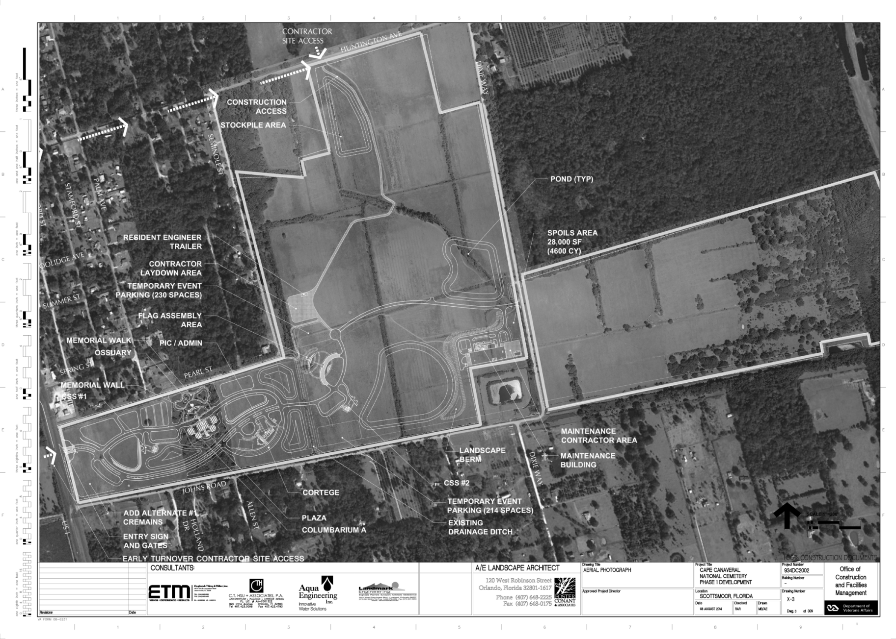
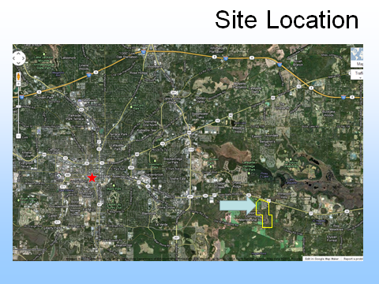

Slide 19
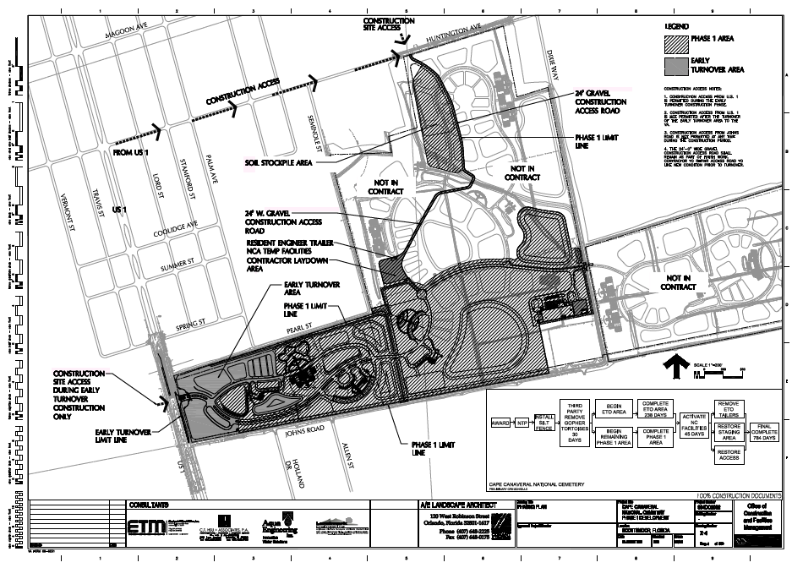

Slide 20
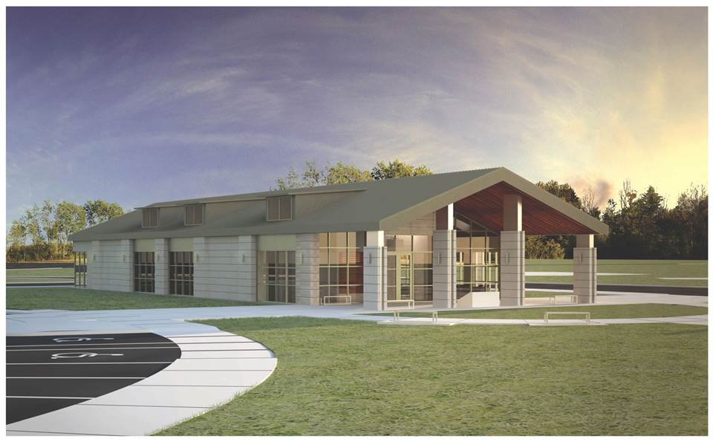
Public Information Center and Administration Building

Slide 21
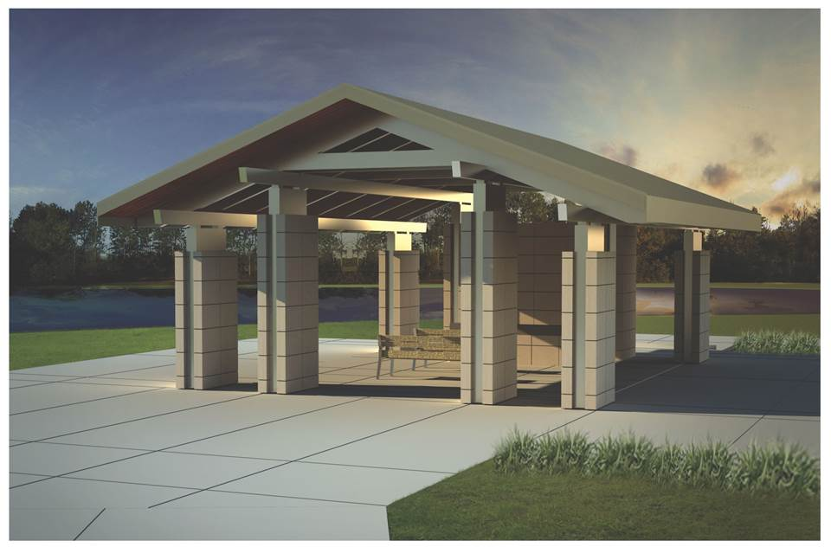
Committal Service Shelter

Slide 22
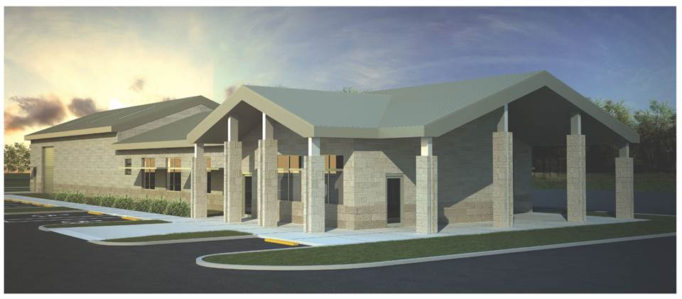
Maintenance Building

Slide 23
Project Logistics
Kevin Dix
VACFM Project Manager

Slide 24
Project Logistics
Approximately 98 acres developed
Post award conference / NTP October 2014
Staging area / trailers
Temp Admin / Restrooms / Maintenance
Early Turnover 238 days after NTP
After ETO GC must work around cemetery ops/hrs
Project completes 784 days after NTP
Resident Engineer is ACO / QA
Monthly payments with CPM schedule updates

Slide 25
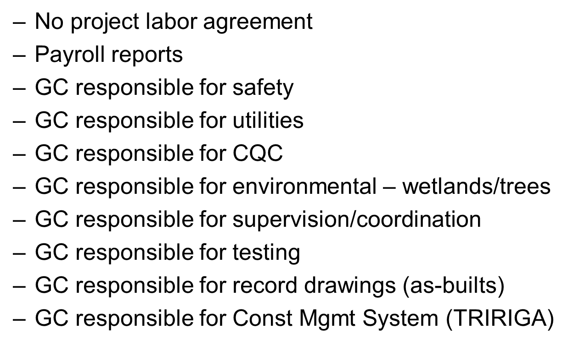
Project Logistics (cont’d)

Slide 26
Site Visit
Cape Canaveral National Cemetery
5525 Highway 1
Mims, Florida 32754

