Slide 1
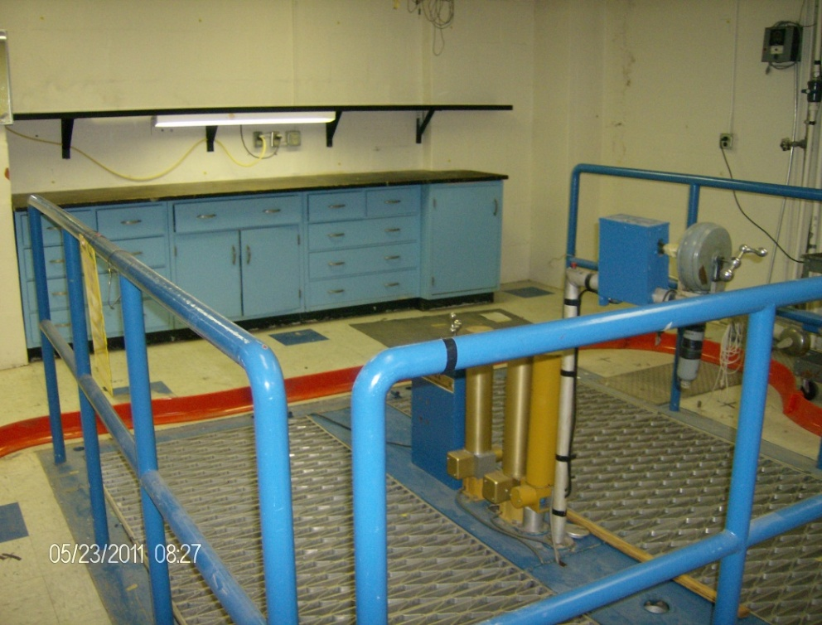
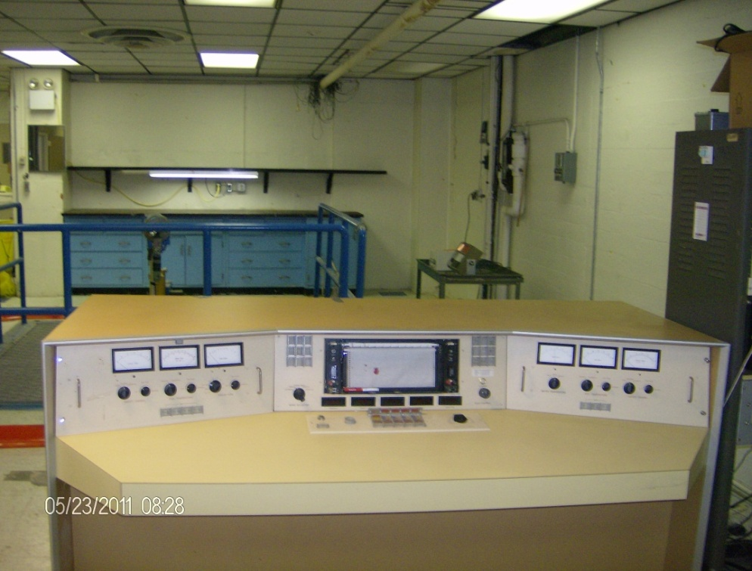
AJ Blotcky Research Reactor
Pre-Bid Meeting 3 September 2014

Slide 2
Agenda
  Short presentation / Q & A
  Outside area walk-around
    Loading dock overview
    Cooling tower
    Courtyard
  Reactor area walk-around
  Depart via Loading dock

Slide 3
Rules of Engagement
Stay in group
VA security will accompany us
Photos OK ONLY for outside and Reactor areas
NO PHOTOS inside Medical Center

Slide 4
Administrative
Submit questions via e-mail to CO by 5 Sep 14 [as noted in RFP: Valentino.Rosas@va.gov]
VA will publish responses to Q’s via FedBizOps
See also list of Q & A’s from pre-solicitation Apr 13
Submittals due in 12 Sep 14

Slide 5
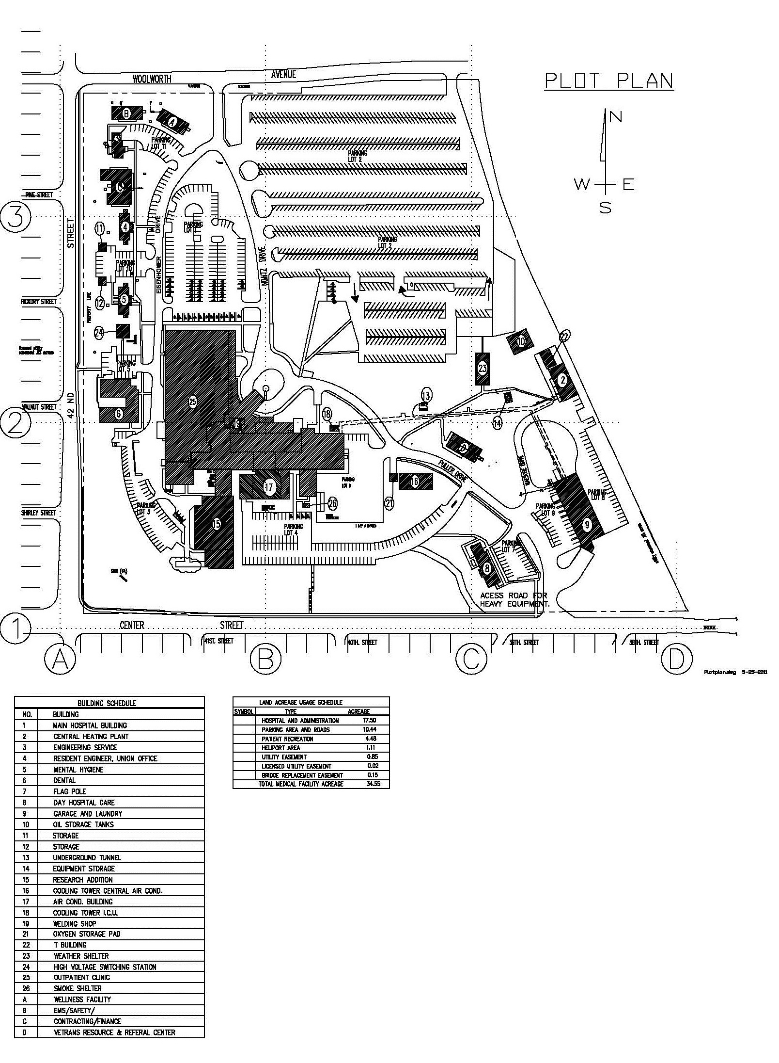
Site and Facility Access
Main Entrance
Loading Dock
AJBF Access
Back Entrance

Slide 6
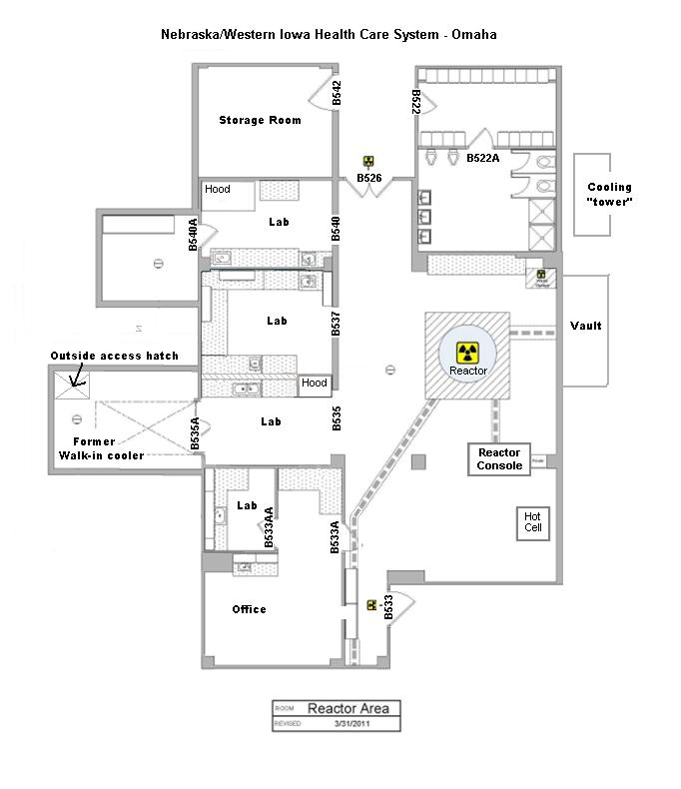

Slide 7
Facility Timeline
January 1959:
Facility Construction Begins
November 2001:
Facility permanently shut down
1989-2001:
Facility used for training of
Fort Calhoun Operators
May 2011:
Pre-Decommissioning Survey
and Release
1959-1965
Operated as National Lab
1955
1960
1965
1970
1975
1980
1985
1990
1995
2000
2005
2010
2015
2015
June 1959:
Construction Complete, Operation Begins
1991:
Amendment 9
Maximum power increased to 20kW
February 2002:
Fuel removed and transported to USGS Colorado facility

Slide 8
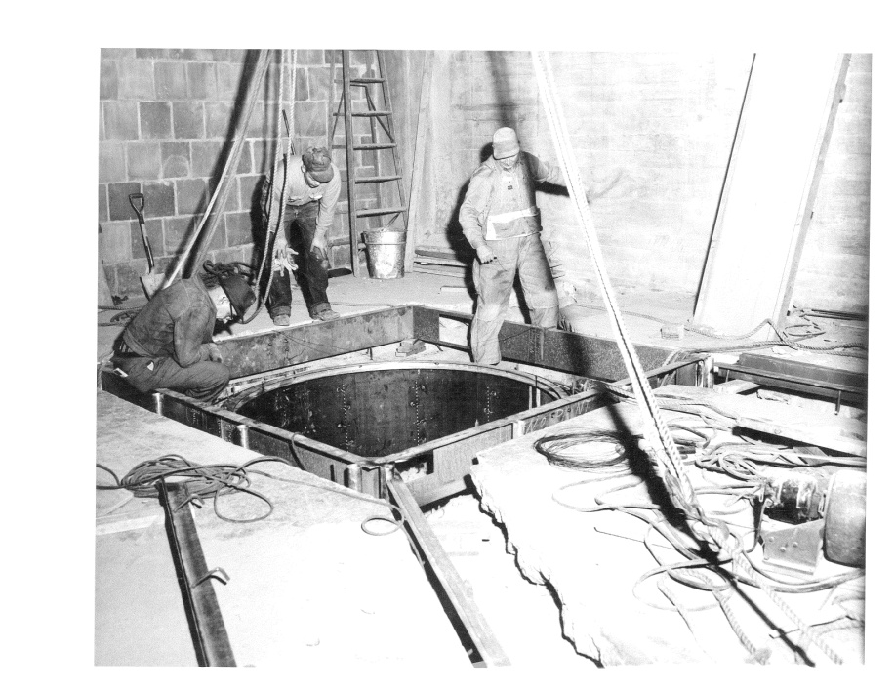
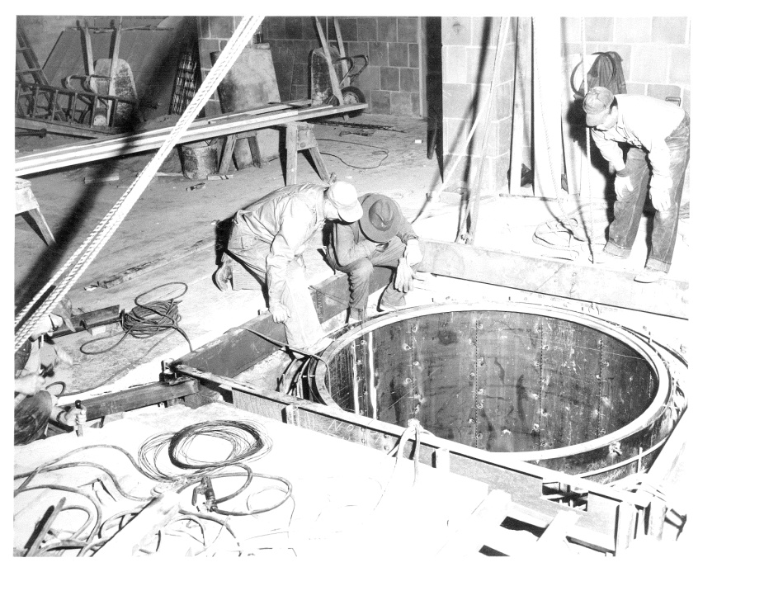
Historic Construction Photos

Slide 9
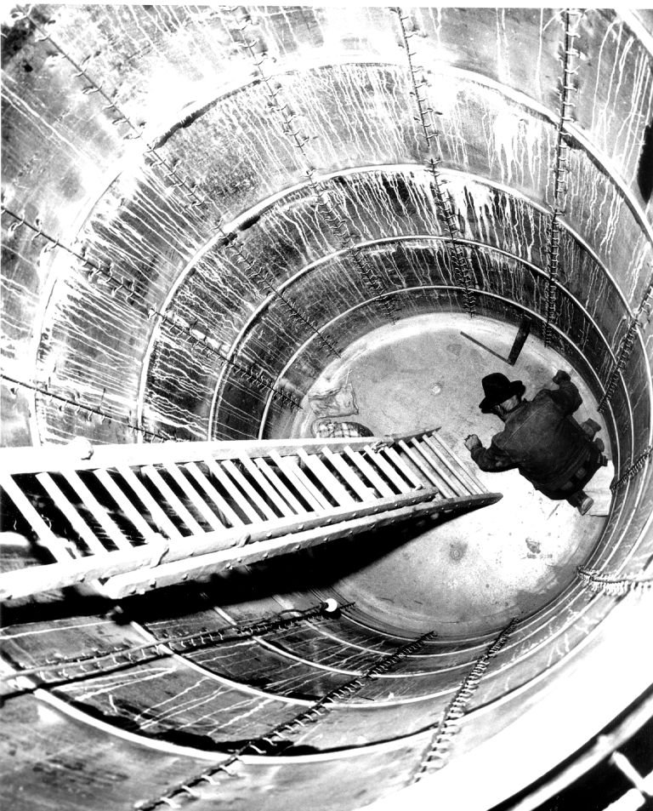
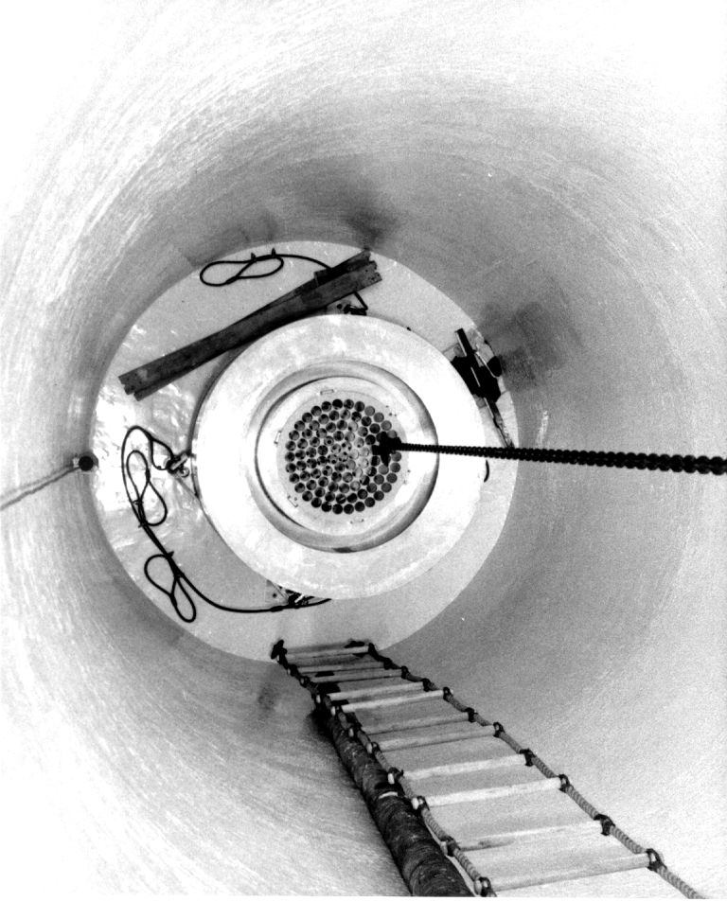
Historic Construction Photos (2)

Slide 10
Document Timeline
August 2002 –Safety Evaluation Report Related to the Renewal of the Operating License for the AJ Blotcky Reactor Facility (VA 2002a)
August 2002 –Amendment 11, Renewal of the Facility Operating License No. R-57 (VA 2002a)
February 2003 –AJ Blotcky Reactor Facility Omaha Veterans Administration Medical Center, Omaha, Nebraska, Characterization Survey Report (Duratek 2003)
February 2003 – Activation Analysis of the AJB Reactor Facility (Appendix C of Duratek 2003)
March 2004 – Original Decommissioning and Decontamination Plan for the AJ Blotcky Reactor Facility (VA 2004)
May 2008 –Request for Additional Information Regarding AJ Blotcky Reactor Facility Decommissioning Plan (US NRC 2008)
April 2011 – AJ Blotcky Reactor Facility Additional Characterization Work Plan (AECOM)
June 2011 – AJ Blotcky Reactor Facility Free Release Materials Report (AECOM 2011b)
July 2011 – AJ Blotcky Reactor Facility Characterization Report (AECOM 2011a)
February 2012 – Draft AJ Blotcky Reactor Facility Decommissioning Plan (Revised) (AECOM)
April 2013 – Final AJ Blotcky Reactor Facility Decommissioning Plan (Revised) (AECOM)

Slide 11
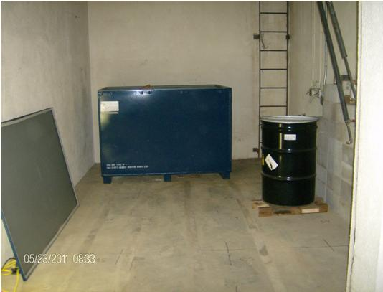
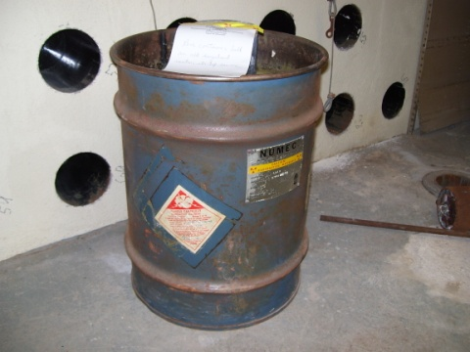
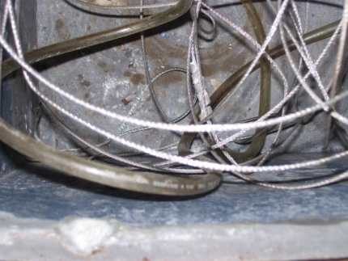
Current Waste Inventory
Po-Be source
Contaminated Lead
Misc. debris and activate metals

Slide 12
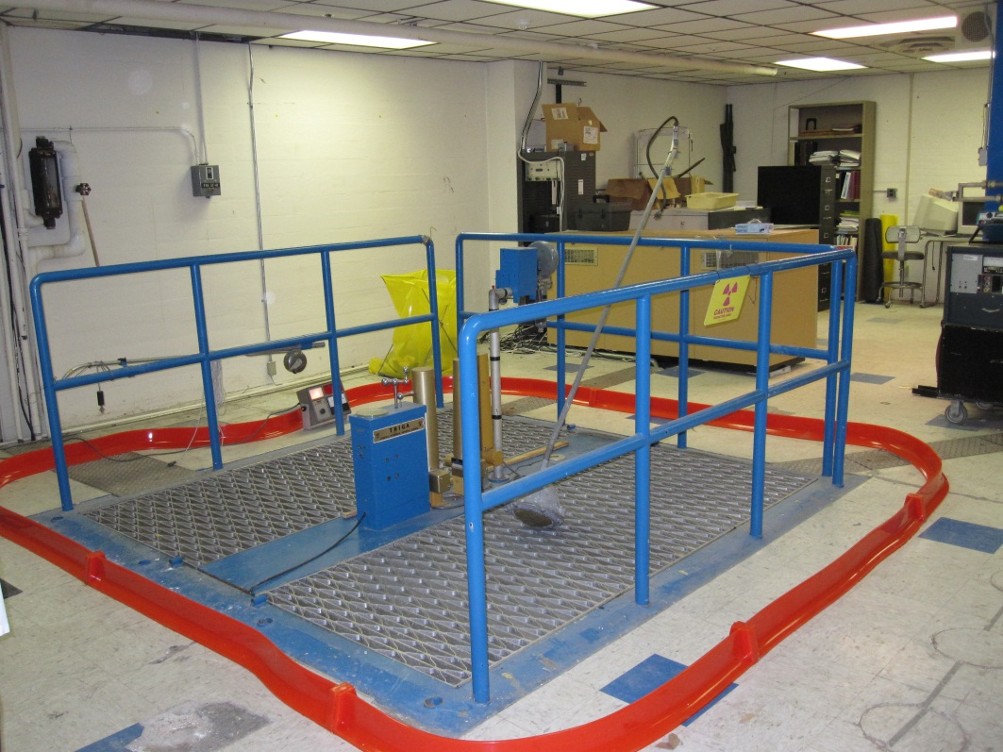
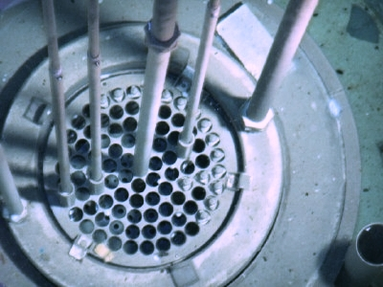
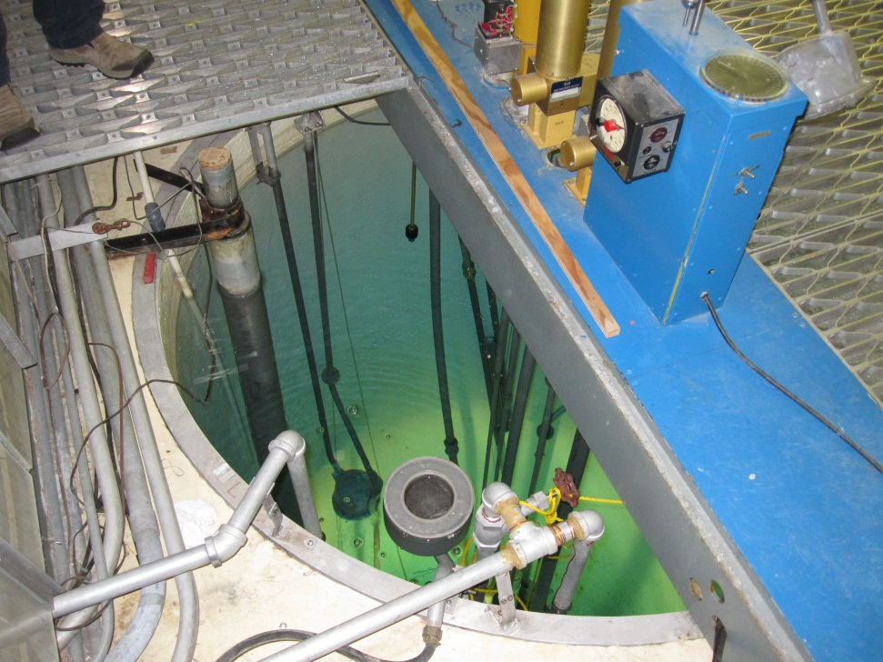
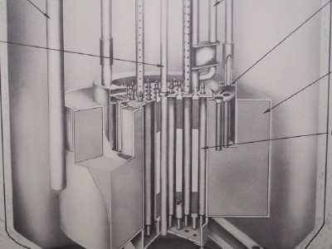
Reactor

Slide 13
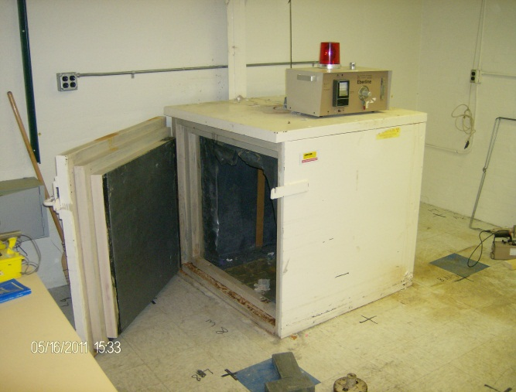
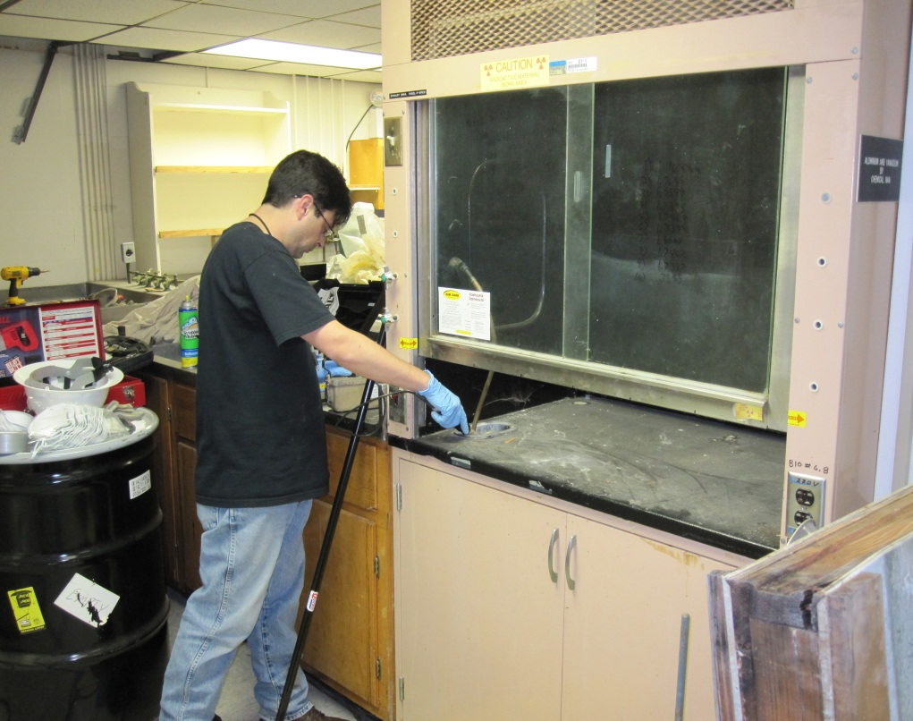
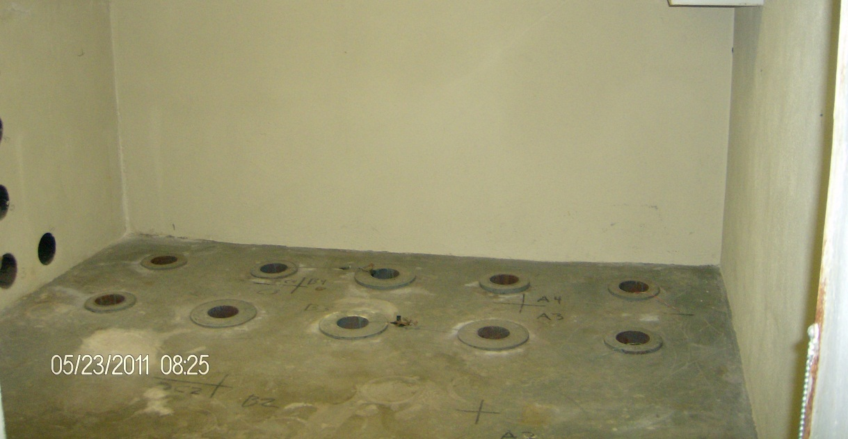
Facility Components
Low Background Sampling Box
Fume Hoods
Source Cubbies/Vaults

Slide 14
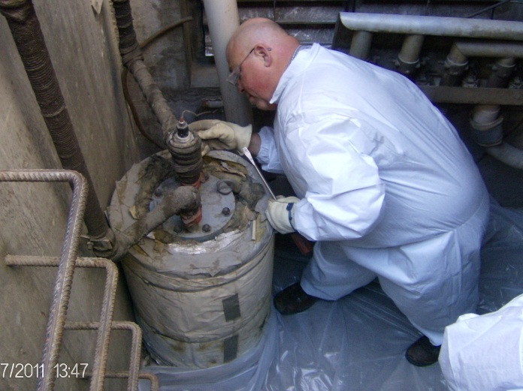
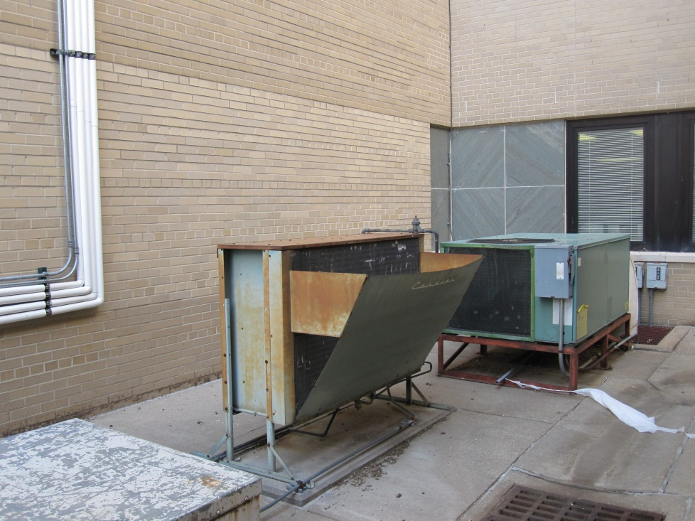
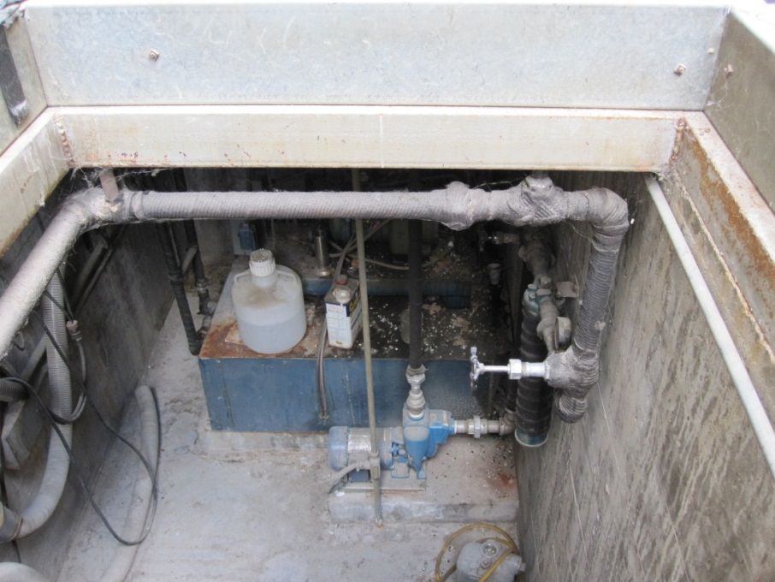
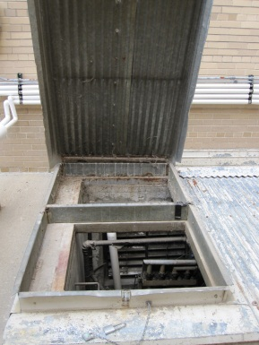
Outdoor Components
Cooling “Tower”
Pump/Filter Vault

