Slide 1
Defining HI Interoperability Vision
December 10, 2013
Acting Director VA/DoD Health Information Sharing
Office of Informatics and Analytics
Veterans Health Administration
Department of Veterans Affairs

Slide 2
Agenda
Interoperability Coordination Office Objectives
Interoperability Coordination Structure
Interoperability Coordination Office Use Case
  Interoperability Request from VA Program
  Interoperability Request from Outside Source
Interoperability Coordination Office Organizational Chart

Slide 3
Interoperability Coordination Office Objectives
Define role of VA in Interoperability with:
  IPO
  Private Community
  Other Federal partners
Coordination and oversight of VHA stakeholders involved in Health Data Interoperability related programs/projects (JLV, VLER Health, BHIE, My HealtheVet, VistA Evolution)
  Coordination of overarching policy and process documents
  Prevention of duplication of efforts btw organizational elements
  Overall process improvements

Slide 4
Interoperability Coordination Office Objectives
Provide consulting and SME direction from appointed Technical, Semantic, and Process (Clinical) Interoperability leads
  Program/Project Management Guidance
  Interoperability Expertise
Track interoperability Milestones, Accomplishments, and Challenges
  Identify which group is currently tracking
  Define success criteria, baseline metrics, track Meaningful Use progress
  Identify projects and use cases to prevent duplication of efforts and promote efficiency

Slide 5
Interoperability Coordination Office Objectives
Liaison between VHA and internal partners (VBA, OIT, 10N) to promote transparent collaboration, communications, and information sharing on health data interoperability related programs/projects
Liaison between VHA and external partners (DoD, IHS, IPO, OSEHRA, Federal Partners, Commercial Partners) to promote transparent collaboration, communications, and effective information sharing on health data interoperability programs/projects
Promote customer and end-user awareness and satisfaction for products/processes implemented to promote health data interoperability

Slide 6
Interoperability Coordination Office Objectives
    Establish and facilitate coordination and collaboration with DoD Interoperability counterpart at the IPO, ICIB and other VHA external counterparts including DoD, IHS, IPO, OSEHRA, Federal Partners, Commercial Partners
    Identification of Interoperability Subject Matter Experts (SMEs) within VHA and other stakeholder organizations
    Establish and lead coordination of VHA Health Interoperability Workgroups to increase collaboration between VHA Interoperability entities
    Develop and maintain a VHA Interoperability Tracking Tool for the tracking of Interoperability activities and groups within VHA for promoting accountability and effective resource utilization
    Develop Interoperability communications products for distribution within and outside of OIA (e.g. fact sheets, blog posts, briefing materials, email blasts, etc.)

Slide 7
Health Informatics – Interoperability Coordination Structure
The graphic below describes the process for providing Interoperability and Program/Project Management Consulting and Oversight to Programs/Projects that support Health Data Interoperability
Interoperability Office:
Support establishing project timelines, achieving project milestones, coordinating communications and collaboration across the execution bodies
Interoperability Office Internal Projects: VLER Health, BHIE, JAL FHCC, HIS
(Final listing TBD)
Technical, Semantic, and Process Interoperability SMEs:
Provide the expertise needed for defining milestones
Execution Bodies: Monitoring project delivery schedule, provide program specific knowledge base to SMEs
External Projects:
JLV, My HealtheVet, VistA Evolution, OSEHRA
(Final listing TBD)

Slide 8
High-Level Interoperability Coordination Office Use Case –
Interoperability Request from Outside Source (DoD, Congress, Non-HI VHA)
Receive task/request for information
Interoperability Office
Can the task be completed internally?
Complete Task
Yes
No
Interoperability Office Partnered with HI SME
Can the task be completed by partnering with HI SMEs?
Complete Task
Yes
No
VHA Source
External to HI
Identify appropriate source for completion
Complete Task

Slide 9
High-Level Interoperability Coordination Office Use Case –
Interoperability Request from VA Program
JLV Policy Request Sample
Realizes Policy Issue with VBA Disability Staff Using JLV Applications
Brings Issue to Interoperability Office Coordination meeting
Execute Strategy in JLV environment
JLV Program Manager
End
Evaluates and Analyzes Interoperability Issue
Leverages Interoperability SMEs to develop recommendation for changing policy
Deliver Recommendation to VA OGC
Work with JLV Program Manager to develop strategy to apply new policy to application environment
Interoperability Office Coordination
Team
VA OGC
Carry out functions to change policy

Slide 10
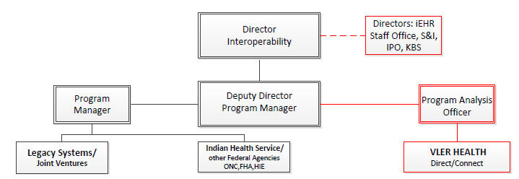
Interoperability Coordination Office
Organizational Chart

