Slide 1
Million Veteran Program:
Data Storage and Computing
James Breeling, MD

Slide 2
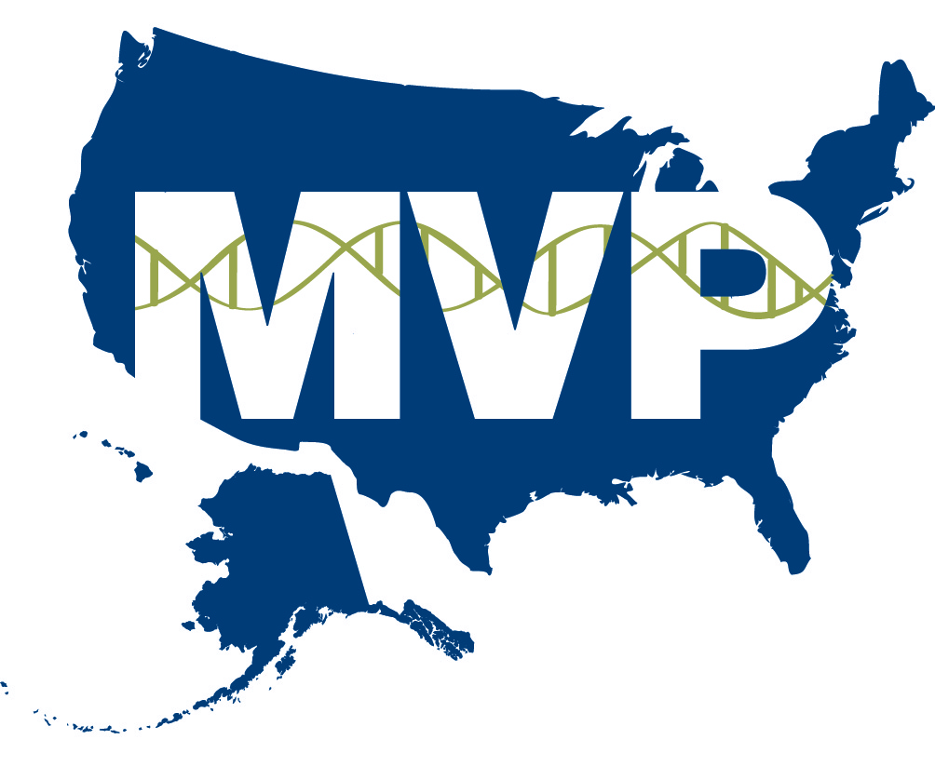
Data Access – Current State & Gaps
IRB Access Required, must be VA WOC appointee at minimum
~25 simultaneous investigators thru secure portal
All data will remain behind the VA firewall; data may not leave the GenISIS system
Access limited due to bandwidth constraints of the VA network.
Lack reliable methods for de-identification
Any direct network connectivity between platforms requires routing through a Trusted Internet Connection (TIC)
Internal VA policies for accessing EHR data and moving the data between systems within the VA limit studies

Slide 3
Data Storage & Analytics – Current State & Gaps
Stores SNP data from ~200,000 samples, and self-reported surveys data from more than 400,000 participants. SNP genotyping data from another 200,000 samples will be added by the end of the year.
1PB storage capacity and compute power that can accommodate SNP chip data from 400,000 samples plus allow distribution of the data into 6-10 study marts to support the alpha and beta test projects. Manual data cleaning and curation on a per study basis
No data replication (COOP/DR)
Bandwidth limitations; can only receive data on encrypted hard drives
Current HPC can’t support converting raw sequence data into variant files in reasonable time frame

Slide 4
PMI Objectives
Make MVP participation available to all Veterans and active duty military personnel
Make data accessible to a broad community of researchers
Develop a versatile and agile technical computational environment
Provide data back to participants as well as the EHR to support clinical decision-making

Slide 5
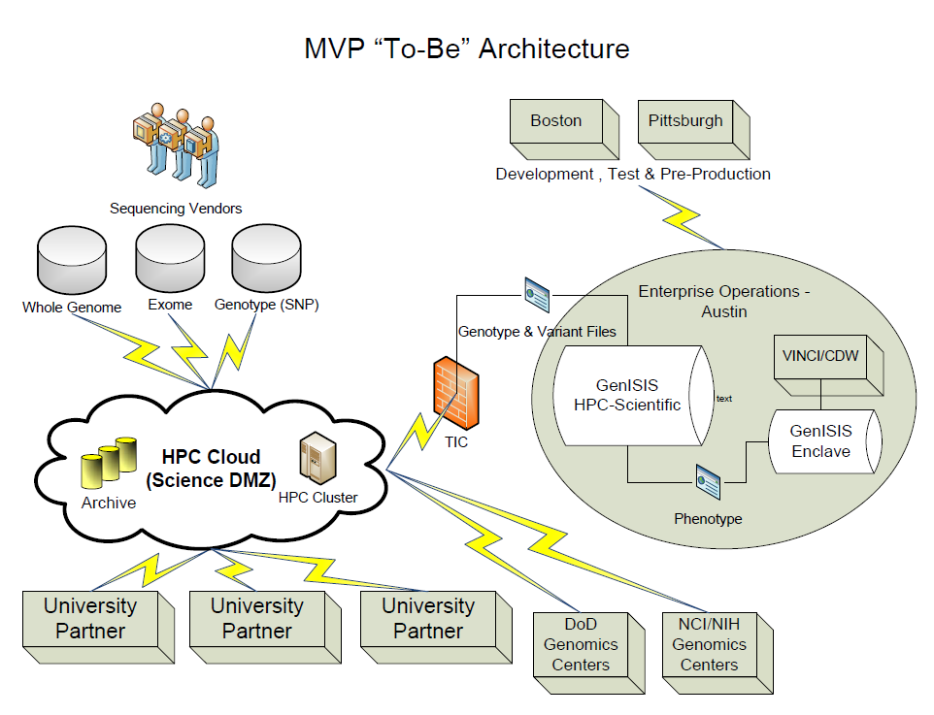
Hybrid Cloud

Slide 6
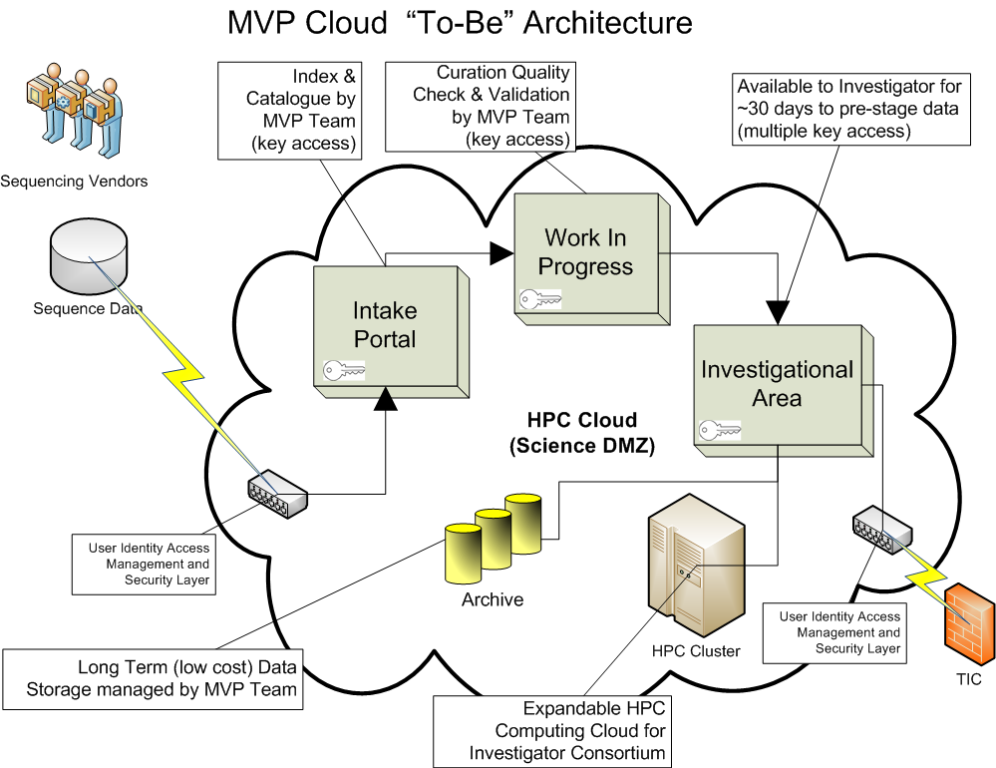

Slide 7
Projected Requirements
Segregate capability for development, pre-production and production-level activities, to facilitate ongoing systems development while data is being accessed and used by the research community.
Replicate a 10PB capacity HPC environment similar to the one in Pittsburgh. This would provide a) Core MVP data and system redundancy and b) allow for load balancing to scale the number of research users to 150-200 users.
Develop a hybrid cloud with GenISIS interfacing with a scalable public/private cloud computing infrastructure for archival storage, short bursts for performing specific computing and very large scale analysis in a reasonable time frame. This system should support upwards of 1000 simultaneous users, and be capable of annotating 1,000,000 genomes in three to six months. Include aggregation of genome data directly from sequencing vendors
Pilot the ability to interface with platforms supporting the VHA EHR and DoD EHRs, enabling data extraction without creating security vulnerabilities of any sort, starting in FY2016.
Pilot the ability to accept health data from other sources, including Blue Button downloads from outside healthcare systems, starting in FY2016.
Establish a help desk for investigators using the system.

