Slide 1
Million Veteran Program:
Industry Day
Genomic Data Processing and Storage
Saiju Pyarajan, PhD and Philip Tsao, PhD

Slide 2
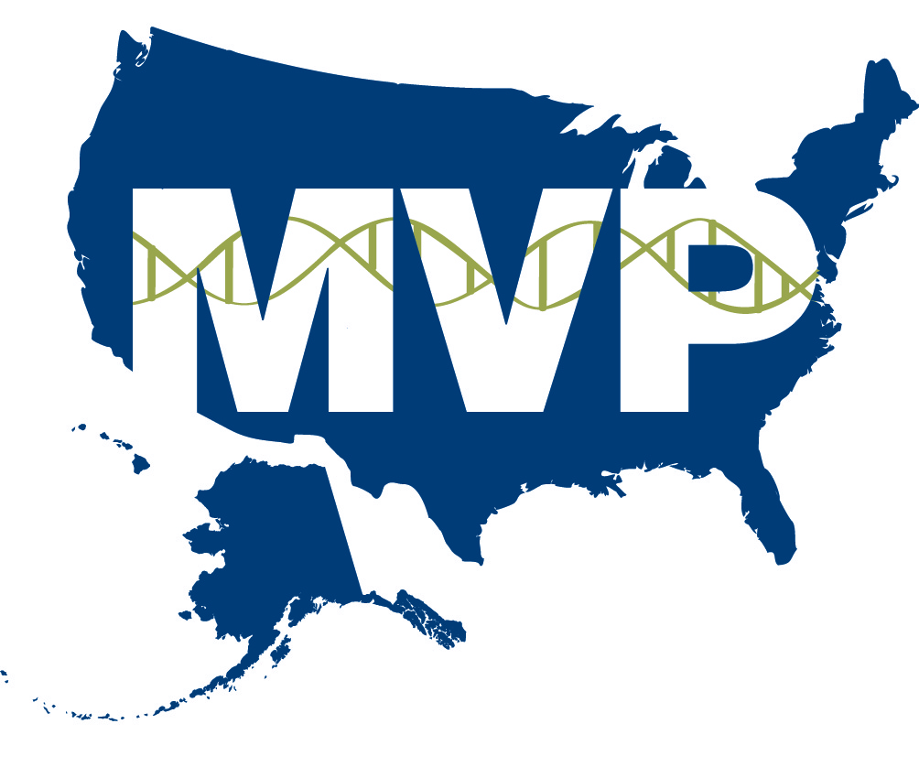
Current State - Genomics
MVP Study conduct facilitates standardization of
  tissue collection & processing
  DNA extraction & quality assurance
Enterprise LIMS for sample tracking
  Electronic manifest for all sample transfers
Genotyping at two vendors
  Affymetrix Axiom platform with MVP Custom Chip
Sequencing at two vendors
  Illumina
  Ion Torrent
FY 15 target
  ~400,000 for genotyping
  ~25,000 Whole exome & 2,000 Whole genome sequencing

Slide 3
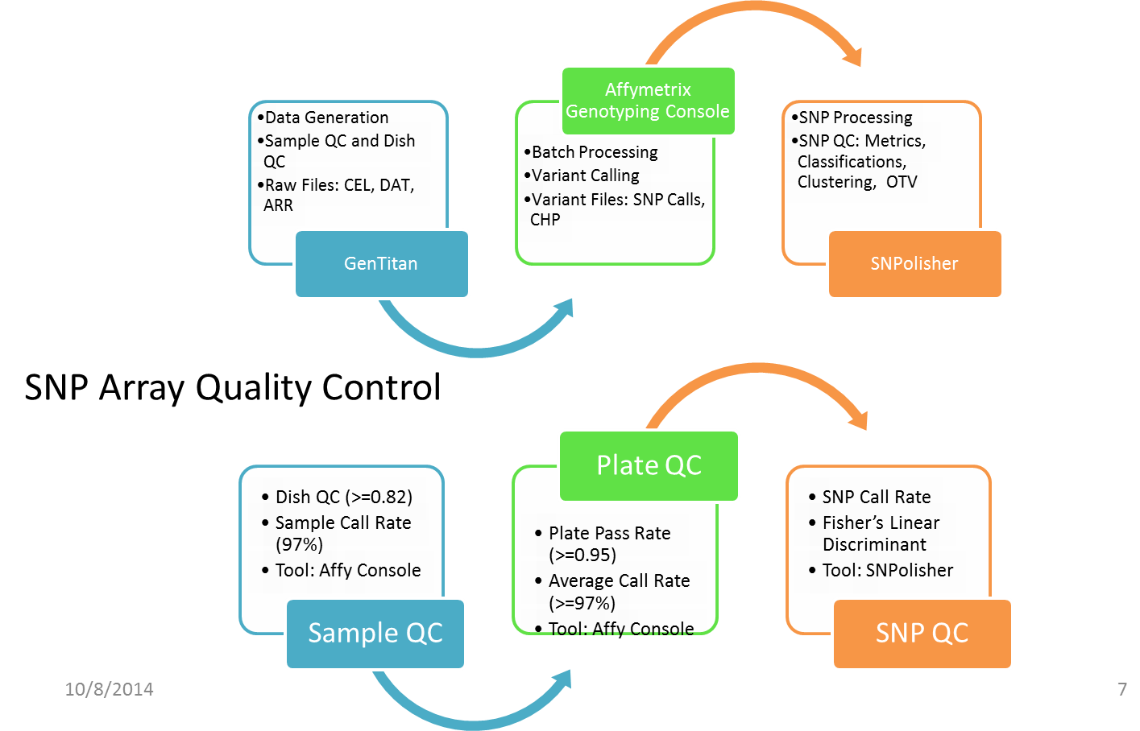
Data QA/QC
Tier 1 QA/QC being performed by vendors
Vendor SNP Array Genotyping Process Flow

Slide 4
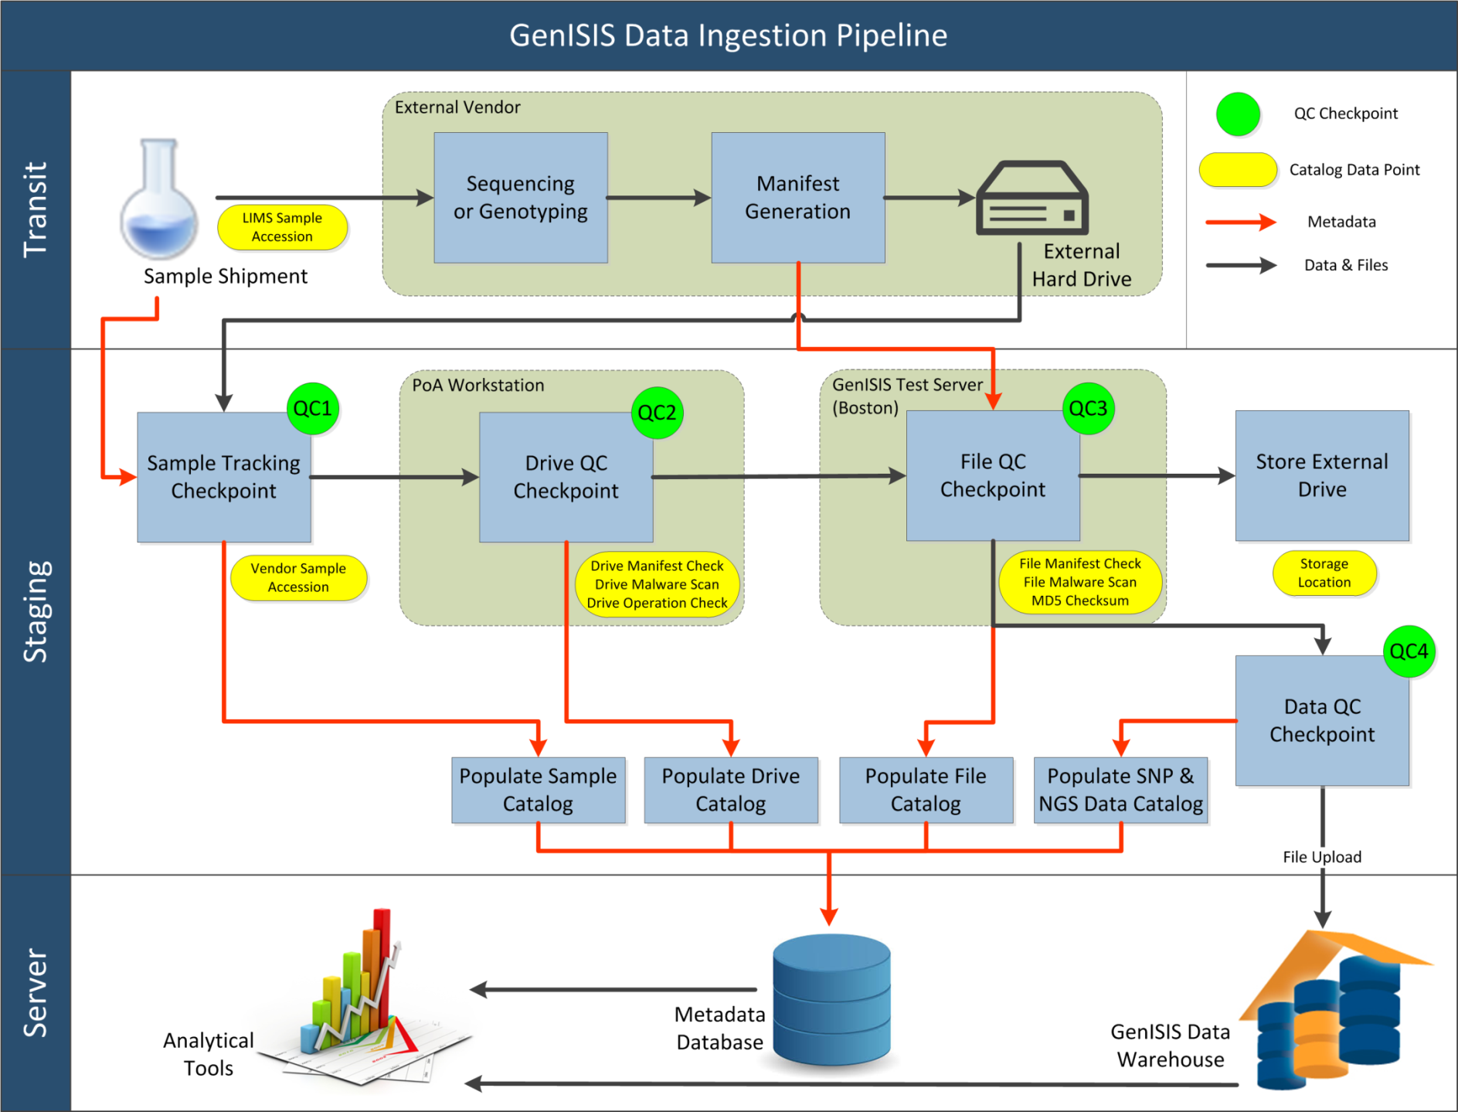
Genomic Data Ingestion Pipeline

Slide 5
Current State –
Whole Genome Sequencing
Data Drives received from vendors
VAPAHCS/Stanford WGS Pipeline
  Encrypted keys to unlock drives
  Analysis pipeline that can take raw sequence data and process to call variants (sequence and structural) at a rate of ~4/day
  1° analysis: QA/QC of sequence data (VQSR); check with SNP array data
  2° analysis: QA filtering, alignment/assembly and variant calling; quality metrics from VCF
  3° analysis: multi-sample processing; QA of variant calls; QA of population structure; annotation and filtering; association analysis; prediction algorithms
scale pipeline for MVP
  Increase throughput
  Enhance general utility for end users
  AAA genomes are used to design, test and tune pipeline

Slide 6
Current State –
Whole Exome Sequencing
Data Drives received from vendors
VAPAHCS/Stanford WES Pipeline
  Encrypted keys to unlock drives
  Get checksum manifest of files on each drive
    Evaluate data stability/corruption
  Analysis of Coverage (from BAM)
    Determine coverage of coding regions
  Analysis of Mapping (from BAM)
    Mapping quality indicative of potential contamination
  Analysis of Variants
    Variant quality
  Exome vs. Genome
    Some duplicate samples between vendors/platforms
scale pipeline for MVP
  Increase throughput
  Enhance general utility for end users

Slide 7
“Big Data” Challenges for MVP
Data Volume –
  Tiered storage by data types and use
Data Storage architecture
  Efficiency, compression
Data Query/Metadata Manager Service
Computing/Analytical infrastructure
  Bringing processing power to the data instead of moving data
Data security, Data access and Data governance
  Flexible for researchers yet secure
Consistent Data quality
  Across vendors, batches and time

Slide 8
MVP Data - Looking ahead
  Capability
    Tiered data storage for raw vs processed data computing
    Data & system access controls based on MVP governance
    Dynamic annotation of data and self enriching knowledgebase
    Integrative clinical-genomic query capability for cohort identification
    Automated creation of customized extracts for individual studies without data duplication
  Scalability
    Scalable hardware and file systems
    Horizontal scaling for hardware and data changes with minimal downtime
  Flexibility
    Extremely fast and efficient querying across high-throughput data (>million for each data type)
    Data Architecture to allow for maximum flexibility for Scientific and technology changes – (genomics, proteomics, other “omics”)
  Efficiency
    Fast upload and storage of data
    “Out-of-the box” computing resource management
  Security
    Granular tiered access controls

