Slide 1
Million Veteran Program:
Industry Day
Phenomics
J. Michael Gaziano, MD, MPH

Slide 2
Background
Traditional cohorts:
  Nurses’ Health Study, Physicians’ Health Study, Framingham Heart Study, Women’s Genome Health Study, etc.
Consortia:
  Cancer Cohort Consortium, eMERGE, CHARGE, dbGaP, etc.
Other large-scale biobanks:
  BioVU, UK Biobank, Kaiser, Geisinger, etc.

Slide 3
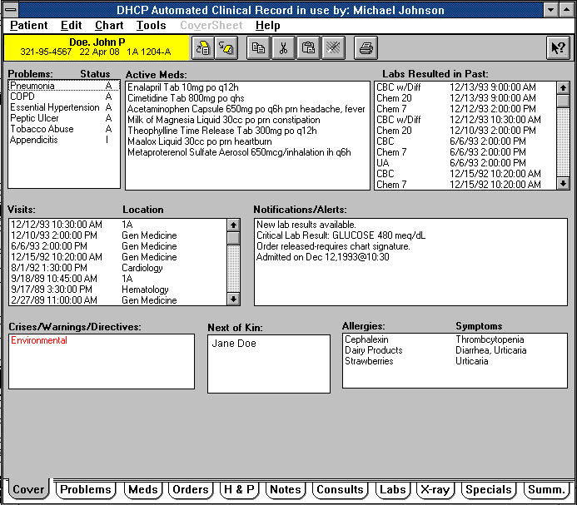
Nesting Population Research in the VA Healthcare System
VA ideal setting for nested large-scale population research
  Stable and willing veteran population of 8 million using the system each year
  Outstanding electronic medical record; fully integrated; data reaching back as far as 20 years; access to CMS and NDI data
  Research infrastructure with diverse expertise
  Prototypes for health system based research:
    Pragmatic trial of HCTZ vs Chlorthalidone
    Million Veteran Program

Slide 4

Million Veteran Program (MVP)
Million Veteran Program (MVP)
Enroll up to one million users of the VHA into an observational mega-cohort
  Collect health and lifestyle information
  Blood collection for storage in biorepository for future research
  Access to electronic medical record
  Ability to recontact participants
Veterans Health
Administration
Million Veteran Program

Slide 5

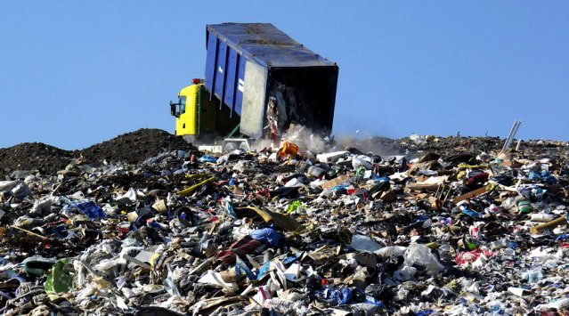
The Future: “Big Data”
More and more data is becoming available for health care research:
is it a blessing or a curse?
Sometimes, data warehouses resemble landfills more than libraries.
Notes:
Stockholm-Public-Library-Interior-2.jpg

Slide 6
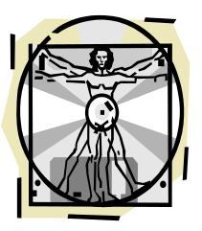
Million Veteran Program (MVP)
Data Universe
Molecular
Data
Self-reported
MVP surveys
MVP
Participant
Biospecimens
VA - Clinical
VINCI, VIReC,
Non-VA
NDI, CMS, etc.

Slide 7
MVP Data Sources
MVP Consented Data
Passive Data
Self-Reported Survey Data:
  Lifestyle Survey Data (Personal Information, Well-Being, Activity, Health, Military Experience, Dietary Intake, Medication, Habits)
  Baseline Survey (Health, Military Experiences, family medical history)
  Future data collection, follow-up surveys,
Genetic Data
  Genomic data (Sequence, genotype, etc.)
  Other omics
Non-VA Data
  National Death Index (NDI)
  Centers for Medicare and Medicaid Services (CMS)
  DOD
  Other novel data sources: particulate matter, geospacial, etc.
VA Healthcare System Data

Slide 8
VA Data Sources
Corporate Data Warehouse Databases
National Patient Care Databases
Vital Status
Decision Support System
National Data Extract
Beneficiary Identification Records Locator (BIRLS) death file
New England VISN-1 Pharmacy files
Outpatient Clinic File (OPC)
Patient Treatment File (PTF)
Inpatient and Outpatient Hospitalizations
Clinic Inpatient and Outpatient Visits
Diagnosis (ICD-9) codes
Procedure (CPT) codes
Pharmacy data and laboratory data
Pharmacy Benefit Management (PBM) system database
OEF/OIF and OND Roster
VA Clinical Assessment Reporting and Tracking (CART)
Veterans Affairs Surgical Quality Improvement Program (VASQIP)
Veterans Affairs Central Cancer Registry (VACCR)
National Data Systems (NDS)
Special Data Access w/ Data Steward

Slide 9
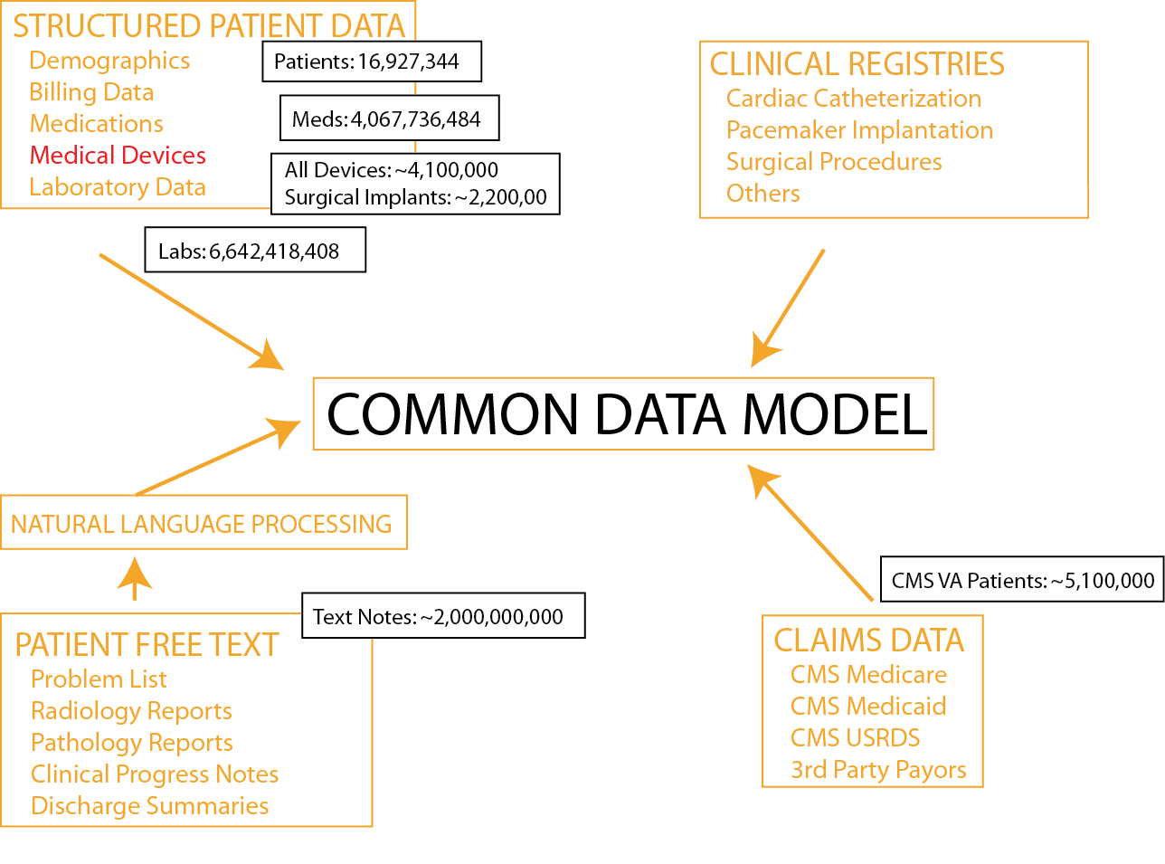
VA VINCI Strategic Roadmap

Slide 10

MVP System Architecture
Data
Warehouse
Study Mart
Vendor
Survey Data
Honest
Broker
Study Mart
Analysis
Environment
VA
Clinical Data
Study Mart
Non VA
NDI, CMS
Consent Manager
Molecular Lab
Molecular data
Query
Mart
Query Portal
Access Authorization by Governance System
Researcher

Slide 11
MVP Complex Phenotypes Strategy
Develop data processing pipelines to accommodate a high-throughput EMR database
Quantify phenotypes using a probabilistic algorithm approach
Create phenotype data library resource that is reproducible, reusable, scalable and efficient
Repurpose data elements as the library grows.

Slide 12
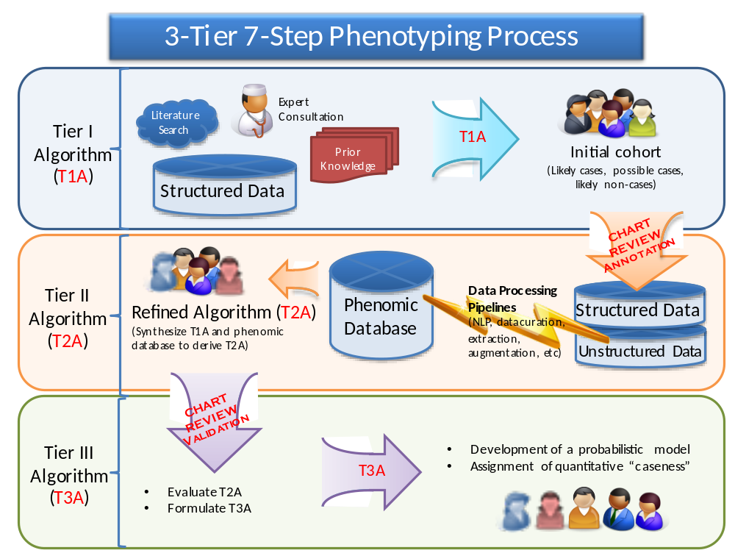
Step 1: Define initial working algorithm (T1A) | Step 5: Derive T2A
Step 2: Create study cohort and apply T1A | Step 6: Evaluate T2A to formulate T3A
Step 3: Create Annotation Data Set | Step 7: Develop probabilistic model and assign caseness
Step 4: Create Phenomic Database through Data Processing Pipelines | Deposit resulting algorithms to a central Phenotype Library

Slide 13
MVP Phenotyping Activities
Core Variables
Demographics
  Age
  Sex
  Race
Laboratory values
  Total cholesterol
  HDL, LDL
  Albumin
  Serum creatinine
  Triglycerides
Medications
Other characteristics
  Blood pressure
  Height/weight/BMI
  Smoking
  Alcohol consumption
  Combat exposure
Complex Phenotypes
Disease
  Myocardial infarction (MI)
  Stroke
  Unstable angina with revascularization
  Acute congestive heart failure
  Death from cardiovascular disease
  Vascular procedure
  Posttraumatic stress disorder (PTSD)
  Schizophrenia
  Bipolar disorder
  Traumatic brain injury
  Depression
  Vascular dementia
  Cognitive impairment
  Type 2 diabetes mellitus
Other
  Creatinine trajectory
  Glucose tragectory
Algorithm Development
Validation Methods

Slide 14
eMERGE Phenotypes
ACE Inhibitor (ACE-I) induced cough
ADHD phenotype algorithm
Appendicitis
Atrial Fibrillation
Autism
Cardiac Conduction (QRS)
Cataracts
Clopidogrel Poor Metabolizers
Crohn's Disease
Dementia
Diabetic Retinopathy
Drug Induced Liver Injury
Heart Failure
Height
Herpes Zoster
HDL
Hypothyroidism
Fibromyalgia in an RA cohort
Lipids
MidSouth CDRN CHD Algorithm
Multiple Sclerosis
Peripheral Arterial Disease
Red Blood Cell Indices
Rheumatoid Arthritis
Severe Early Childhood Obesity
Sleep Apnea Phenotype
Type 2 Diabetes – 2 phenotypes
Warfarin dose/response
White Blood Cell Indices

Slide 15
CHARGE Consortium Working Groups
Adiposity | Hemostasis
Atrial Fibrillation/PR-Interval | Inflammation
Aging and Longevity | Insulin Like Growth Factor
Blood Pressure | Lipids
CHARGE-S Analysis & Bioinformatics | Microbiome
CHARGE mtDNA+ | Musculoskeletal
Depression | Natriuretic Peptides
Echocardiography: EchoGen | Neurology (specific subgroups on Stroke, Dementia…)
Educational Attainment | Nutrition
EKG | Pharmacogenetics
Endothelial Function | Physical Activity
Entrepreneurship | Pulmonary
Epigenetics | Renal
Exome Chip | Repro-GEN
Eye Retina | Sex Hormone
Family Studies | Sleep
Fatty Acid | Subclinical / CHD
Gene Expression | Sudden Cardiac Arrest
Gene-Lifestyle Interactions | Telomeres
Glycemia/Diabetes | Thyroid Function
Hearing loss | Tonometry
Heart Failure | Venous Thromboembolism
Hematology

Slide 16
Evolution of Phenotyping:
Current Approaches
 | Manual Algorithm Development | Fully Automated Phenotyping
Benefits | Input from clinical experts | Accelerated phenotype development: saves time and increases scale
Limitations | Creating list of informative variables is time-consuming Manual medical record review causes a bottleneck | Reliance on the data to direct phenotyping instead of clinical experts

Slide 17
Our Vision for Phenotyping in MVP:
A New Approach
Manual
Semi-automated
Automated
Semi-automated phenotyping combines features of manual and automated phenotype development

Slide 18
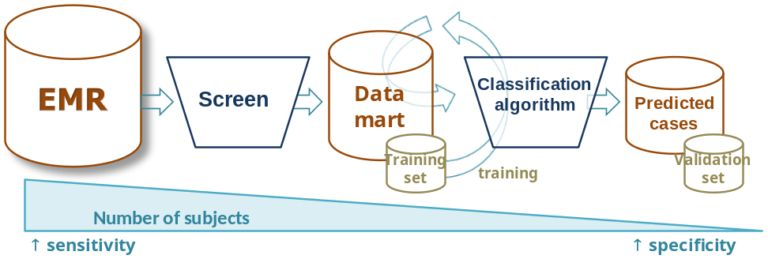
Overview of semi-automated method for developing EMR phenotypes
Step 1: Create “Phenotype X Mart”
Step 2: Develop gold standard training set
Step 3: Identify variables important for predicting Phenotype X
Codified + narrative data (extracted using natural language processing)
Step 4: Develop algorithm
Logistic regression with LASSO
Step 5: Validation

Slide 19
MVP System Architecture
Data
Warehouse
Study Mart
Vendor
Survey Data
Honest
Broker
Study Mart
Analysis
Environment
VA
Clinical Data
Study Mart
Non VA
NDI, CMS
Consent Manager
Molecular Lab
Molecular data
Query
Mart
Query Portal
Access Authorization by Governance System
Researcher

Slide 20
Summary of Unmet Needs
Data mapping
Data cleaning, cataloguing
Automating the curation pipeline
Library
Viewing / moving data
Versioning control
Tracking uses of data
Retaining

