Slide 1
Million Veteran Program
Industry Day:
Data Marts and Data Access
John Concato, MD, MS, MPH

Slide 2
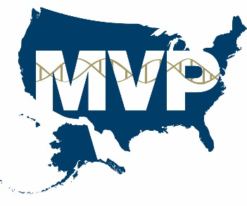
Overview of topic
Projects currently in “pipeline”
Proposed structure for access to data
Timeline for progress
Requirements

Slide 3
‘Alpha Test’ Projects
‘GWAS’ of schizophrenia and bipolar disorder:
• N=9,354 case patients w/ extensive phenotyping
• control patients to-be-identified from MVP
‘GWAS’ of posttraumatic stress disorder:
• case (>10K) and control (>10K) patients from MVP
• phenotyping w/ electronic records & questionnaire

Slide 4

‘Beta Test’ Projects
• Four (among 30) proposals funded in Spring 2015
• Research focus on:
- cardiovascular risk factors
- metabolic disorders
- multi-substance use
- kidney disease
• Linked to MVP genotyping; “studies haven’t started yet”

Slide 5
Conduct of Current MVP-linked Studies
• Access to GenISIS Scientific Computing Environment (SCE):
  - registration (based on valid VA account)
  - requirements of funding approval
• Genotypic data on ≈400K samples
• Study-specific clinical data set (imported from VA Informatics and Computing Infrastructure, or ‘VINCI’)
• MVP Baseline and Lifestyle Survey data, as applicable
• Analytic tools for genotype-phenotype association

Slide 6

‘Envisioned’ MVP Architecture
Data
Warehouse
Study Mart
Vendor
Survey Data
Honest
Broker
Study Mart
Analysis
Environment
VA
Clinical Data
Study Mart
Non VA
NDI, CMS
Consent Manager
Molecular Lab
Molecular data
Query
Mart
Query Portal
Access Authorization by Governance System
Researcher

Slide 7
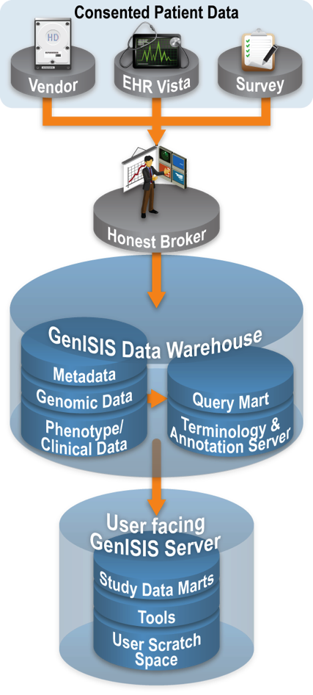
Ability to Query and Extract Data
  • Genomic data linked with clinical and
  survey data by Honest Broker system
  • Metadata Database of clinical,
  survey, & genomic data (w/ QC metrics)
  • Query Mart capability for projects
  • Terminology and Annotation Server
  for genomic and clinical annotations
  • Study Data Mart & Tools for analysis

Slide 8
Future Timeline
• FY16: Expanded access to more VA medical centers
  - genotype data on 400K samples
• FY17: Further expansion of scope
  - also offer epidemiological data (w/o genomics)
  - pilot access to exome and genome sequence data
  - pilot access to non-VA researchers (within GenISIS SCE)

Slide 9
Requirements
  • “Scale” the Honest Broker and Governance systems to meet
  increasing MVP scope of data & potential user population
  • Assist with the implementation of:
  - Metadata Database
  - Query Marts
  - Terminology & Annotation Server
  - Study Data Marts

