Slide 1
The Correspondence Engine and Notification (CEN)/Centralized Printing Project

Slide 2
This presentation will review:
OBPI
VBA Printing Background
Centralized Printing
Enterprise Solution
CEN Process
Resources

Slide 3

What is OBPI?
OBPI = The Office of Business Process Integration
OBPI is responsible for ensuring the Veterans Benefits Administration’s (VBA) strategic business needs and requirements are properly documented, integrated and communicated both internally and externally. OBPI facilitates the design, development and implementation of business systems and information technology to enhance claims processing within VBA.

Slide 4
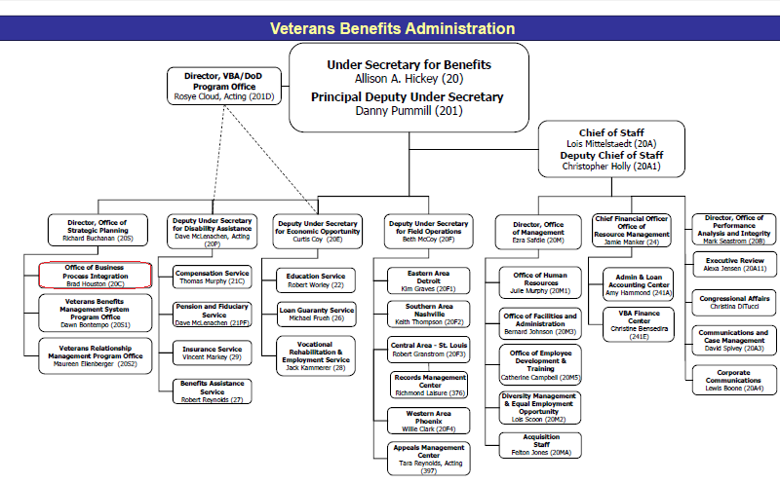
Notes:
Better pic

Slide 5
Background on Printing
VBA currently receives and sends mail from every facility using a variety of templates, fonts and methods.
VBA currently use 13 systems to create over 17.9M correspondence annually at a cost of $10.3M (print and mail costs).
If left unchanged, the projected cost of outbound printing and mailing for FY16-20 will be $65.6M.
The VA Center for Innovation (VACI) is providing funding for the development of the CEN prototype “stand alone application”; this pilot will serve as proof of concept.

Slide 6
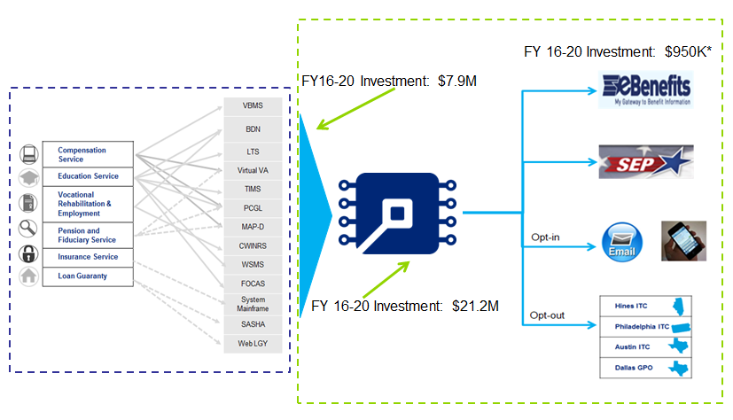
13 systems to create over 17.9M letters annually of which 16.8M are printed through VBA facilities at a cost of $10.3M per year.
Future State
Current State
Notes:
Definitions of ebenefits, SEP

Slide 7
Centralized Printing
The VBA prints and sends mail from various facilities, including Regional Offices (ROs) and Central Offices.
There are 56 Regional offices and 3 Information Technology Centers( Hines, Austin, Philadelphia)
A list of these offices can be found here: http://www.benefits.va.gov/benefits/offices.asp
Current Printing State
Local RO Printing - 16% Central Printing - 78% e.g., Hines, Austin, Phil eCorrespondence - 6%
Target Printing State:
Local RO Printing - 0% Central Printing - 25% e.g., Hines, Austin, Phil eCorrespondence - 75%

Slide 8
Enterprise Solution
CEN will serve as an enterprise-wide correspondence shared service to centrally manage all outbound correspondence across the VBA.
CEN will enhance 13 VBA Systems (including platforms such as eBenefits and SEP) to enable VA to provide real-time correspondence & notifications using electronic communications.
Benefits:
Improve the speed of correspondence and interaction with Veterans. Provide convenient seamless communication between the VA and Veterans. Provides and enterprise shared correspondence repository. Reduces VBA operating costs through use of a common correspondence service.
Expected Outcomes:
Reduce outbound correspondence print volume by 75% by 2020, achieving a cost savings of $35M. Increase the Veterans that opt-in to receive correspondence electronically. Increase Veteran satisfaction through improved communication and access.

Slide 9
CEN Pilot
The CEN prototype will provide proof of concept and gather user feedback for the following:
Centralizing Printing Efforts
Integrating an innovative solution for electronic correspondence by pulling information directly from the e-folder
The CEN prototype will NOT be:
A permanent solution
Dependent on or fully integrated with other systems
Notes:
Prototype Constraints:
Short time frame
Small budget

Slide 10
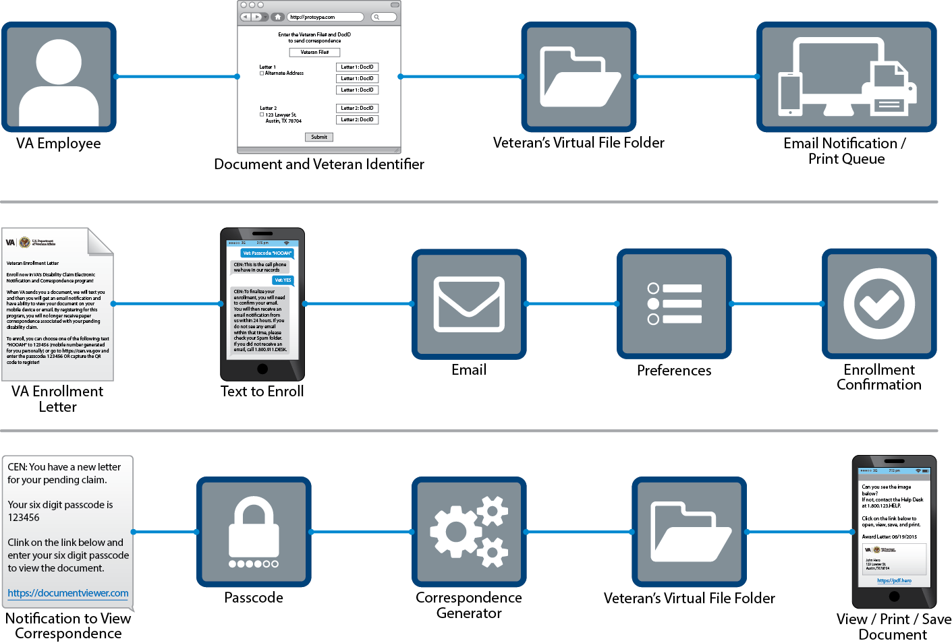
CEN Process
Notes:
First process: “Document and Veteran identifiers” instead of VBMS Doc ID. “Veteran’s Virtual File Folder” instead of VBMS e-folder.
Notification: “Notification to View Correspondence” replaces “Corr. Not”

Slide 11
CEN Team
Marissa Limsiaco - Program Manager
Christopher Maclin – Program Supervisor
Michael Taylor –Technical Solutions Architect
Drew Myklegard – VA Center of Innovation Advisor
Justin Isbell – Contracted Operations Representative
Tory Paronish – Program Coordinator
Anthony Dimaria – Program Coordinator

