Slide 1
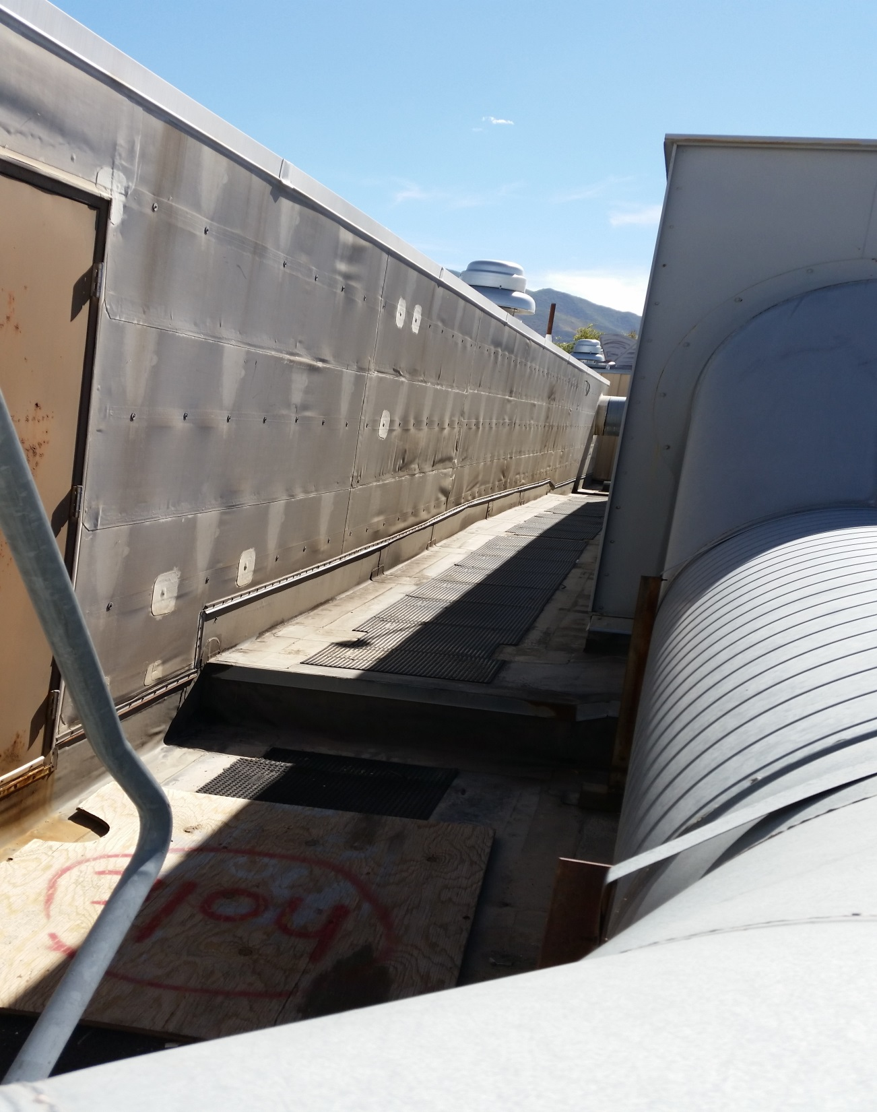
Building 3 Section C

Slide 2
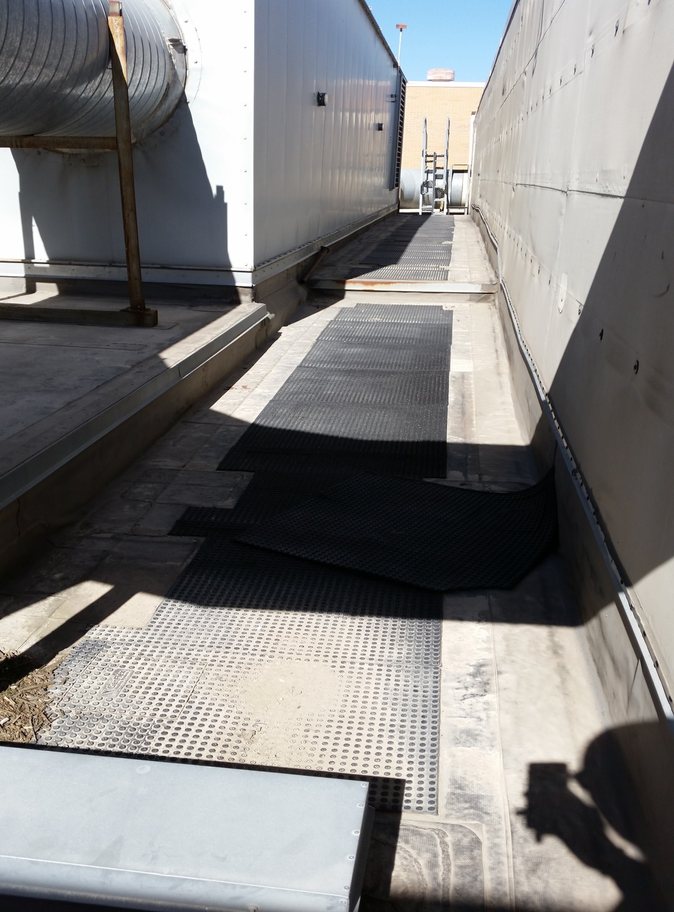
Building 3 Section C
Opposite View

Slide 3
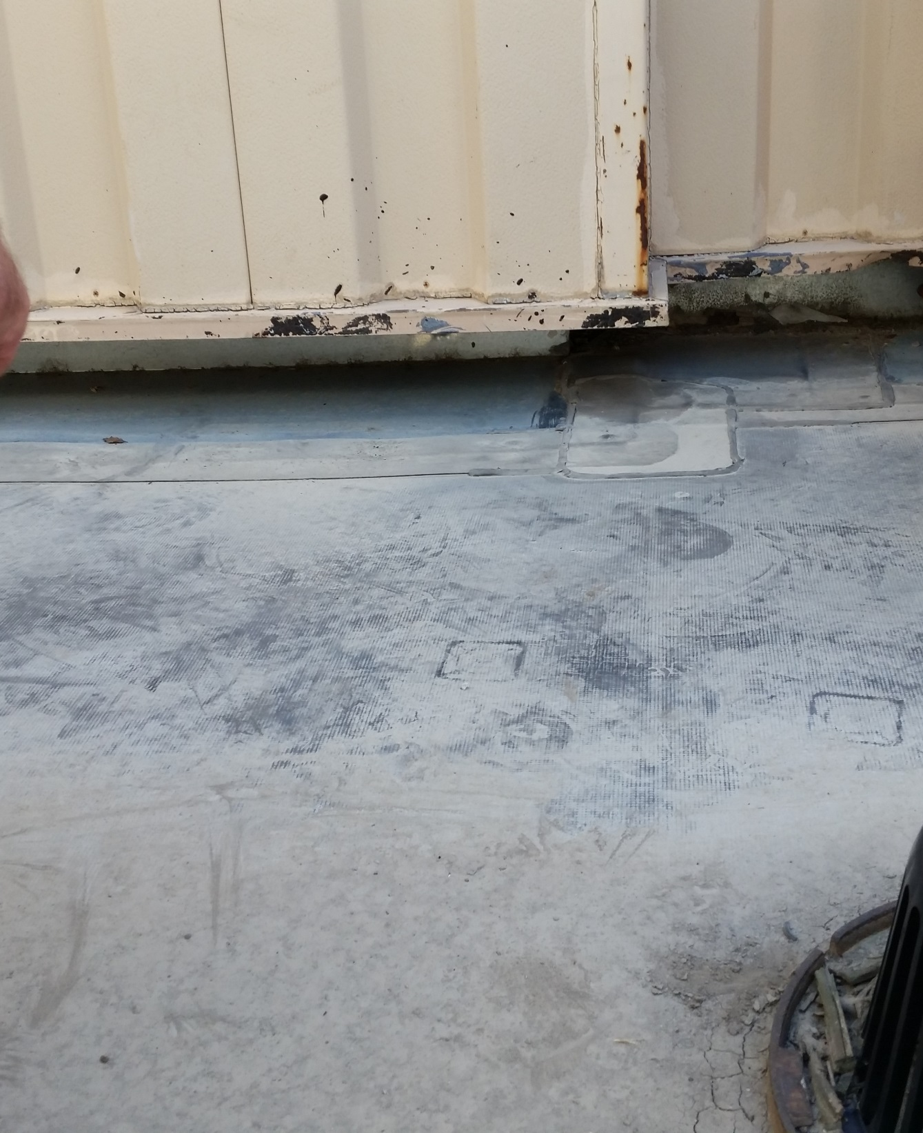
Building 3 Section C

Slide 4
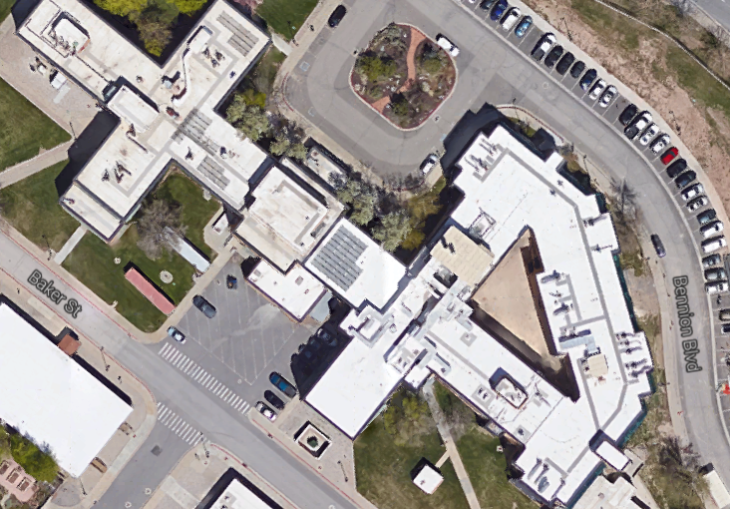
Building 2 Roof

