Slide 1

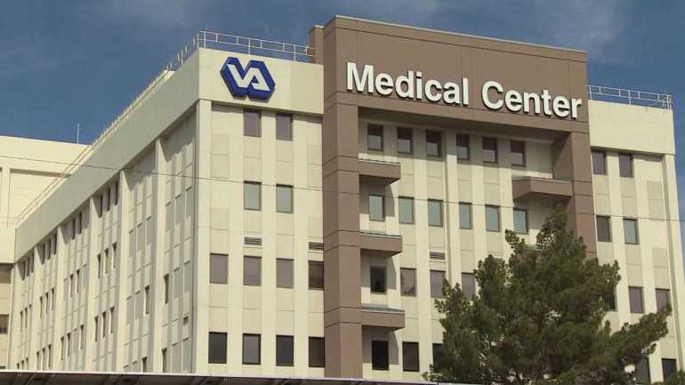



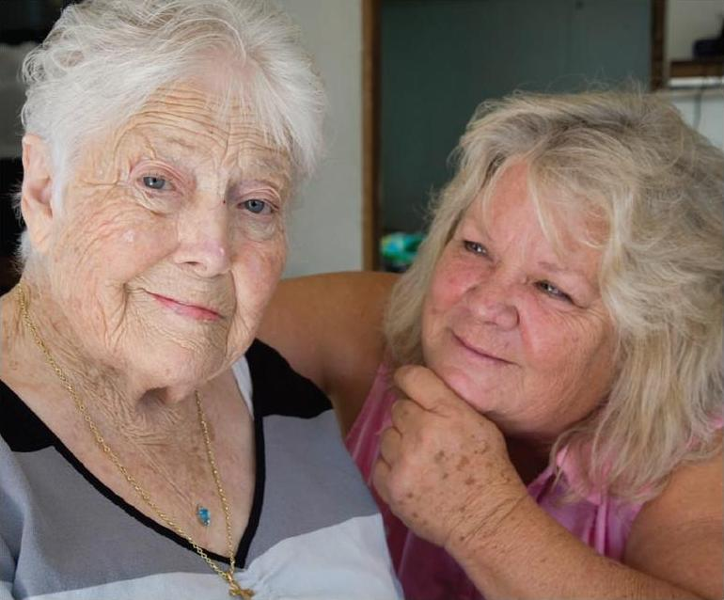
VD-HCBS Roles and Responsibilities
Performance Work Statement Attachment 1
VACO GEC program office oversight of implementation and provision of technical assistance
Trains VAMC Staff
VAMCs: identify eligible Veterans and buy services from State and local agencies
Provides Technical Assistance
The Contractor:
Assesses State and local agency readiness and Makes Recommendation
State and local agencies: oversee Veteran-caregiver relationship: manage budget, pay caregivers, payroll taxes, provide counselors
Frail and elderly Veterans select caregivers from the community

