Slide 1

Department of Veterans Affairs
Network Contracting Office (NCO) 21
Design New Parking Structure
Pre-Solicitation Conference and Site Walk
January 19, 2016
VA Sierra Nevada Health Care System

Slide 2
INTRODUCTIONS
VA REPRESENTATIVES:
Contracting Officer: Megan Barr
Contracting Officer Representative: Philip Feiler
Your point of contact for all correspondence: charee.harris@va.gov

Slide 3
Agenda
A/E firm sign-in sheet
SF 330 Requirements
Scope Overview
Project Site Walk
Q & A - Open Discussion

Slide 4
Set-Aside
This procurement is a total service disabled veteran owned small business set-aside, which applies to the prime A/E firm
SDVOSB businesses may partner with larger businesses; however we will be focusing heavily on the ostensible contractor rule

Slide 5
Questions
Submit all Requests for Information (RFI)s in writing to Charee Harris at charee.harris@va.gov.
Submit in a Word Document or in the body of email
Responses will be obtained and issued via amendment and posted to FedBizOpps
Cutoff date for questions will be January 26, 2016, 2PM local time
Attempts will be made to respond to RFIs after the cutoff date, but due to time constraints, responses may not be provided

Slide 6
SF 330 Overview
100% Set Aside for Service Disable Veteran Owned Small Business – Prime only
FedBizOpps www.fbo.gov is the only authorized website for solicitation information
All prime A/E firms shall be registered in SAM www.sam.gov prior to submission of SF 330

Slide 7
SF 330 Overview
  SF 330 includes 5 evaluation criteria
  SF 330’s are due by COB (4:00pm) on February 1, 2016
  Three (3) hard copy SF 330’s submitted to Philip Feiler(address listed in pre-solicitation notice)
  One (1) electronic copy sent to charee.harris@va.gov

Slide 8
SF 330 Overview
  Interviews will take place at the beginning of March 2016.
  Contract award is scheduled no later than April 29, 2016.

Slide 9
Questions??
Notes:
9

Slide 10

Project No. 654-250
Replace Original Parking Garage

Slide 11
Project No. 654-250
Replace Original Parking Garage
Current
Original parking garage constructed in 2006.
Original garage was not appropriately designed for the local climate, as a result, remaining life expectancy is less than 10 years.
This design is in no way intended to mimic or repeat the design of the existing garage.
The facility must remain fully operational throughout any construction or renovation; construction should be phased as necessary in order to minimize any disruption of services.

Slide 12
Project No. 654-250
Replace Original Parking Garage
Scope Details
The new garage to be designed for approximately 320 parking stalls contained on three floors.
Three floors is flexible – deliver the most cost-effective layout for the garage given the constraints of the selected location – this might mean more than three floors.
20% bid deducts is required (a whole floor??)
The highlighted location shown herein (upcoming slide) is not locked in stone. This design must consider other locations on campus as part of the charrette process.
This garage will contain storage for emergency preparedness materials and eqpt.

Slide 13
Project No. 654-250
Replace Original Parking Garage
Schedule – 235 days from NTP
ACTION | CALENDAR DAYS | AFTER …
Preliminary ½ Day Coordination Meeting | 7 Days | Issuance of Notice to Proceed
Charrette #1 | 21 Days | Prelim Coordination Mtg
Charrette #2 | 14 Day | Charrette #1
ACTION | CALENDAR DAYS | AFTER …
35% Design Submittal | 40 Days | Approval of Charrette #3 concept
VA Review of Submittal | 10 Days | 35% Submittal
Review Meeting | 1 Day | VA Review of 35%
65% Design Submittal | 40 Days | 35% Review Meeting
VA Review of Submittal | 10 Days | 65% Submittal
Review Meeting | 1 Day | VA Review of 65%
90% Design Submittal | 45 Days | 65% Review Meeting
VA Review of Submittal | 10 Days | 90% Submittal
Review Meeting | 1 Day | VA Review of 90%
100% Design Submittal | 15 Days | 90% Review Meeting
VA Review of Submittal | 10 Days | 100% Submittal
Bid Documents (BD) Submittal | 10 Days | 100% Review

Slide 14
Project No. 654-250
Replace Original Parking Garage

Slide 15
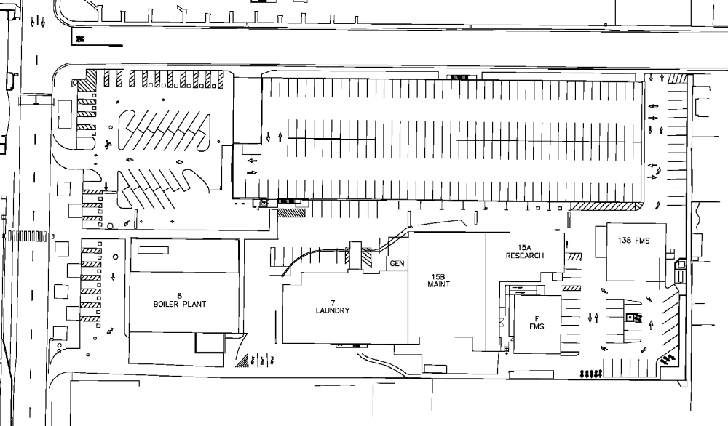
Project No. 654-250
Replace Original Parking Garage

Slide 16

Project No. 654-250
Replace Original Parking Garage
Questions?

