Slide 1
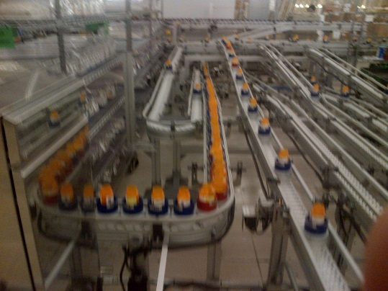

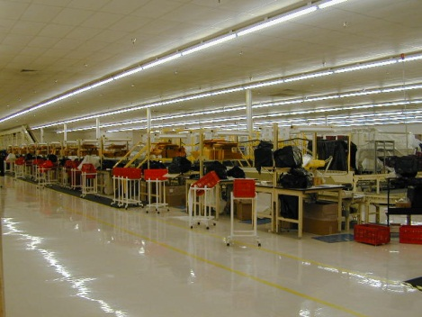
Welcome to the
Charleston CMOP
Automated Prescription Fulfillment System (APFS)
Pre-Solicitation Conference

Slide 2
Welcome and Introductions
NCO-15 Contracting Officers: John Fisher and James Justus
CMOP-Charleston
  Dena Wolforth, Director
  Lisa Harle, Associate Director
  Will Lavinghousez, Quality Manager
  Ann Harville, CIO
  Richard (Buck) Wheat, Facility Engineer
  Alan Benson, CLO
  James Hopkins, Production Supervisor
Vendor Introduction
Agenda Review

Slide 3


Slide 4
“Cart before Horse” Items
Current lease expires in September of 2017
Concurrent replacement of building and equipment
Conceptual floor plan included in the requirements documents
National CMOP initiative will standardize Warehouse Management System
  Will not be completed prior to solicitation
  Included a WMS as part of our requirements.

Slide 5
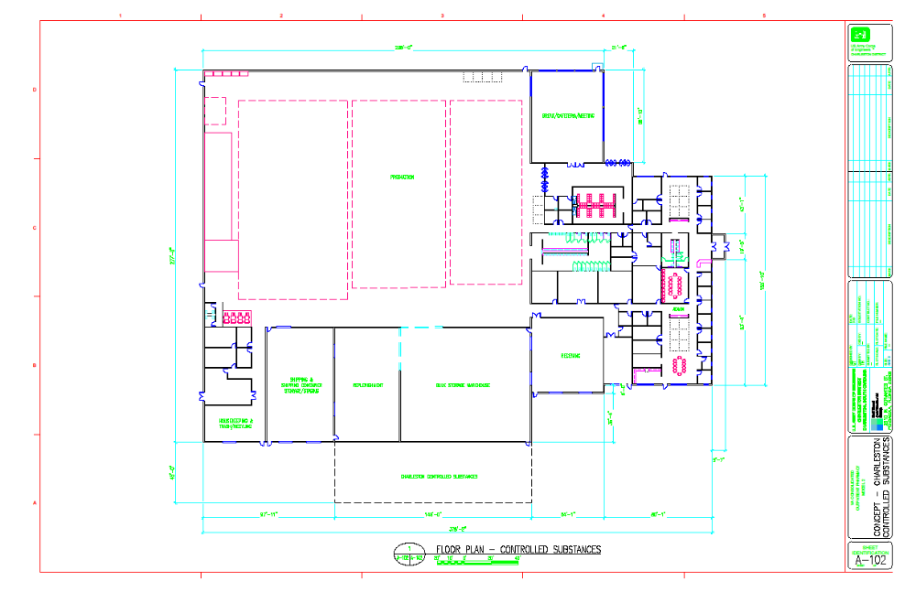

Slide 6


Slide 7
Include in Design
Ergonomics
  Automate workload distribution, compensate for variation in operator processing rate
  Ensure workstation adjustability
  Minimize the need for transportation or the distance required to move work and supplies
  Consider ease of access to equipment for both routine operation and maintenance
Safety
  E-stops should be readily identifiable and accessible and activation should be intuitive
  Travel paths should be clear and distinct with minimal walkovers and dead-end paths
Housekeeping
  Minimize dust
  Design with room under conveyors and wire-ways to ensure ease of cleaning

Slide 8


Slide 9
Include in Design
White space
  Ease of access, future growth, and the ebb and flow of inventory levels
Simple and intuitive operation with minimal need for operator adjustment
Comprehensive training plan:
  Managers should be familiar with the overall system design and configuration and process tools.
  Operators should understand standard operation, basic troubleshooting and corrective actions.
  Maintenance and IT support staff should be well versed in system integration and detailed troubleshooting tools, and understand when to enlist outside support.

Slide 10


Slide 11
Include in Design
Status displays
  Meaningful, configurable, and easily accessible
Alerts
  For system faults, software problems, loss of communication or deteriorating performance should be obvious
Redundancy of critical components
  Minimize single points of failure
Robust reporting mechanisms
  Available for both system and operator performance
  Configurable, and intuitive

Slide 12
Other Considerations
Controlled Substance Dispensing
One of two CMOP sites dispensing controlled substances
Will not co-mingle controls and non-controls
Packaging must be the same as the mainline APFS
Require a stand alone CS system
  Receiving
  Inventory management
  Dispensing
  Packing
Possibility of Dispensing C-II’s in the future

Slide 13
Other Considerations
Government Contracting constraints
  Avoid proprietary equipment and consumables
  Consumable design and sources may change, so create some flexibility.
Realistic staffing plan
  Numbers
  Skill set(s) required

Slide 14
TOUR
Please address all questions to Will Lavinghousez so that he can write it down and make sure that we address it when we return for the Q&A
If you feel the explanation would be best while out on the floor, either Lisa or Will can bring it up so that I can address it with everyone via the headsets.
Please note than any examples of good practices that we point out on the floor are not solutions that we desire to have in the final product. We want the best solution that you have to offer that meets the intent of the best practice, not necessarily the design.
Please do not have sidebar conversations with CMOP staff so that we ensure that you all can hear what is being presented and you don’t disturb them from their focus on the Veterans that they serve.
In the case of an emergency, I will give instructions to the group to assist in the safe response to the emergency.
No photos can be taken while on the floor during the tour today.

Slide 15
ACQUISITION MILESTONE CHART
PROJECT NO. | TITLE/DESCRIPTION OF PROPOSED PROCUREMENT
 | Charleston APFS
ESTIMATED AMOUNT |  |  | SPEC REVIEW DATE (CONSTRUCTION ONLY)
$0
PURCHASE REQUEST NO. |  |  | DATE PURCHASE REQUEST RECEIVED
PROCUREMENT MILESTONES (Enter date for each event)
ITEM | PLANNED | ACTUAL | REMARKS
Business Strategy Panel - IPT | 12/8/2015 | 12/8/2015
Requirement Documents Complete | 12/21/2015 | 12/23/2015
Pre-Invitation Notice | 1/8/2016
IFB/RFP to Review Committee | 2/5/2016
CRB Review | 2/15/2016
IFB/RFP to Industry | 2/29/2016
Bids/Proposals Received | 4/4/2016
Oral Presentations | 4/21/2016
Evaluation of proposals | 4/29/2016
Negotiations Completed | 5/16/2016
Contract Prepared | 6/3/2016
Contract to Review Committee | 6/10/2016
CRB Review | 6/17/2016
EEO Clearance | 6/24/2016
Contractor Signature | 7/1/2016
Contract Start Date | TBD

Slide 16
Vendor Feedback
Reasonable, practical PWS requirements?
Issues or concerns?
What about calculation of lifecycle costs – How is the best way to specify to ensure all vendors are providing the proper information? For what time period?

Slide 17
Q & A

