Slide 1
Community Care – Industry Day
Notes:
The “New” Veterans Choice Program

Slide 2
Industry Day Purpose
To gain Industry feedback on VA’s plan for future Community care activities
The VA Budget and Choice Improvement Act calls for improving Veteran access to care by consolidating community programs into one, standardized New Veterans Choice Program (New VCP)
Stakeholder feedback, including VSO, VA Staff and Clinicians, Federal Partners, and Health care industry leaders, along with best practices, financial modeling, and alignment with VA’s future vision for health care informed design
The new program will standardize Veterans we serve, access to community care, high-performing networks, care coordination, and provider payment
Transformation of this scale and impact will require a phased Implementation approach and a systems approach

Slide 3
Stakeholder Feedback Highlights Key Themes
VA gathered insights from VSOs, health care leaders, Federal partners, VA clinicians and staff, feedback on the Choice Program, and VACAA Independent Assessments Report
Veteran Service Organizations
Health Care Leaders
VA Staff and Clinicians
  VSOs emphasized the voice of Veterans, including:
  VA provides a unique environment and culture for Veteran health care
  Some Veterans are willing to travel farther to see VA providers
  Current processes for accessing community care are confusing
  Concerns the current VA provider system would be underfunded to purchase care in the community
  VA should be the face of care coordination for Veterans
  Procedures for filling claims (for payment or reimbursement of emergency care) are restrictive and burdensome
  Leaders from across health care emphasized the:
  Use of data and metrics to drive decision-making
  Use of new technologies to advance care delivery
  Need to build a sound technology infrastructure
  VA’s opportunity to lead the field in care coordination
  Importance of a high-performing network to provide the care and services Veterans require
  VA staff/clinicians emphasized the need to:
  Identify, use, and disseminate existing best practices at VA
  Improve efficiency/timeliness of business processes and clinical pathways so that Veterans are successfully connected to care in the community
  Simplify and consolidate various programs to reduce confusion
  Increase staffing and dedicate VA employees to care coordination
  Implement technologies to replace manual processes and increase information sharing
  Establish quality metrics/review processes for community care

Slide 4
Proposed Future State Vision for VA Healthcare
Deliver personalized, proactive, and patient-driven health care
Use innovative technologies and care models to optimize health outcomes
Use metrics and data analytics to drive improvement
Best Care Anywhere: VA delivers best-in-class care for Veterans through VA-Delivered Services while leveraging its network for Community-Delivered Services
Invest and grow VA-Delivered Foundational Services
Maintain a high-performing network to deliver community care
Focus on research and education
aligned with Veterans health needs
Notes:
Plan aligns with VA’s vision, discuss how these concepts exist today, but need to be right size over time

Slide 5
Impact to the Veteran
Our aim is to improve the Veteran experience both inside VA and within our provider network.
Provide expedited access to VA’s centers of excellence and medical care
Ensure access to private sector’s best providers
VA’s promise to our Veterans…
Connect Veterans with a care team in-person or virtually
Provide personalized tools and treatment plans to help manage the Veteran’s health
Seek individualized help from VA when needed
Coordinate care across the system, whether within or outside VA
Oversee and ensure outcomes of care and experience

Slide 6
Proposed Veteran Journey
High-Performing Network
Functional
Area(s)
Access to Community Care
(Referral and Authorization)
Veterans We Serve
(Eligibility)
Provider
Payment
(Claims)
Care Coordination
Access VHA care
Veteran
Journey
Identify need for VA health care
Contact local facility or national customer service center
Access care coordination services
Pay copayment
(If applicable)
Access community care
Veteran
Experience
“I know what services I’m eligible for and whether I can access them in the community”
“I was able to see a provider quickly and all of my appointments and tests were scheduled when I needed them”
“My care coordinator keeps me and my doctors in the loop and makes sure I am getting the care I need when I need it”
“I know how much I have to pay and am not surprised when I get a bill”
High-Performing Network Systems
Supporting
Systems
Integrated Customer Services Systems
Integrated Care Coordination Systems
Integrated Administrative Systems
(Eligibility, Patient Authorization, Referral, Billing and Reimbursement)
Integrated Operations Systems (Enterprise Governance, Analytics, and Reporting)

Slide 7
Simplify and Consolidate Community Care Programs
The “VA Budget and Choice Improvement Act” calls for a plan to consolidate VA’s various ways of purchasing care in the community.
Multiple, disjointed approaches
Consolidates VA’s community care programs focuses on the following:
VA Community Care “Individual Arrangements”
Access to Community Care (Referral)
PC3
Federal Partnerships
Care Coordination
Veterans We Serve (Eligibility)
Academic Affiliations
Veterans Choice Program
Project ARCH
Emergency Care
Provider Payment
(Claims)
High-Performing Network
Dialysis Contracts
Other Authorities
(e.g., Dependent Programs)

Slide 8
Patient Eligibility Criteria
Current Criteria for Community Care
VA determines eligibility for community care through a number of mechanisms focused on:
Geographic Distance / Convenience
Availability of Service
Wait Times for Care

Slide 9
Patient Eligibility Criteria
Eligibility Category | Proposed Criteria Veterans Choice Program | Change to Eligible Population
Wait Times for Care | An appointment cannot be scheduled within VA wait-time goals for providing the service or within the clinically necessary time frame indicated by the provider if that time frame is less than VA wait-time goals
Geographic Distance / Convenience | Veteran lives 40 miles or farther driving distance from their PCP as designated by the VA OR Veteran faces excessive burden in accessing care at a VA facility, including: Geographical challenges Environmental factors Medical conditions that affect travel Other factors (nature of care, frequency of care, and need for an attendant)
Availability of Service | Facility does not provide the service or has chosen to ‘buy’ service from the community OR There is a compelling reason why the Veteran needs to receive the service outside a VA facility (e.g., female victims of MST unable to be seen by a female provider).
Provides more access to community care than is available today
Does not significantly change access to community care
New eligibility criteria that does not exist today

Slide 10
Referrals and Authorizations – Current and Future State
Referrals and authorizations will follow an industry leading approach where fewer services require referrals and/or authorizations, allowing Veterans quicker access to care
Definitions
Referral: A written or electronic transfer of care initiated by a clinician that enables a patient to see another provider for specific care or to receive medical services.
Authorization: A decision that a health care service, treatment plan, prescription drug, or DME is medically necessary.
Current State Service Categories | Description
Referral Only (with or without an authorization) | For all non-emergent services, a referral is required
Future State Service Categories | Description
Referral Only (no Authorization) | A clinician’s referral is all that is required for most services and promotes coordination of care between the providers
Referral and Authorization Required | A defined, limited set of services requiring clinical review and approval after referral
Notes:
These two slides are about the approach -

Slide 11
Provider Network – Future State
Tiered Provider Network Evolution
  Phase 1
  Phase 2
  Phase 3
  Growth of VA Core Network through stronger relationships with Federal and academic teaching partners
  Expansion of External Network and shift to complementary clinical services
  Expansion of Preferred Tier Providers supplying complementary clinical services
  Network actively managed and integrated with claims and customer service departments
  Federally Funded and Academic Affiliates*
  VA Core Network
Preferred Provider Designation
  Quality: Adherence to evidence-based care guidelines
  Value: Delivery of high quality and appropriate care based on defined metrics and goals
  Compact: Pledge to serving US Veterans
  Preferred Tier
  External Network
  Standard Tier
*”Academic affiliates” have active teaching relationships with VA (Directive 1663) and are in the Core Network. Remaining academic institutions without teaching relationships are in the External Network.

Slide 12
Provider Reimbursement Rates
Networks Evolve to Value-Based Care
  Community Providers
  (Standard Fee Schedule)
VA will move to a value-based care model in the future
  Preferred Community Providers
  (Higher reimbursement based on quality metrics)
  VA, DoD, IHS, Tribal, FQHC, and Academic Teaching Partners
Improvements
Streamline rate structure
Move to value based rate schedule
Provides a clear basis for business rules in claims systems
Maintains existing relationships with DoD, IHS, Tribal, FQHC partners
  VA Core Network
  Community Networks

Slide 13
Medical Records Management – Future State
VA
High-Performing Network
Appointment Made
Health Information Exchanges
Vista
Referral/ Clinical Information
VA Health Information Gateway and Services
Community Providers
Receive Claim and Clinical Information
Clinical Information
Referral
Authorization (if necessary)
Formulary
VA Critical Pathways
Claim
Future State Improvements
Supports PCP care coordination
High Electronic Data Interchange (EDI) and less paper involved in transfer of health information
Quicker processing time and clearer definition of information ownership at each step
Consistent and more user-friendly process
Incoming Information
Outgoing
Information
Health Information Exchanges

Slide 14

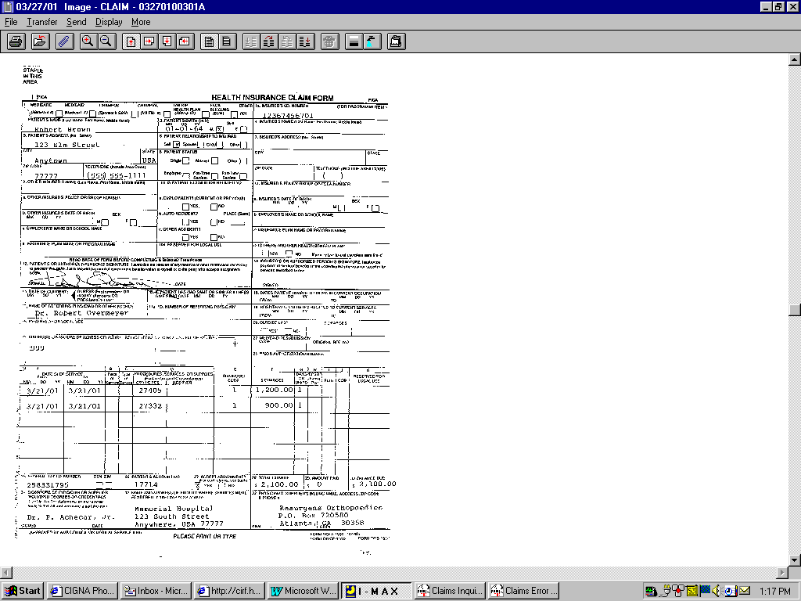
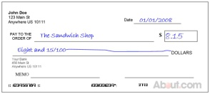
Billing and Reimbursement – Future State
Claims Process
VA
Claims Infrastructure
Network Provider
Contractor
Intake
Check
Eligibility
Check
Auth
Price
Claim
Remit
Payment
Provider
Claim
Provider Check
Claims System
Claim Processing Site
Automated Adjudication
Work Queues
Invoice
Denied or Rejected Claims
Payment
No requirement for return of medical record to pay claims
Notes:
Infrastructure
1 system that everyone can access; data is centralized enabling greater transparency with more effective reporting capability / decision making
Shared service enables policies and procedures to be defined and quickly deployed; easier to monitor productivity across a small number of sites
Flexibility to make changes based on smaller number of sites with centralized management / leadership
Process
Auto adjudication will enable us to pay claims on time and reduce human intervention (which adds processing time but also increases risk for manual mistakes to be made)
Tying community care approval with funding obligation potentially leads to funds that go unused; instead the funding occurs when the claim is paid

Slide 15
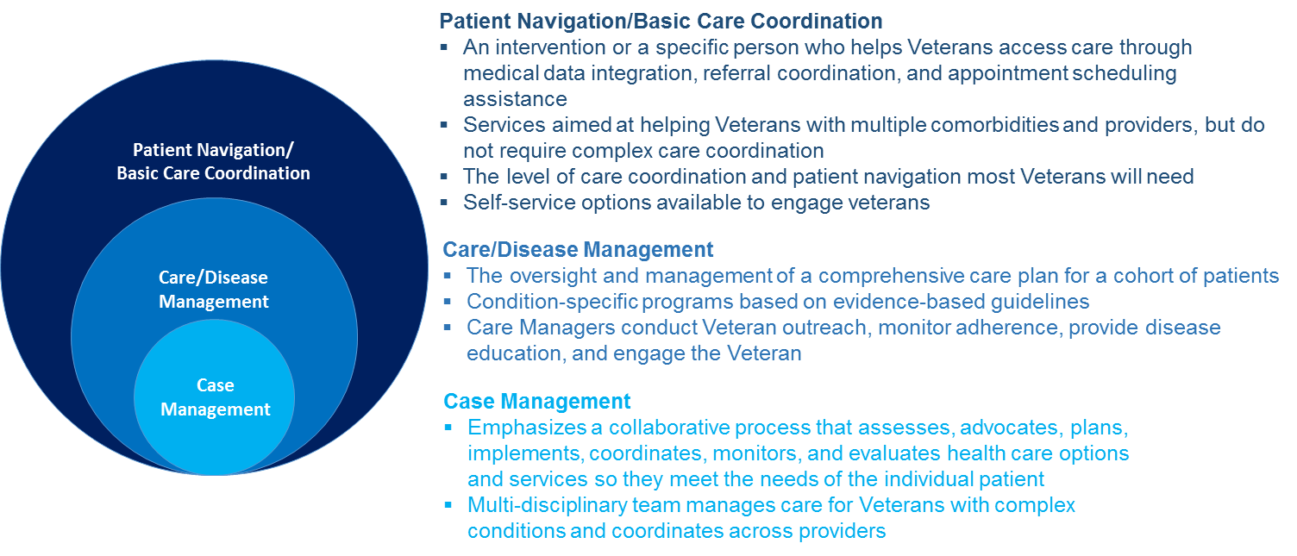
Future State Care Coordination Model & Components
Within the continuum of care, there may be some overlap between levels of service
The levels of care are coordinated and governed at the enterprise level and executed locally.

