Slide 1
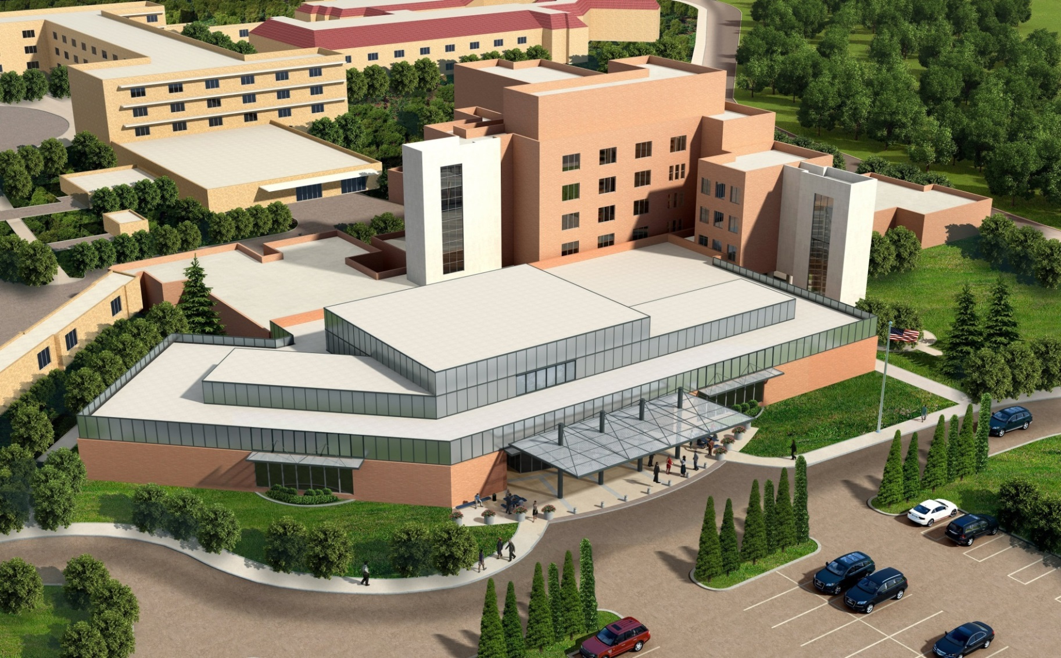
RENOVATE AND EXPAND AMBULATORY CARE & LAB

Slide 2
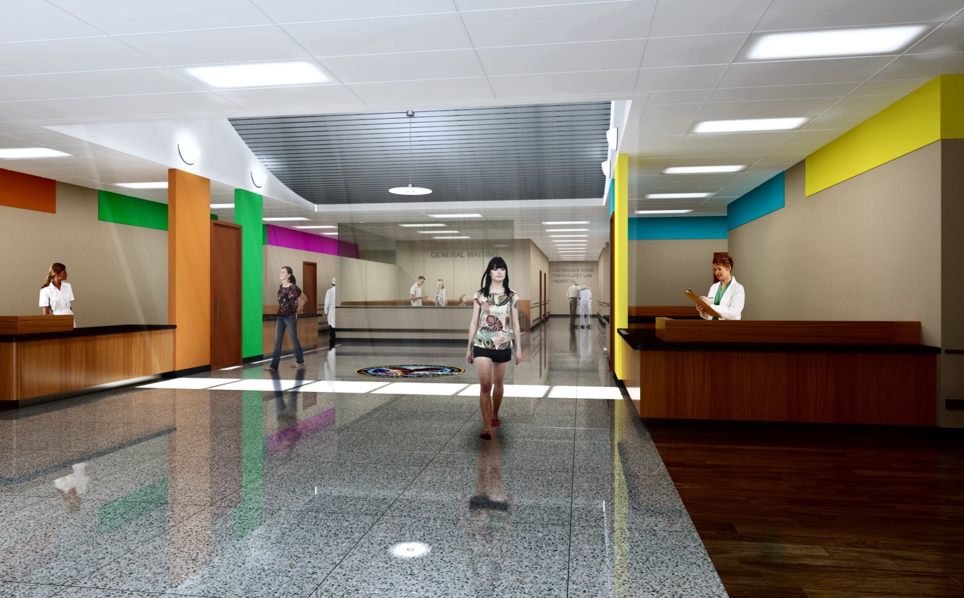
WELCOME

Slide 3
OVERVIEW
Construction Locations
Specifications
  Table of contents
  General Requirements
  Deduct-Options
  Temporary Parking Detail
Drawings
  Project Phasing
Site Visit

Slide 4
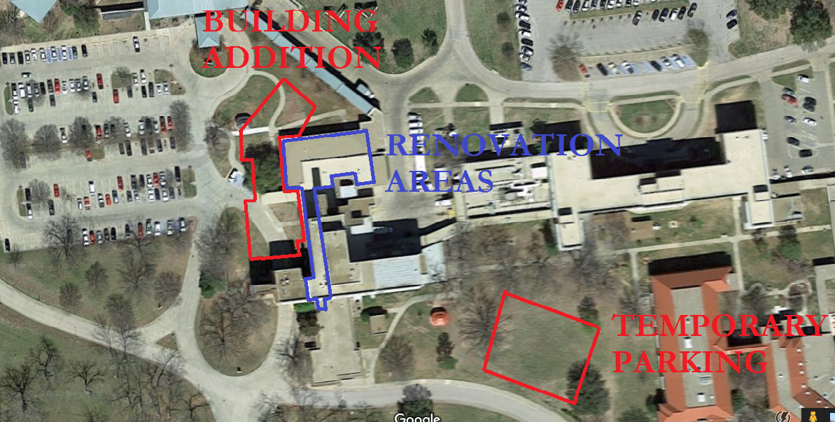
Construction Locations

Slide 5
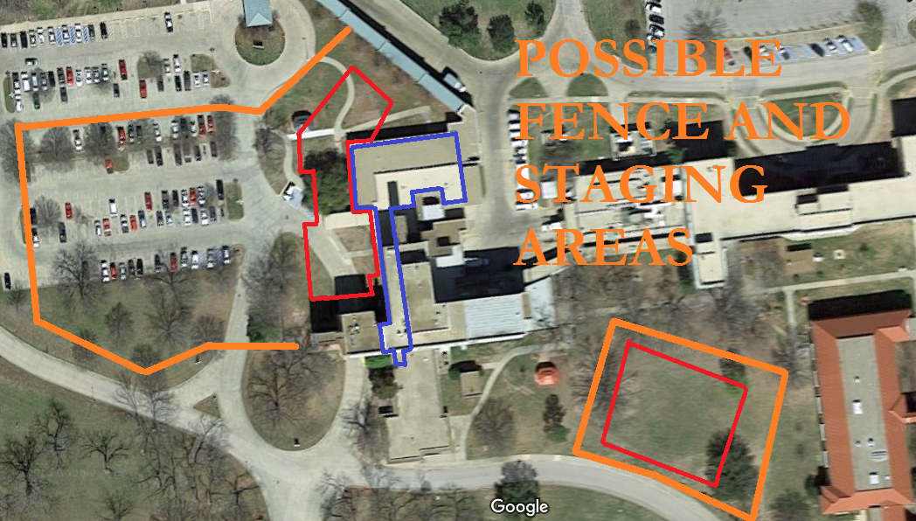
Construction Fencing

Slide 6
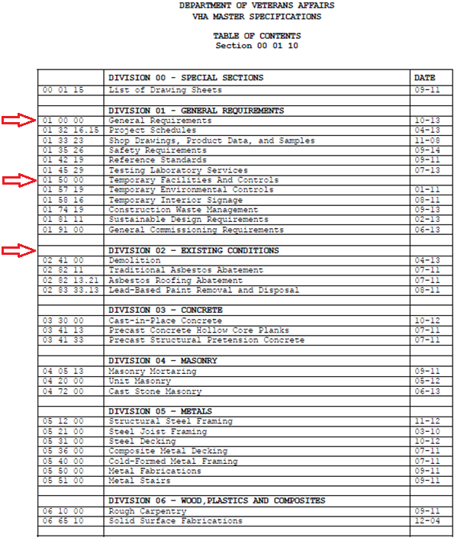
Specifications

Slide 7
SECTION 01 00 00
GENERAL REQUIREMENTS
1.1 GENERAL INTENTION
A. Contractor shall completely prepare site for building operations, including demolition and removal of existing structures, and furnish labor and materials and perform work for Project 549A4-130 EXPAND AND RENOVATE AMBULATORY CARE AND LAB as required by drawings and specifications.
1.2 STATEMENT OF BID ITEM(S)
A. ITEM I, GENERAL CONSTRUCTION: Work includes general construction, alterations, parking lots, walks, grading, drainage, mechanical and electrical work, utility systems, necessary removal of existing structures and construction and certain other items.

Slide 8
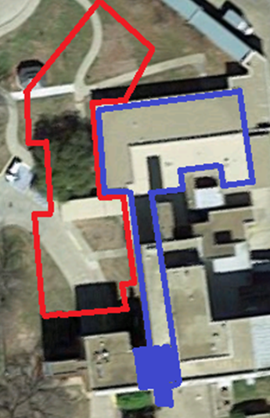
POLICE RENOVATION
B. Deduct Option 1:
State amount to be deducted from the Base Bid to delete work indicated for rooms: Conference F100, Operations F101, Holding F102, Office F103, Office F104, Office F105, Lockers F106, Storage F107, Armory F108, Shower F109, Toilet F110, and Evidence F111.

Slide 9
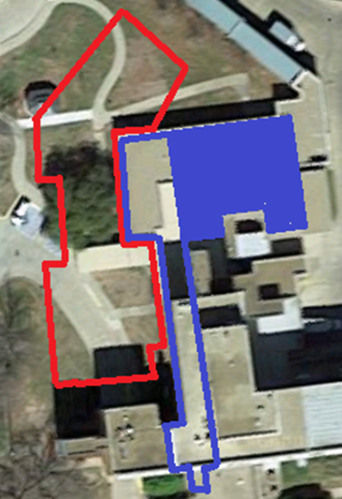
LAB RENOVATION
C. Deduct Option 2:
State amount to be deducted from the Base Bid to delete work indicated for rooms: Waiting H100, Reception H101, Blood Draw Rooms H102, thru H105, Corridor H106, Alcove H107, Toilet H108, thru H110, VA Project 549-130 Renovate and Expand Ambulatory Care & Lab Sam Rayburn Memorial Veterans Center, Bonham, Texas 100% ISSUED FOR CONSTRUCTION 05-01-13 01 00 00 -2 Storage H111, Corridor H112, Toilet H113, Admin Office H114, Chief Office H115, IT H116, HAC H117, Bulk Storage H118, Conference H119,
Corridors H120 and H121, Lab H122 and Corridor G147.

Slide 10
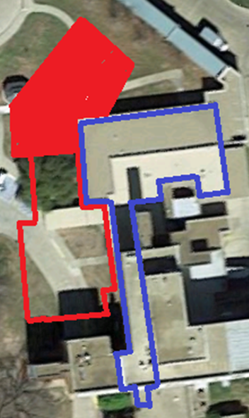
SHELL
D. Deduct Option 3:
State amount to be deducted from the Base Bid to delete work indicated for rooms: Corridor A100, Waiting A101, MD/SCI A102, MD A103, RN A104, LVN A105, RN A106, HAC A107, LVN A108, Corridor A109, MD A110, LVN A111, RN A112, Mental Health A113, Social Worker A114,
Pharmacy A115, Corridor B100, Copy B101, Socal Worker B102, Scale B103, RN B104, LVN B105, MD B106, Toilet B107, LVN B108, RN B100, LVN B110, RN B111, MD B112, MD B113, and Waiting B114.

Slide 11
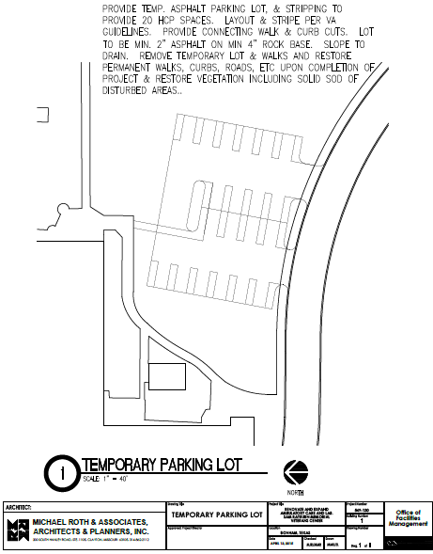
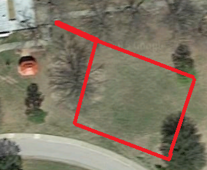
SECTION 01 50 00
TEMPORARY FACILITIES AND CONTROLS
(LAST PAGE IN THIS SECTION.)
Temporary Parking

