Slide 1
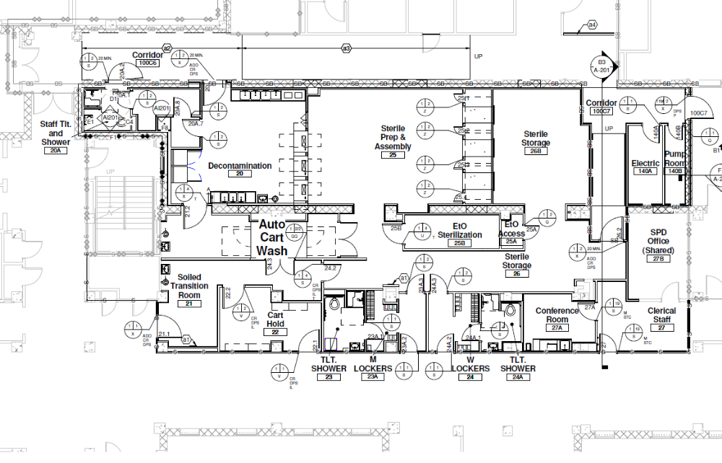
D
B
A
C
E
F
Demo and build A, B as hallway, C envelope
Activate B as hallway
Alter floor D
Build E
Demo F
Finish C and B into SPS

