Slide 1

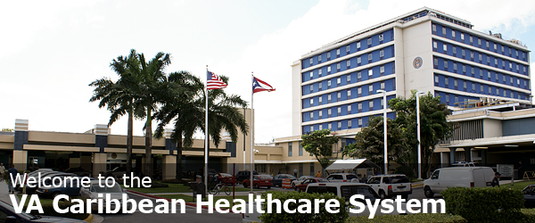

Design-Build Construction Phase 4 Parking Structure
VA Medical Center - San Juan, PR
Solicitation #VA 101-11-RP-0132
Project No. 672-085-D
Pre-Proposal Conference
October 19, 2011

Slide 2
Agenda
Opening Remarks
New Acquisition – RFP VA-101-11-RP-0132
Submission Requirements
Milestones
Project Scope & Overview
Questions & Answer Session
Site Visit

Slide 3
Pre-Proposal Conference
INTRODUCTIONS
VA Representatives
- VA CFM – Diane Campbell, Contracting Officer
- VA CFM – William Picking, Jr., Project Executive
Architect of Record
- N.K. Bhandari, Architecture &
Engineering, P.C. – James Resig, P.E.

Slide 4
Pre-Proposal Conference
Our discussion of each section shown on the agenda will be brief and generally will highlight those areas of importance as you prepare for your offer.
I would like to make clear that anything said should not be interpreted as a change to the solicitation/contract documents as posted. If a statement is made that is inconsistent with the solicitation requirements, you should not submit your proposal based on the statements. Submit based on the posted/written solicitation and all amendments.

Slide 5
Pre-Proposal Conference
  NEW ACQUISITION REQUIREMENTS
  VA 101-11-RP-0132
  - Pre-Solicitation Notice - September 13, 2011
  - RFP ( 100% Small Business Set-Aside) – September 28, 2011
  Federal, State and Local Taxes (FAR Clause 52.229-3)
  - Is the Responsibility of the Contractor
  Amendment 1 issued 10/10/2011
  Amendment 2 will be issued following today’s meeting to include updated RFI Log and Presentation Slides and Sign-In Sheets

Slide 6
Pre-Proposal Conference
NEW ACQUISITION REQUIREMENTS
CLIN 001 - BASE BID ITEM 1 - GENERAL CONSTRUCTION
CLIN 002 - BASE BID ITEM 2 - PHYSICAL SECURITY
CLIN 003 - ADD ALTERNATE #1 - ADD SUICIDE DETERRENT GRILLES IN
ALL OPENINGS
CLIN 004 - ADD ALTERNATE #2 - PHOTO VOLTAIC ARRAY
CLIN 005 - ADD ALTERNATE #3 - VEGETATED “GREEN” WALLS
CLIN 006 - ADD ALTERNATE #4 - SUICIDE DETERRENT GRILLES AND STAINLESS STEEL MESH SCREENING
CLIN 007 - ADD ALTERNATE #5 - PARKING SPACE COUNTERS: GENERAL AT ALL LEVELS AND ACCESSIBLE SPACES AT LEVELS 1 AND 4
CLIN 008 - ADD ALTERNATE #6 - ELEVATORS 1 & 2

Slide 7
Pre-Proposal Conference
  NEW ACQUISITION REQUIREMENTS
  Cost Range
  - Between $20,000,000 - $50,000,000
  RFP Due Date
  - November 15, 2011
  Bid Bond / Bid Guarantee (SF24)
  - 20 percent of the offer price but shall not exceed $3,000,000

Slide 8
Pre-Proposal Conference
  NEW ACQUISITION REQUIREMENTS
  Annual Representation and Certification
  - At https://orca.bpn.gov/
  Central Contractor Registration (CCR)
  - At http:/www.ccr/gov
  - Must be in CCR prior to award
  Davis Bacon Act (Applies)
  Buy American Act (Applies)

Slide 9
Pre-Proposal Conference
  NEW ACQUISITION REQUIREMENTS
  Completion Time
  - 485 Calendar Days after Notice to Proceed
  Bonds (within 10 calendar days after award)
  Liquidated Damages
  - $1,950 each calendar day of delay
  OSHA & VA Requirement (Construction Safety Course)
  - Competent Person (supervisor) 30 hours
  - All other employees 10 hours

Slide 10
Pre-Proposal Conference
  NEW ACQUISITION REQUIREMENTS
  Insurance
  - General Liability required prior to commencing work
  Questions & Answers (RFS’s)
  - Questions Due: October 27, 2011
  - Answers Due: November 3, 2011
  - Email Diane Campbell at diane.campbell@va.gov. Copy William Picking, Jr. at william.picking@va.gov and James Resig at jresig@nkbpc.com
  - The subject line to read “VA San Juan Parking Structure Phase 4

Slide 11
Pre-Proposal Conference
  NEW ACQUISITION REQUIREMENTS
  Office of Small and Disadvantaged Business Utilization (OSDBU)
  Washington, DC
  - POC – Mark Taylor 202-461-4258

Slide 12
Pre-Proposal Conference
  This procurement is a 100% Set-Aside for Small Business competition.
  A public bid opening will not occur. This is a request for proposals and not a sealed bid.
  52.219-14 LIMITATIONS ON SUBCONTRACTING (DEC 1996) : Performance of work by the prime contractor is at least 15%.
  Commence work within 10 days of the Notice to Proceed.

Slide 13
Tentative Schedule
Request for proposal issued | September 28, 2011
Pre-proposal conference | October 19, 2011
Proposal submitted | November 15, 2011
Contract award | January 25, 2012
Notice to proceed | February 25, 2012
Construction completion/final inspection/ custody receipt | TBD (485 Calendar Days from NTP)
All Dates are estimates only and subject to change.

Slide 14
Pre-Proposal Conference
Proposals shall be in two parts:
(1) Technical proposals
  - Significantly more important than cost.
  - will consist of three factors (listed in descending order of importance):
  Past Performance
  Construction Management:
  3. Schedule

Slide 15
Pre-Proposal Conference
(2) Cost proposals
  Volume II shall consist of the signed SF-1442, Price (continuation price page 4) acknowledgment of amendments, Representations and Certifications, and bid guarantee.
  Cost Proposal will be reviewed for its acceptability and
  price reasonableness. VA may award without discussions.
Provide your best technical and cost proposals for the initial submission because VA may award without discussion.

Slide 16
Pre-Proposal Conference
Review Clauses and Provisions: Clauses apply to post-award actions and Provisions apply to Pre-award actions.
Proposal Deliver Date and Time: November 15, 2011 at 2:00 EST, unless date and time are changed by amendment. Proposal deliver location is specified within the solicitation.
Please sign all amendment forms and acknowledge the amendments on the bid.
Check at www.fbo.gov for amendments BEFORE submitting your proposal.

Slide 17
Pre-Proposal Conference
Offerors are cautioned that their offers may be considered non-responsive if they include any qualifications, including but not limited to price escalation reservations.
Equal Opportunity: The contractor shall not discriminate against any employee or applicant for employment because of race, color, religion, sex, or national origin.
Licenses/Permits: Contractor is fully responsible for any and all required licenses and permits to complete this project.
Partnering is voluntary but highly encouraged. Cost will be split between contractor and government. The goal is to build professional work relationships geared toward successful project completion by promoting mutual benefits.

Slide 18
Pre-Proposal Conference
Project Background/Scope
CFM Project Executive
William Picking, Jr.
A/E Project Manager
James Resig, PE

Slide 19
Pre-Proposal Conference
RFP/AE Consultants:
N.K. BHANDARI, Architecture & Engineering, P.C.,
- Architecture & Civil Engineering
Carl Walker Inc.
- Parking Consultant & Structural Engineering
RAM-TECH Engineers, P.C.
- Mechanical, Plumbing, Fire Protection & Electrical Engineering

Slide 20
Pre-Proposal Conference
RFP/AE Consultants:
NIKA Technologies, Inc.
- Security Engineering
Lammers Associates
- Vertical Transport Consultant
Klein Engineering
- Traffic Engineering

Slide 21
New Parking Structure – 1st phase of 2-phase program
Phase 4: Approximately 741 Parking Spaces in Structure;
68 surface parking spaces outside of structure
Phase 5 will add 678 more parking spaces
Pedestrian Skywalk connecting to the first floor of the hospital
SCI patient access and parking accommodations
Vehicular Access from Casia Street
Maintain access to existing Admin Lots ‘D’ & ‘E’
Maintain access to existing loading dock area
Access to New Bed Tower for emergency, service, & patients
Interface with all existing and proposed infrastructure
Accommodate potential future projects
Project Scope
NKB
New Parking Structure, Phase 4 & Phase 5, VA San Juan, Puerto Rico

Slide 22
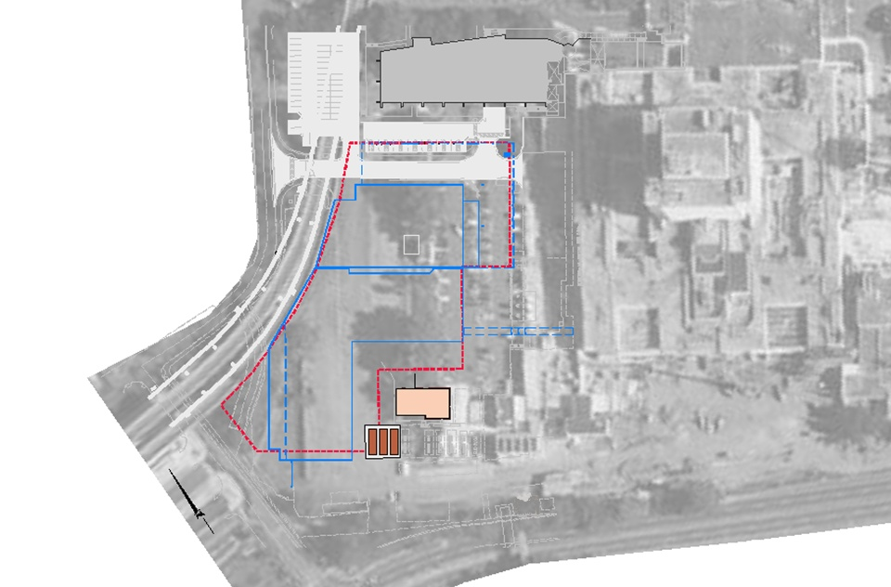
MAINTAIN MINIMUM 2.5M SETBACK FROM ELEVATED TRAM RAIL
TREN URBANO ELEVATED RAIL
CASIA STREET
EXISTING HOSPITAL BUILDING
FEMA 100-YEAR FLOOD PLAIN
NEW PARKING STRUCTURE
CONCRETE CHANNEL
TREN URBANO ACCESS ROAD
PR-21
Site Constraints
NKB
New Parking Structure, Phase 4 & Phase 5, VA San Juan, Puerto Rico

Slide 23
ADMIN BUILDING
EXISTING ENTRANCE ROAD
FOR LOADING DOCK AND ADMIN BUILDING ACCESS
CASIA STREET
LOADING DOCK
EXISTING HOSPITAL BUILDING
ELEVATED RAIL
NEW PARKING STRUCTURE
TREN URBANO
TREN URBANO ACCESS ROAD
PR-21
Site Constraints
NKB
New Parking Structure, Phase 4 & Phase 5, VA San Juan, Puerto Rico

Slide 24
NEW ADMIN. BUILDING (UNDER CONSTRUCTION)
ELECTRICAL CONDUITS
CASIA STREET
LOADING DOCK
EXISTING HOSPITAL BUILDING
NEW PARKING STRUCTURE
ACCESS TO UPPER AND LOWER LEVELS OF ELECT. DIST. BUILDING AND ELECT. CONDUITS IN THE ELECTRICAL DIST. IMPROVEMENTS PROJECT (IN BIDDING PROCESS)
TREN URBANO ACCESS ROAD
NEW GENERATORS (INSTALLED)
PR-21
Site Constraints
NKB
New Parking Structure, Phase 4 & Phase 5, VA San Juan, Puerto Rico

Slide 25
NEW ADMIN. BUILDING (UNDER CONSTRUCTION)
OVERHANG OF LEVELS 4-7
CASIA STREET
EXISTING HOSPITAL BUILDING
LOADING DOCK
FOOT PRINT LEVELS 1-3
NEW PARKING STRUCTURE
TREN URBANO ACCESS ROAD
NEW HAZARDOUS MATERIALS STORAGE BUILDING (PHASE 5)
PR-21
Parking Structure Footprint
NKB
New Parking Structure, Phase 4 & Phase 5, VA San Juan, Puerto Rico

Slide 26
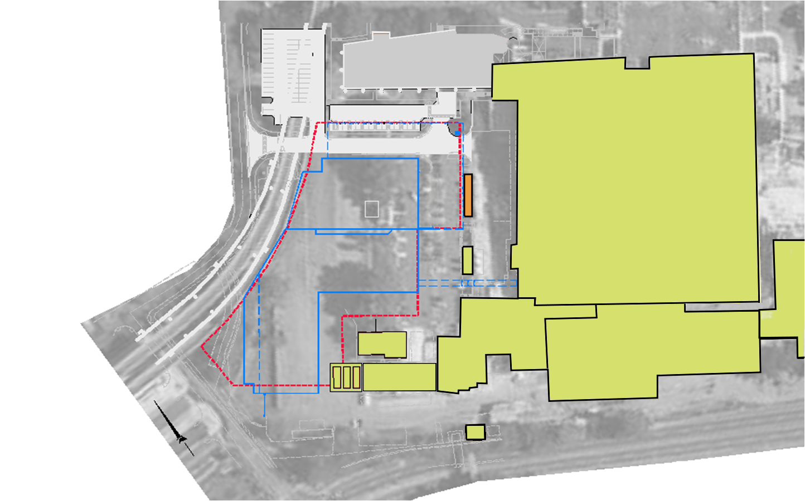
Mission Critical Facility
ADMIN
BUILDING
CASIA STREET
EXISTING HOSPITAL BUILDING
LOADING DOCK
Generators
3 & 4 to be removed
NEW PARKING STRUCTURE
Oxygen
Tanks
Electrical
Distribution
Generators
TREN URBANO ACCESS ROAD
New Hazardous Materials Storage Building
PR-21
Physical Security
NKB
New Parking Structure, Phase 4 & Phase 5, VA San Juan, Puerto Rico

Slide 27
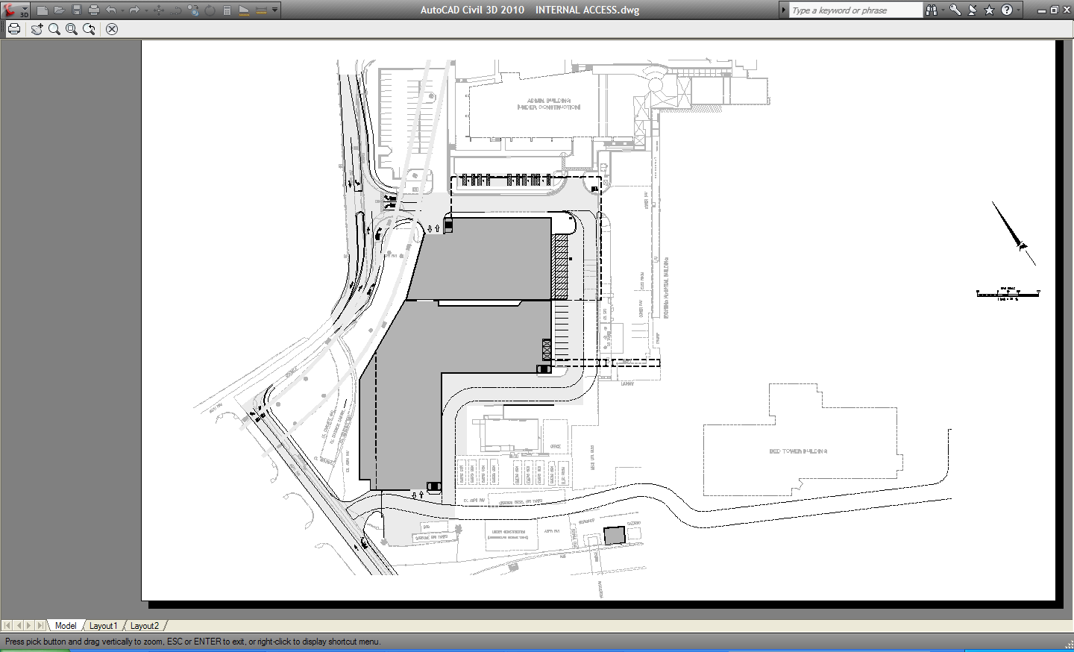
DEDICATED LEFT TURN LANE IN
EX. ADMIN & LOADING
DOCK ACCESS ROUTE
NEW ADMIN. BUILDING (UNDER CONSTRUCTION)
DEDICATED LEFT AND RIGHT TURN LANES OUT
PROPOSED OFFSITE ROAD IMPROVEMENTS
Endorsement received from Authority for Proposed Off-site Improvements
RIGHT TURN LANE IN
SERVICE ROUTE
DEDICATED LEFT AND RIGHT TURN LANES ON TO CASIA STREET
CASIA STREET
PROPOSED OFFSITE ROAD IMPROVEMENTS
SERVICE ROUTE
NEW BED TOWER
TREN URBANO ACCESS ROAD
NEW EMERGENCY/ SERVICE ENTRANCE
PR-21
Site Access: Off-Site Improvements
NKB
New Parking Structure, Phase 4 & Phase 5, VA San Juan, Puerto Rico

Slide 28
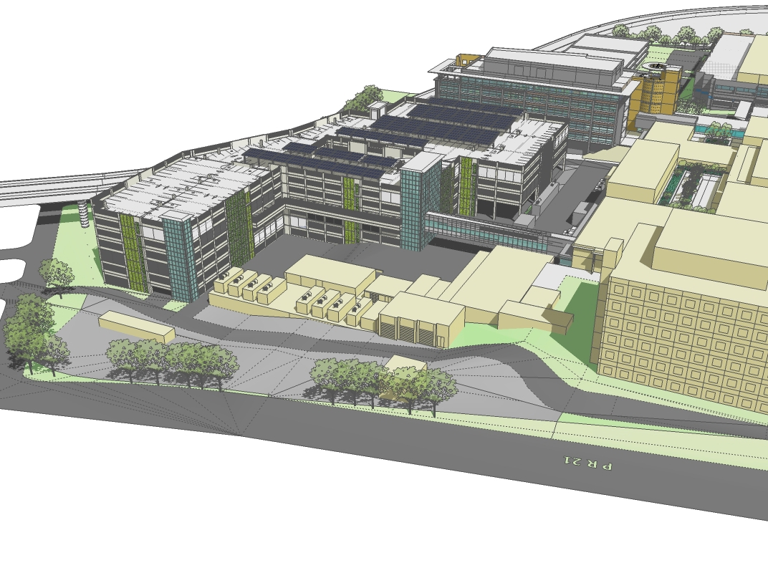
View Looking North – Phases 4 & 5
NKB
New Parking Structure, Phase 4 & Phase 5, VA San Juan, Puerto Rico

Slide 29
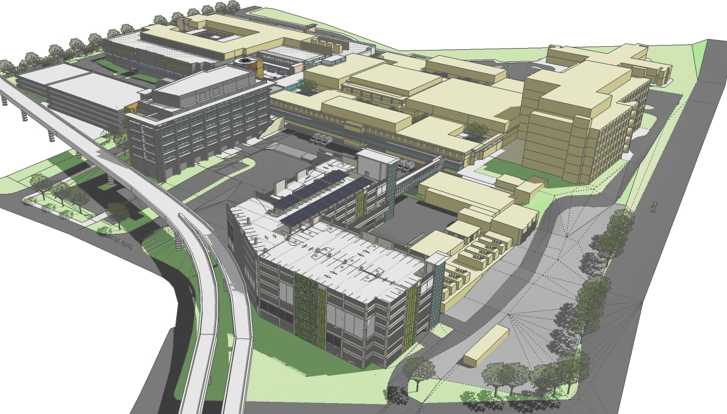
View Looking Northeast – Phase 4
NKB
New Parking Structure, Phase 4 & Phase 5, VA San Juan, Puerto Rico

Slide 30
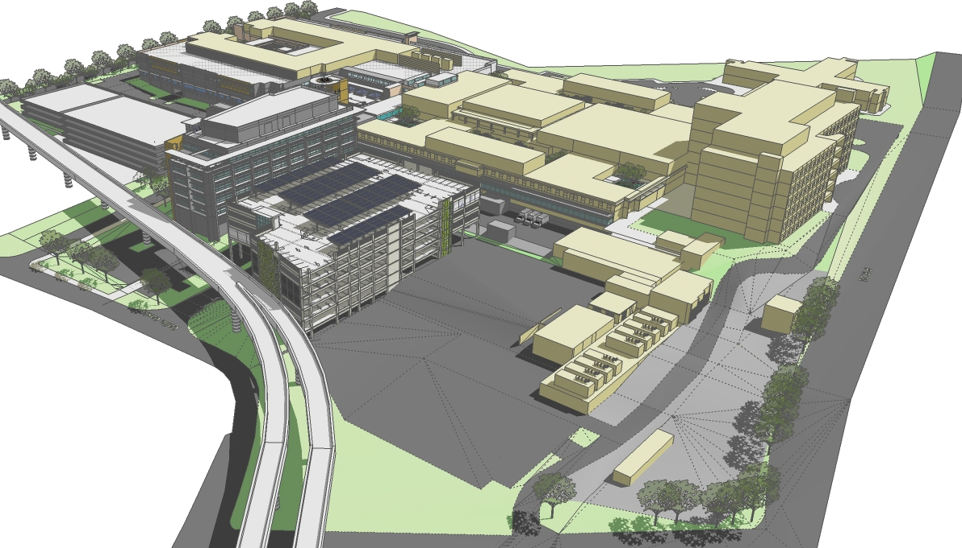
View Looking Northeast – Phase 5
NKB
New Parking Structure, Phase 4 & Phase 5, VA San Juan, Puerto Rico

Slide 31

View Looking Northeast – Phases 4 & 5
NKB
New Parking Structure, Phase 4 & Phase 5, VA San Juan, Puerto Rico

Slide 32
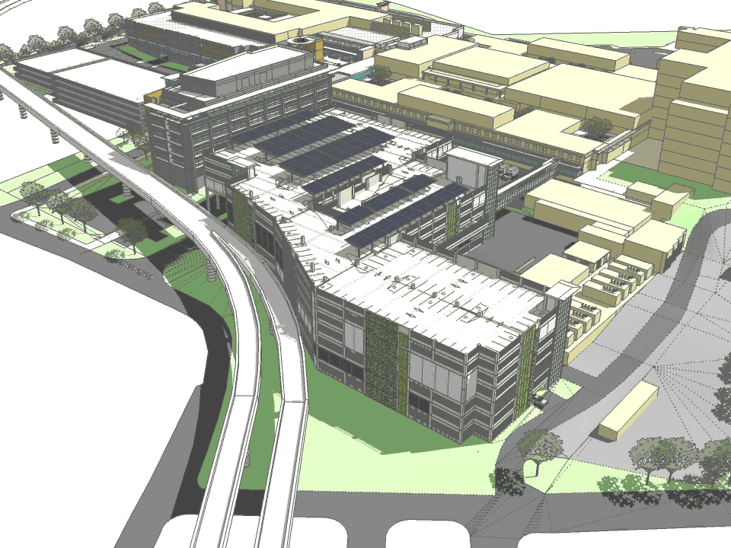
Animation
NKB
New Parking Structure, Phase 4 & Phase 5, VA San Juan, Puerto Rico

Slide 33
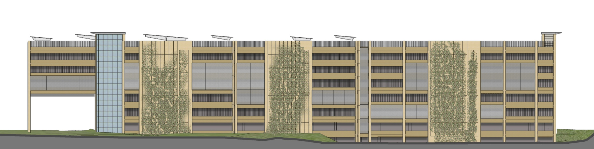
West Elevation
Exterior Façade Concept
NKB
New Parking Structure, Phase 4 & Phase 5, VA San Juan, Puerto Rico

Slide 34
Discussion
NKB
New Parking Structure, Phase 4 & Phase 5, VA San Juan, Puerto Rico

Slide 35
Site Visit
NKB
New Parking Structure, Phase 4 & Phase 5, VA San Juan, Puerto Rico

