Slide 1

NCO 12
Great Lakes Acquisition Center
Solicitation VA69D-16-R-0583
Rehab Renovation
Pre-Proposal Conference
June 22, 2016 9:00am CDT

Slide 2
Agenda
NCO 12
Great Lakes Acquisition Center
Ground Rules
What is a Request for Proposal?
Important Dates
SDVOSB Set Aside
FAR 52.215-1
Instructions to Offerors
Basis for Award
Evaluation Factors
Site Visit

Slide 3
Ground Rules
NCO 12
Great Lakes Acquisition Center
No questions! All questions must be submitted via email to paul.seivert@va.gov.
The solicitation trumps this presentation.

Slide 4
What is a Request for Proposal?
NCO 12
Great Lakes Acquisition Center
Follows FAR Part 15 (Contracting by Negotiation) rather than FAR Part 14 (Sealed Bidding)
Allows the Government to consider factors other than price in the award decision.
There will be no public opening of proposals.

Slide 5
Important Dates
NCO 12
Great Lakes Acquisition Center
Pre-Proposal Conference – June 22, 2016 @ 9:00am CDT
RFIs Due – July 1, 2016 @ 2:00pm CDT
Proposals Due – July 18, 2016 @ 3:00pm CDT

Slide 6
SDVOSB Set Aside
NCO 12
Great Lakes Acquisition Center
Offerors must be CVE verified prior to submitting a proposal in accordance with VAAR 819.7003(b).

Slide 7
FAR 52.215-1
NCO 12
Great Lakes Acquisition Center
FAR 52.215-1 Instructions to Offerors – Competitive Acquisition is an important provision that governs the RFP process.
  FAR 52.215-1(f)(4) states:
    The Government intends to evaluate proposals and award a contract without discussions with offerors (except clarifications as described in FAR 15.306(a)). Therefore, the offeror’s initial proposal should contain the offeror’s best terms from a cost or price and technical standpoint. The Government reserves the right to conduct discussions if the Contracting Officer later determines them to be necessary.

Slide 8
Instructions to Offerors
NCO 12
Great Lakes Acquisition Center
Submission Instructions
  Offerors must submit one (1) electronic copy AND three (3) hard copies of their proposal
  Faxed proposals are NOT permitted

Slide 9
Instructions to Offerors
NCO 12
Great Lakes Acquisition Center
Proposal Format
  Two Volumes:
    Volume 1 – TECHNICAL and PAST PERFORMANCE (shall NOT include any information related to pricing of the Rehab Renovation project)
    Volume 2 - PRICE

Slide 10
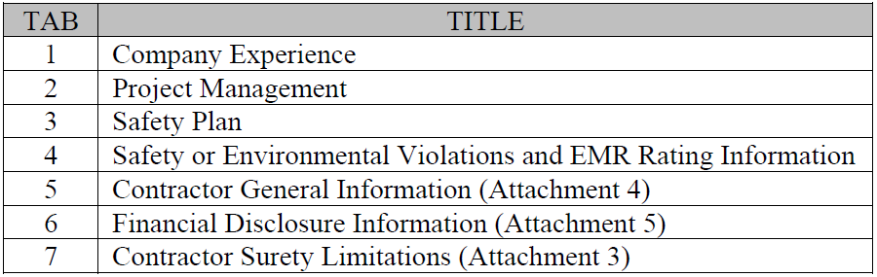
Instructions to Offerors
NCO 12
Great Lakes Acquisition Center
Volume 1, Part 1 - TECHNICAL

Slide 11
Instructions to Offerors
NCO 12
Great Lakes Acquisition Center
Volume 1, Part 1 – TECHNICAL
  Technical proposals shall be limited to 25 pages.
  Company Experience
    Include detailed information about the company’s experience in providing construction services
    Offerors shall have a minimum of 3 years’ experience performing construction in a health care environment.

Slide 12
Instructions to Offerors
NCO 12
Great Lakes Acquisition Center
Volume 1, Part 1 – TECHNICAL
  Project Management
    Include detailed information on management team.
    Submit resumes for Project Manager/Superintendent, QC Manager, and Safety Officer

Slide 13
Instructions to Offerors
NCO 12
Great Lakes Acquisition Center
Volume 1, Part 1 – TECHNICAL
  Safety Plan
    Include detailed procedures ensuring all employees are properly trained.

Slide 14
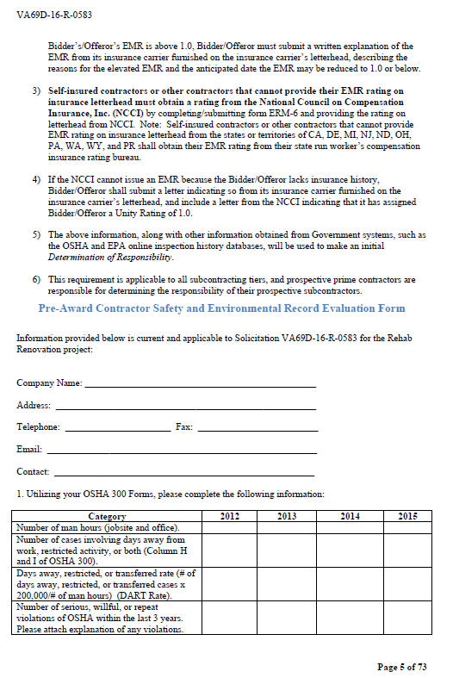
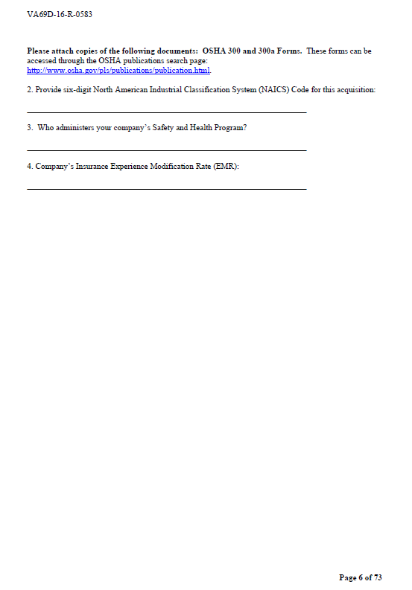
Instructions to Offerors
NCO 12
Great Lakes Acquisition Center
Volume 1, Part 1 – TECHNICAL
  Safety or Environmental Violations and EMR Rating Information

Slide 15
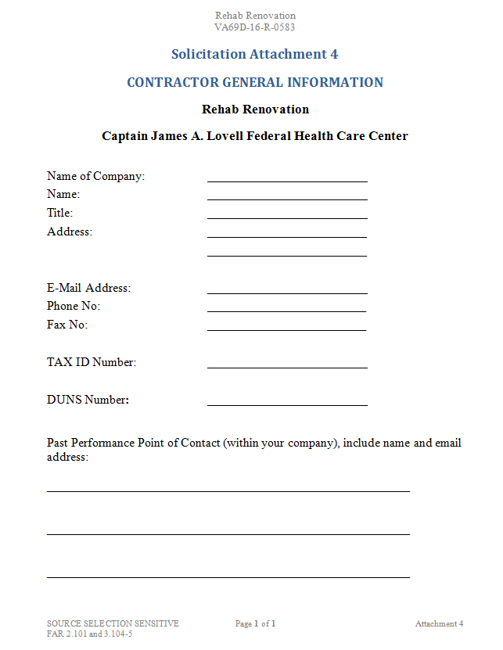
Instructions to Offerors
NCO 12
Great Lakes Acquisition Center
Volume 1, Part 1 – TECHNICAL
  Contractor General Information (Attachment 4)

Slide 16
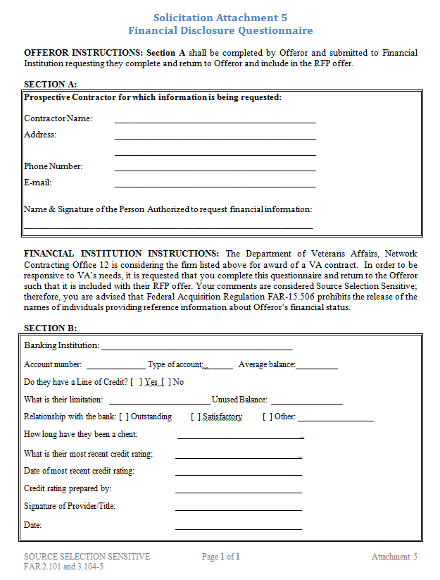
Instructions to Offerors
NCO 12
Great Lakes Acquisition Center
Volume 1, Part 1 – TECHNICAL
  Financial Disclosure Information (Attachment 5)

Slide 17
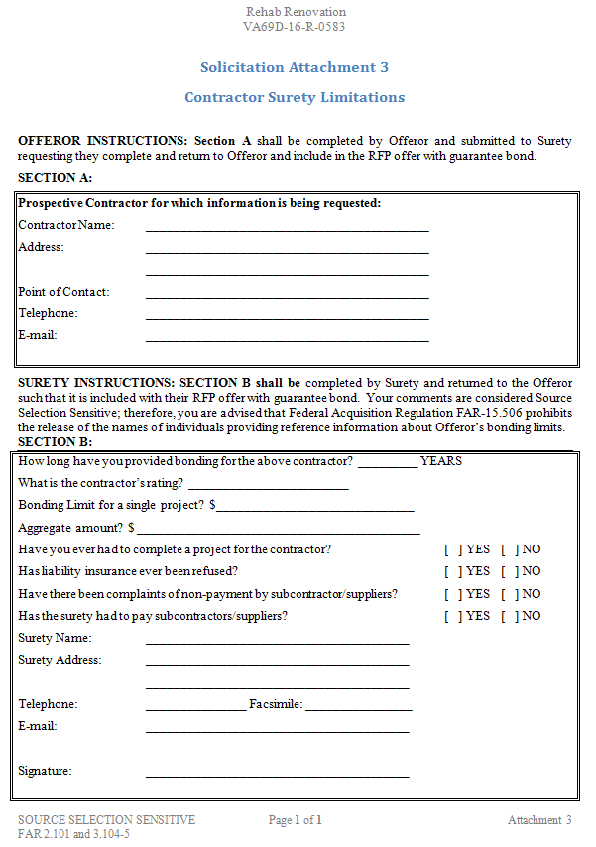
Instructions to Offerors
NCO 12
Great Lakes Acquisition Center
Volume 1, Part 1 – TECHNICAL
  Contractor Surety Limitations (Attachment 3)

Slide 18
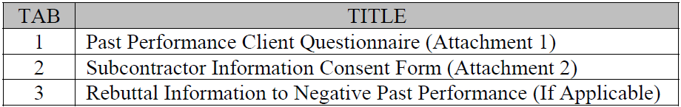
Instructions to Offerors
NCO 12
Great Lakes Acquisition Center
Volume 1, Part 2 – PAST PERFORMANCE

Slide 19
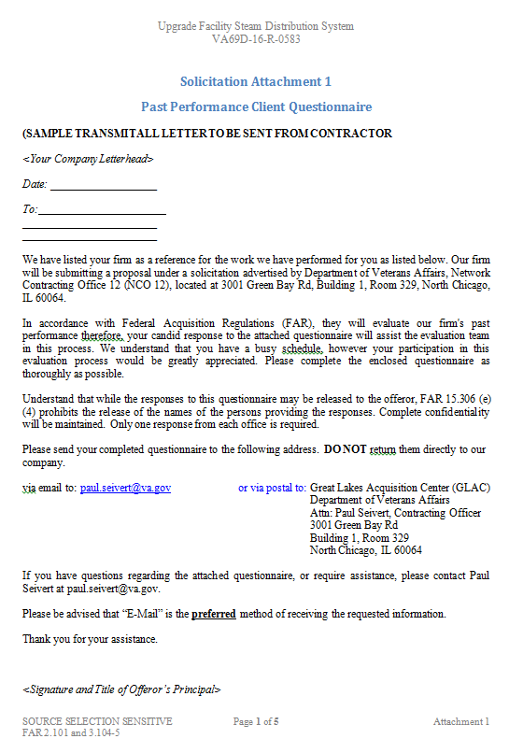
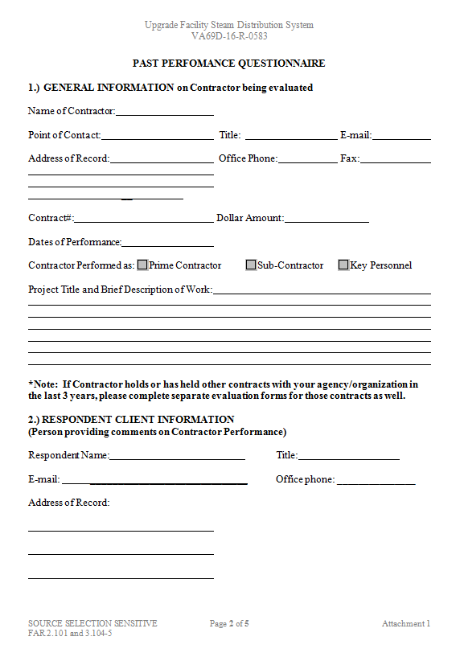
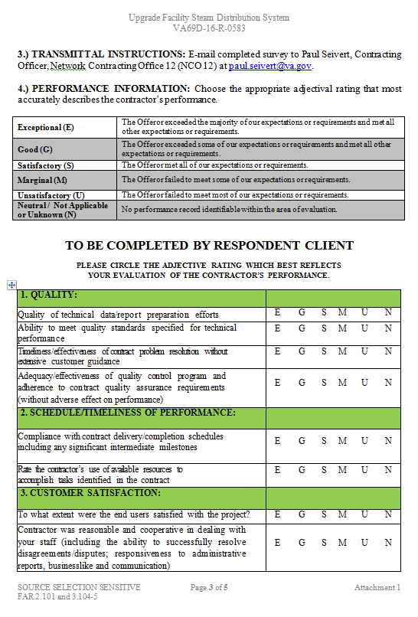
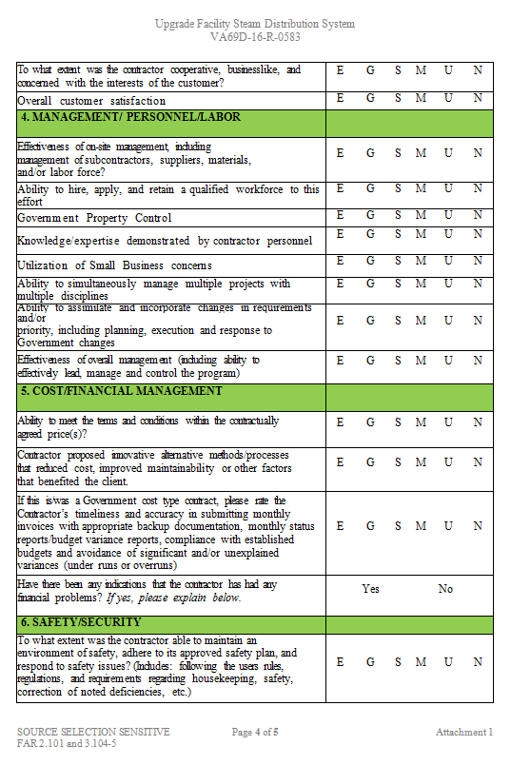
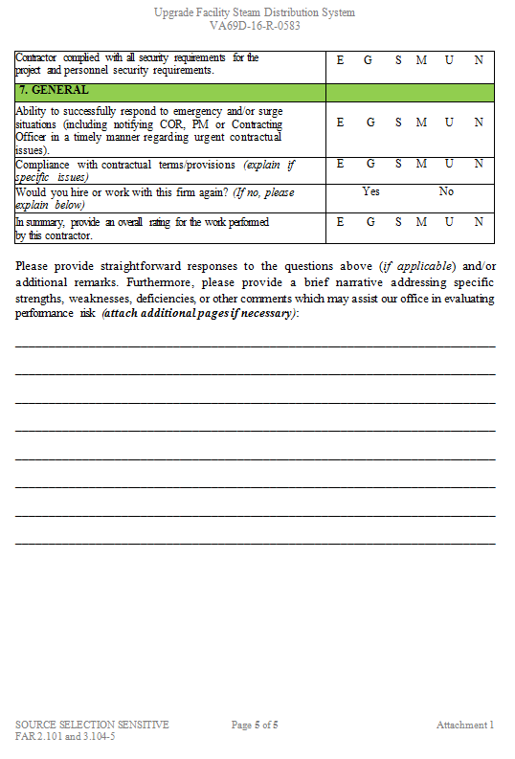
Instructions to Offerors
NCO 12
Great Lakes Acquisition Center
Volume 1, Part 2 – PAST PERFORMANCE
  Past Performance Client Questionnaire (Attachment 1)
  Clients shall forward directly to paul.seivert@va.gov
  Due same time as proposals

Slide 20
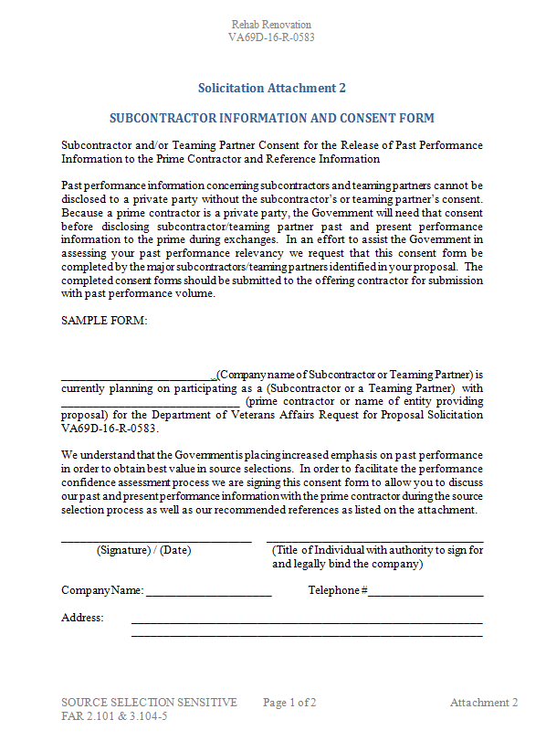
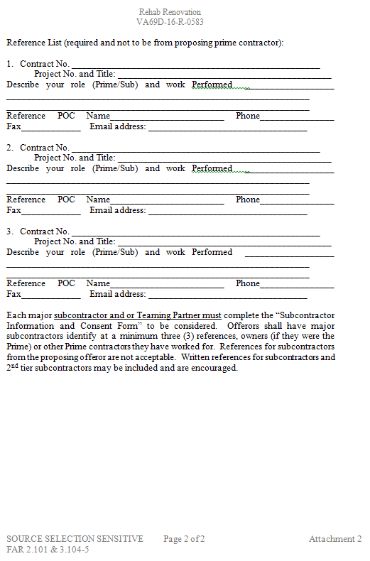
Instructions to Offerors
NCO 12
Great Lakes Acquisition Center
Volume 1, Part 2 – PAST PERFORMANCE
  Subcontractor Information Consent Form (Attachment 2)
  Teaming partners must complete this form to be considered for past performance

Slide 21
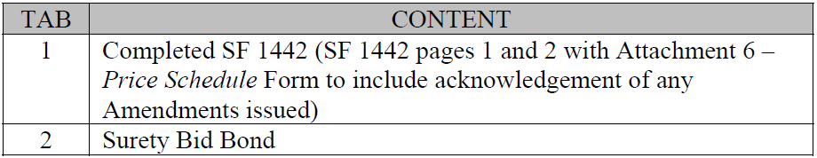
Instructions to Offerors
NCO 12
Great Lakes Acquisition Center
Volume 2 - PRICE

Slide 22
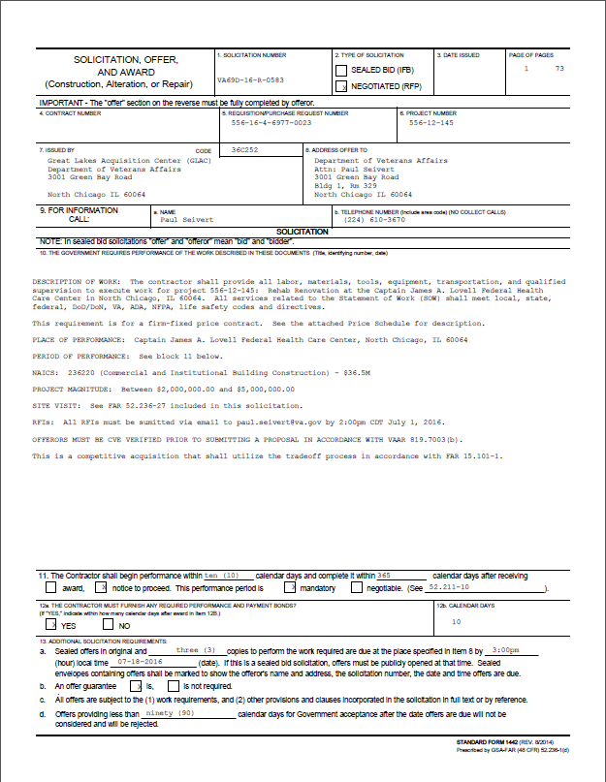
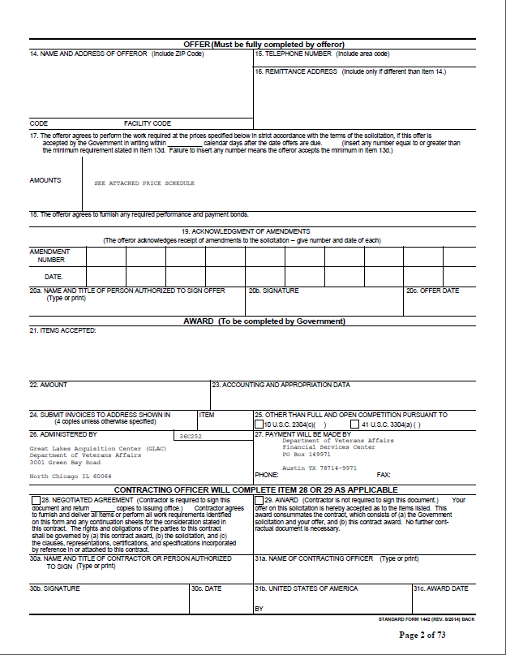
Instructions to Offerors
NCO 12
Great Lakes Acquisition Center
Volume 2 – PRICE
  Completed SF 1442

Slide 23
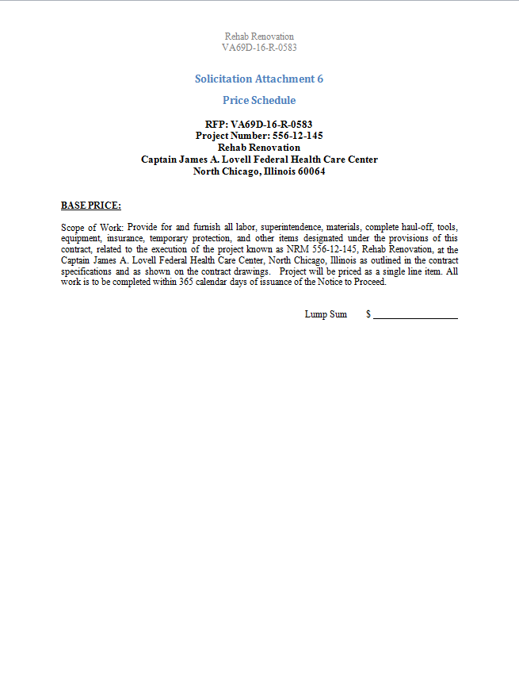
Instructions to Offerors
NCO 12
Great Lakes Acquisition Center
Volume 2 – PRICE
  Completed Price Schedule (Attachment 6)

Slide 24
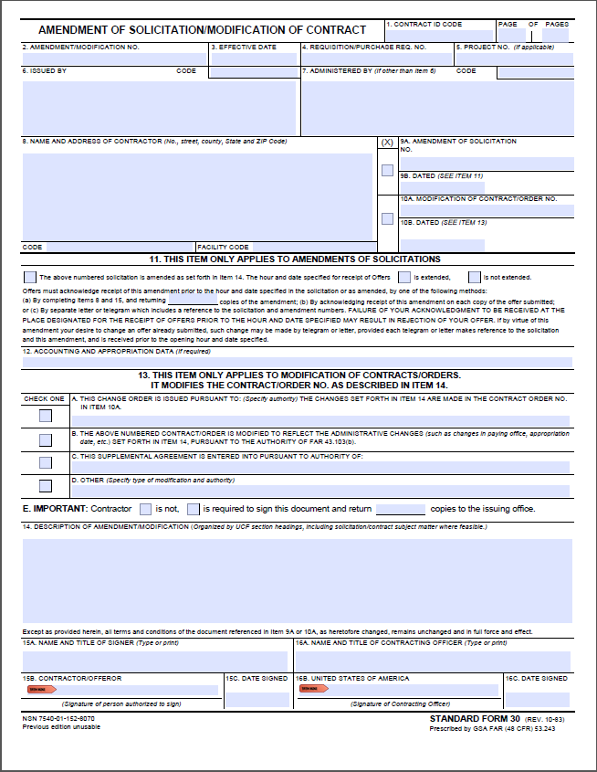
Instructions to Offerors
NCO 12
Great Lakes Acquisition Center
Volume 2 – PRICE
  Acknowledgment of any Amendments

Slide 25
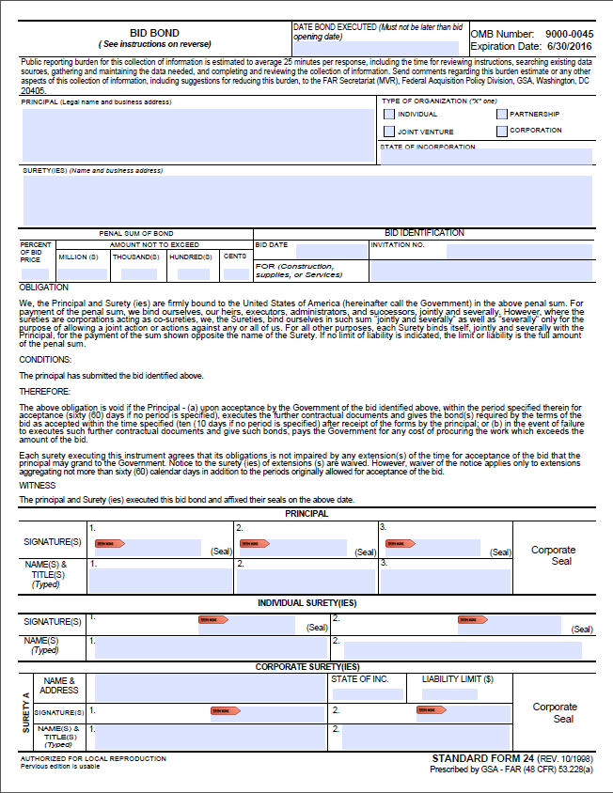
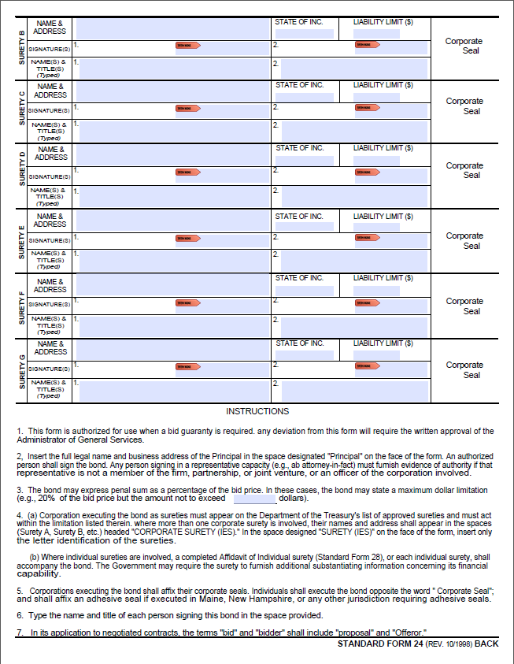
Instructions to Offerors
NCO 12
Great Lakes Acquisition Center
Volume 2 – PRICE
  Surety Bid Bond

Slide 26
Basis for Award
NCO 12
Great Lakes Acquisition Center
This is a competitive procurement using the best value tradeoff source selection process identified in FAR Part 15.101-1.
For this procurement, the Government will award a contract resulting from the solicitation to the responsible Offeror whose offer, conforming to the solicitation, is evaluated as being the most advantageous to the Government, price and other factors considered.

Slide 27
Basis for Award
NCO 12
Great Lakes Acquisition Center
A contract will only be awarded to an Offeror who is deemed responsible in accordance with FAR Part 9 and whose proposal conforms to the RFP’s requirements (to include all stated terms, conditions, representations, and certifications).

Slide 28
Evaluation Factors
NCO 12
Great Lakes Acquisition Center
The following factors are included in the solicitation and will be used to evaluate proposals:
  Company Experience
  Project Management
  Safety Plan
  Past Performance
  Price
Non-Price Factors

Slide 29
Evaluation Factors
NCO 12
Great Lakes Acquisition Center
All non-price factors are of equal importance and, when combined, are significantly more important than price.

Slide 30
Evaluation Factors
NCO 12
Great Lakes Acquisition Center
Company Experience
  This factor will be used to assess an Offeror’s experience in performing construction work in a health care environment. The Government will evaluate each Offeror’s company experience in providing construction services, which are of similar nature to the work to be performed under the requirement described in the solicitation. The company’s relevant experience will be assessed on the basis of its breadth and depth. Offeror shall have a minimum of 3 years’ experience performing construction in a health care environment. Offeror shall also demonstrate experience with sequencing/phasing construction projects in order to maintain a functioning facility.

Slide 31
Evaluation Factors
NCO 12
Great Lakes Acquisition Center
Project Management
  The Offeror will be evaluated on the resumes for the Project Manager/Superintendent, Quality Control Manager, and Safety Officer. Resumes will be evaluated on the level and type of experience and education.
  Evaluation of the Project Manager/Superintendent will include types of projects managed, types of subcontractors supervised, and the ability to coordinate multiple contract tasks. Resume shall demonstrate at least 7 years’ experience on construction projects of $2,000,000 to $5,000,000.
  OR
  A graduate of a 4-year accredited college program in one of the following disciplines: Engineering, Architecture, Construction Management, Engineering Technology, Environmental Health, Building Science, or Project Management Professional (Project Management Professional (PMP) is a credential offered by the Project Management Institute (PMI)), AND a minimum of 3 years’ experience as a project manager, superintendent, or construction manager on projects of $2,000,000 to $5,000,000.

Slide 32
Evaluation Factors
NCO 12
Great Lakes Acquisition Center
Project Management (cont’d)
  Quality Control Manger and Safety Officer shall have at least 4 years’ experience in a construction related environment.
  OR
  A graduate of a 4-year accredited college program in one of the following disciplines: Engineering, Architecture, Construction Management, Engineering Technology, Environmental Health, Building Science, or Project Management Professional (Project Management Professional (PMP) is a credential offered by the Project Management Institute (PMI)), AND a minimum of 2 years’ experience as a Quality Control Manager and Safety Officer (respectively) in a construction related environment.

Slide 33
Evaluation Factors
NCO 12
Great Lakes Acquisition Center
Safety Plan
  The Government will evaluate the Offeror’s proposed safety plan. The safety plan shall demonstrate familiarity with and adherence to OSHA standards and State OSHA safety requirements. The proposed safety plan must address the following in detailed measures:
    Work activity safety measures
    Emergency response measures
    Safety reporting plan
    Safety plan shall outline training requirements to ensure that the Project Superintendent has completed OSHA Construction 30-hour training and each employee has completed OSHA Construction 10-hour training.
    How the plan will be monitored and enforced

Slide 34
Evaluation Factors
NCO 12
Great Lakes Acquisition Center
Past Performance
  The Contracting Officer and the TEB will evaluate past performance to assess the risk associated with an Offeror’s likelihood of success in performing the solicitation’s requirements as indicated by an Offeror’s record of past performance under other contracts. The Contracting Officer and TEB will consider references from either inside or outside the federal government, so long as the performance is recent (within the last three years) and relevant (for the same or similar work). The Contracting Officer and TEB may also consider past performance information from sources other than those provided by the Offerors.
  In the case of an Offeror without a record of recent/relevant past performance or for whom information on past performance is not available or so sparse that no meaningful past performance rating can be reasonably assigned, the Offeror will not be evaluated favorably or unfavorably on past performance.

Slide 35
Evaluation Factors
NCO 12
Great Lakes Acquisition Center
Price
  The Offeror’s price will be evaluated by the Contracting Officer for reasonableness per the below definition.
  Price Reasonableness: Reasonableness is based on the proposed price compare to historical prices for similar efforts, comparison to the Independent Government Estimate (IGE), and price competition obtained by the other Offeror’s proposals submitted in response to this RFP. A reasonable price represents an amount that a prudent person would pay in a competitive business environment.

Slide 36
Questions?
NCO 12
Great Lakes Acquisition Center
Email all questions to paul.seivert@va.gov no later than July 1, 2016 @ 2:00pm CDT.

Slide 37
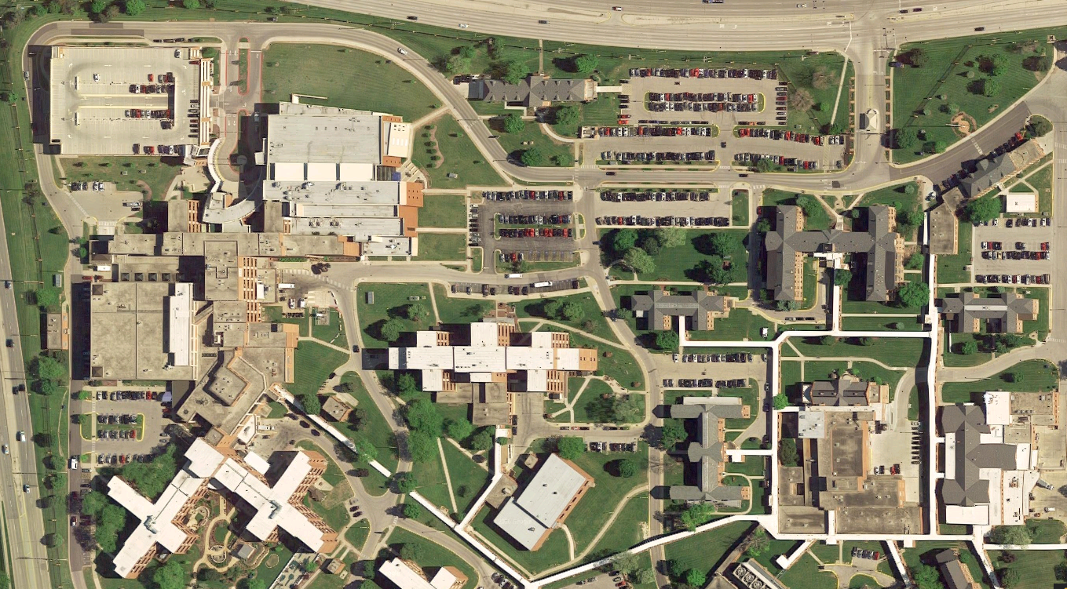
Site Visit
NCO 12
Great Lakes Acquisition Center

