Slide 1


WILLAMETTE NATIONAL CEMETERY
PHASE I, PRE-PROPOSAL CONFERENCE
SITE VISIT
PORTLAND, OREGON
PROJECT # 907CM2036
JULY 14, 2016
IAS
Notes:
I would like to welcome all of you to this Pre-proposal Conference regarding RFP VA101-16-R- 0147, entitled, Willamette National Cemetery
Please be sure that everyone has signed-in
Hold all questions to the end

Slide 2
Agenda
Opening Remarks – Housekeeping items
New Acquisition: VA101-16-R-0147
Submission Requirements
Milestones
Project Scope and Overview
Question & Answer Session
Site Visit
Notes:
I would like to make clear that anything said should not be interpreted as a change to the solicitation/contract documents as posted. If a statement is made that is inconsistent with the solicitation requirements, you should not submit your proposal based on the statements, only submit based on the posted solicitation and all amendments.

Slide 3
Opening Remarks
Introductions
  VA Representatives
    VA CFM: Crystal Cole, Contracting Officer
    VA CFM: Chuck Bolen, Project Manager
    VA CFM: Bill Peach, Director of Project Delivery
    VA CFM: Glenn Elliott, Environmental Engineer
    NCA: George A. Allen, Director

Slide 4
New Acquisition Requirements
VA101-16-R-0147
  Pre-Solicitation Notice: February 26, 2016
Federal , State, and Local Tax (FAR Clause 52.229-3)
  Are the Responsibility of the Contractor
OSHA & VA Requirement (Construction Safety Course)
  Competent Person (supervisor) 30 Hours
  All other employees 10 Hours
Notes:
All Proposal documents are posted and will be posted at www.fbo.gov under the RFP #

Slide 5
New Acquisition Requirements
Cost Magnitude
  Between $20,000,000 - $50,000,000
  Design To number provided in Phase II
Proposal Due Date
  August 11, 2016, at 4:30 P.M. Eastern Standard Time
Notes:
1. RFP due date see Block 8 of the SF 1442 for the location

Slide 6
New Acquisition Requirements
Bid Bond/Bid Guarantee (SF 24)
  20% of the offer price but shall not exceed $3,000,000
  NAME OF PRINCIPAL IDENTICAL WITH NAME ON CONTRACT OR BID
  Make sure you are in compliance with Far Part 28
Annual Representation and Certification
Central Contractor Registration (CCR)
  http://www.sam.gov
  Must be registered in SAM and VetBiz prior to award
Davis Bacon Act (Applies)
Buy American Act (Applies)
Notes:
DBA – Heavy & Hwy is for Backhoe; Bulldozer; Grader; Mechanics; Paver
Must be registered in SAM and VetBiz prior to Award

Slide 7
New Acquisition Requirements
Completion Time
  730 Calendar days after the Notice to Proceed
Bonds (within 10 calendar days after award)
  Performance Bond 100%
  Payment Bond 100%
  NAME OF PRINCIPAL IDENTICAL WITH NAME ON CONTRACT OR BID
Liquidated Damages
  $3,230.68 for each calendar day of delay

Slide 8
New Acquisition Requirements
Insurance
  General Liability required prior to commencing work
Questions & Answers (RFI’s)
  Questions Due: July 21, 2016, by 4:30PM EST
  Answers Posted: July 28, 2016
  Email:
    Crystal.Cole2@va.gov
    The email subject line to read
    “RFI for Willamette National Cemetery VA101-16-R-0147” – Company Name

Slide 9
Service-Disabled
Veteran-Owned Small Business
Office of Small and Disadvantaged Business Utilization (OSDBU) Washington, D.C.
    Point Of Contact: Mark Taylor (202)632-5514
    www.va.gov/osdbu/
  Joint Ventures (See IL 049-06-4)
  Teaming Agreement
Notes:
JV for VA is a SDVOSB joining with another SB
JV/TA/MPP must be submitted w/proposal

Slide 10
Submission Requirements
1 SF 1442 (pages 1 - 4)
2 Amendments
3 Bid Guarantee/Bid Bond
4 Volume I – Technical Proposal
    No cost information in Technical proposal
    Spiral bound Technical proposal (no 3-ring binders)
    Organize your proposal in accordance with Section D. Phase I – Request for Qualifications and special clause 4.34 of the RFP
    Mail: One (1) Sealed Original and Four (4) copies
    Email: One (1) PDF and Four (4) copies

Slide 11
Submission Requirements
5 Volume I – Technical Qualifications
      1) Past Performance 2) Specialized Experience
      3) Capability to Perform
      DO NOT PUT ANY PRICING INFORMATION IN VOLUME I
Volume II – Cost Proposal
    Only one original copy
    Include any JV, Agreements, Reps and Certs and Bonds
    Submit Volumes I & II on a Compact Disc (excel, pdf and word format only)
6 Others Documents
    Representations and Certification completed in SAM
    Joint Venture (registered in Vetbiz prior to proposal submission); Teaming Agreement; Mentor-Protégé Program

Slide 12
Milestones
1 Pre-Solicitation Notice February 26, 2016
2 Issue 2-Phased RFP/Solicitation (Phase 1) June 30, 2016
3 Phase I Pre-Proposal Conference (Site Visit) July 14, 2016
4 Request for Information (RFIs) Deadline July 21, 2016
5 Phase I Proposal Received August 11, 2016
6 Establish Competitive Range (maximum of 5) September 9, 2016
7 Issue Phase II RFP & Documents to Competitive September 14, 2016
Range Offerors
8 Phase II Pre-Proposal Conference September 28, 2016
9 Phase II Proposals Received October 14, 2016
10 Technical Evaluation of Proposals November 14, 2016
11 QA & OGC Review December 14, 2016
12 Contract award January 9, 2017
13 Notice to Proceed February 9, 2017
14 Construction Completion/Final Inspection January 19, 2021

Slide 13
VAAR 809-406-2
Cause for debarment
Misrepresentation of SDVOSB eligibility may result in action taken by VA officials to debar the business concern for a period not to exceed 5 years from contracting with VA as a prime contractor or subcontractor.
Any deliberate violation of the limitation on subcontracting clause requirements for acquisitions under subpart 819.70 may result in action taken by VA officials to debar any service-disabled veteran-owned, veteran-owned small business concern or any large business concern involved in such action.

Slide 14
Questions & Answers
Contractual Administrative
Notes:
Identify yourself & company

Slide 15
Project Scope & Overview
Chuck Bolen
CFM Project Manager

Slide 16
Project Overview
Scope and Elements
Program Requirements:
Update Master Plan and master plan new acreage
Interment:
  6,650± pre-placed crypts
  3,500± traditional in-ground niche
  13,000± columbarium niches
Ossuary
Memorial Walls
Access Roads, Roadway System & Parking
Site Furnishings & Signage
Grading & Drainage
Fencing & Landscaping for 38.2-acre site
Investigate feasibility in removing City easement
Bridge or mitigation to span access environmental easement
Consider accessing new property thru Section AA and BB
Irrigation System
Additional well to augment water capacity.
Utility Distribution Systems
Upgrades to Administration Building:
  Chest-high counter, front lobby area
  Alternatives to increase space utilization
  Repurposing public restrooms space for other requirements.
  Expand basement into crawl space
  Feasibility to construct ADA exterior access to basement
Demolish & replace the existing Maintenance Buildings #3001 and #3002
Correct site drainage, (including Section D)

Slide 17
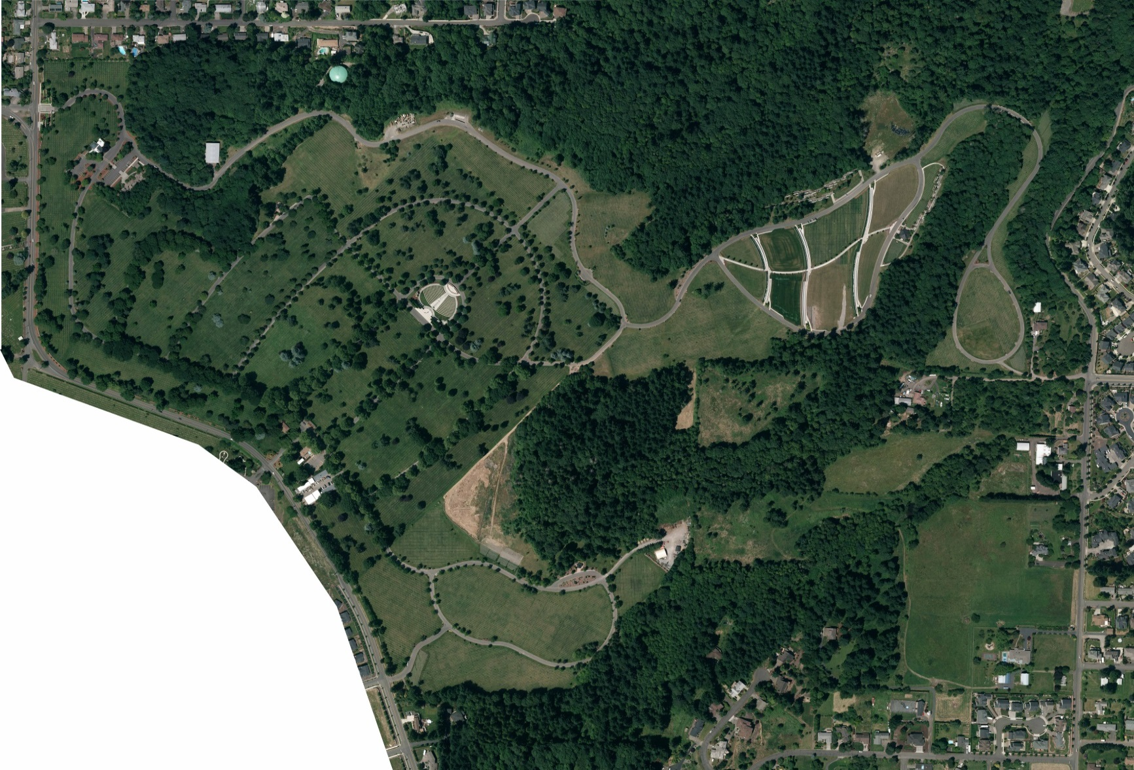
Aerial Photo

Slide 18
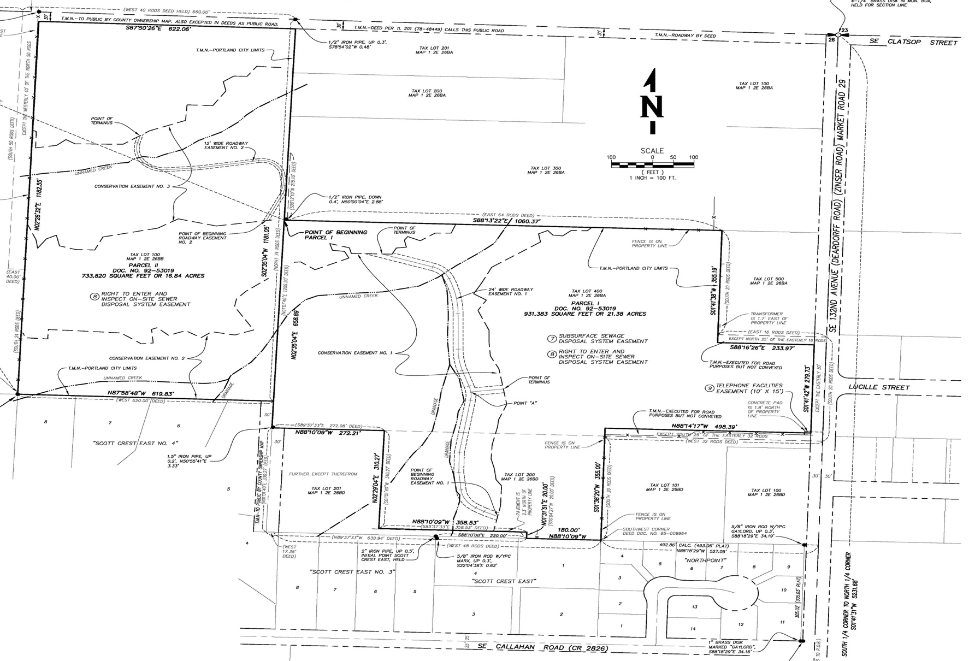
Site Location

Slide 19
Project Logistics
Chuck Bolen
CFM Project Manager

Slide 20
Project Logistics
─ Develop approximately 10-20 acres
─ Post Award Conference / NTP February 2017
─ Early Turnover Over 730 days after NTP
─ Project completion1440 calendar days from NTP
─ Resident Engineer is ACO/QA

Slide 21
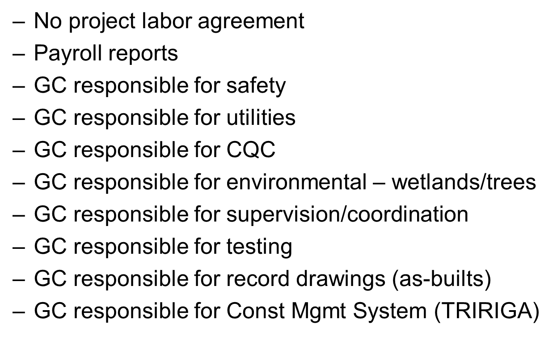
Project Logistics (cont’d)

Slide 22
Questions & Answers
Notes:
Identify yourself & company

