Slide 1


2015 State and Tribal Veterans Cemetery
Satisfaction Survey
U.S. Department of Veterans Affairs
National Cemetery Administration
NATIONAL FINDINGS
December 18, 2015
1

Slide 2
Briefing Agenda
Overview
Strategic Performance Measures
Key Findings
National Cemetery and State/Tribal Veterans Cemetery Comparisons
Improvement Analysis
Conclusions/Recommendations
Discussion/Questions
2

Slide 3
Overview
3

Slide 4
Executive Summary - I
Overall, 97 percent of all respondents (97% Next of Kin and 96% of Funeral Directors) agreed or strongly agreed that they were satisfied with their experience.
Strategic Performance Measures
  96 percent of all respondents (96% of Next of Kin and 96% of Funeral Directors) agreed or strongly agreed the quality of service they received from cemetery staff was excellent
  98 percent of all respondents (98% of Next of Kin and 97% of Funeral Directors) agreed or strongly agreed the overall appearance of State or Tribal Veteran cemeteries was excellent
  98 percent of respondents (99% of Next of Kin and 94% of Funeral Directors) indicated they would recommend State or Tribal Veteran cemeteries to Veteran families during their time of need
Key Findings
  Relationship to deceased and distance from cemetery did not influence Next of Kin ratings. Also, overall, years working with a cemetery was unrelated to differences in ratings for Funeral Directors
  Exceeding expectations was highly related to overall satisfaction and all three strategic performance measures
    Being informed was related to exceeding expectations, as well as overall satisfaction and strategic performance measures
4

Slide 5
Executive Summary - II
National Cemetery and State/Tribal Comparisons
  55 percent of Next of Kin indicated that they had visited a VA National Cemetery. Of these respondents, 87 percent of Next of Kin agreed or strongly agreed that based on their visit, the appearance of the State and Tribal Veterans Cemetery compares favorably to the VA National Cemetery.
  80 percent of Next of Kin agreed or strongly agreed that based on their visit; the quality of service at the State and Tribal Veterans Cemetery compares favorably to the VA National Cemetery, and 79 percent indicated that the honor of being interred at a State and Tribal Veterans Cemetery is equivalent to that of being interred at a VA National Cemetery.
  15 percent of Next of Kin agreed or strongly agreed that had they been able, they would have chosen to inter their loved one at a VA National Cemetery rather than the State and Tribal Veterans Cemetery
Improvement Analysis
  An analysis of respondent satisfaction and importance identified the following areas for improvement:
    Next of Kin – service quality, gravesite/columbaria appearance, exceeding expectations
    Funeral Directors –staff courtesy, hours of operation, perceptions of reliance on State/Tribal governments, exceeding expectations
5

Slide 6
Survey Background
This briefing presents an overview of National results for the 2015 State and Tribal Veterans Cemetery Satisfaction Survey
The survey collects data from family members of recently deceased Veterans and the Funeral Directors who serve those families at State or Tribal Veterans Cemeteries
The survey targets several key areas in satisfaction: Overall Satisfaction; Trust; Information and Communication; Committal Services; Headstones, Markers, and Columbarium Niche Covers; and Cemetery Appearance and Visitor Accommodations
  Survey content largely and intentionally overlaps with the National Cemetery Survey
Respondents were also surveyed on their thoughts regarding State and Tribal Veterans Cemeteries in comparison to National Cemeteries
The 2015 survey represents the second full administration of this customer satisfaction survey.
6

Slide 7
Methodology
The 2015 questionnaire included 66 questions for Next of Kin; 47 questions for Funeral Directors, including some open-ended questions.
To draw the sample, we determined sample size needed for each State or Tribal Veterans Cemetery to yield valid data at the 95 percent confidence level, assuming a 60 percent response rate.
The Next of Kin sample size was 12,108. The Funeral Director sample size was 12,789.
Identical to the 2014 administration, in 2015 the three funeral director surveys (National Cemetery, Memorial Products, and State/Tribal) were combined into one consolidated instrument in recognition that many Funeral Directors could be sampled for all three surveys.
The sample of Next of Kin was selected at the end of May of 2015 using a minimum bereavement buffer period of 3 months (i.e., interments prior to February 28, 2015).
The survey was administered from August 20 to October 9, 2015.
All mail communications contained a web link to access the survey online
A toll-free assistance line for survey respondents was available to respondents during regular business hours
7

Slide 8
Response Rates
Survey Response Rates
 | Next of Kin | Funeral Directors | Total
Sample Frame | 15,286 | 12,789 | 28,075
Total Sample Sent | 12,108 | 12,789 | 24,897
Undeliverable | 606 | 470 | 1,076
Total Eligible Questionnaires | 11,502 | 12,319 | 23,821
Total Returned Surveys | 5,692 | 1,190 | 6,772
Mail Returns | 4,941 | 946 | 5,887
Web Returns | 751 | 244 | 995
Total Response Rate (Returned/Eligible) | 50% | 10% | 29%
8

Slide 9
Strategic Performance Measures
9

Slide 10
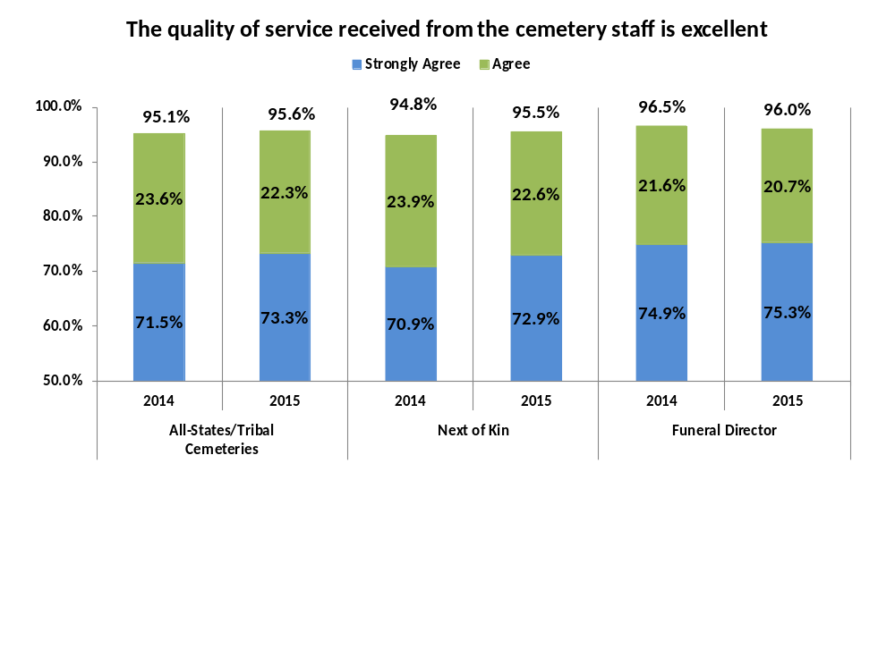
Strategic Performance Measure: Quality of Service
Overall 96 percent of respondents agreed or strongly agreed that the quality of service received from the cemetery staff is excellent.
  National Cemetery overall agreement on this item was 96 percent.
Satisfaction remained mainly stagnant across the two years.
10

Slide 11
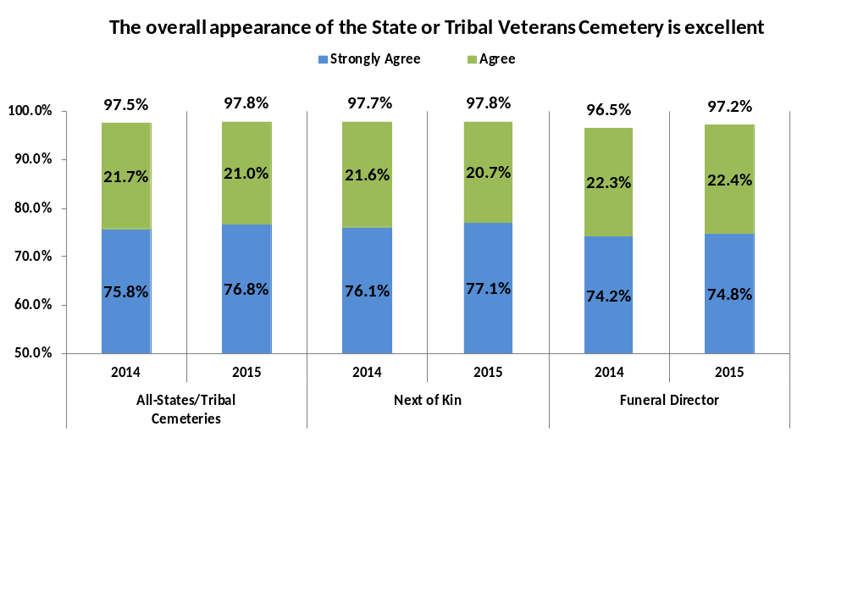
Strategic Performance Measure: Overall Appearance
Overall 98 percent of respondents agreed or strongly agreed that the appearance of the State or Tribal Veterans Cemetery is excellent
  National Cemetery overall agreement was 99 percent.
Satisfaction remained mainly stagnant across the two years.
11

Slide 12
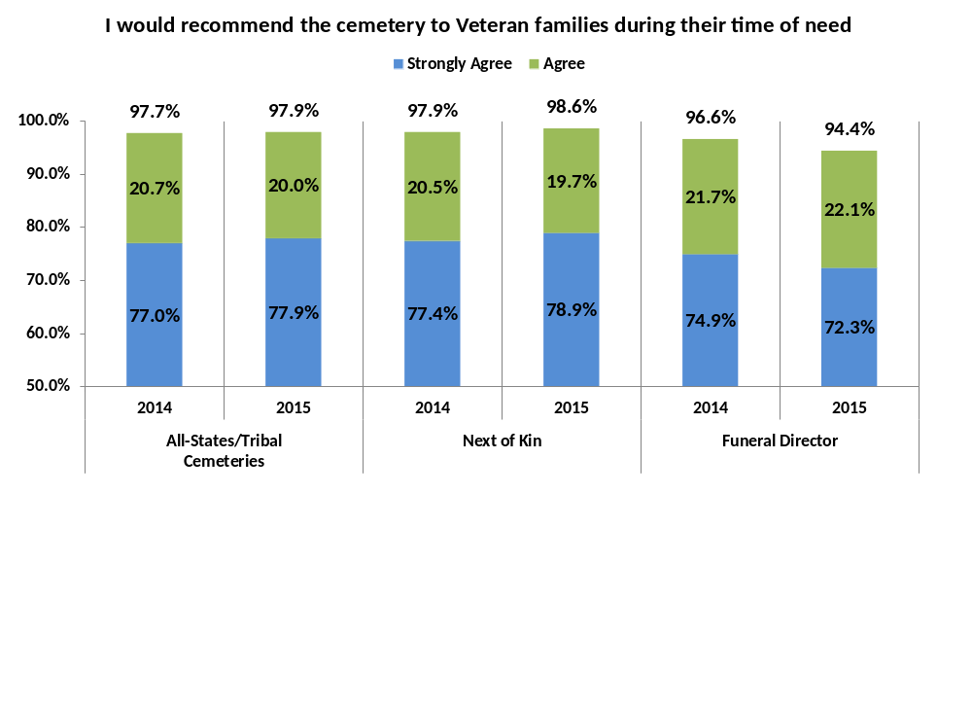
Strategic Performance Measure: Recommendation
Overall 98 percent of respondents agreed or strongly agreed that they would recommend the cemetery to Veteran families
  National Cemetery overall agreement was 99 percent.
Next of Kin were significantly more likely to agree that they would recommend the cemetery to Veteran families. In 2015, there was a significant decrease in the number of Funeral Directors that agreed they would recommend the State/Tribal Veterans Cemetery.
12

Slide 13
Key Findings
13

Slide 14
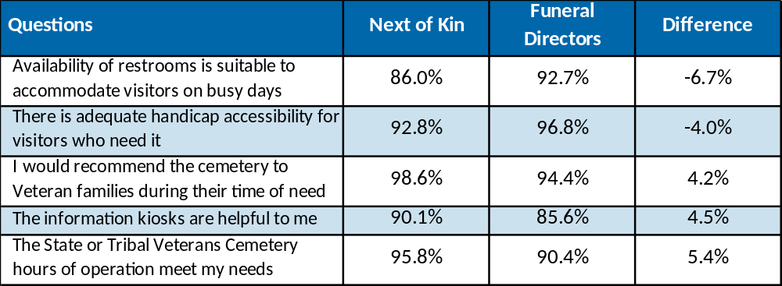
Statistically Significant Differences in Agreement between Next of Kin and Funeral Directors
Next of Kin reported higher levels of agreement compared to Funeral Directors nationally for three questions and lower levels of satisfaction nationally for two questions.
  Lower satisfaction appeared to occur for each respondent type, respectively, on items that could be viewed as more relevant to their particular needs.
Percent Agree/Strongly Agree for
Next of Kin and Funeral Directors
14
Notes:
14

Slide 15
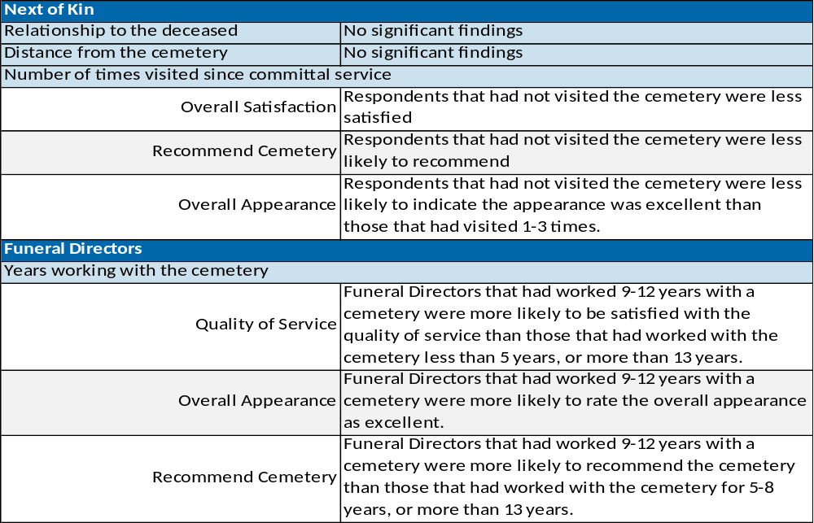
Relationships and Non-Relationships
The table below provides a summary of the relationships and non-relationships that were found pertaining to distance from the cemetery, relationship to deceased, number of visits, and years doing business with the cemetery.
15
Notes:
15

Slide 16
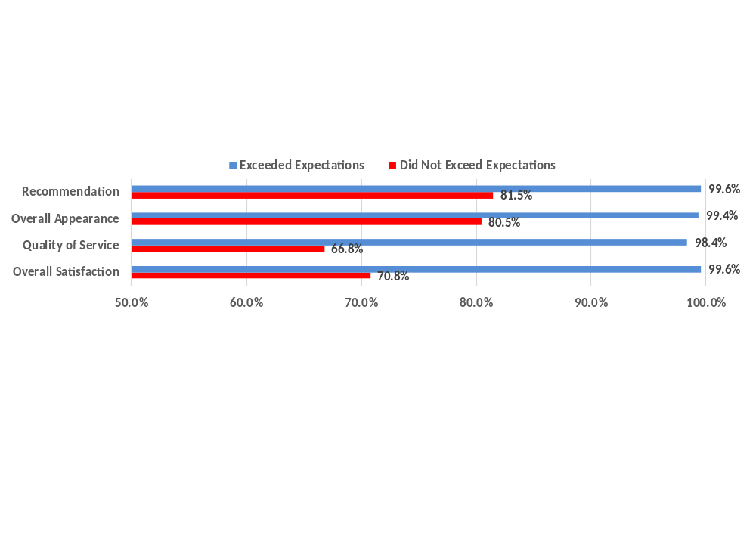
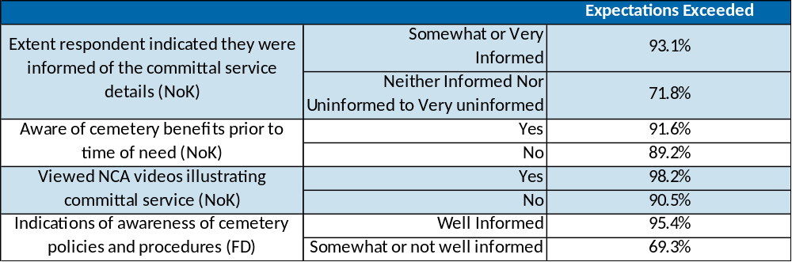
Impact of Expectations
Overall, 91 percent of respondents (91% of Next of Kin, 90% of Funeral Directors) agreed that the State/Tribal Veterans Cemetery exceeded expectations
  Exceeding expectations was positively related to ratings of overall satisfaction, quality of service, and overall appearance, as well as likelihood of recommending the cemetery for both Next of Kin and Funeral Directors
Expectations were influenced by information (all differences statistically significant)
16
Notes:
16

Slide 17
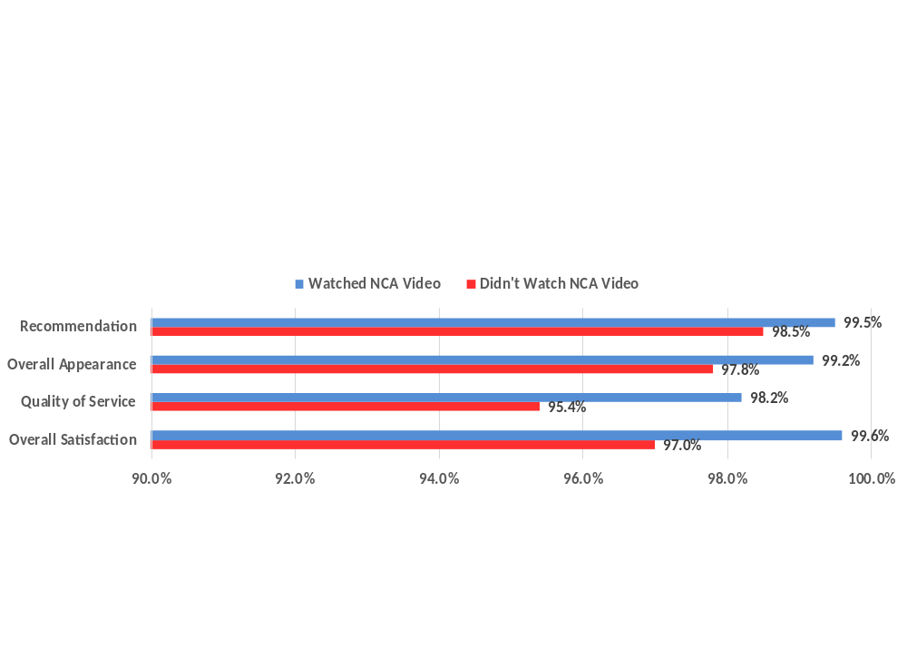
Impact of Being Informed
In 2015, only five percent of Next of Kin indicated that they had viewed NCA videos illustrating different committal service options. 92 percent of these respondents indicated that the video helped them understand the burial process.
  The viewing of NCA Videos had a significant impact on perceptions of being informed (98% vs. 89%) and exceeding expectations (98% vs. 91%). In addition, the viewing of NCA Videos had a significant positive relationship on ratings of overall satisfaction, and all three strategic performance measures(see graph displaying agreement below).
75 percent of Next of Kin indicated that they were aware of benefits related to burial in a State/Tribal Veterans Cemetery prior to their time of need.
  Similarly to the NCA Videos, awareness of benefits prior to time of need was significantly positively related to ratings of quality of service, and likelihood of recommending the cemetery.
17
Notes:
17

Slide 18
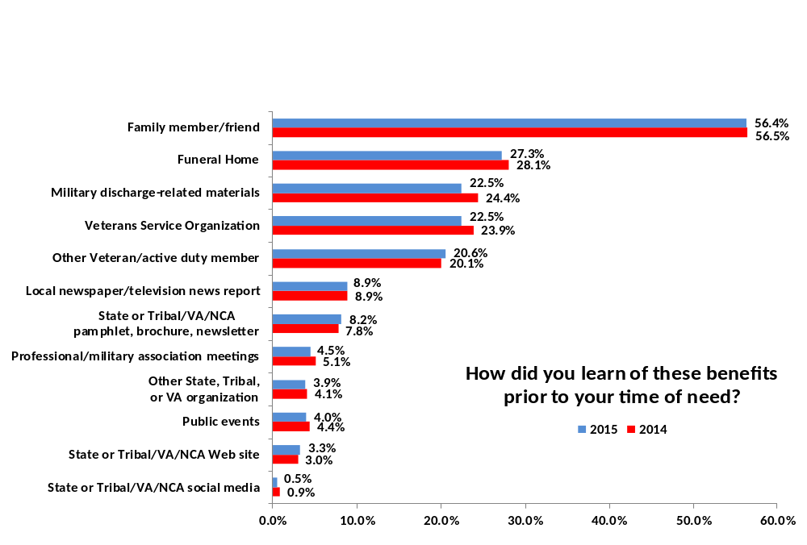
Sources of Information – Next of Kin
Primary methods of learning of benefits: family members or friends (56%) and funeral homes (28%)
  Respondents that were 70 years or older were less likely to learn of benefits via Family member/Friend (47%), and more likely to learn through Veterans Service Organization (27%) than other age groups. Younger Next of Kin were not more likely to use the website or social media to learn of benefits.
18
Notes:
18

Slide 19
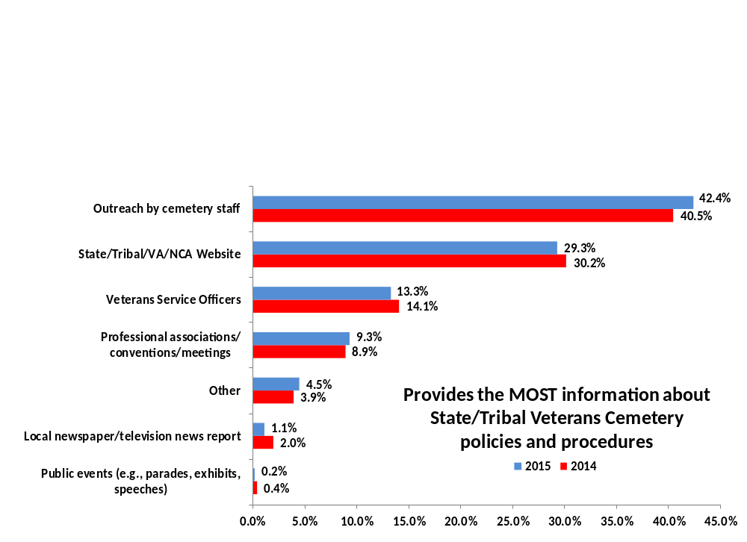
Sources of Information – Funeral Directors
Primary service that provides Funeral Directors with the most information about the cemeteries: learning of benefits: Outreach by cemetery staff (42%) and State/Tribal/VA/NCA Website (29%).
    Funeral directors that indicated they were somewhat well-informed or not well-informed were less likely to indicate that they reached out to cemetery staff than those that indicated they were well-informed (29% and 47%, respectively).
      The most commonly requested information among those somewhat and not well-informed was eligibility requirements (40%)
19
Notes:
19

Slide 20
National Cemetery and State/Tribal Veterans Cemetery Comparisons
20

Slide 21
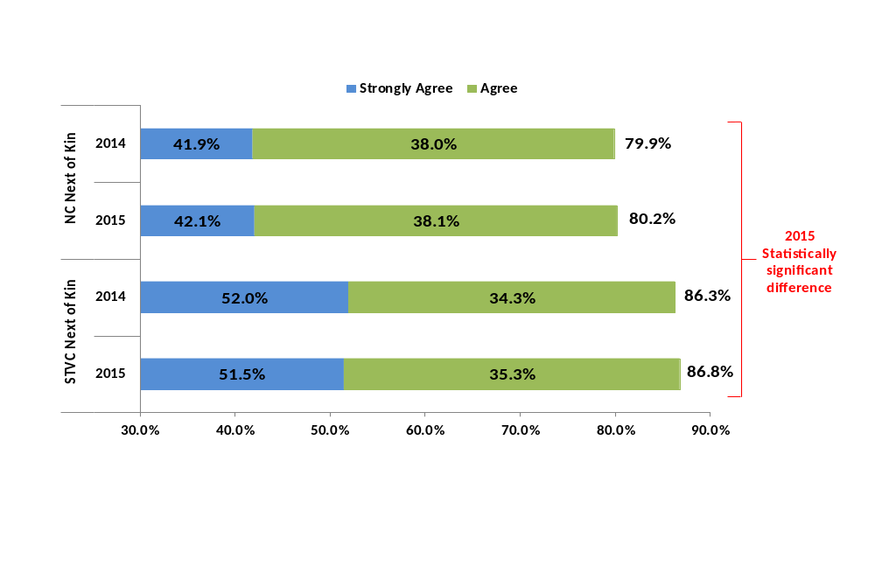
Appearance Comparison
Based on your visit the appearance of the State or Tribal Veterans Cemetery compares favorably to the VA National Cemetery
State/Tribal Veteran Cemetery Next of Kin respondents were statistically more likely to indicate agreement that the appearance of State/Tribal Veterans Cemeteries compared favorably to VA National Cemeteries.
Overall, respondents agreed that the appearance of State/Tribal Veteran Cemeteries compared favorably to National Cemeteries. Agreement in 2015 was almost identical to 2014.
21

Slide 22
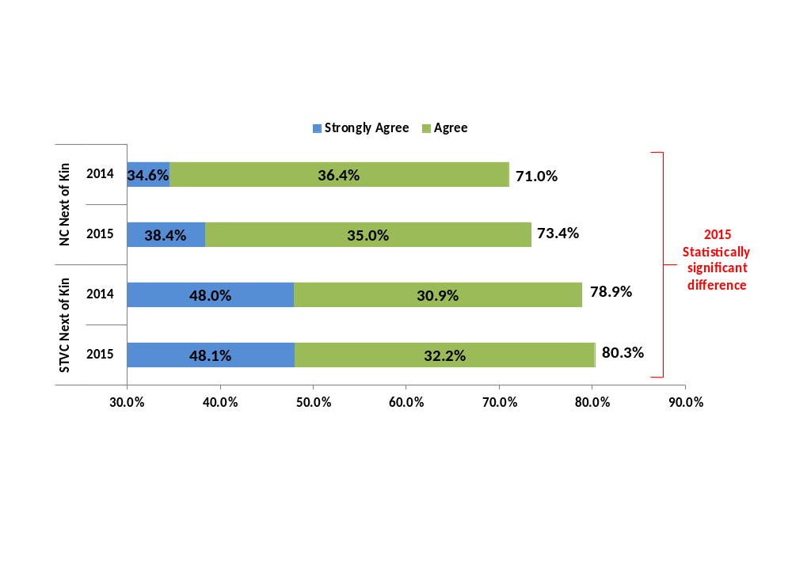
Quality of Service Comparison
Based on your visit the quality of service at the State or Tribal Veterans Cemetery compares favorably to the VA National Cemetery
State/Tribal Veteran Cemetery Next of Kin respondents were statistically more likely to indicate agreement that the quality of service of State/Tribal Veterans Cemeteries compared favorably to VA National Cemeteries.
Overall, respondents agreed that the quality of service of State/Tribal Veteran Cemeteries compared favorably to National Cemeteries. Agreement in 2015 was similar to 2014.
22

Slide 23
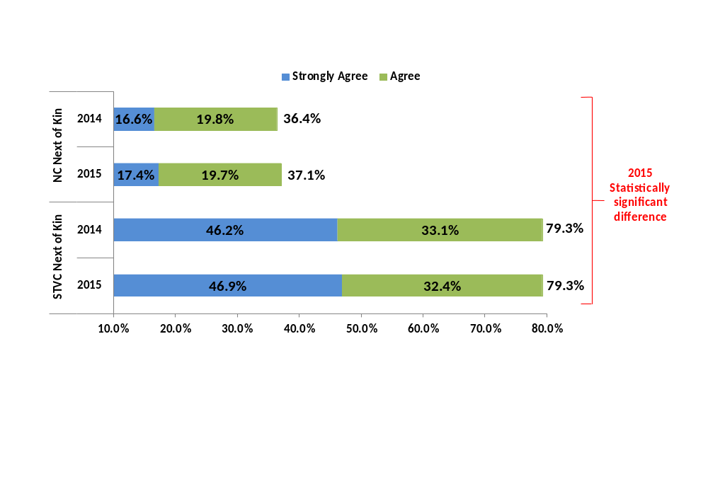
Interment Comparison
The honor of being interred at a State or Tribal Veterans Cemetery is equivalent to that of being interred at a VA National Cemetery
State/Tribal Veteran Cemetery Next of Kin respondents were statistically more likely to indicate agreement that the honor of being interred at a State/Tribal Veterans Cemetery is equivalent to that of being interred at a VA National Cemetery.
While majority of State/Tribal Veteran Cemetery Next of Kin respondents (79%) indicated that the honor of being interred in a State/Tribal Veteran Cemetery was equivalent to that of being interred at a VA National Cemetery, only 37 percent of National Cemetery Next of Kin respondents agreed with this statement. Agreement in 2015 was almost identical to 2014.
23

Slide 24
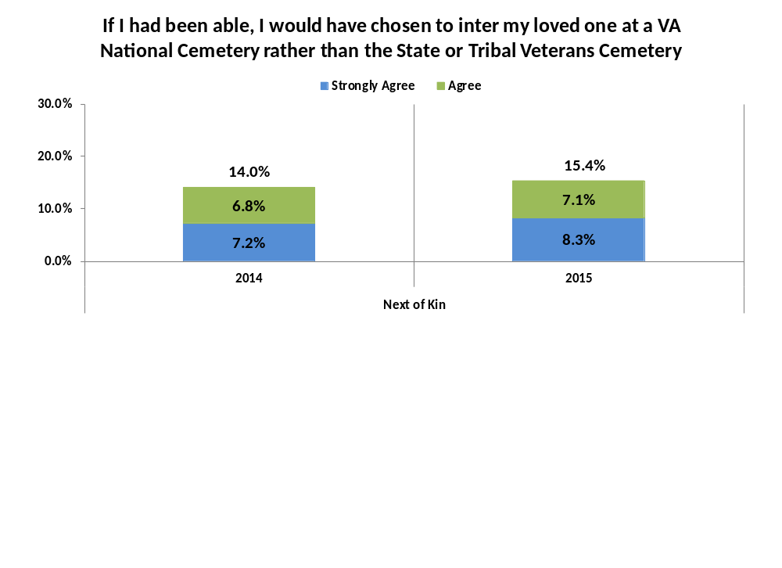
Interment Comparison
In 2015, 15 percent of State or Tribal Veterans Cemetery respondents agreed or strongly agreed with the statement that they would have chosen to inter their loved one at a VA National Cemetery had they been able to do so, a statistically significant increase from 2014.
    The main reason cited by respondents was that their loved one wanted to be buried in a National Cemetery
Respondents that would have preferred to inter their loved one in a National Cemetery reported statistically lower overall satisfaction, and lower agreement that the quality of service received was excellent. There were no differences in perceptions of honor, appearance, or likelihood of recommending.
24

Slide 25
Improvement Analysis
25

Slide 26
Quadrant Analysis – Next of Kin
A quadrant analysis ranks measures on derived importance to the customer and reported satisfaction
  For this analysis, satisfaction is determined by the level of agreement indicated by the respondent to the statement. The higher agreement, the greater the satisfaction.
  Derived importance is determined by calculating the strength of the relationship between the specific item and overall reported satisfaction. NCA should recommend resources be devoted to improve items in Block 4.
← (Lower) Satisfaction (Higher) → | Block 1 - Higher Satisfaction/Lower Importance q36 - The maintenance of the cemetery grounds is excellent. q37 - The upkeep of the headstones, markers, or columbarium niche covers is excellent. q39 - The committal shelter used for the service was private, clean, and free of safety hazards q42 - The cemetery honors all Veterans and their service to our nation | Block 2 - Higher Satisfaction/Higher Importance q38 - The maintenance of other landscape features (e.g. flowers, trees, shrubs) is excellent q47 - The S/T Veterans Cemetery staff was courteous q48 - The S/T Veterans Cemetery staff was professional in terms of being knowledgeable, helpful, and responsive q53 - The overall appearance of the S/T Veterans Cemetery is excellent q55 - I would recommend the cemetery to Veteran families during their time of need q56 - I am willing to rely on the State or Tribal Veterans Cemetery to meet the burial needs of Veterans in the future q57- I am willing to rely on S/T governments to maintain S/T Veterans Cemeteries as national shrines in the future
 | Block 3 - Lower Satisfaction/Lower Importance q40 - There is adequate handicap accessibility for visitor who need it q41 - The availability of restrooms is suitable to accommodate visitors on busy days q43 - There are sufficient signs within the cemetery to assist visitors q44 - Parking at the cemetery is adequate to accommodate visitors on most days q45 - The cemetery's roadways and intersections are safe and easily navigated q49 - The S/T Veterans Cemetery hours of operation meet my needs for visiting my loved one's gravesite q51 - The information kiosks (i.e., gravesite locators) are helpful to me | Block 4 - Lower Satisfaction/Higher Importance q46 - The quality of service received from cemetery staff is excellent q50 - The appearance of my loved one's gravesite/columbaria is excellent q52 - Public ceremonies and events at the cemetery promote a sense of patriotism and heritage q58 - My experiences with the S/T Veteran Cemetery exceeded my expectations
 | ← (Lower) Importance (Higher) →
26

Slide 27
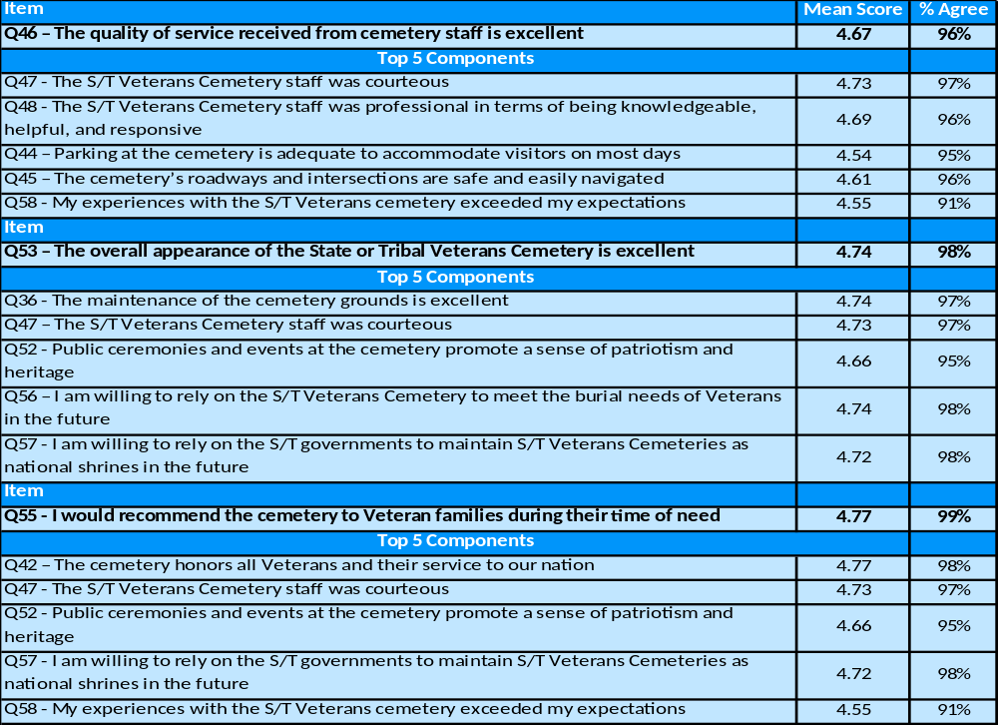
Strategic Performance Measure Components – Next of Kin
We performed a regression analysis that calculated the strength of the relationship between each Strategic Performance Measure and the items of interest. The tables below present each Strategic Performance Measure and the measures that are key components of each respective score.
27

Slide 28
Quadrant Analysis – Funeral Directors
A quadrant analysis ranks measures on derived importance to the customer and reported satisfaction
  For this analysis, satisfaction is determined by the level of agreement indicated by the respondent to the statement. The higher agreement, the greater the satisfaction.
  Derived importance is determined by calculating the strength of the relationship between the specific item and overall reported satisfaction. NCA should recommend resources be devoted to improve items in Block 4.
← (Lower) Satisfaction (Higher) → | Block 1 - Higher Satisfaction/Lower Importance q25 – The maintenance of the cemetery grounds is excellent q26 – The upkeep of the headstones, markers, or columbarium niche covers is excellent q27 – The maintenance of other landscape features is excellent q28 – The committal shelter used for the service was private, clean, and free of safety hazards q29 – There is adequate handicap accessibility for visitors who need it q31 – The cemetery honors all Veterans and their service to our nation | Block 2 - Higher Satisfaction/Higher Importance q35 – The quality of service received from cemetery staff is excellent q37 – The S/T Veterans Cemetery staff was professional in terms of being knowledgeable, helpful, and responsive q40 – Public ceremonies and events at the cemetery promote a sense of patriotism and heritage q41 – The overall appearance of the S/T Veterans Cemetery is excellent
 | Block 3 - Lower Satisfaction/Lower Importance q30 – The availability of restrooms is suitable to accommodate visitors on busy days q32 – There are sufficient signs within the cemetery to assist visitors q33 – Parking at the cemetery is adequate to accommodate visitors on most days q34 – The cemetery’s roadways and intersections are safe and easily navigated q39 – The information kiosks are helpful to me | Block 4 - Lower Satisfaction/Higher Importance q36 – The S/T Veterans Cemetery staff was courteous q38 – The S/T Veterans Cemetery hours of operation meet my needs for scheduling services q43 – I would recommend the cemetery to Veteran families during their time of need q44 – I am willing to rely on the State or Tribal Veterans Cemetery to meet the burial needs of Veterans in the future q45 – I am willing to rely on S/T governments to maintain S/T Veterans Cemeteries as a national shrines in the future q46 – My experiences with the S/T Veterans Cemetery exceeded my expectations
 | ← (Lower) Importance (Higher) →
28

Slide 29
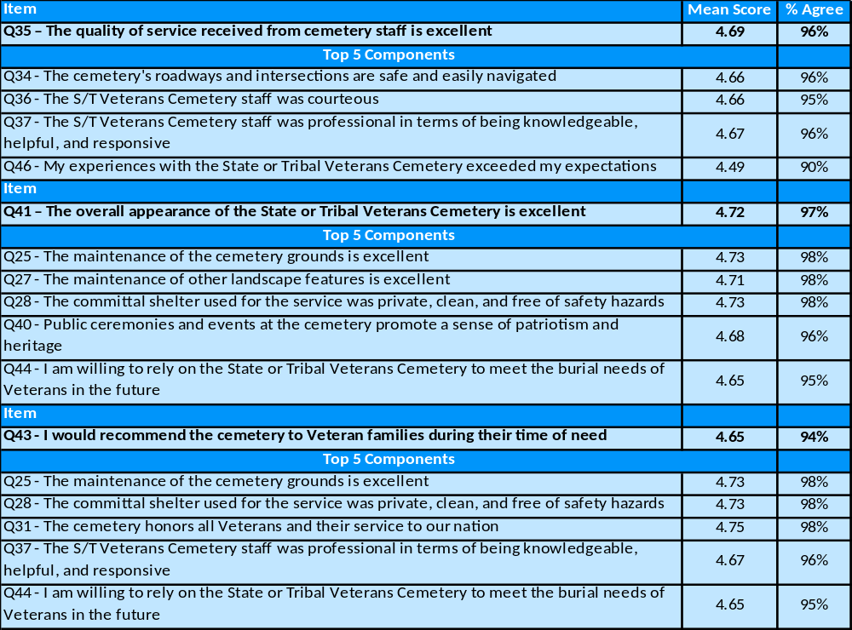
Strategic Performance Measure Components – Funeral Directors
We performed a regression analysis that calculated the strength of the relationship between each Strategic Performance Measure and the items of interest. The tables below present each Strategic Performance Measure and the measures that are key components of each respective score.
29

Slide 30
Conclusions/recommendations
30

Slide 31
Conclusions/Recommendations - I
Overall, scores on the Strategic Performance Measures (quality of service, cemetery appearance, and recommendation) were high (96%, 98%, and 98% agreement, respectively).
  There was little difference between Next of Kin and Funeral Directors ratings, with the exception of likelihood of recommending the cemetery.
  National scores are comparable to those received by National Cemeteries.
Overall, State/Tribal Veteran Cemetery Next of Kin respondents feel that the State/Tribal Veteran Cemeteries compare favorably to National Cemeteries on all elements.
  Only 15 percent of respondents indicated that they would have preferred to inter their loved one in a VA National Cemetery as opposed to the State/Tribal Veterans Cemetery.
    The main reason for this was that loved one wanted to be buried in a VA National Cemetery (55%).
    Preference for loved one to be buried in a VA National Cemetery was related to lower overall satisfaction, and lower agreement that the quality of service was excellent.
    Recommendation 1 (R1) – Given the absence of significant findings in 2014, further trending is needed to verify the significant findings of 2015. These questions should be kept for the 2016 administration, and same analysis performed again.
31

Slide 32
Conclusions/Recommendations - II
Key Findings
  Exceeding expectations was significantly related to ratings of overall satisfaction and all three strategic performance measures. Next of Kin perceptions of how informed they were influenced ratings of expectations. Viewing NCA videos of committal services had a significant positive relationship with exceeding expectations, as well as overall satisfaction, and the three strategic performance measures.
    Recommendation 2 (R2) - Encourage Funeral Directors to show NCA Videos to Next of Kin.
  The key source of information for Next of Kin continues to be family members/friends, while Funeral Directors obtain their information from cemetery staff
    Recommendation 3 (R3) - Improving outbound communication
      (R3a) Consider avenues to increase outreach to Next of Kin to ensure that the information that they are receiving is accurate, (R3b) reevaluate information provided by cemetery staff to Funeral Directors to ensure expectations are clearly communicated, and (R3c) evaluate Funeral Director access and potential barriers to outbound cemetery staff.
    Recommendation 4 (R4) - Add questions that more specifically identify what expectations were and were not met.
32

Slide 33
Conclusions/Recommendations - III
Overall Satisfaction Targets
  To improve overall satisfaction, the data suggest that State/Tribal Veteran Cemeteries should focus on the following:
    Recommendation 5 (R5) - Improving quality of service
      Specifically, resources and improvement efforts should focus on (R5a) expanding hours of operation, (R5b) gravesite/columbaria appearance, and (R5c) understanding and navigating customer expectations.
    Recommendation 6 (R6) - Improving staff professionalism, courtesy, and knowledge
      (R6a) Assess whether there are any knowledge gaps among outward facing staff (specifically those that interact most frequently with Funeral Directors), and (R6b) responsiveness to customers
    Recommendation 7 (R7) – Understanding what reservations Funeral Directors have in relying on State/Tribal Governments to serve Veteran needs and maintain Veteran Cemeteries
      (R7a) Consider adding a question to the 2016 State/Tribal Veterans Cemetery Satisfaction Survey that assesses this content
33

Slide 34
Discussion/Questions?
34

