Slide 1


2015 VA MEMORIAL PRODUCTS SURVEY
U.S. Department of Veterans Affairs
National Cemetery Administration
NATIONAL FINDINGS
December 18, 2015
1

Slide 2
Briefing Agenda
Overview
Strategic Performance Measures
Key Findings
Improvement Analysis
Conclusions/Recommendations
Discussion/Questions
2

Slide 3
Overview
3

Slide 4
Executive Summary
We have data from 2013 and 2014 for trend comparisons.
Overall, 89 percent of all respondents (90% of Next of Kin and 88% of Funeral Directors) were very or somewhat satisfied with their experiences with the VA Memorial Programs Service products and services
Strategic Performance Measures
  91 percent of all respondents (93% of Next of Kin and 91% of Funeral Directors) agreed or strongly agreed the overall quality of the VA headstones, markers, or medallions they received was excellent
  89 percent of Next of Kin agreed or strongly agreed that the overall quality of the Presidential Memorial Certificate (PMC) was excellent.
Key Findings
  94 percent of Next of Kin and 89% of Funeral Directors reported being satisfied with the service received from a NCA Customer Service Representative. Satisfaction was significantly greater for Funeral Directors that spoke directly to a NCA representative.
  Consistent with 2013 and 2014, the lowest satisfaction rating received across any quality area of the headstones or makers was the inscription depth (78% in 2015).
  Unexpected costs of more than $100 had a significant impact on the overall satisfaction of Next of Kin.
Improvement Analysis
  An analysis of respondent satisfaction and importance identified the following areas for improvement:
    Next of Kin – time it took to receive the headstone/marker/medallion
    Funeral Directors – timeliness of getting problems resolved
  Multiple items were identified as being related to the respective Funeral Director and Next of Kin strategic performance measures including experience with headstone/marker/medallion issues, and satisfaction with the ordering process.
4

Slide 5
Survey Background
The purpose of the survey is to better assess customer awareness, knowledge, and satisfaction with products and services provided by NCA’s Memorial Programs Service.
The survey collects data from family members of recently deceased Veterans and the Funeral Directors who serve those families at national cemeteries
The survey targets several key areas in satisfaction: Information and Communication, and Quality of Products and Services
The 2015 survey represents the sixth full administration of this customer satisfaction survey.
  Three new questions were added to and one question dropped from the Next of Kin survey. Text and response options were also edited for six questions.
  One new question was added to and one was dropped from the Funeral Director survey. Two questions were truncated into one, and text and response options were also edited for seven questions.
5

Slide 6
Methodology
The 2015 questionnaire included 37 questions for Next of Kin; 26 questions for Funeral Directors, including some open-ended questions.
To draw the sample, we determined sample size needed to obtain a representative sample of bronze markers, headstones and medallions at the 95% confidence level.
The Next of Kin sample size was 2,500, and the funeral director sample size was 12,789.
Identical to the 2014 administration, in 2015 the three funeral director surveys (National Cemetery, Memorial Products, and State/Tribal) were combined into one consolidated instrument in recognition that many Funeral Directors could be sampled for all three surveys.
The sample of Next of Kin was selected at the end of May of 2015 using a minimum bereavement buffer period of 3 months (i.e., interments prior to February 28, 2015).
The survey was administered from August 20 to October 9, 2015.
All mail communications contained a web link to access the survey online
A toll-free assistance line for survey respondents was available to respondents during regular business hours
6

Slide 7
Response Rates
Survey Response Rates
 | Next of Kin | Funeral Directors | Total
Sample Frame | 80,144 | 12,789 | 92,933
Total Sample Sent | 2,500 | 12,789 | 15,289
Undeliverable | 79 | 470 | 549
Total Eligible Questionnaires | 2,421 | 12,319 | 14,740
Total Returned Surveys | 1,160 | 2,961 | 4,121
Mail Returns | 887 | 2,179 | 3,066
Web Returns | 273 | 782 | 1,055
Total Response Rate (Returned/Eligible) | 48% | 24% | 28%
7

Slide 8
Strategic Performance Measures
8

Slide 9
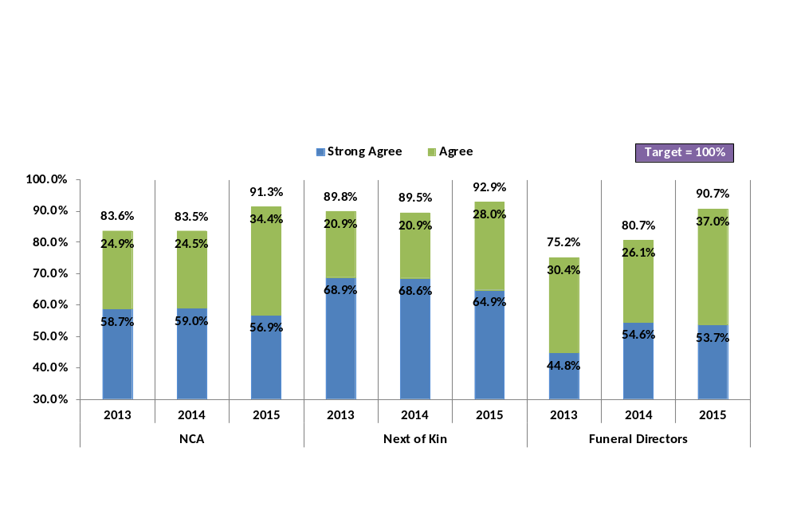
Strategic Performance Measure: Quality Of Product
The overall quality of the headstone, marker, or medallion I received from the VA was excellent.
Question text changed in 2015, to an agreement scale. In 2014 and 2013, question text asked respondents to rate the quality from “Extremely Poor” to “Excellent”. As a result, comparisons with previous years should be interpreted with caution.
Overall 91 percent of respondents agreed that the quality of the headstone, marker, or medallion received was excellent, a statistically significant increase from previous year scores, driven largely by the increase among Funeral Directors (10% increase).
9

Slide 10
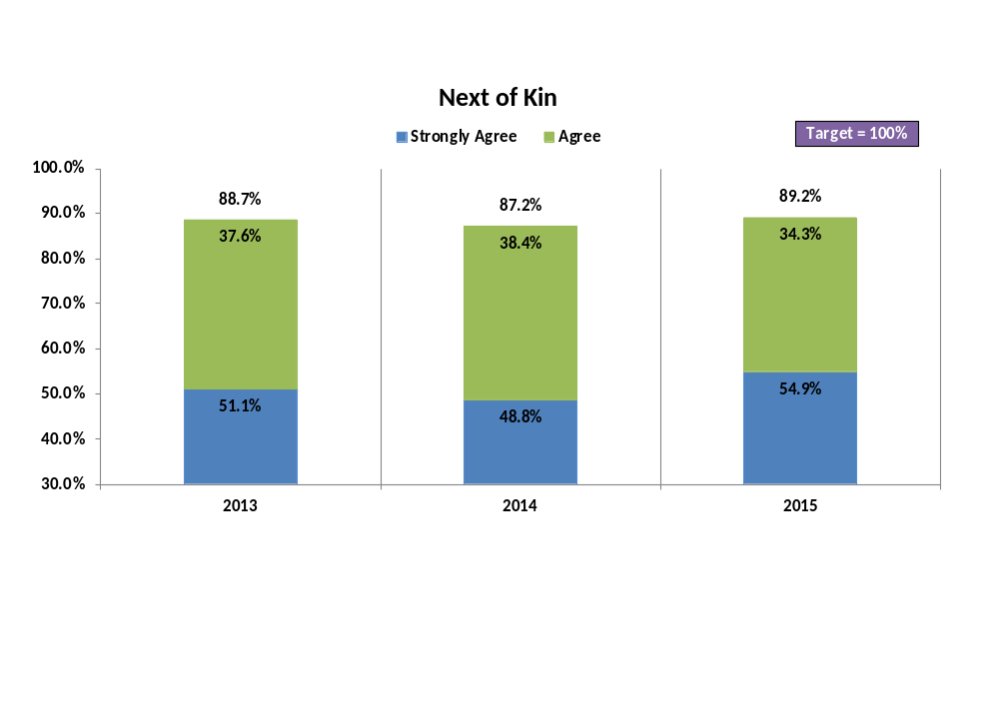
Strategic Performance Measure: Quality Of PMC
The overall quality of the Presidential Memorial Certificate (PMC) I received from the VA was excellent
Overall 89 percent of Next of Kin agreed that the quality of the PMC they received was excellent.
Over the past 3 years agreement on the overall quality of the PMC has remained consistent.
10

Slide 11
Key Findings
11

Slide 12
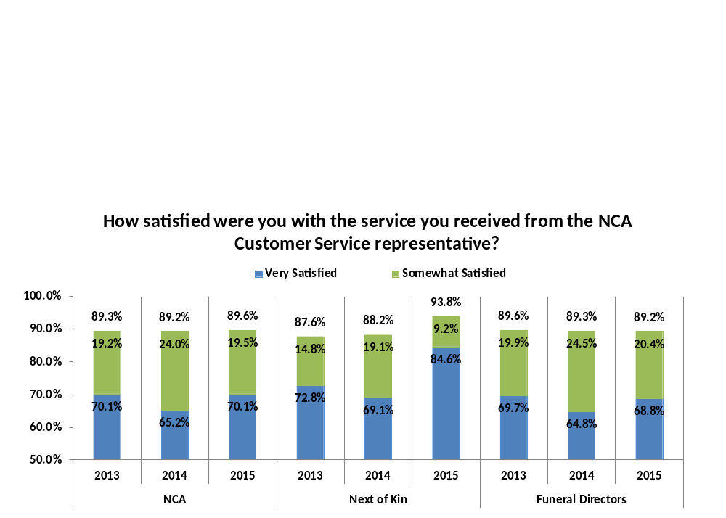
NCA Customer Service - Findings
6 percent of Next of Kin and 25 percent of Funeral Directors called the NCA Applicant Assistance number. Majority of calls were to check on the status of their order, only 10 percent of calls were to file a complaint (a significant decrease from 2014).
  Funeral Directors that spoke directly to a NCA Customer Service Representative reported significantly higher levels of satisfaction with the service than those that were transferred and those that didn’t know if they’d been transferred.
There was a significant increase in the percentage of Next of Kin respondents that were “Very Satisfied” with the service they received.
12
Notes:
12

Slide 13
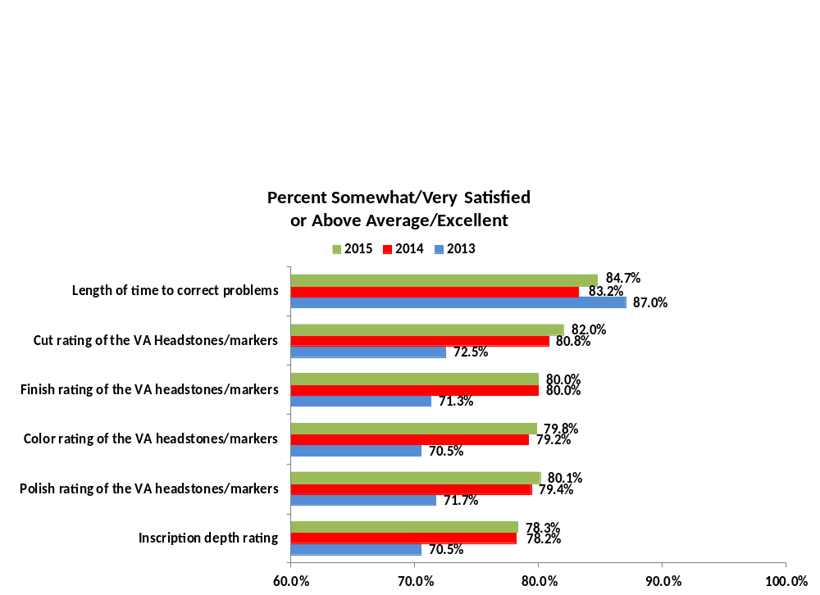
Evaluation of Headstone/Marker
76 percent of respondents (80% Next of Kin; 75% Funeral Directors) were satisfied with the amount of time it took to receive their headstone or marker
  The difference between Next of Kin and Funeral Directors was significant
There were no significant differences in the perceptions of the quality of the headstones/markers, or the length of time to correct errors from 2014 to 2015 among Funeral Directors (graph below)
13
Notes:
13

Slide 14
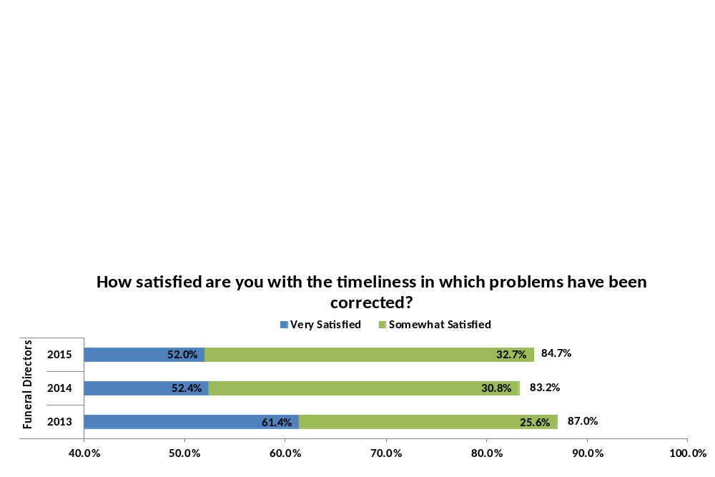
Headstone, Marker, Medallion Issues
In 2015, 31 percent of Funeral Directors indicated they had experienced problems with delivered headstones, markers or medallions – identical to 2014
  Of these respondents, 67 percent of Funeral Directors indicated that less than 1% of the markers received had problems (next highest - 26% indicated 1% to 5%)
  The most common error reported was Typographical errors (54%), Damaged (47%), and Wrong Information (26%) – consistent over the past three years
There were no significant differences in overall satisfaction between those Funeral Directors that identified problems, and those that did not (86% and 89%, respectively). However, there was a significant difference in perceptions of overall quality (89% and 92%, respectively).
Funeral Directors that reported a problem were overall satisfied with the timeliness in which the problems were corrected (85%).
14
Notes:
14

Slide 15
Headstone, Marker, Medallion Costs
In 2015, 83 percent of Next of Kin indicated they were not required to pay any unexpected fees regarding their government headstone/marker/medallion
  59 percent of Next of Kin that indicated they were required to pay an unexpected cost report an expense of $100 or more.
  The table below provides the average unexpected amount reported across the three different products
Product | Mean Unexpected Cost | Minimum Unexpected Cost | Maximum Unexpected Cost
Bronze Marker | $506.94 | $0.00* | $4000.00
Granite/Marble Headstone | $409.65 | $0.00* | $7500.00
Bronze Medallion | $185.53 | $0.00* | $1050.00
*Respondents intentionally reported an unexpected cost of $0.00
Reporting an expense of over $100 had a significant negative relationship with overall satisfaction. Mean scores are provided below.
Product | Mean Overall Satisfaction Rating
Respondents that indicated an unexpected cost of $100 or more | 4.33
Respondents that indicated no unexpected cost or unexpected costs of less than $100 | 4.62
15
Notes:
15

Slide 16
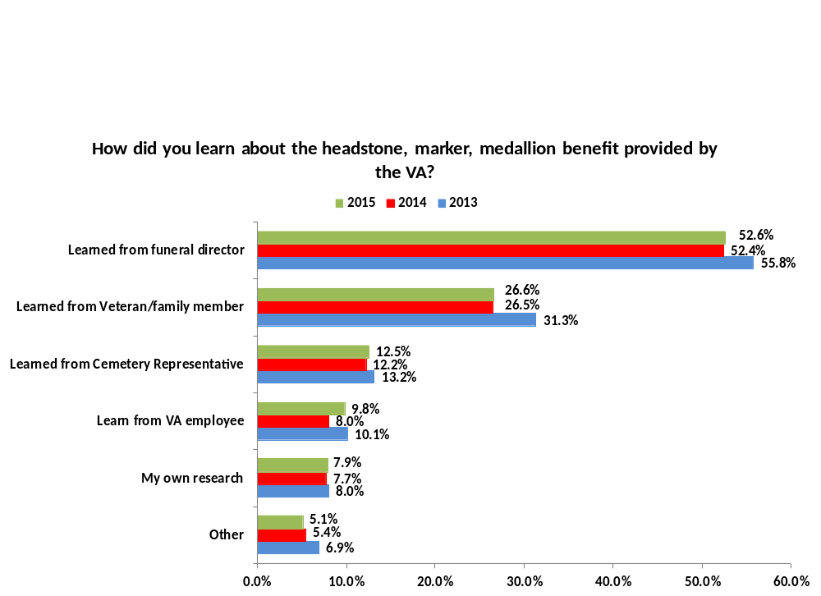
Outreach
Primary methods of learning of benefits: Funeral Director (53%) and Veteran/family member (27%) – these trends have stayed consistent for the past three years and there were no significant differences across age.
16
Notes:
16

Slide 17
Improvement Analysis
17

Slide 18
Quadrant Analysis – Next of Kin
A quadrant analysis ranks measures on derived importance to the customer and reported satisfaction
  For this analysis, satisfaction is determined by the level of agreement indicated by the respondent to the statement. The higher agreement, the greater the satisfaction.
  Derived importance is determined by calculating the strength of the relationship between the specific item and overall reported satisfaction.
← (Lower) Satisfaction (Higher) → | Block 1 - Higher Satisfaction/Lower Importance q11 – How satisfied were you with the service you received from the NCA Customer Service representative? | Block 2 - Higher Satisfaction/Higher Importance q7 – How satisfied were you with the process you used to order the headstone, marker, or medallion? q14 – How satisfied were you with the ease of finding information you were looking for?
 | Block 3 - Lower Satisfaction/Lower Importance q20 – The overall quality of the headstone, marker, or medallion I received from the VA was excellent. q22 – The overall quality of the PMC I received from the VA was excellent. | Block 4 - Lower Satisfaction/Higher Importance q18 – How satisfied were you with the amount of time it took to receive the headstone, marker, or medallion?
 | ← (Lower) Importance (Higher) →
No change from 2014 in item Importance. Items that fell in Block 2 were also identical to 2014.
18

Slide 19
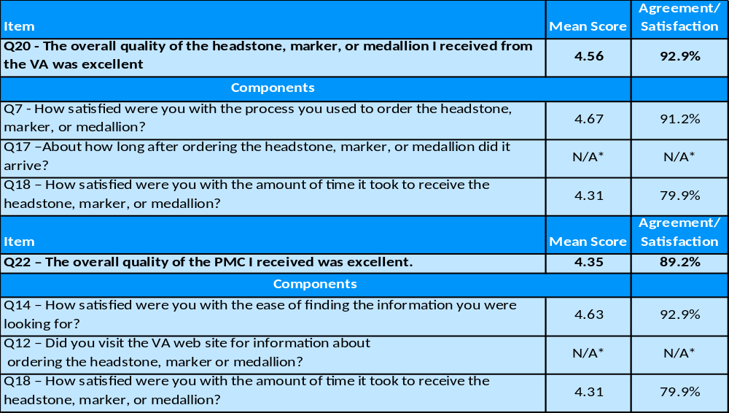
Strategic Performance Measure Components – Next of Kin
We performed a regression analysis that calculated the strength of the relationship between each Strategic Performance Measure and the items of interest. The tables below present each Strategic Performance Measure and the measures that are key components of each respective score.
*Mean not provided as questions do not use Likert-type scales; note 14 percent reported it took over 3 months for headstone to arrive and 12 percent had visit the VA web site
19

Slide 20
Quadrant Analysis – Funeral Directors
A quadrant analysis ranks measures on derived importance to the customer and reported satisfaction
  For this analysis, satisfaction is determined by the level of agreement indicated by the respondent to the statement. The higher agreement, the greater the satisfaction.
  Derived importance is determined by calculating the strength of the relationship between the specific item and overall reported satisfaction.
← (Lower) Satisfaction (Higher) → | Block 1 - Higher Satisfaction/Lower Importance *No items loaded in this Block | Block 2 - Higher Satisfaction/Higher Importance q4 - How satisfied are you with the process you typically used to order headstones, markers, and medallions? q8 - How satisfied were you with the service you received from the NCA Customer Service representative? q11 - How satisfied were you with the ease of finding the information you were looking for? q21 – Overall quality of VA headstone/marker
 | Block 3 - Lower Satisfaction/Lower Importance q15 - How satisfied are you with the amount of time it takes to receive VA markers? q20a – Cut quality of VA headstone/marker q20b – Polish quality of VA headstone/marker q20c – Color quality of VA headstone/marker q20d – Finish quality of VA headstone/marker q20e – Depth of inscription | Block 4 - Lower Satisfaction/Higher Importance q19 - How satisfied are you with the timeliness in which problems have been corrected?
 | ← (Lower) Importance (Higher) →
No change from 2014 in item Importance. Items that fell in Block 2 and Block 4 were also identical to 2014.
20

Slide 21
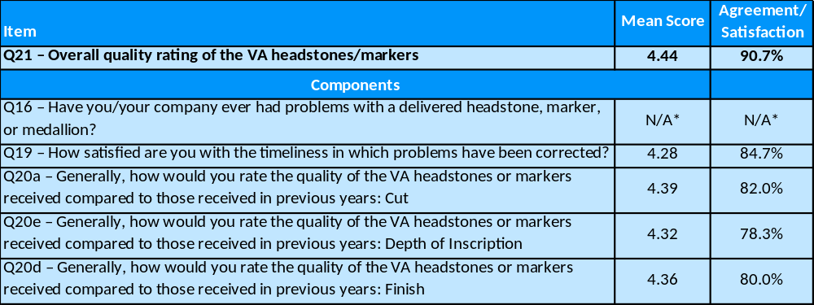
Strategic Performance Measure Components – Funeral Directors
We performed a regression analysis that calculated the strength of the relationship between each Strategic Performance Measure and the items of interest. The tables below present each Strategic Performance Measure and the measures that are key components of each respective score.
*Mean not provided as questions do not use Likert-type scales; note 31 percent reported experiencing a problem with a delivered product
21

Slide 22
Conclusions/recommendations
22

Slide 23
Conclusions/Recommendations - I
Overall, scores on the strategic performance measures (overall quality of VA headstones/markers, overall quality of the PMC) were high (91% and 89%, respectively)
  In 2015, there was a statistically significant increase in Funeral Director and Next of Kin ratings (91% and 93%, respectively) of overall quality from 2014.
Overall, respondents that contact the NCA Applicant Assistance number reported high levels of satisfaction with the service they received (90%).
  In 2015 there was a significant decrease from 2014 in the number of respondents that indicated they called to file a complaint (10% and 14% respectively).
Funeral director ratings of VA headstones/markers were overall positive
  Inscription depth has consistently been the lowest rated quality area over the past three years, with 78 percent of respondents indicating above average/excellent in 2015.
23

Slide 24
Conclusions/Recommendations - II
Overall Satisfaction and Strategic Performance Measures
  To improve overall satisfaction and strategic performance measure ratings, the data suggests that NCA should focus on the following:
    Recommendation 1 (R1) – Timeliness in which headstones/markers/medallions are received (Next of Kin specific)
      Establishing expectations is important to maintaining customer satisfaction. NCA could investigate (R1a) the expectations communicated to respondents regarding how soon they should received the product, and (R1b) verify timelines with producing vendors to ensure consistency between communication.
    Recommendation 2 (R2) – Timeliness in which problems are resolved should be examined (Funeral Director specific)
      NCA could investigate (R2a) the expectations communicated regarding how quickly problems should be resolved, (R2b) the average turnaround for fixing reported issues, (R2c) is the turnaround timeframe and process transparent to the customer
      The most commonly reported error for the past three years has been Typographical (54% in 2015). NCA could (R2d) examine this process to identify whether there are any additional quality control steps that could be taken to reduce the likelihood of these errors occurring.
        Instances of errors was also discussed in Key Findings
    Recommendation 3 (R3) – Add items that more directly relate to the PMC in order to better identify opportunities for improvement beyond overall experience.
24

Slide 25
Conclusions/Recommendations - III
Key Findings
  To address concerns associated in the key findings analysis, the data suggests NCA should consider focusing on the following:
    Recommendation 4 (R4) – Unexpected costs associated with headstones/markers/medallions
      Unexpected costs greater than $100 resulted in a significant decrease in overall satisfaction. NCA should consider (R4a) examining its communication of cost expectations, and (R4b) whether respondents are attributing those costs to NCA rather than the third party’s responsible (e.g., private cemetery charge for headstone placement).
    Recommendation 5 (R5) – Assess expectations, as well as how informed Next of Kin feel after receiving benefit information regarding headstones/markers/medallions
      Currently, the MPS asks Next of Kin how they learned about the headstone/marker/medallion (primary response is Funeral Director), but not how informed they feel. As a result, NCA cannot assess whether there are information gaps that could be impacting customer expectations/satisfaction.
Assessing Dissatisfaction
  Recommendation 6 (R6) – Evaluate whether there is any anecdotal data collected that suggests dissatisfaction in specific areas of importance to NCA, and incorporate assessment questions of these areas into survey.
25

Slide 26
Discussion/Questions?
26

