Slide 1


2015 National Cemetery Satisfaction Survey
U.S. Department of Veterans Affairs
National Cemetery Administration
NATIONAL FINDINGS
December 18, 2015
1

Slide 2
Briefing Agenda
Overview
Strategic Performance Measures
Key Findings
National Cemetery and State/Tribal Veterans Cemetery Comparisons
Improvement Analysis
Conclusions/Recommendations
Discussion/Questions
2

Slide 3
Overview
3

Slide 4
Executive Summary - I
We have data from 2013 and 2014 for trend comparisons
Overall, 98 percent of all respondents (98% Next of Kin and 98% of Funeral Directors) agreed or strongly agreed that they were satisfied with their experience
Strategic Performance Measures
  96 percent of all respondents (96% of Next of Kin and 97% of Funeral Directors) agreed or strongly agreed the quality of service they received from cemetery staff was excellent
  99 percent of all respondents (99% of Next of Kin and 99% of Funeral Directors) agreed or strongly agreed the overall appearance of their national cemeteries was excellent
  98 percent of respondents (99% of Next of Kin and 97% of Funeral Directors) agreed or strongly agreed they would recommend their national cemeteries to Veteran families during their time of need
Key Findings
  Next of Kin that lived over 75 miles away from the cemetery indicated less agreement that they would recommend the cemetery to other Veteran families
  Next of Kin that had not visited the cemetery since the committal service indicated less agreement across all three strategic performance measures
4

Slide 5
Executive Summary - II
Key Findings (cont.)
  Exceeding expectations was highly related to overall satisfaction and all three strategic performance measures
    Being informed was related to exceeding expectations. Viewing NCA videos of committal services for Next of Kin, and outreach by cemetery staff for Funeral Directors were positively related to being informed.
National Cemetery and State/Tribal Comparisons
  14 percent of Next of Kin indicated that they had visited a State or Tribal Veterans Cemetery. Of these respondents, 80 percent agreed or strongly agreed that the appearance of the State or Tribal Veterans Cemetery compared favorably to the national cemetery. 73 percent agreed or strongly agreed that the quality of service at the State or Tribal Veterans Cemetery compares favorably to the national cemetery.
  37 percent of Next of Kin indicated that the honor of being interred at a State or Tribal Veterans Cemetery is equivalent to that of being interred at a national cemetery.
Improvement Analysis
  An analysis of respondent satisfaction and importance identified the following areas for improvement:
    Next of Kin – quality of service, hours of operation, gravesite/columbaria appearance, events promoting patriotism, exceeding expectations
    Funeral Directors – quality of service, staff courtesy and professionalism, perceptions of reliance on VA and NCA to meet burial needs, exceeding expectations
5

Slide 6
Survey Background - I
This briefing presents an overview of National results for the 2015 National Cemetery Satisfaction Survey
The survey collects data from the Next of Kin of recently deceased Veterans and/or eligible family members that were interred at a national cemetery, and the Funeral Directors who serve those families.
The survey targets several key areas in satisfaction: Overall Satisfaction; Trust; Information and Communication; Committal Services; Headstones, Markers, and Columbarium Niche Covers; and Cemetery Appearance and Visitor Accommodations
The 2015 survey represents the fifteenth full administration of this customer satisfaction survey
6

Slide 7
Methodology
The 2015 questionnaire included 67 questions for Next of Kin and 49 questions for Funeral Directors, including some open-ended questions.
To draw the sample, we determined sample size needed for each national cemetery to yield valid data at the 95 percent confidence level, assuming a 60 percent response rate.
The Next of Kin sample size was 26,679 – 19,828 from cemeteries with 400 or more interments, and 6,851 from cemeteries with fewer than 400 interments. The funeral director sample size was 12,789.
In 2015, the three funeral director surveys (National Cemetery, Memorial Products, and State/Tribal) were combined into one consolidated instrument in recognition that many Funeral Directors could be sampled for all three surveys .
The sample of Next of Kin was selected in May of 2015 using a minimum bereavement buffer period of 3 months (i.e., interments prior to February 28, 2015).
The survey was administered from August 20 to October 9, 2015.
All mail communications contained a web link to access the survey online
A toll-free assistance line for survey respondents was maintained during regular business hours
7

Slide 8
Response Rates
Survey Response Rates
 | Next of Kin | Funeral Directors | Total
Sample Frame | 62,728 | 12,789 | 75,517
Total Sample Sent | 26,679 | 12,789 | 39,468
Undeliverable | 1,213 | 470 | 1,683
Total Eligible Questionnaires | 25,466 | 12,319 | 37,785
Total Returned Surveys | 12,943 | 3,335 | 16,278
Mail Returns | 11,053 | 2,418 | 13,471
Web Returns | 1,890 | 917 | 2,807
Total Response Rate (Returned/Eligible) | 51% | 27% | 43%
8

Slide 9
Strategic Performance Measures
9

Slide 10
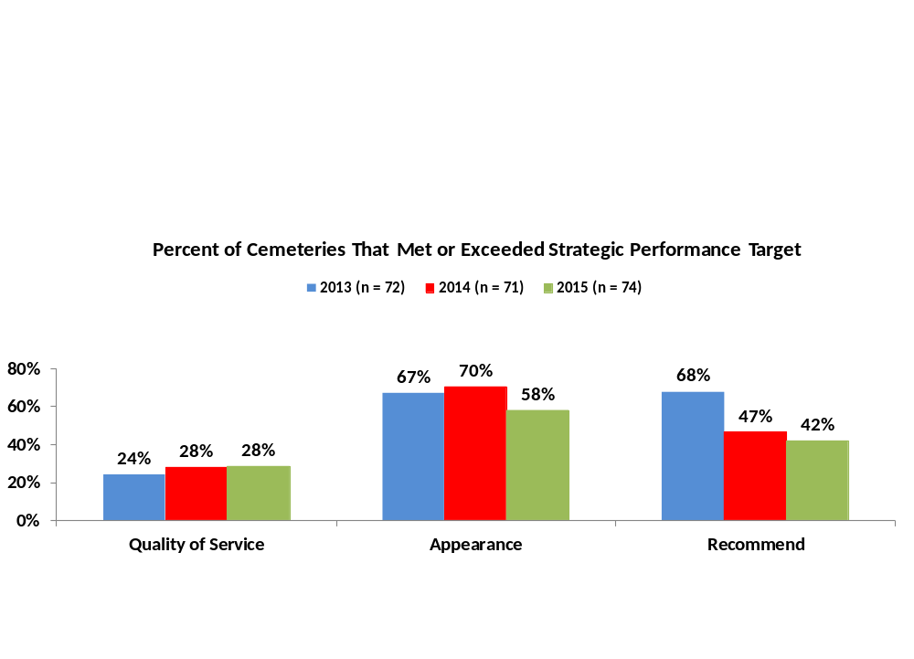
Strategic Performance Measures – Cemeteries Meeting/Exceeding Targets
In 2015, 28 percent of cemeteries met/exceeded the quality of service target, 58 percent of cemeteries met/exceeded the appearance target, and 42 percent of cemeteries met/exceeded the recommend target.
  There were no significant differences between 2014 and 2015.
The percent of cemeteries meeting/exceeding target goal for quality of service has been trending up over the past three years, while the percent of cemeteries meeting/exceeding the target goal for recommend has been trending down over the past three years
In 2015, 62 percent of cemeteries are within two percent of the quality of service goal, 89 percent of cemeteries are within two percent of the appearance goal, and 92 percent of cemeteries are within two percent of the recommend goal.
Target 98%
Target 99%
Target 99%
10
Notes:
10

Slide 11
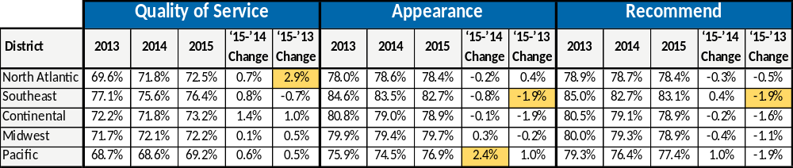
Strategic Performance Measures by District– Strongly Agree
Percent of respondents that “strongly agree” remains steady from 2013 to 2015, with all differences falling below three percent within district.
  In 2015, North Atlantic District respondents indicated a significant increase in agreement that the quality of service was excellent from 2013.
  In 2015, Southeast District respondents indicated a significant decrease in agreement that the appearance was excellent, and that the respondent would recommend the cemetery from 2013.
  In 2015, Pacific District respondents indicated a significant increase in agreement that the appearance of the national cemeteries was excellent from 2014.
Percent Strongly Agree
Note: Changes highlighted in gold are significantly different.
11
Notes:
11

Slide 12
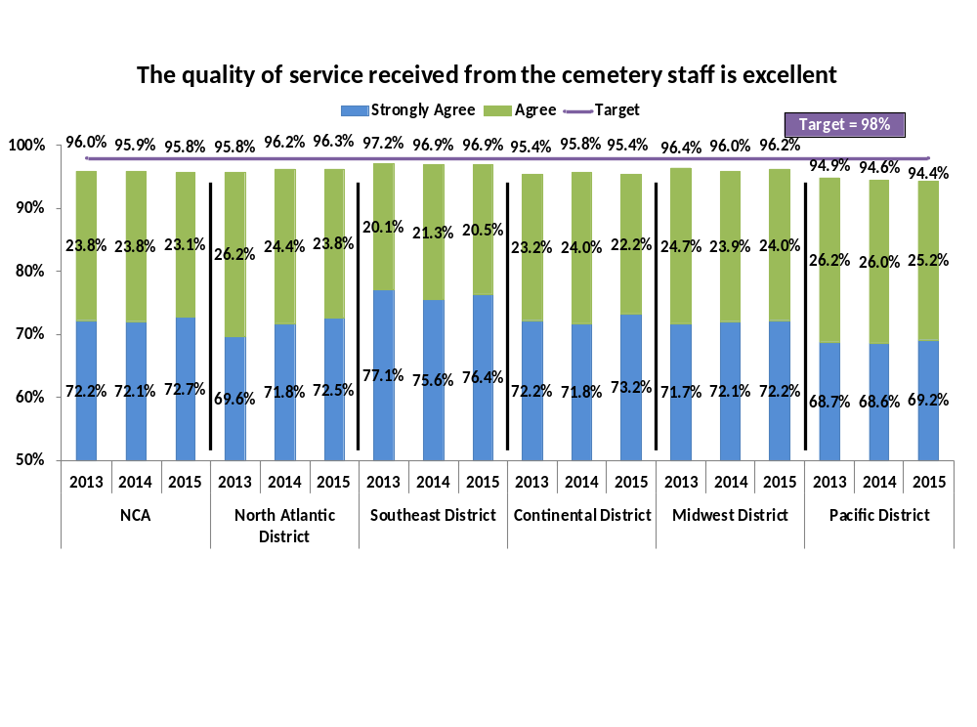
Strategic Performance Measure: Quality of Service
Overall 96 percent of respondents agreed or strongly agreed that the quality of service received from the cemetery staff is excellent, slightly below the target of 98 percent. Agreement has been fairly stagnant over the past 3 years.
All districts fell slightly short of the target goal of 98 percent
The Pacific District had the lowest agreement of all districts, however, still achieved 94 percent agreement from respondents with this statement
12

Slide 13
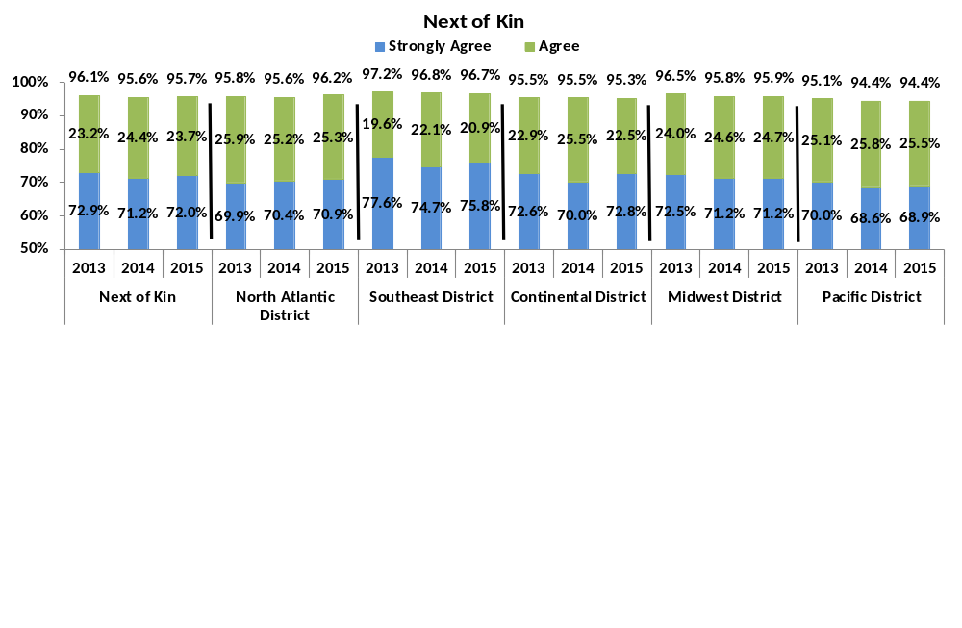
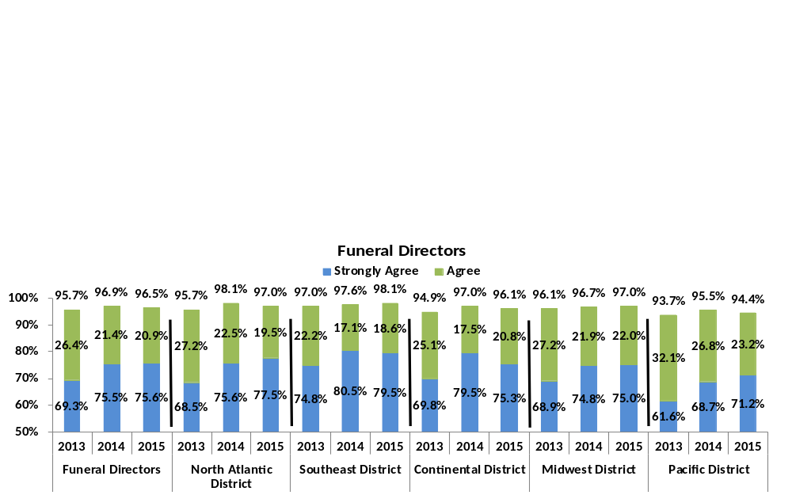
Strategic Performance Measure: Quality of Service
The quality of service received from the cemetery staff is excellent
13

Slide 14
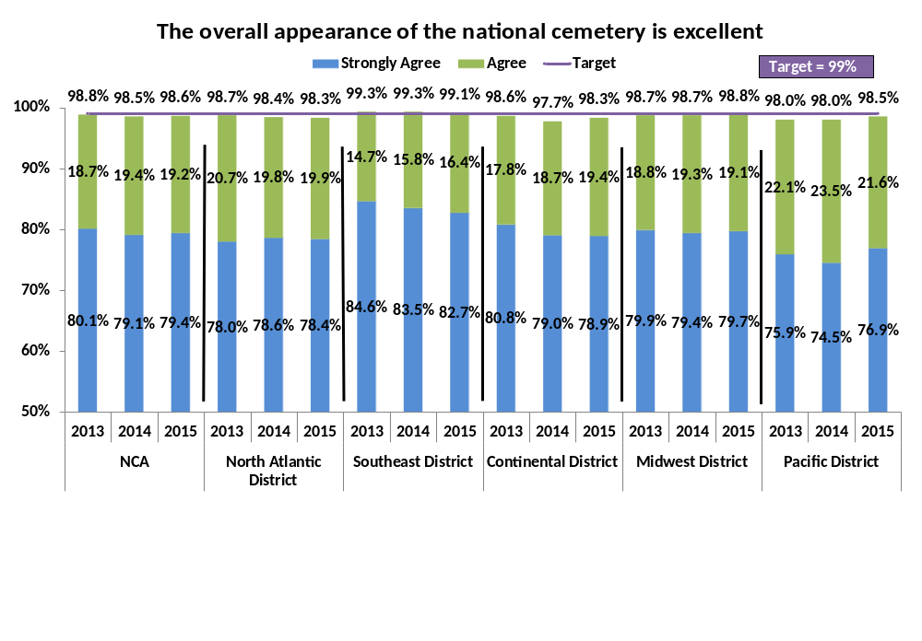
Strategic Performance Measure: Overall Appearance
Overall 99 percent of respondents agreed or strongly agreed that the appearance of the national cemetery is excellent, achieving the target goal
  All districts except North Atlantic and Continental achieved the target goal. North Atlantic and Continental both had 98 percent agreement
Overall, and within district, over the past 3 years differences have not varied by more than 1 percent
14

Slide 15
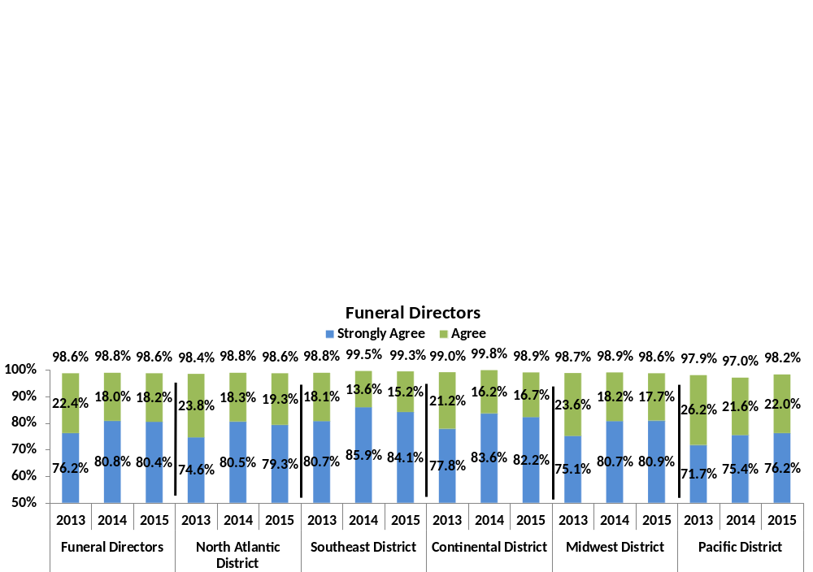
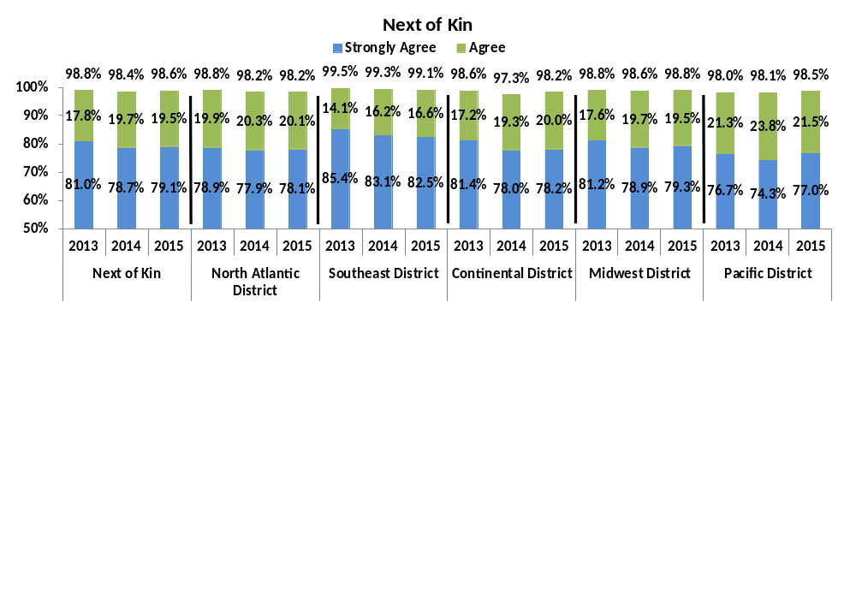
Strategic Performance Measure: Overall Appearance
The overall appearance of the national cemetery is excellent
15

Slide 16
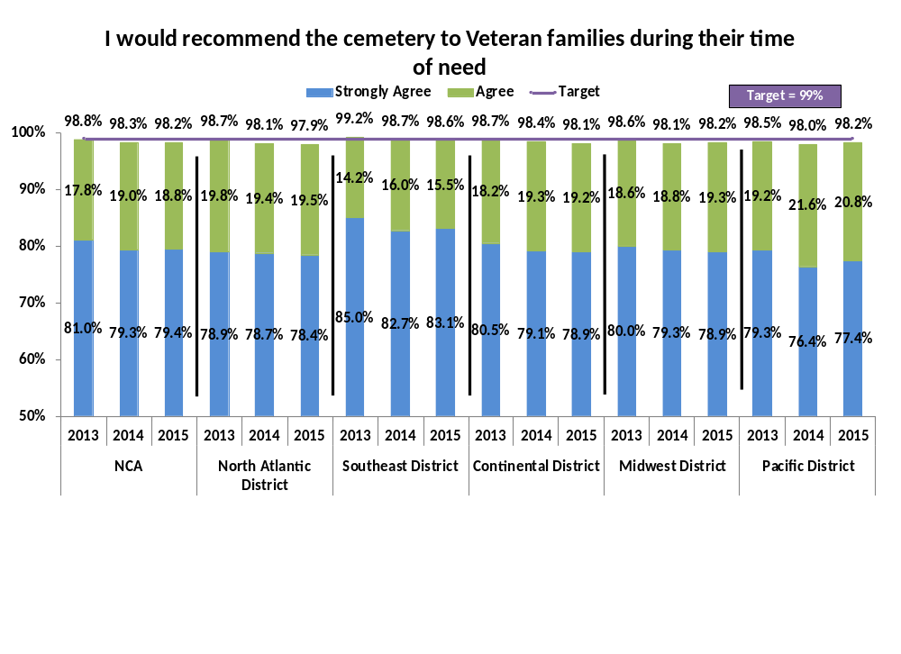
Strategic Performance Measure: Recommendation
Overall 98 percent of respondents agreed or strongly agreed that they would recommend the cemetery to Veteran families, slightly below the target goal of 99 percent
  In 2015, Southeast District achieved the target goal of 99 percent agreement
Overall, and within district, over the past 3 years differences have not varied by more than 1 percent
16

Slide 17
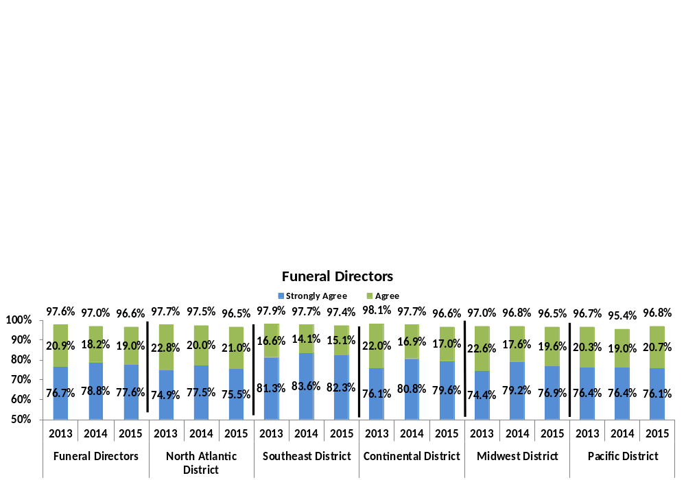
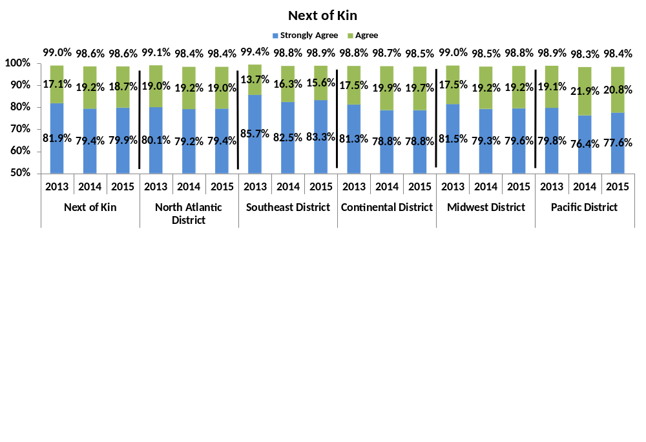
Strategic Performance Measure: Recommendation
I would recommend the cemetery to Veteran families during their time of need
17

Slide 18
Key Findings
18

Slide 19
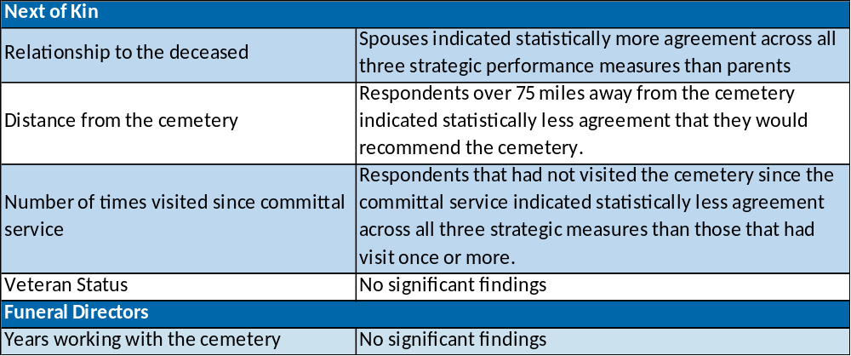
Relationships and Non-Relationships
The table below provides a summary of the relationship and non-relationship trends that were found pertaining to distance from the cemetery, relationship to deceased, number of visits, and years doing business with the cemetery.
19
Notes:
19

Slide 20
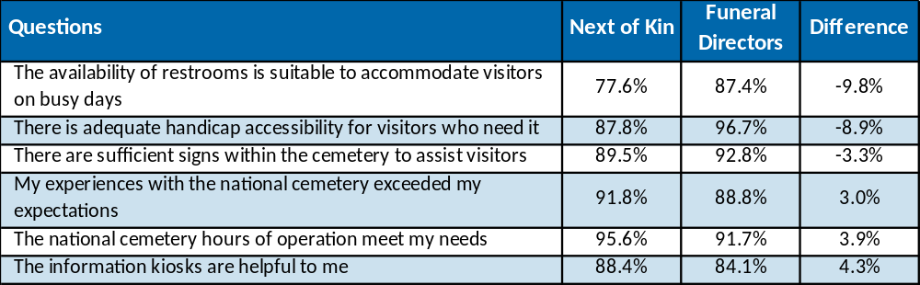
Statistically Significant Differences in Agreement by Next of Kin and Funeral Directors
Next of Kin reported significantly higher levels of agreement compared to Funeral Directors nationally for three questions and significantly lower levels of satisfaction nationally for three questions.
  Lower satisfaction appeared to occur for each respondent type, respectively, on items that could be viewed as more relevant to their particular needs.
Percent Agree/Strongly Agree for
Next of Kin and Funeral Directors
(with 3% or Greater Difference)
20
Notes:
20

Slide 21
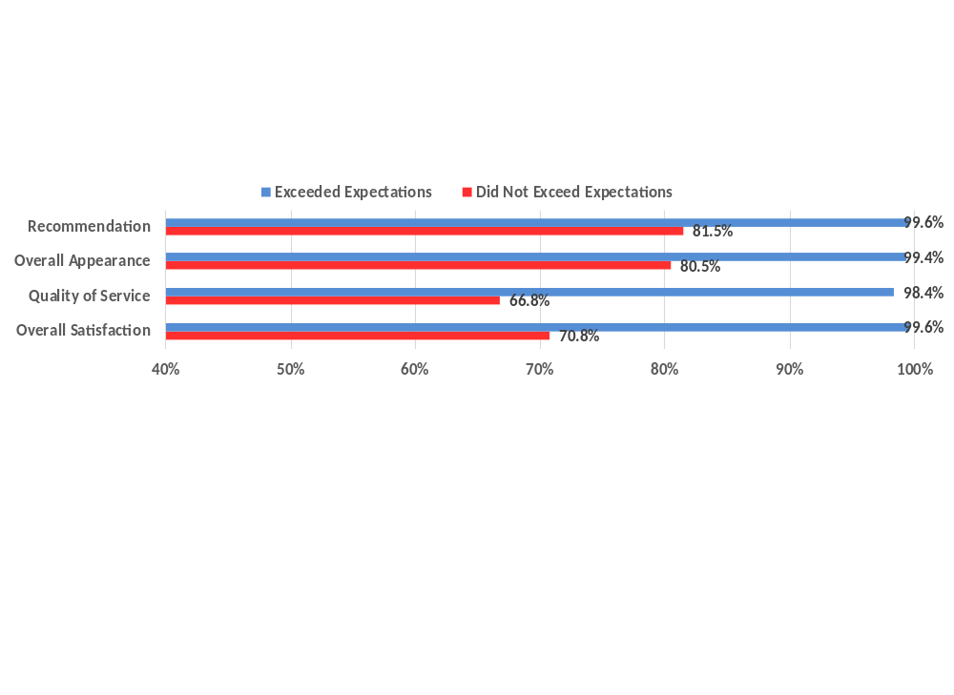
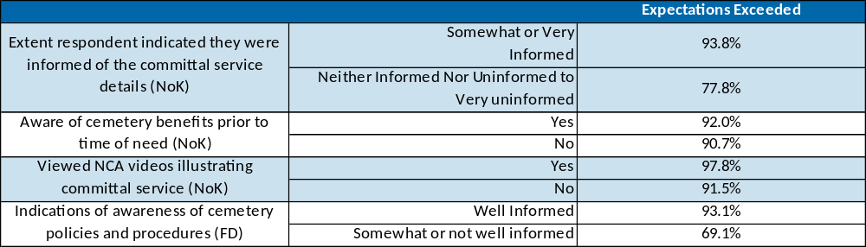
Impact of Expectations
Overall, 91 percent of respondents (92% of Next of Kin, 89% of Funeral Directors) agreed that the national cemetery exceeded expectations
  Exceeding expectations was positively related to ratings of overall satisfaction, quality of service, and overall appearance, as well as likelihood of recommending the cemetery for both Next of Kin and Funeral Directors
Expectations were influenced by information (all differences statistically significant)
21
Notes:
21

Slide 22
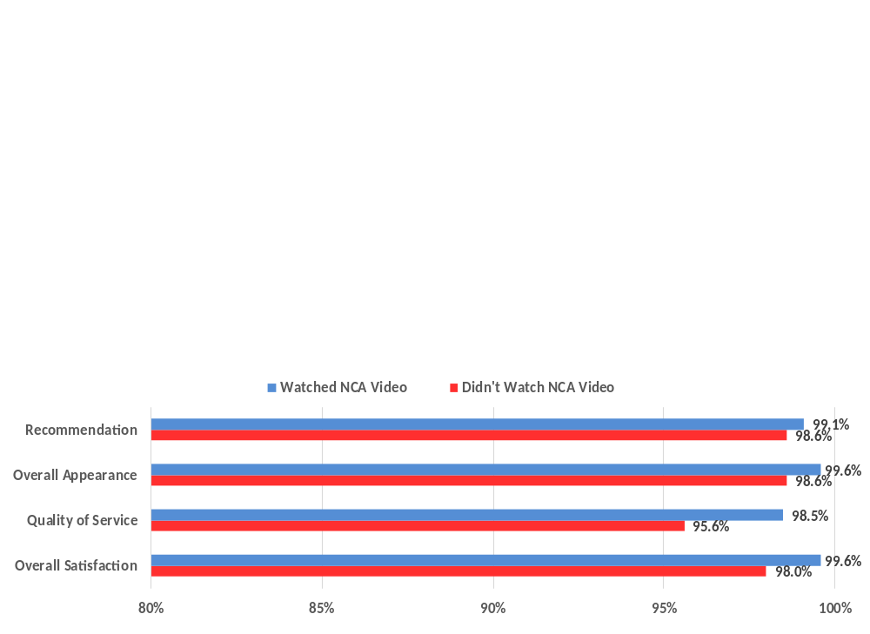
Impact of Being Informed
Nationally, 70 percent of Funeral Directors were aware that the NCA Website had links to NCA videos illustrating different committal service options. 77 percent of Funeral Directors found these videos to be useful
93 percent of Next of Kin agreed or strongly agreed that the videos were helpful in understanding the burial process. However, only 5 percent indicated that they had been shown the video prior to the committal service.
  Next of Kin that had seen the video prior to the committal service indicated that they felt more informed of the details related to the committal service than those who had not been show the video (96% and 88%, respectively), and that their experience had exceeded expectations (98% and 92%, respectively).
  In addition, viewing the videos had a positive, but small, impact on overall satisfaction, and the three strategic performance measures.
22
Notes:
22

Slide 23
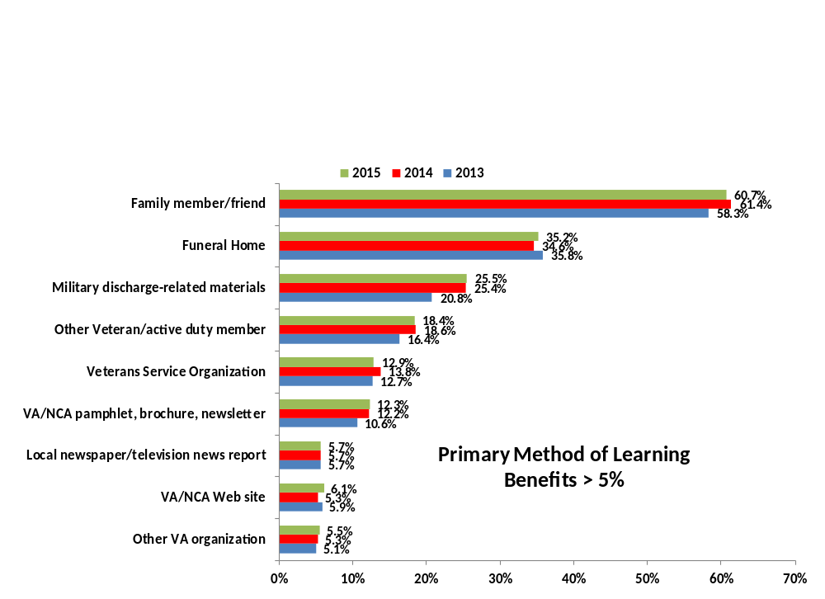
Sources of Information – Next of Kin
Primary methods of learning of benefits: family members or friends (61%) and funeral homes (35%) (similar to 2013 and 2014).
  Respondents that were 70 or older were less likely to learn of benefits via family member/friend (53%), and more likely to learn through funeral homes (37%), military discharge-related materials (32%), pamphlets/brochures/newsletters (12%), Veteran Service Organizations (16%), and Local newspaper/television reports (9%) than other age groups. Respondents age 50 to 69 years old were most likely to learn of benefits through family members or friends (67%).
23
Notes:
23

Slide 24
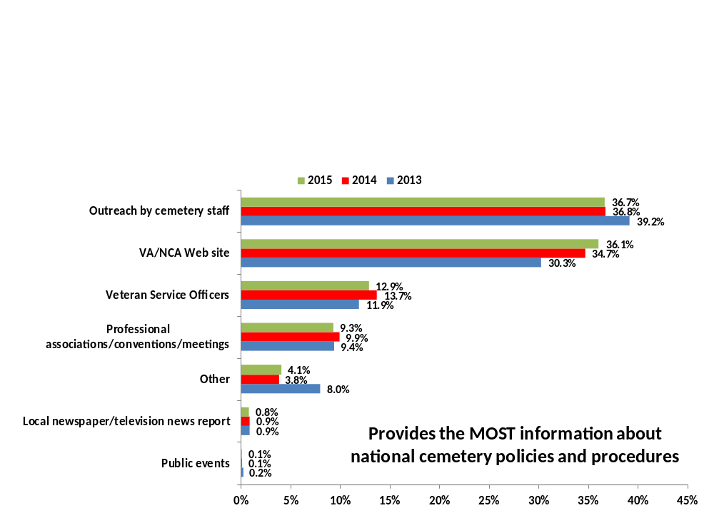
Sources of Information – Funeral Directors
In 2015, Funeral Directors indicated that the sources that provided the most information about national cemetery policies and procedures were outreach by cemetery staff (37%), and VA/NCA web site (36%).
  Funeral directors that indicated they were somewhat well-informed or not well-informed were less likely to indicate that they reached out to cemetery staff than those that indicated they were well-informed (27% and 39%, respectively).
24
Notes:
24

Slide 25
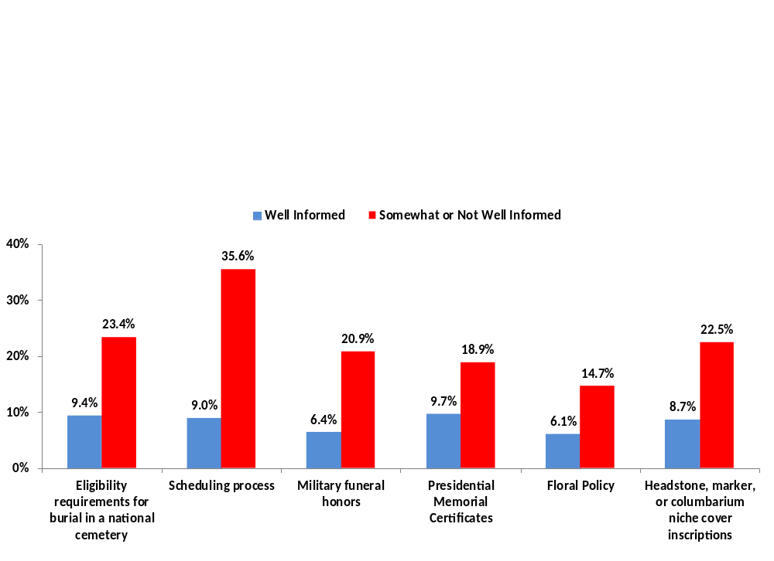
Desired Information – Funeral Directors
Funeral Directors that indicated they were Somewhat or Not Well Informed were significantly more likely to indicate they needed more information about all listed national cemetery policies and procedures (provided in the graph below) than those that indicated they were Well Informed.
  Expectedly there was a further relationship between needing more information and satisfaction with services (e.g., Funeral Directors that needed more information regarding the scheduling process were less likely to indicate that the process of scheduling an interment was easy (65% vs. 88%)
25
Notes:
25

Slide 26
National Cemetery and State/Tribal Veterans Cemetery Comparisons
26

Slide 27
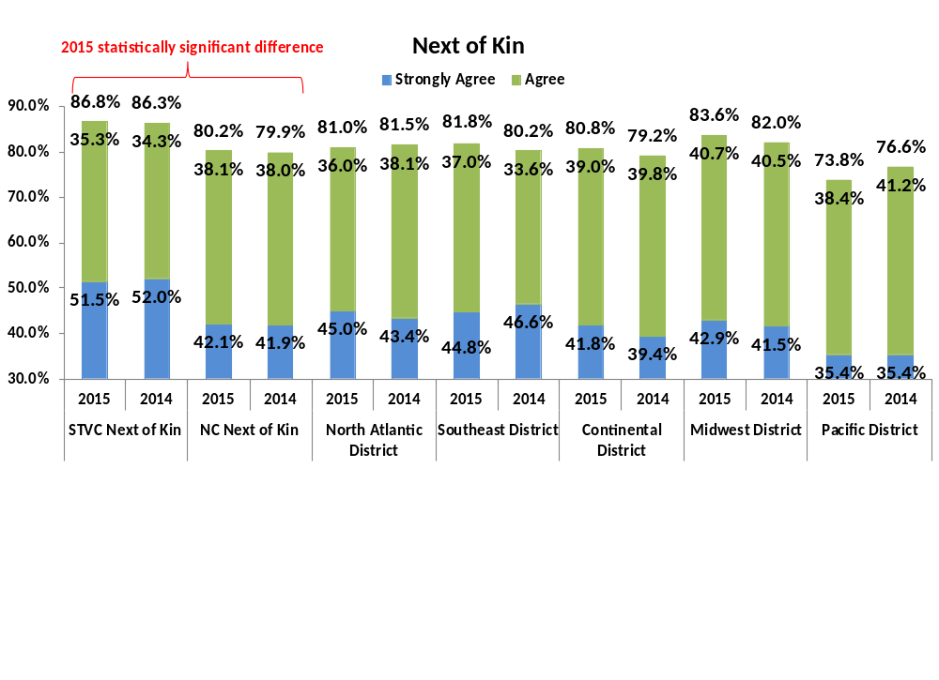
Appearance Comparison
Based on your visit the appearance of the State or Tribal Veterans Cemetery compares favorably to the VA National Cemetery
State/Tribal Veteran Cemetery Next of Kin respondents were statistically more likely to indicate agreement that the appearance of State/Tribal Veterans Cemeteries compared favorably to VA National Cemeteries.
Overall, respondents agreed that the appearance of State/Tribal Veteran Cemeteries compared favorably to National Cemeteries.
27

Slide 28
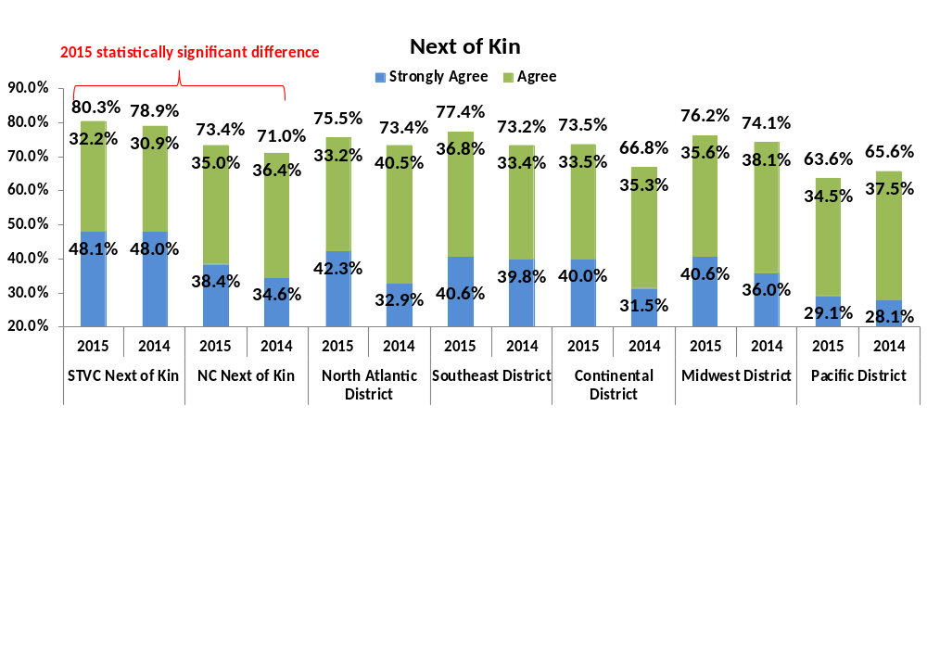
Quality of Service Comparison
Based on your visit the quality of service at the State or Tribal Veterans Cemetery compares favorably to the VA National Cemetery
State/Tribal Veteran Cemetery Next of Kin respondents were statistically more likely to indicate agreement that the quality of service of State/Tribal Veterans Cemeteries compared favorably to VA National Cemeteries.
Overall, respondents agreed that the quality of service of State/Tribal Veteran Cemeteries compared favorably to National Cemeteries.
Significant differences across districts are as follows:
  Pacific District respondents indicated statistically lower agreement that the quality of service of State/Tribal Veterans Cemeteries compared favorably to VA National Cemeteries than all other district respondents
28

Slide 29
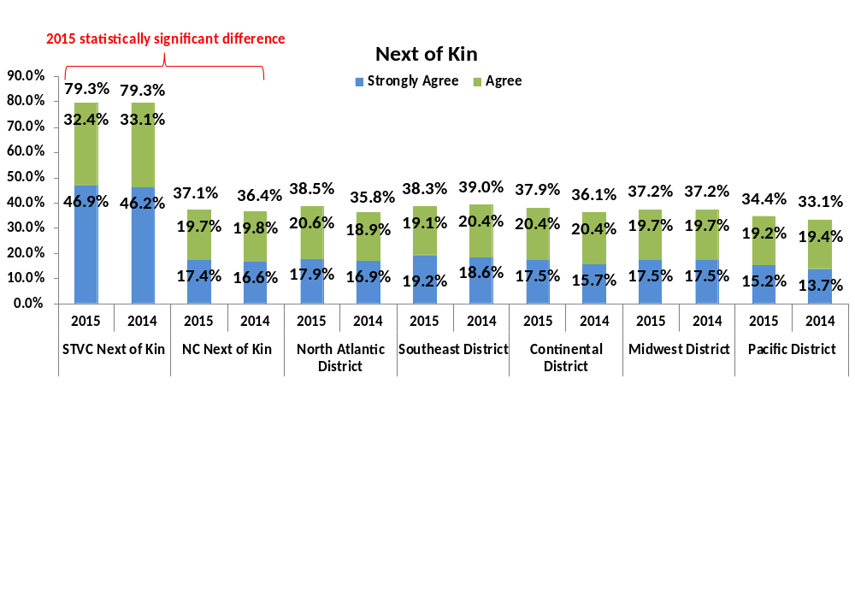
Interment Comparison
The honor of being interred at a State or Tribal Veterans Cemetery is equivalent to that of being interred at a VA National Cemetery
State/Tribal Veteran Cemetery Next of Kin respondents indicated statistically higher agreement that the honor of being interred at a State/Tribal Veterans Cemetery is equivalent to that of being interred at a VA National Cemetery.
  Only 37 percent of National Cemetery respondents indicated agreement
  Pacific District respondents indicated statistically less agreement that the honor of being interred at a State/Tribal Veterans Cemetery is equivalent to that of being interred at a VA National Cemetery than other district respondents.
Respondents that had visited a State/Tribal Veterans Cemetery were statistically more likely to agree that the honor in being interred at either cemetery is equivalent
29

Slide 30
Improvement Analysis
30

Slide 31
Quadrant Analysis – Next of Kin
A quadrant analysis ranks measures on derived importance to the customer and reported satisfaction
  For this analysis, satisfaction is determined by the level of agreement indicated by the respondent to the statement. The higher agreement, the greater the satisfaction.
  Derived importance is determined by calculating the strength of the relationship between the specific item and overall reported satisfaction
← (Lower) Satisfaction (Higher) → | Block 1 - Higher Satisfaction/Lower Importance q40 - The maintenance of the cemetery grounds is excellent. q41 - The upkeep of the headstones, markers, or columbarium niche covers is excellent. q42 - The maintenance of other landscape features (e.g. flowers, trees, shrubs) is excellent q43 - The committal shelter used for the service was private, clean, and free of safety hazards q46 - The cemetery honors all Veterans and their service to our nation | Block 2 - Higher Satisfaction/Higher Importance q51 - The national cemetery staff was courteous q52 - The national cemetery staff was professional in terms of being knowledgeable, helpful, and responsive q57 - The overall appearance of the national cemetery is excellent q59 - I would recommend the cemetery to Veteran families during their time of need q60 - I am willing to rely on VA and the National Cemetery Administration to meet the burial needs of Veterans in the future q61 - I am willing to rely on VA and the NCA to maintain national cemeteries as national shrines in the future
 | Block 3 - Lower Satisfaction/Lower Importance q44 - There is adequate handicap accessibility for visitor who need it q45 - The availability of restrooms is suitable to accommodate visitors on busy days q47 - There are sufficient signs within the cemetery to assist visitors q48 - Parking at the cemetery is adequate to accommodate visitors on most days q49 - The cemetery's roadways and intersections are safe and easily navigated q55 - The information kiosks (i.e., gravesite locators) are helpful to me | Block 4 - Lower Satisfaction/Higher Importance q50 - The quality of service received from cemetery staff is excellent q53 - The national cemetery hours of operation meet my needs for visiting my loved one's gravesite q54 - The appearance of my loved one's gravesite/columbaria is excellent q56 - Public ceremonies and events at the cemetery promote a sense of patriotism and heritage q62 - My experiences with the national cemetery exceeded my expectations
 | ← (Lower) Importance (Higher) →
NCA should focus improvement resources on the items in the lower half of the of the table in an effort to improve the overall satisfaction of Next of Kin. High value targets include those in Block 4.
31

Slide 32
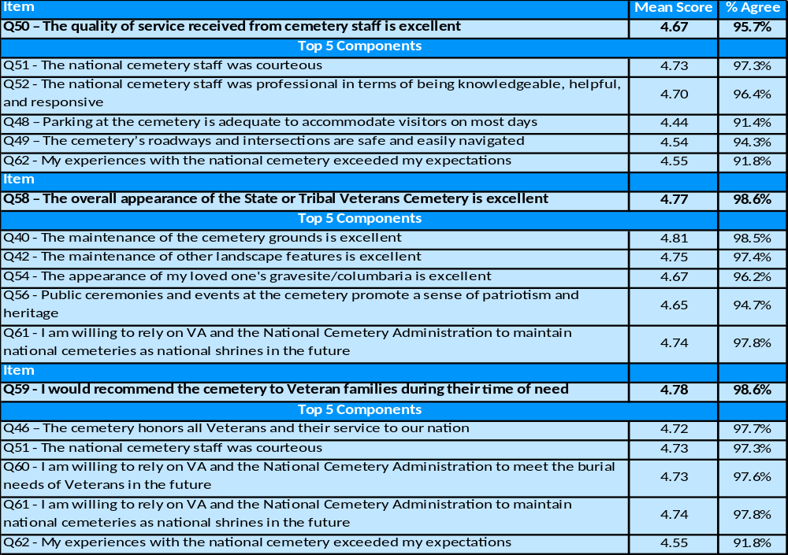
Strategic Performance Measure Components – Next of Kin
We performed a regression analysis that calculated the strength of the relationship between each Strategic Performance Measure and the items of interest. The tables below present each Strategic Performance Measure and the measures that are key components of each respective score.
32

Slide 33
Quadrant Analysis – Funeral Directors
A quadrant analysis ranks measures on derived importance to the customer and reported satisfaction
  For this analysis, satisfaction is determined by the level of agreement indicated by the respondent to the statement. The higher agreement, the greater the satisfaction.
  Derived importance is determined by calculating the strength of the relationship between the specific item and overall reported satisfaction
← (Lower) Satisfaction (Higher) → | Block 1 - Higher Satisfaction/Lower Importance q29 – The committal shelter used for the service was private, clean, and free of safety hazards q30 – There is adequate handicap accessibility for visitors who need it q32 – The cemetery honors all Veterans and their service to our nation q41 – The information kiosks are helpful to me q42 – Public ceremonies and events at the cemetery promote a sense of patriotism and heritage | Block 2 - Higher Satisfaction/Higher Importance q26 – The maintenance of the cemetery grounds is excellent q27 – The upkeep of the headstones, markers, or columbarium niche covers is excellent q28 – The maintenance of other landscape features is excellent q43 – The overall appearance of the national cemetery is excellent q45 – I would recommend the cemetery to Veteran families during their time of need q47 – I am willing to rely on VA and NCA to maintain national cemeteries as a national shrines in the future
 | Block 3 - Lower Satisfaction/Lower Importance q31 – The availability of restrooms is suitable to accommodate visitors on busy days q33 – There are sufficient signs within the cemetery to assist visitors q34 – Parking at the cemetery is adequate to accommodate visitors on most days q35 – The cemetery’s roadways and intersections are safe and easily navigated q39 – The National Cemetery Scheduling Office’s hours of operation meet my needs for scheduling services q40 – The national cemetery hours of operation meet my needs for scheduling services | Block 4 - Lower Satisfaction/Higher Importance q36 – The quality of service received from cemetery staff is excellent q37 – The national cemetery staff was courteous q38 – The national cemetery staff was professional in terms of being knowledgeable, helpful, and responsive q46 – I am willing to rely on VA and the NCA to meet the burial needs of Veterans in the future q48 – My experiences with the national cemetery exceeded my expectations
 | ← (Lower) Importance (Higher) →
NCA should focus improvement resources on the items in the lower half of the of the table in an effort to improve the overall satisfaction of Funeral Directors. High value targets include those in Block 4.
33

Slide 34
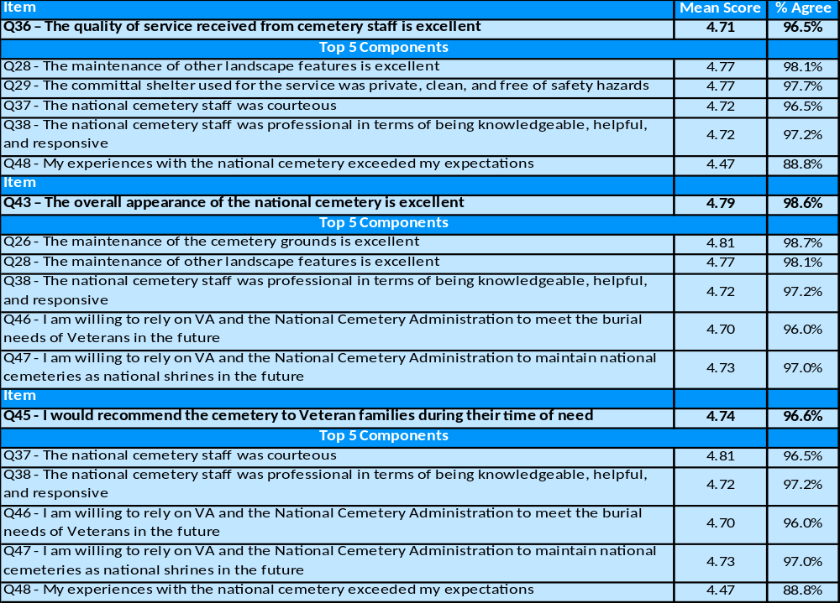
Strategic Performance Measure Components – Funeral Directors
We performed a regression analysis that calculated the strength of the relationship between each Strategic Performance Measure and the items of interest. The tables below present each Strategic Performance Measure and the measures that are key components of each respective score.
34

Slide 35
Conclusions/recommendations
35

Slide 36
Conclusions/Recommendations - I
In 2015, National Cemetery respondents indicated 99% agreement that the overall appearance of their national cemeteries was excellent, meeting the NCA target goal for this strategic performance measure.
Agreement that quality of service was excellent, and likelihood of recommending were high, although slightly below target goals (98% agreement for both)
  Overall, respondents are satisfied with their experience (98% across all respondents)
  There was little difference between Next of Kin and Funeral Directors ratings
  Overall, District scores have remained stagnant over the past three years, with only one significant change from 2014 to 2015 (Pacific District significant increase in agreement that appearance was excellent).
  In 2015, the percentage of cemeteries that met or exceeded the target goals for Appearance and Recommend fell. However, this decrease was not significant, and it should be noted that in 2015, responses from more cemeteries were received (99 in 2015 vs. 71 in 2014) impacting these percentages. The actual number of cemeteries meeting or exceeding the target goals increased.
36

Slide 37
Conclusions/Recommendations - II
  A key driver of the strategic performance measures and overall satisfaction for both Next of Kin and Funeral Directors was perceptions that expectations had been exceeded.
  Recommendation 1 (R1) – Consider adding questions that specifically evaluate where the national cemetery met and did not meet expectations.
  When expectations were exceeded, agreement on overall satisfaction and strategic performance measures ranged from 15%-39% higher (see slide 20 for specifics)
  Influencing expectations was the extent to which respondents felt informed about the process. Viewing the NCA video on the committal service had a significant impact on Next of Kin perceptions of being informed. However, only 5 percent of Next of Kin indicated that they had seen the video.
    Recommendation 2 (R2) - Encourage Funeral Directors to show NCA Videos to Next of Kin
  Funeral Directors that indicated they were somewhat well informed, or not well informed were less likely to indicate that they received their information from cemetery staff, and could use more information about the scheduling process.
    Recommendation 3 (R3) – (R3a) Increase Funeral Director access to cemetery staff or increase outreach; and (R3b) examine the modes of communication adopted by NCA to communicate with Funeral Directors and whether it matches the preferred mode of choice - email.
37

Slide 38
Conclusions/Recommendations - III
Measures that relate to overall satisfaction are similar across respondent type, but improvement focus is different
  Relationships with overall satisfaction theme toward staff service (e.g., courteous, professionalism, responsive) and appearance (e.g., maintenance of headstones/gravesite, cemetery appearance)
  Recommendation 4 (R4) - Improving quality of service
    Specifically, resources and improvement efforts should focus on (R4a) expanding hours of operation, and (R4b) gravesite/columbaria appearance
    (R4c) Examine relationships between quality of service and the All-Employee Survey (AES) results at the cemetery level (where possible).
  Recommendation 5 (R5) - Improving staff professionalism, courtesy, and knowledge
    (R5a) Assess whether there are any knowledge gaps among staff (specifically those that interact most frequently with Funeral Directors), and (R5b) responsiveness to customer requests
38

Slide 39
Discussion/Questions?
39

