Slide 1


BARRANCAS NATIONAL CEMETERY
SITE VISIT
PHASE I, PRE-PROPOSAL CONFERENCE
PENSACOLA, FLORIDA
PROJECT # 828CM2036
JULY 12, 2016
IAS
Notes:
I would like to welcome all of you to this Pre-proposal Conference regarding RFP VA101-16-R- 0142, entitled, Barrancas National Cemetery
Please be sure that everyone has signed-in
Hold all questions to the end

Slide 2
Agenda
Opening Remarks – Housekeeping items
New Acquisition: VA101-16-R-0142
Submission Requirements
Milestones
Project Scope and Overview
Question & Answer Session
Site Visit
Notes:
I would like to make clear that anything said should not be interpreted as a change to the solicitation/contract documents as posted. If a statement is made that is inconsistent with the solicitation requirements, you should not submit your proposal based on the statements, only submit based on the posted solicitation and all amendments.

Slide 3
Opening Remarks
Introductions
  VA Representatives
    VA CFM: Crystal Cole, Contracting Officer
    VA CFM: Bryan Bodner, Project Manager
    VA CFM: Bill Peach, Director of Project Delivery
    VA CFM: Glenn Elliott, Environmental Engineer
    NCA: Craig LaChance, Barrancas Cemetery Director

Slide 4
New Acquisition Requirements
VA101-16-R-0142
  Pre-Solicitation Notice: February 26, 2016
Federal , State, and Local Tax (FAR Clause 52.229-3)
  Is the Responsibility of the Contractor
OSHA & VA Requirement (Construction Safety Course)
  Competent Person (supervisor) 30 Hours
  All other employees 10 Hours
Notes:
All Proposal documents are posted and will be posted at www.fbo.gov under the RFP #

Slide 5
New Acquisition Requirements
Anticipated Cost Range
  Between $20,000,000 - $50,000,000
Proposal Due Date
  August 9, 2016 at 4:30 P.M. Eastern Standard Time
Notes:
1. RFP due date see Block 8 of the SF 1442 for the location

Slide 6
New Acquisition Requirements
Bid Bond/Bid Guarantee (SF 24)
  20% of the offer price but shall not exceed $3,000,000
  NAME OF PRINCIPAL IDENTICAL WITH NAME ON CONTRACT OR BID
  Make sure you are in compliance with Far Part 28
Annual Representation and Certification
Central Contractor Registration (CCR)
  http://www.sam.gov
  Must be registered in SAM and VetBiz prior to award
Davis Bacon Act (Applies)
Buy American Act (Applies)
Notes:
DBA – Heavy & Hwy is for Backhoe; Bulldozer; Grader; Mechanics; Paver
Must be registered in SAM and VetBiz prior to Award

Slide 7
New Acquisition Requirements
Completion Time
  1,450 Calendar days after Notice to Proceed for completion of final D/B scope.
  730 Calendar days after Notice to Proceed for completion of Early Turn Over scope.
Bonds (within 10 calendar days after award)
  Performance Bond 100%
  Payment Bond 100%
  NAME OF PRINCIPAL IDENTICAL WITH NAME ON CONTRACT OR BID
Liquidated Damages
  $3,230.68 for each calendar day of delay

Slide 8
New Acquisition Requirements
Insurance
  General Liability required prior to commencing work
Questions & Answers (RFI’s)
  Questions Due: July 19, 2016, by 4:30PM EST
  Answers Posted: July 26, 2016
  Email:
    Crystal.Cole2@va.gov
    The email subject line to read
    “RFI for Barrancas National Cemetery VA101-16-R-0142” – Company Name

Slide 9
Service-Disabled
Veteran-Owned Small Business
Office of Small and Disadvantaged Business Utilization (OSDBU) Washington, D.C.
    Point Of Contact: Mark Taylor (202)632-5514
    www.va.gov/osdbu/
  Joint Ventures (See IL 049-06-4)
  Teaming Agreement
Notes:
JV for VA is a SDVOSB joining with another SB
JV/TA/MPP must be submitted w/proposal

Slide 10
Submission Requirements
1 SF 1442 (pages 1 - 4)
2 Amendments
3 Bid Guarantee/Bid Bond
4 Volume I – Technical Proposal ( Phase I)
    No cost information in Technical proposal
    Spiral bound Technical proposal (no 3-ring binders)
    Organize your proposal in accordance with Section D. Phase I – Request for Qualifications and special clause 4.34 of the RFP
    Mail: One (1) Sealed Original and Four (4) copies
    Email: One (1) PDF and Four (4) copies

Slide 11
Submission Requirements
Volume I – Technical Qualifications (Phase I)
      1) Past Performance 2) Specialized Experience
      3) Capability to Perform
      DO NOT PUT ANY PRICING INFORMATION IN VOLUME I
Volume II – Cost Proposal
    Only one original copy
    Include any JV, Agreements, Reps and Certs and Bonds
    Submit Volumes I & II on a Compact Disc (excel, pdf and word format only)
6 Others Documents
    Representations and Certification completed in SAM
    Joint Venture (registered in Vetbiz prior to proposal submission); Teaming Agreement; Mentor-Protégé Program

Slide 12
Milestones
1 Pre-Solicitation Notice February 26, 2016
2 Issue 2-Phased RFP/Solicitation (Phase 1) June 30, 2016
3 Phase I Pre-Proposal Conference (Site Visit) July 12, 2016
4 Request for Information (RFIs) Deadline July 19, 2016
5 Phase I Proposal Received August 9, 2016
6 Establish Competitive Range (maximum of 5) September 9, 2016
7 Issue Phase II RFP & Documents to Competitive September 12, 2016
Range Offerors
8 Phase II Pre-Proposal Conference September 26, 2016
9 Phase II Proposals Received October 12, 2016
10 Technical Evaluation of Proposals November 11, 2016
11 QA & OGC Review December 12, 2016
12 Contract award January 7, 2017
13 Notice to Proceed February 7, 2017
14 Construction Completion/Final Inspection January 27, 2021

Slide 13
VAAR 809-406-2
Cause for debarment
Misrepresentation of SDVOSB eligibility may result in action taken by VA officials to debar the business concern for a period not to exceed 5 years from contracting with VA as a prime contractor or subcontractor.
Any deliberate violation of the limitation on subcontracting clause requirements for acquisitions under subpart 819.70 may result in action taken by VA officials to debar any service-disabled veteran-owned, veteran-owned small business concern or any large business concern involved in such action.

Slide 14
Project Scope & Overview
Bryan Bodner
CFM Project Manager

Slide 15
Project Overview
Scope and Elements
Expansion Area
Update Master Plan
Interments
  8.150 pre-placed crypts
  350 traditional gravesites
  4,500 columbarium niches
Memorial Wall & Ossuary
Access Roads and Parking
Grading, Drainage, Landscaping
Site Furnishings & Signage
Public Assembly Area
Memorial Walkway
Irrigation
  Evaluate alternative water source
Habitat/Wetlands preservation & mitigation
GPS Site Integration
Existing Cemetery (new and old)
Update Master Plan
Evaluate/Repair Storm Drainage
Renovate new Maintenance Facility
Corrections to Admin Building
Additional Cortege Lane
Expand and Pave Gravel Road
Repairs and upgrades to Historic Maintenance Facility
Modify Irrigation System
Evaluate facilities and retrofit for LEED & Renewable Energy
Upgrade Facility Security Standards
Facility Condition Assessment Deficiencies Corrections

Slide 16
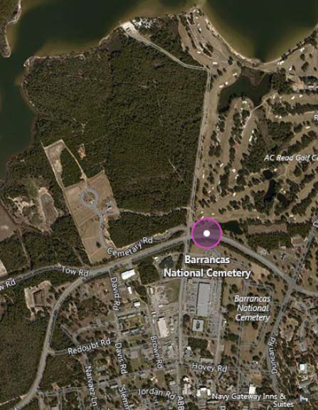
Site Location

Slide 17
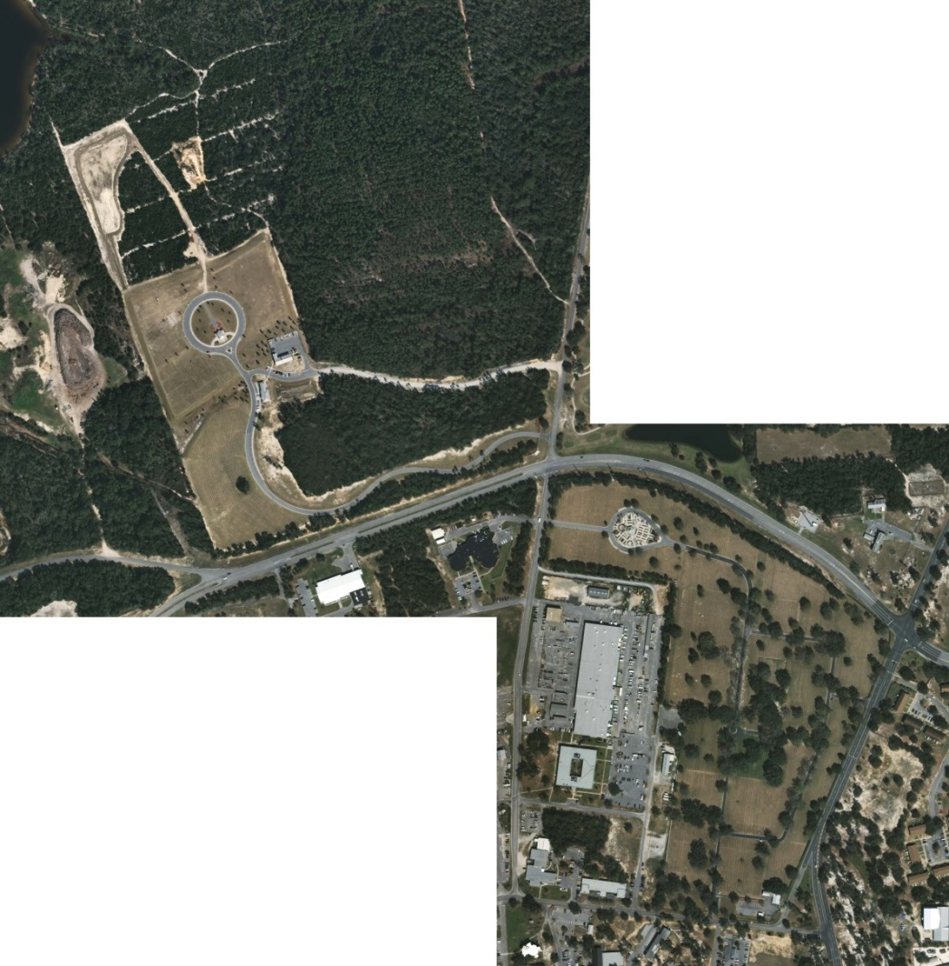
Aerial Photo

Slide 18
Project Logistics
Bryan Bodner
CFM Project Manager

Slide 19
Project Logistics
─ Approximately 15 acres developed
─ Post Award Conference / NTP February 2017
─ Early Turnover Over 730 days after NTP
─ Project completion 1450 calendar days from NTP
─ Resident Engineer is ACO/QA

Slide 20
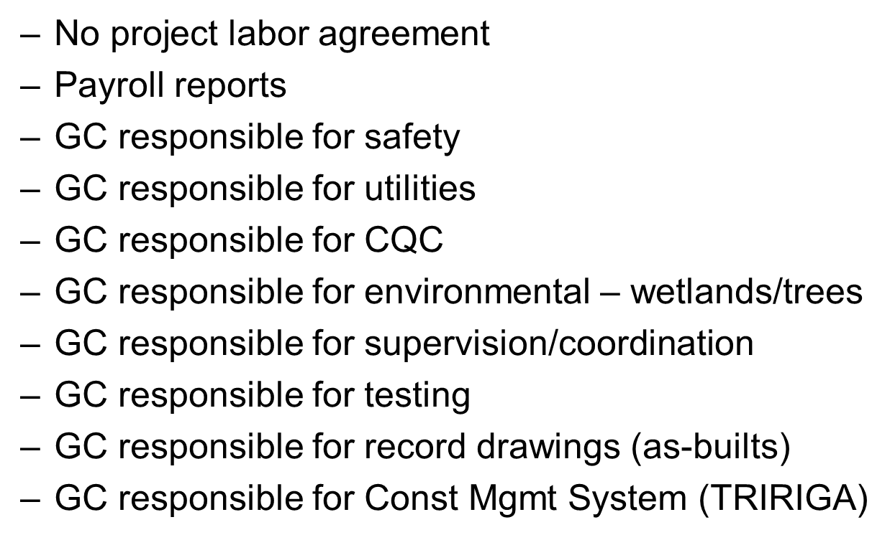
Project Logistics (cont’d)

Slide 21
Questions & Answers
Notes:
Identify yourself & company

