Slide 1

Community Care Network Webinar

Slide 2
Agenda
Welcome and Overview
Changes Made After Industry Comment
Additional Enhancements
Timeline Update
Questions

Slide 3
Overview

Slide 4
Our Goal for VA Community Care
Deliver a program that is easy to understand, simple to administer, and meets the needs of Veterans, community providers, and VA Staff.

Slide 5
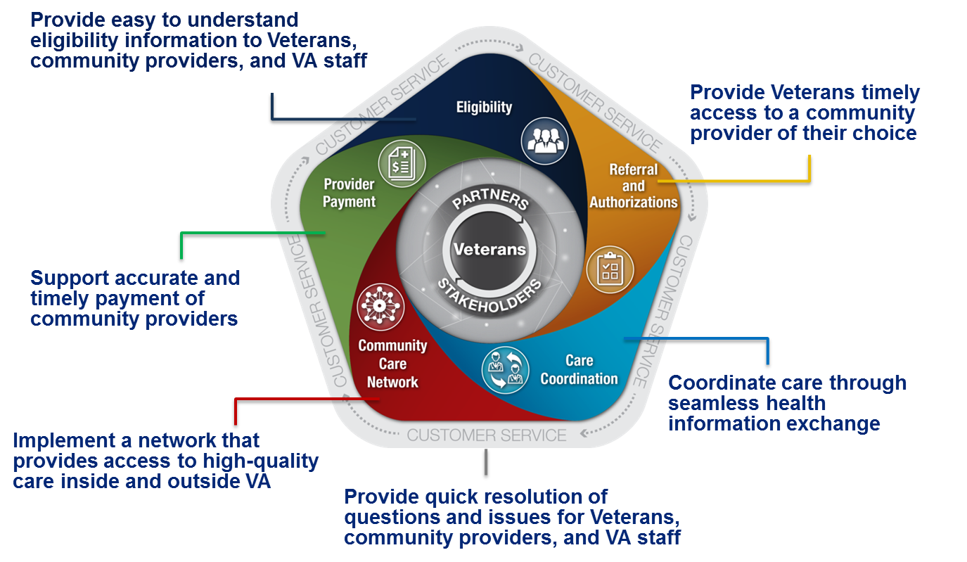
Five Key Components Impact the Veteran Community Care Journey

Slide 6
How Will We Get There?
By leveraging both VA and community provider networks.
VA sought and received industry input and designed a program that meets our goal for VA Community Care.
The Performance Work Statement (PWS) will outline the requirements for the Community Care Network (CCN).

Slide 7
Community Care Network PWS Overview
VA
Contractor
Both
Optional
Part 1
Community Care Network
Part 2
Veterans We Serve
Part 3
Access to
Community Care
Part 4
Care Coordination
Part 5
Provider Payment
Section 3.0
High Performing Network
Section 4.0
Health Benefit Package
Sections 7.2 & 7.3
Referrals
Section 8.0
Scheduling of Appointments
Section 12.0
Claims Processing
Sections 3.1 & 3.6
Network Adequacy
Section 5.1
Eligibility Data
Section 7.4
Prior Authorizations
Section 11.1
Discharge Planning
Invoicing
Section 14.0
Clinical Quality Monitoring
Section 5.2
Enrollment
Section 9.0
Medical Documentation
Section 11.3
Disease Management
Section 12.9
Claims Auditing
Sections 3.2 & 3.3
Provider Networks
Section 6.1
Contractor Call Center to Support VA
Section 10.0
Training
Section 11.2
Case Management
Section 12.9
Fraud and Abuse
Section 3.7
Network Credentialing
Section 12.9
Improper Payment
Section 6.2
Provider Call Center Support
Part 6: Section 18.0 Technology Section 19.0 Data Analytics
Veteran Customer Service

Slide 8
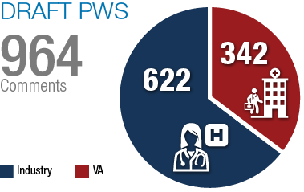
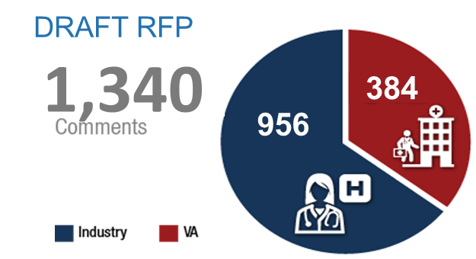
Engaging VA and Industry
Response to Draft PWS / RFP
Drafts were posted in February (PWS) and April (RFP).
February feedback was considered prior to VA issuing the April version.
2,304
Total Comments
February Draft PWS
April Draft RFP

Slide 9
Major Changes Made After Industry Comment on April’s Draft RFP

Slide 10
Major Changes Made
PWS Section | Description of Changes Made
Medical Management | Added a section to address additional services supporting care coordination i.e., follow-up on appointments, medical documentation return, and open referrals that have not had a claim submitted.
Technology | Improved the technical requirements by defining specific data transfer requirements. New requirements include: Reporting data definitions Models described through attachments Standardization
Network Adequacy | Updated the network adequacy standards to separate requirements for complementary and integrative health services. Adjusted the primary drive time, and urgent and emergent appointment availability requirements for complementary and integrative health services.
High Performing Providers | Modified requirements to better define the intentions and desires for having high performing providers.

Slide 11
Major Changes Made (continued)
PWS Section | Description of Changes Made
Health Benefit Package | Clarified the benefits under Complementary and Integrative Health Services Network
Eligibility and Enrollment | Clarified processes for exchanging eligibility information between the contractor and VA.
Customer Service | Clarified language for online services requirements. Adjusted operating hours. Provided historical data around call volume, grievances, and inquiries to include in RFP.
Dental | Adjusted requirements for dental provider participation .

Slide 12
Additional Enhancements

Slide 13

Scheduling
Approach: VA will participate in schedule management
We heard from Veterans and stakeholders who desire improved coordination of Veteran medical care.
Approach allows VA to partner with Veterans in both scheduling and managing care, whether provided internally or externally.
VA will empower Veterans by providing options to self-schedule.
To address industry’s feedback, VA will provide the Contractor with all available appointment information associated with the referral for each appointment scheduled by VA.

Slide 14

Customer Service
Approach: VA internal management
We heard from Veterans and stakeholders who believe VA is the best single point of contact for Veteran medical eligibility, questions, and care management.
With VA providing customer service, we can provide faster resolution of questions and issues for Veterans and VA staff.
To address industry feedback, adjustments were made to only require the Contractor to provide:
  Tier 2 support to the VA Customer Call Center, and
  Customer support to the CCN providers in their networks.

Slide 15

Referral and Prior Authorization
Approach: VA internal management
VA is the owner of eligibility determination and the best capable of providing a consistent referral approach to Veterans, internally or in the community.
VA will manage all Veteran touchpoints, partnering with Veterans, through streamlined and standardized referral and authorization (R&A) processes.
To address industry feedback,
  VA will provide the Contractor with all available applicable R&A information,
  VA and Contractor will conduct monthly reporting to ensure delivery of all R&A information, and
  All data will be communicated via a data exchange platform. IT integration is not required.

Slide 16
Timeline Update
Q3 FY2016
  Conduct Industry Webinar
  Complete PWS Updates
Q1 FY2017
  Release RFP on FedBizOpps

Slide 17
Questions?

