Slide 1
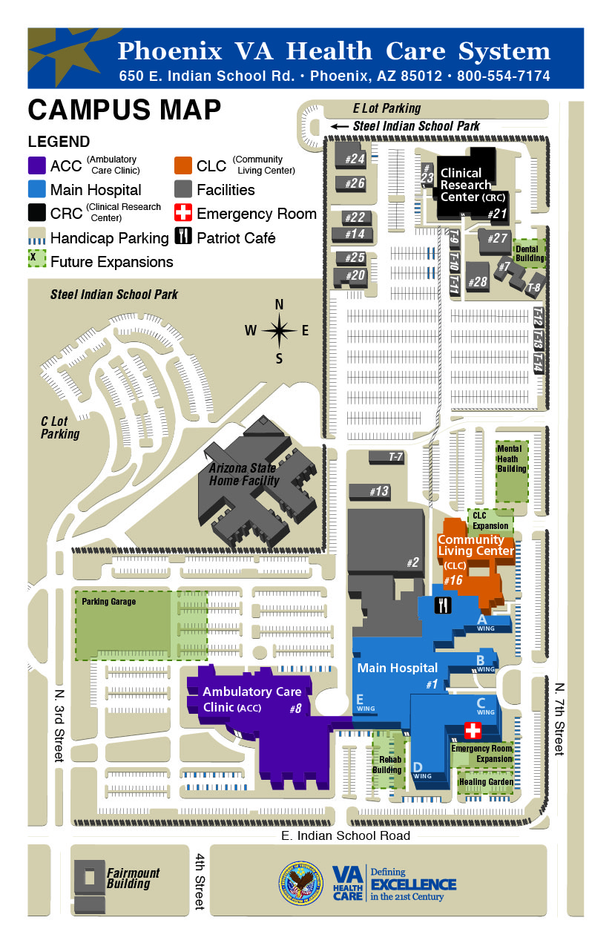
total
E lot
123
Old parking lot #
1
3
28
68
12
10
17
50
Row total
64
2
1
5
42
Handicap
14
7
5
50
8
5
50
Motorcycle (not counted in total)
7
20
94
4
26
26
88
TOTAL
385
122
137
223
89
345
184
94
68
42
? (156)
1,843
45
-5
36
C lot
230
40
50
345
36
184
50
284
36
127
50
36
6
50
34
-5
39
21
?
156
22
1,768
15
19
11
6
30
12
15
17
17
14
18
Lot 6
89
Lot 4
385
34
38
3
17
Lot 4
122
34
38
8
38
20
34
34
13
32
17
34
6
17
3
12
15
16
Lot 4
137
17
13
30
32
29
34
16
9
42
16
16
6
25
38
Lot 5
223

