Slide 1
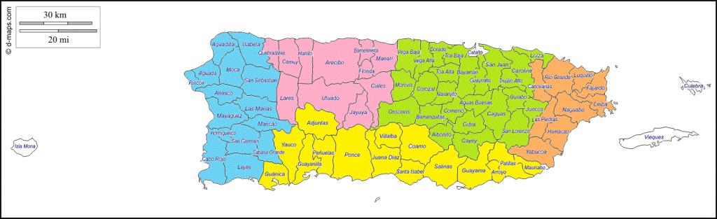
VA Caribbean Healthcare System
Ambulances Service Areas (Catchment areas)
North Area
East Area
South Area
West Area
San Juan/Metro/Central Area

