Slide 1

Community Care Network
Pre-Proposal Conference
January 9, 2017

Slide 2
Introduction
Veterans Health Administration (VHA)
Denver Acquisition & Logistic Center (DALC)
Points of Contact
  Contracting is the sole point of contact for this procurement
  Email: laura.arscott@va.gov or david.little@va.gov
Contracting Staff
  David Little, Contracting Officer
  Laura Arscott, Alternate Contracting Officer
Purpose of Pre-proposal Conference

Slide 3
SF 1449 & Important Dates
Proposals are due by 5:00 PM MT on 3/1/2017
Questions are due on January 17, 2017 by close of business.
Include any questions generated from this pre-proposal conference
Acknowledge amendments
Sign your offer – complete boxes 30a – 30c.

Slide 4
Schedule of Services – Section A.2
Sets forth the amount VA pays for services
4 Regional Pricing Schedules - Contract Line Item Numbers (CLINs):
  CLIN XXX1 Healthcare Services
  CLIN XXX2 Reimbursement for Highly Rural Areas
  CLIN XXX3 Urgent/Emergent Durable Medical Equipment
  CLIN XXX4 Home Health – skilled and unskilled
  CLIN XXX5 Seasonal Influenza Vaccination
  CLIN XXX6 Non-Medicare Healthcare Services – VA Fee Schedule
  CLIN XXX7 Non-Medicare, Non-Fee Schedule Healthcare Services
  CLIN XXX8 Home Infusion Therapy
  CLIN XXX9 Urgent and Emergent Medication
  CLIN XX10 Dental Services
  CLIN XX11 Administrative Services
  CLIN XX12 Medical Administrative Management Fees
  CLIN XX13 Implementation
  CLIN XX14 Eyeglasses
  CLIN XX15 Data

Slide 5
RFP Section B
Awardees must complete a Business Associate Agreement IAW VHA Directive 1605.05. Don’t submit this with your proposal.
IT Contract Security – FISMA High
Data Rights
Small Business Subcontracting and Commitments
Term of Contract:
  Base period will last up to one year and end on September 30 of the fiscal year the contracts are awarded
  VA will have the ability to exercise 7 one-year option periods
  Option to Extend (52.217-8)
  Continuity period
Performance Incentives
Ordering and Invoicing

Slide 6
Performance Work Statement – B.16 (continued)
Kickoff Meetings – Section 2.0
  Contractor presents its project management plan
Implementation Strategy – Section 2.2.1
  Achieve full healthcare delivery within 12 months
Various Deliverables - Section 2.0 and 20.4
  Contractors will be required to submit various deliverables regarding implementation and deployment activities within 15, 30 and 90 days after the kickoff meeting
  Accreditation - Section 2.6
  The CCN must always be accredited by a nationally recognized accrediting organization for the healthcare services that are within scope of an accreditation
  High Performing Network, Section 3.0
  Adequacy will be constantly monitored - drive time and appointment availability

Slide 7
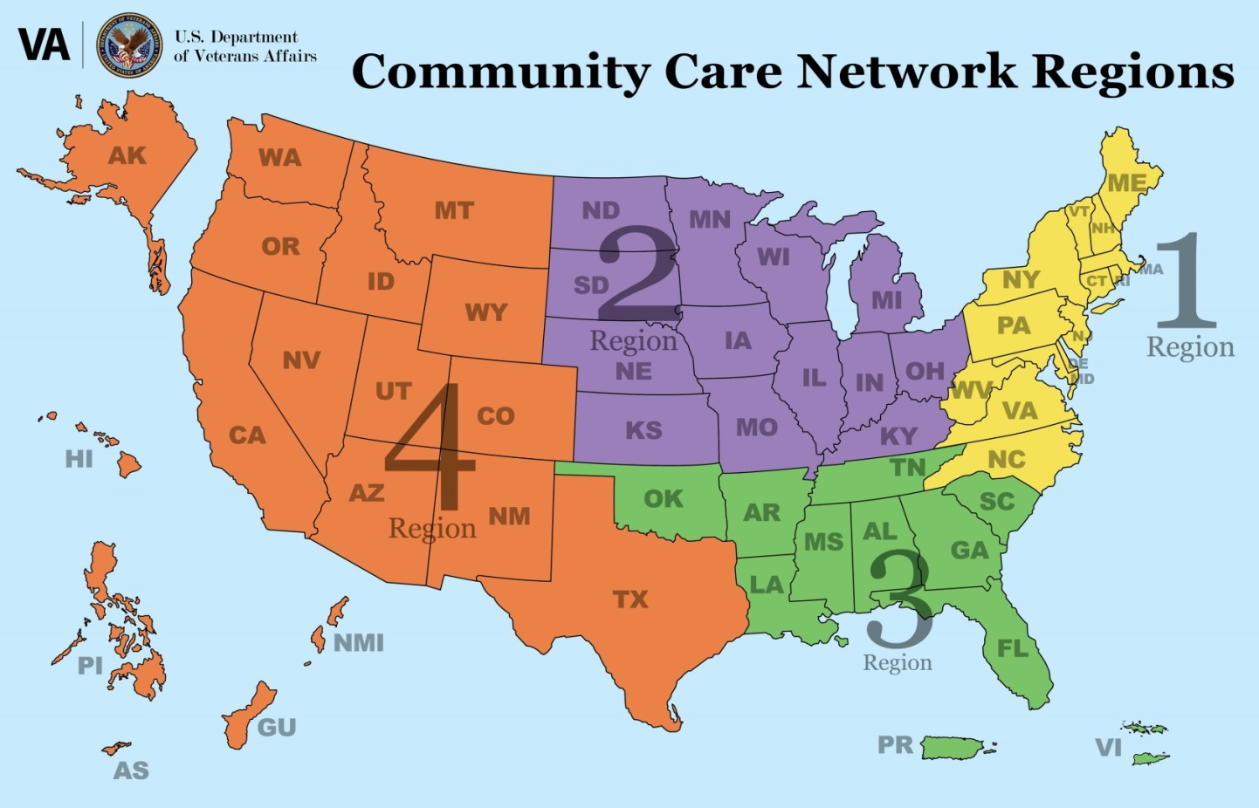
Performance Work Statement – B.16 (continued)
CCN Regions – Section 3.5
Regions divided by state boundaries
Region boundaries established by:
  volume of veterans enrolled in VA system
  number of Community Care referrals in FY15 by state

Slide 8
Performance Work Statement – B.16 (continued)
Credentialing – Section 3.7
  The Contractor must always confirm that CCN Healthcare Services Network providers and facilities are credentialed in accordance with the requirements set forth by the nationally recognized accrediting organization for the Contractor’s credentialing program unless the accrediting organization’s standards are not applicable to such services, facilities and providers

Slide 9
  Performance Work Statement – B.16 (continued)
CCN Healthcare Services – Sections 4.1 & 4.2
Health Benefits Included for all Eligible Veterans
Preventive Care | Outpatient Diagnostic and Treatment Services (including laboratory services)
Comprehensive Rehabilitative Services | Inpatient Diagnostic and Treatment Services
Hospital Services | Long Term Acute Care
Ancillary Services | Acupuncture
Mental Health (to include professional counseling) | Maternity and Women’s Health
Residential Care | Telehealth
Home Healthcare (Skilled and Unskilled) | Hospice/Palliative Care/Respite
Geriatrics (Non-institutional extended care services, including but not limited to non-institutional geriatric evaluation, non-institutional adult day health care, and non-institutional respite care)

Slide 10
Performance Work Statement – B.16 (continued)
Health Benefits Included Under Special Authority
Skilled Nursing Facility Care | Immunizations
Pharmacy | Implants
Dental | Urgent Care
Emergent Care | Implants
DME, Medical Devices, Orthotic, and Prosthetic Items | Reconstructive Surgery
Biofeedback | Massage Therapy
Hypnotherapy | Native American Healing
Relaxation Techniques (e.g., meditation, guided imagery) | Tai Chi

Slide 11
Performance Work Statement – B.16 (continued)
  Eligibility Data – Section 5.0
  The Contractor must always confirm eligibility for all Veterans who receive community care based on data received from VA
  Receive, process, and store eligibility data and ongoing updates from VA
Customer Service – Section 6.0
  Answer inquiries from VA (VA Community Contact Center Staff)
  Answer inquiries from CCN Providers
  Online services
  7AM – 7 PM
Veteran Complaints and Grievances – Section 6.5
Congressional and VA Inquiries – Section 6.6
Referrals and Prior Authorization – Section 7.0
  All healthcare services require an “Approved Referral” from VA
  Attachment I, “Prior Authorization List,” is a list of all medical services and procedures that require providers to request Prior Authorization from VA
  Attachment IA, “Dental Service Prior Authorization Exception List” contains a listing of services that are approved without additional requests for authorization.

Slide 12
Performance Work Statement – B.16 (continued)
Referral process – Section 7.2 and 7.3
  VA will send Approved Referrals directly to CCN Providers and a copy to the Contractor
  CCN Providers may create Referral Requests for VA to approve or deny
  Exceptions are listed in Section 4.1.1 and exclusions are listed in 4.3
Scheduling of Appointments – Section 8.0
  The Contractor is not responsible for scheduling appointments for Veterans
  VHA staff will schedule with/for or assist Veterans in scheduling appointments
Medical Documentation – Section 9.0
  Medical documentation will go directly from the CCN Provider to VA
  Content – Section 9.2
  Submission timeframes – typically 30 days
  Electronic submission
  The Contractor assists with escalation when VA cannot obtain directly from the CCN Provider
  Critical findings (CCN Provider communicates to Veteran, referring providers and VA directly)

Slide 13
Performance Work Statement – B.16 (continued)
Training – Section 10.0
Medical Administrative Management – Section 11.0 Optional tasks
  Care coordination follow-up
  Comprehensive case management
  Comprehensive disease management
Claims Processing – Section 12.0
  Minimum data requirements via 837 COB – Section 12.1
  Claims processing data dictionary – Section 12.1.1
  Claims submission and processing timeframe – Section 12.4
Veteran Claim Appeals and Provider Reconsideration – Section 13.0
Clinical Quality Monitoring – Section 14.0
Pharmacy – Section 15.0
  Retail pharmacy networks
  CCN prescriptions and VA prescriptions
  VA Urgent/Emergent Drug Formulary (Attachment M)

Slide 14
Performance Work Statement – B.16 (continued)
Durable Medical Equipment – Section 16.0
  Contractor must provide urgent/emergent DME
  CCN providers must submit prescriptions for routine DME to VA for fulfillment
Eyeglasses – Section 16.3
  CCN network must include eyeglass capability with retail locations available for Veterans
Dental – Section 17.0
  Minimum requirements for adequacy based on drive time and appointment availability

Slide 15
Performance Work Statement – B.16 (continued)
Technology – Section 18.0
  The Contractor must provide VA with real-time, read-only access to the Contractor’s system(s) that provide the functionalities required under this contract.
  The Contractor is required to integrate with VA’s Data Access Service (DAS) to provide a standard interface for data access and storage of structured and unstructured data.
  VA will establish a Community Care Provider Portal that will allow the CCN provider to view a Veteran’s EHR as well as the capability to exchange data/documentation between VA and CCN providers.
  The Contractor must provide a secure, role-based website/portal for Veterans, CCN providers, and VA Personnel. This Contractor-provided portal will be separate and unique from the provider portal to be established by VA.
  The Contractor must always ensure that CCN Healthcare Services Network Providers and CCN CIHS Network practitioners submit medical documentation to VA using Direct Messaging or eHealth Exchange, or if not available through the Community Provider Portal, or other accepted modalities.
  The Contractor must always submit a weekly OHI Report through DAS.
  The Contractor must create and deliver a Network Provider File and submit to the VA.
  VA will provide to the Contractor a detailed VA provider data file weekly through DAS. The Contractor must maintain a process to integrate the VA provider data into their systems.

Slide 16
Performance Work Statement – B.16 (continued)
Data Analytics – Section 19.0
  VA will provide you with a detailed data specification within 30 days of award.
  VA will provide you with a database within 30 days of award.
  Your Interactive Dashboard will be derived from the database VA provides. VA will provide you with the report format for the dashboard.
  VA will provide you with the method of access to the DAS system, your ETL’s will be provided according to the detailed data specification we provide you under 19.1.
Deliverables – Section 20.0

Slide 17
Contract Clauses – Section C
Commercial Service Contract
Single Award Indefinite-Delivery Indefinite-Quantity contract(s)
  Services are ordered through Approved Referrals or Task Orders
  C.7 Order Limitations
  C.23 Contract Minimum and Maximum Dollar Value
    Maximum total contract value varies per region
    Minimum guaranteed amount $10,000,000 per region
Small Business Subcontracting Plan
Indemnification and Medical Liability Insurance – C.18
Guaranteed Minimum – C.23
  $10,000,000 per region
Attachments – Section D

Slide 18
Solicitation Provisions – Section E Instructions to Offerors
E.1 Instructions to Offerors – tailored paragraphs (c), (f) and (g)
E.4 Specific Instructions to Offerors
  Provides instructions for proposal submission
  Separate Business and Technical Volumes
  System for Award Management (SAM) https://governmentcontractorregistration.org/register-now

Slide 19
Solicitation Provisions – Section E Evaluation
E.5 Evaluation – Tradeoff process
Four factors – Technical, Past Performance, Socioeconomic Concerns and Price
  Relative importance
Award Limitations – no more than four contracts
Solicitation attachments – 5 total
Exchanges – VA reserves the right to conduct exchanges IAW VAAR 873.114
Best Value Pool
SBA All Small Mentor-Protégé Program
  VA discontinued its program and will rely on SBA’s All Small Mentor-Protégé Program for this procurement
  VA’s VIP database – use it to search for Veteran-Owned companies (www.vip.vetbiz.gov)

Slide 20
THANK YOU
Questions due January 17, 2017 close of business
  VA will use its discretion in considering questions submitted after this date
Proposals due March 1, 2017, 5:00 PM Mountain Time
Contact information: laura.arscott@va.gov or david.little@va.gov
Please continue to watch FBO.gov for amendments.

