Slide 1

NCO 12
Great Lakes Acquisition Center
Pre-Proposal Conference
VA69D-17-B-0053
Project 550-13-116
Station Wide Roads, Curbs, Gutter, and Drainage Removal and Replacement
January 13, 2017 at 1:00pm CST
Agenda
Sign-In Sheet
Introduction
Solicitation information
Questions and RFIs
Instructions to Offerors
Site visit

Slide 2
Introductions
Great Lakes Acquisition Center (GLAC)
Isabell Coad – Contract Specialist (CS)
isabell.coad@va.gov
224-610-3646
Jeff Gerbensky – Contracting Officer (CO)
Constantine Hanna – Contract Officer’s Representative (COR)

Slide 3
Solicitation Information
Solicitation VA69D-17-B-0053
Project # 550-13-116
Station Wide Roads, Curbs, Gutter, and Drainage Removal and Replacement
100% SDVOSB Set Aside

Slide 4
Solicitation Information
NCO 12
Great Lakes Acquisition Center
This solicitation follows FAR Part 14, Sealed Bidding
Award will be made to the lowest priced, responsive, responsible offeror.
A contract will be awarded to an Offeror who is deemed responsive and responsible in accordance with FAR Part 9 and whose bid conforms to the IFB’s requirements (to include all stated terms, conditions, representations, and certifications).
There will be a public bid opening on January 31, 2017 at 2pm CST at:
Captain James A. Lovell Federal Health Care Center (FHCC)
Great Lakes Acquisition Center (GLAC/NCO12)
3001 Green Bay Road
Building 1, 3rd Floor, Room 328 (Conference Room)
North Chicago, IL 60064

Slide 5
Questions/RFIs
NCO 12
Great Lakes Acquisition Center
There will be no questions allowed today.
If you have any questions regarding this project you have to submit an RFI form and email it to me. This is to allow everyone interested in bidding to be able to receive the questions and responses. All questions must be submitted via email on RFI forms and received by me, Isabell Coad at isabell.coad@va.gov no later than January 18, 2017 at 2:00pm CST.
All RFI questions received along with responses will be posted on FBO as an amendment to the solicitation no later than January 23, 2017.

Slide 6
Instructions to Offerors
NCO 12
Great Lakes Acquisition Center
Submission Instructions
  Offerors must submit one copy of their bid along with the bid bond no later than January 31, 2017 at 2pm CST to:
  Capt. James A. Lovell Federal Health Care Center
  Great Lakes Acquisition Center (GLAC/NCO12)
  Attention: Isabell Coad
  3001 Green Bay Road
  Building 1, 3rd Floor, Room 329
  North Chicago, IL 60064
  If attending in person: Room 328 (Conference Room)
  Faxed or emailed bids are NOT permitted and will not be accepted.
  If the bid is late, it will be left unopened and not considered.

Slide 7
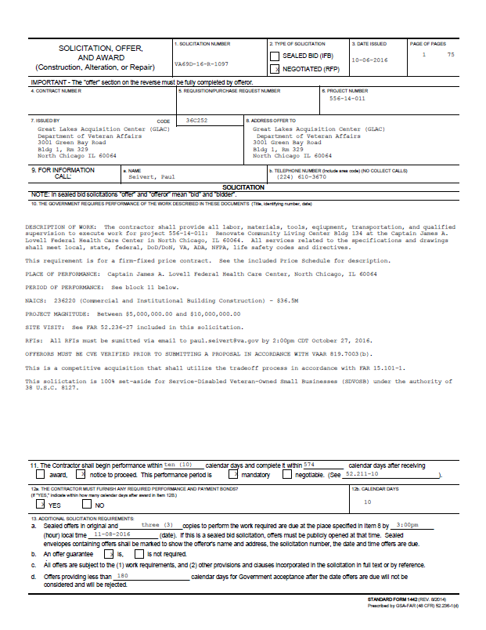
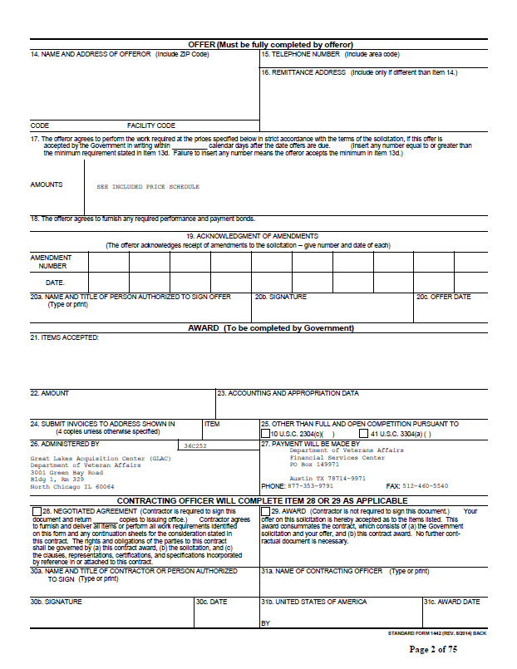
Instructions to Offerors
NCO 12
Great Lakes Acquisition Center
  Completed SF 1442 and all attached forms

Slide 8
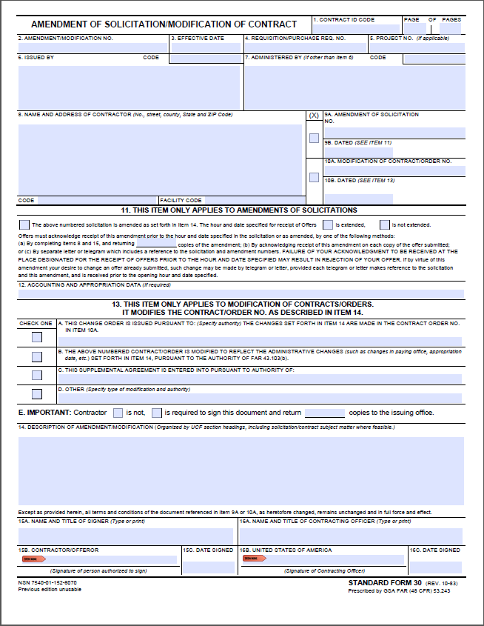
Instructions to Offerors
NCO 12
Great Lakes Acquisition Center
  Acknowledgment of any Amendments

Slide 9
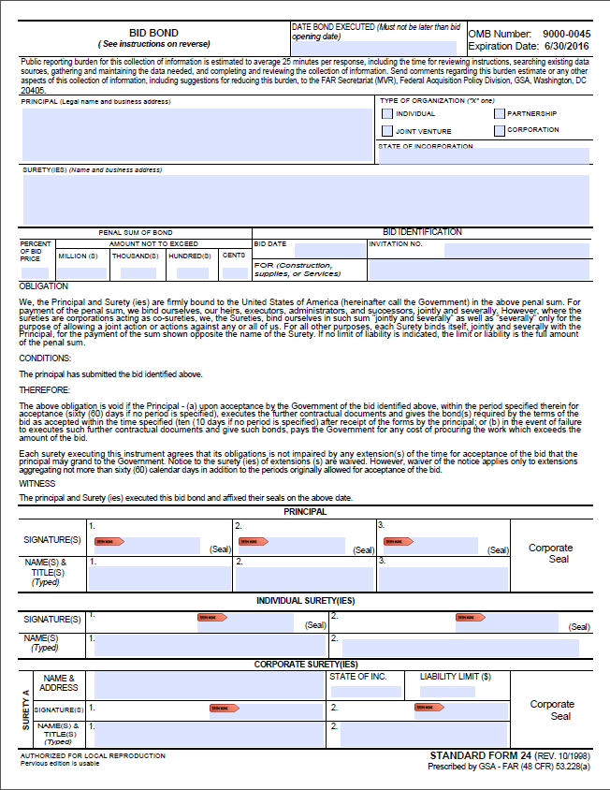
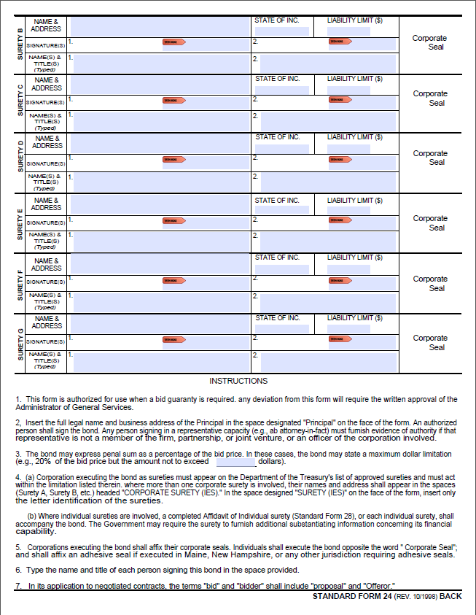
Instructions to Offerors
NCO 12
Great Lakes Acquisition Center
  Surety Bid Bond

Slide 10
Important Dates
NCO 12
Great Lakes Acquisition Center
RFIs Due – January 18, 2017 at 2:00pm CST
Public Bid Opening – January 31, 2017 at 2:00pm CST
Estimated Award date - February 23, 2017

Slide 11
Site Visit
Mr. Constantine Hanna will lead us on the site visit/walk-through.
Please stay in the group and do not walk off.
Questions are only allowed in writing on an RFI form. Please do not ask the COR any questions during the walk-through.

Slide 12
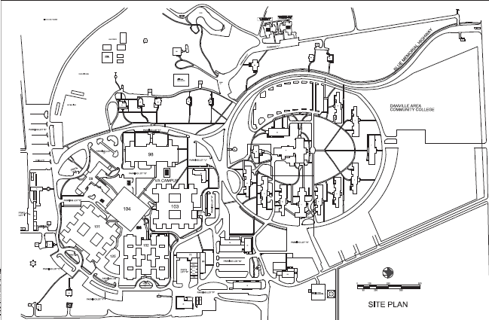
Site Visit
NCO 12
Great Lakes Acquisition Center

