Slide 1
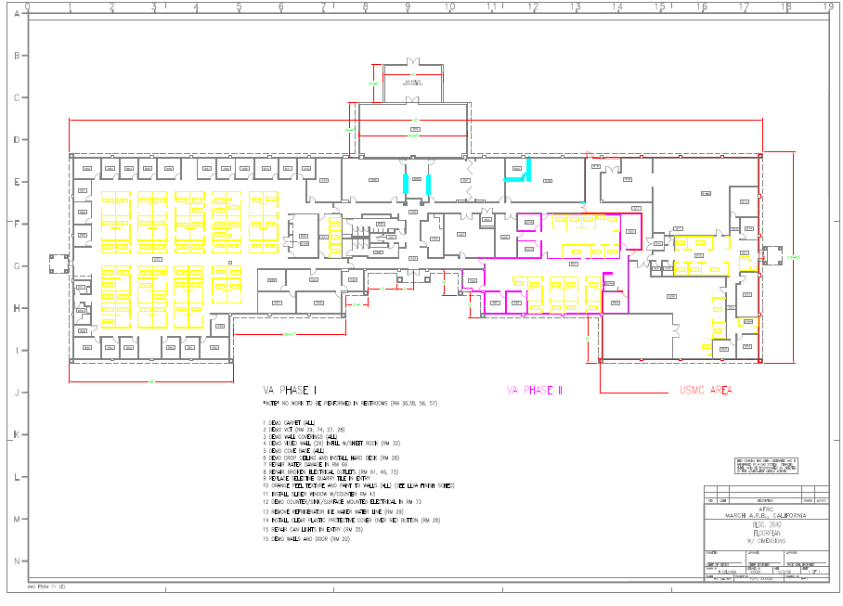


A100 – Site Locations
PHASE I
PHASE II
USMC AREA

Slide 2
DEMO VCT FROM RMS:
27; ~ 549 SF -- NOTE* RM 27 HAS ROLLING SHELVES THAT ARE TO REMAIN
28; ~ 270 SF -- RM 28 IS HALF VCT & HALF CARPET (DEMO BOTH)
29; ~ 240 SF
74; ~375 SF
INSTALL JOHNSONITE GRANITE VINYL TILE, 24”X24” IAW LLVA FINISHES STANDARD

Slide 3
RM 20: DEMO WALLS, METAL DOOR FRAME AND DOOR, SAFE ELECTRICAL TO NEAREST “J” BOX.
PATCH, FLOAT , TEXTURE AND PAINT .
RM 32: DEMO EXISTING VIDEO PROJECTION WINDOWS AND INFILL WITH METAL STUDS AND SHEET ROCK.
FLOAT, TEXTURE AND PAINT ADJOINING ROOM WALLS

Slide 4
INSTALL CLEAR PLASTIC COVE OVER RED ALARM BUTTON
RM 28: DEMO DROP CEILING AND INSTALL HARD DECK
~ 270 SF
RM 66: REPAIR WATER DAMAGE IN CORNER BY WINDOW
~ 5’X5’ AREA

Slide 5
REPAIR CAN LIGHTS IN FOYER, 6 EA
REPAIR ELECTRICAL OUTLET
RM 43: INSTALL SLIDER WINDOW W/COUNTER
DEMO COUNTER/SINK/SURFACE
MOUNTED ELECTRICAL, SAFE BACK
TO NEAREST “J” BOX. CAP PIPES IN
WALL, PATCH, TEXTURE AND PAINT.

