Slide 1
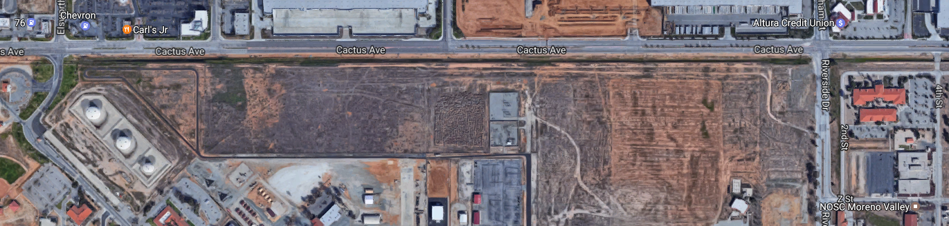
Bldg. 2640
N
To the 215
March ARB Main Gate
From the main gate which is on Cactus Ave:
Travel East on Cactus, turn Right at stoplight (Riverside Drive)
Take first Left, (Z Street)
Take first Left (2nd Street) arrive at Gate

