Slide 1
CEILING LIFT HAZARDS AND MITIGATIONS PRESENTATION
Note: This is an interactive PowerPoint and needs to be viewed in slideshow format.

Slide 2
CEILING LIFT SYSTEM OVERVIEW
1. Ceiling Track / Rail
2
1
2
2. Ceiling Track Gates / Stoppers/ Rail End Stops
3. Lift Unit
4. Lift Unit Battery and Charger
3 / 4
5
5. Lift Tape / Strap
6
7. Lift Bar / Spreader Bar / Hanger Bar / Lift Bracket / Sling Bar
6. Lift Tape Hook
7
8
8
8. Sling Securing Mechanism / Carabineers / Safety Pins / Cotter Pins / Safety Hooks / Sling Hooks
9. Sling
9
Click on any of the above for hazard details

Slide 3
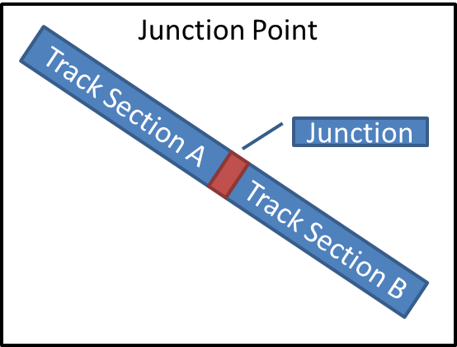
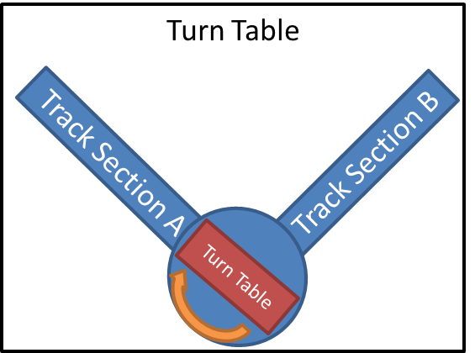
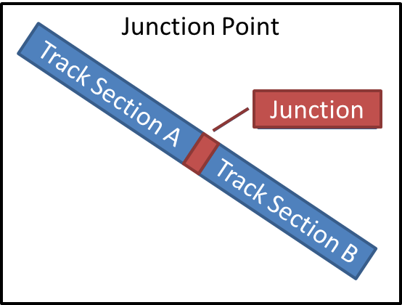
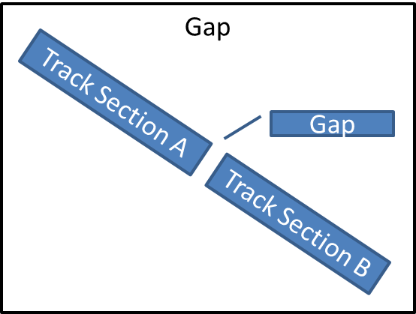
1. Ceiling Track / Rail Points of Weakness
Junction
Gap
Back
Click on any image for details
Main

Slide 4

Junction / Exchange Point
Hazards
Track rail junction / exchange points are points of weakness as they are not solid lengths of track.
These points of weakness can bow after repeated use.
Without checking and maintenance it can result in the Lift Unit falling off of the Track Rail.
Junction
Recommendations
Utilize the acceptance check list for ceiling lift systems attached to AL14-07after the installation, maintenance, service or relocation of the lift system and Lift Track.
Check for track bowing at junctions.
Back
Click here for example checklist items
Main

Slide 5

Turn Table
Hazards
Track Rail turn tables allow for turning of a Lift Unit in different directions of motion.
It is a point of weakness as it is not a solid track. Guardrails and/or gates are required to maintain the security of the Lift Unit during turn table operation.
Missing guardrails and/or gates during installation, maintenance, service or relocation can result in the Lift Unit falling off of the Track Rail.
Recommendations
Utilize the acceptance check list for ceiling lift systems attached to AL14-07after the installation, maintenance, service or relocation of the lift system and Lift Track.
Check for track bowing at turn tables.
Back
Click here for example checklist items
Main

Slide 6
Gap
Hazards
Gaps in the Lift Track created during installation or reinstallation of the Lift.
Gaps can cause the Lift Unit to fall off of the Track Rail.
Gap
Recommendations
Utilize the acceptance check list for ceiling lift systems attached to AL14-07after the installation, maintenance, service or relocation of the lift system and Lift Track.
Check for gaps in the Ceiling Track Rail.
Back
Click here for example checklist items
Main

Slide 7
Junction / Exchange Point
Sample Checklist for Lift Installation Related to Junction / Exchange Points
Checklist Items | √
As-built drawings and structural engineering drawings for lift unit is being used
Connections of structural system to the building’s structure including seismic bracing if applicable, are inspected for integrity and fasteners are checked
Proper structural system is in place and properly installed to support the lift with respect to structural component
Exchanger and junction points functions correctly
Back
Click here for a full example checklist
Main

Slide 8
Turn Table
Sample Checklist for Lift Installation Related to Junction / Exchange Points
Checklist Items | √
As-built drawings and structural engineering drawings for lift unit is being used
Connections of structural system to the building’s structure including seismic bracing if applicable, are inspected for integrity and fasteners checked
Proper structural system is in place and properly installed to support the lift with respect to structural component
Rail turn table functions correctly
Back
Click here for a full example checklist
Main

Slide 9
Gap
Sample Checklist for Lift Installation Related to Junction / Exchange Points
Checklist Items | √
As-built drawings and structural engineering drawings for lift unit is being used
Connections of structural system to the building’s structure including seismic bracing if applicable are inspected for integrity and fasteners checked
Proper structural system is in place and properly installed to support the lift with respect to structural component
The rail is free of gaps and the gates are in alignment
Back
Click here for a full example checklist
Main

Slide 10
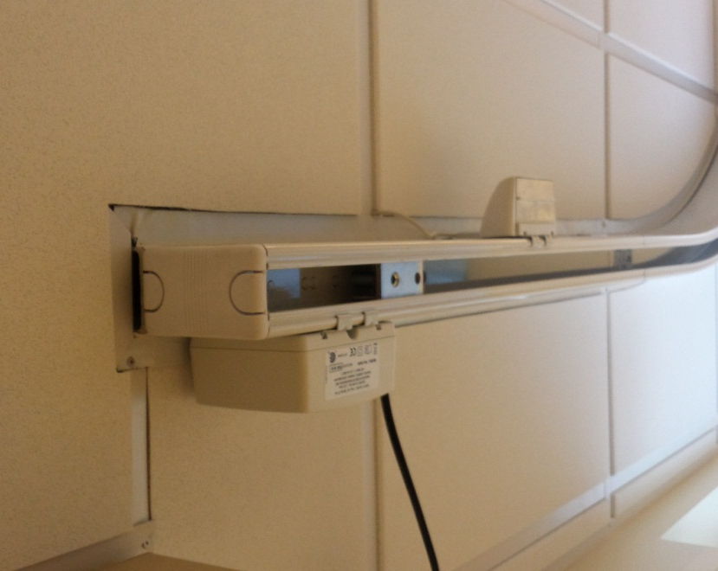
2. Ceiling Track Gates / Stoppers/ Rail End Stops
Hazards
Missing or unsecured Celling Track Gates / Stoppers can cause the Lift Unit to run off of the Lift Track while in motion.
Missing guardrails or gates during installation can result in the Lift Unit falling off of the Track Rail.
Recommendations
Utilize the acceptance check list for ceiling lift systems attached to AL14-07 after the installation, maintenance, service or relocation of the lift system and Lift Track Stoppers.
Verify all rail end stops are in place and tightened and the gates are in alignment
Back
Click here for example checklist items
Main

Slide 11
2. Ceiling Track Gates / Stoppers/ Rail End Stops
Sample Checklist for Lift Installation Related to Junction / Exchange Points
Checklist Items | √
As-built drawings and structural engineering drawings for lift unit is being used
Connections of structural system to the building’s structure including seismic bracing if applicable are inspected for integrity and fasteners checked
All rail end stops are in place and tightened
All rail end stops in the as-built drawings and structural engineering drawings for the lift unit are accounted for
Rail turntable and exchanger functions correctly, the rail is free of gaps and the gates are in alignment
Back
Click here for a full example checklist
Main

Slide 12
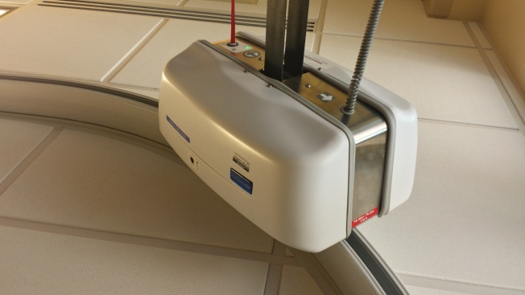
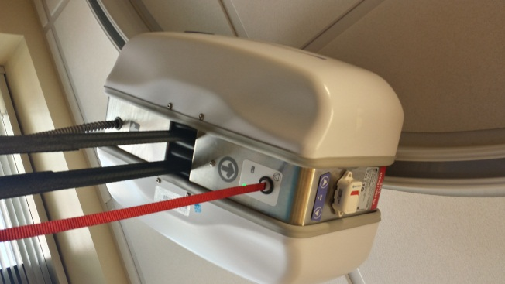
3 & 4. Lift Unit, Lift Unit Battery, and Charger
Hazards
Most Lift Units are not water tight and are not intended for continuous use in wet or humid environments.
Wet or humid environments such as pools and bathrooms can cause early or unexpected signs of wear and, in severe cases, corrosion of internal components of the Lift Unit or Lift Unit Battery.
Failure of internal components of the Lift Unit is hard to detect but can result in sudden breakage, a sudden stop to lifting capabilities ,or the sudden and uncontrolled drop/release of a patient.
Recommendation
Utilize the acceptance check list for ceiling lift systems attached to AL14-07 after the installation, maintenance, service or relocation of the Lift Unit
Be aware of the installation environment
Back
Click here for example checklist items
Main

Slide 13
3 & 4. Lift Unit, Lift Unit Battery, and Charger
Sample Checklist for Lift Installation Related to Lift Unit, Battery and Charger
Checklist Items | √
The lift is installed in the correct location and environment (water proofing / humidity concerns)
Installation is compliant with NFPA 13 for fire sprinklers
Installation is compliant with NFPA 99 and NFPA 70 for grounding and bonding
Installation is compliant with NFPA 99 and NFPA 70 for access to electrical and safety systems
Lift Unit casing has been inspected for cracks and alignment
All motor case indicator lights are functioning
Back
Click here for a full example checklist
Main

Slide 14
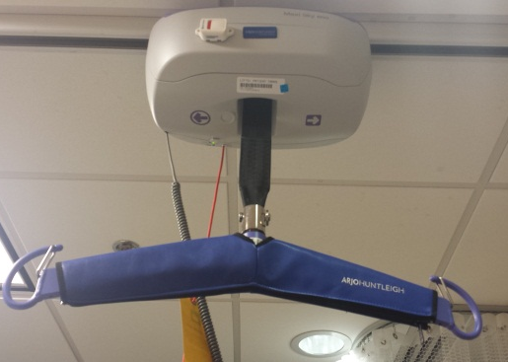
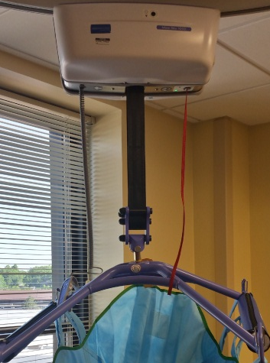
5. Lift Tape / Strap
Hazard
Lift Tape shows signs of wear, fraying and tearing most commonly at the seams and at the attachment points. If these signs are neglected and the Lift Tape is not maintained, repaired, or replaced, a failure could occur resulting in the sudden drop/release of a patient.
Recommendation
Develop a checklist to visually inspect the Lift Tape and Slings prior to use for rips, tears, or fraying. Pay careful attention to attachment points of the sling and major seams.
Replacing Lift Tape and Slings prior to them showing any signs of wear on a regular schedule can also mitigate the risk of breakage.
Back
Click here for an example checklist
Main

Slide 15
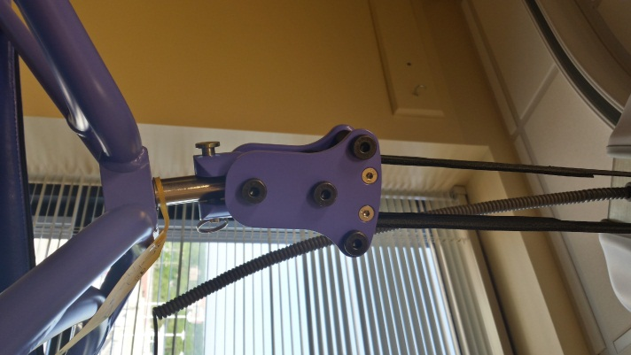
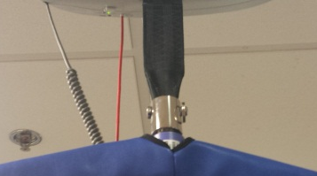
6. Lift Tape Hook
Hazard
Lift Tape Hook shows signs of wear, damage and loose connection. If these signs are neglected and the Lift Tape Hook is not maintained, repaired, or replaced, it can fail and result in the sudden drop/release of a patient.
Recommendation
Develop a checklist to visually inspect the Lift Tape Hook prior to use for wear or damage.
Replacing Lift Tape Hook prior to it showing any signs of wear on a regular schedule can also mitigate the risk of breakage.
Back
Click here for an example checklist
Main

Slide 16

Checklist and Visual Aid for Lifting Operations
Table 2: Checklist for Lifting Operations
Checklist Items | √
The Lift Bar is securely attached to the Lift Tape via the Lift Tape Hook.
The Lift Tape is in good condition, not worn, frayed or torn.
The Sling is securely attached to the Lift Bar at all attachment points.
The Sling is in good condition, not worn, frayed, or torn at the seams.
The Sling in good condition, not worn, frayed, or torn at the points of attachment.
The Sling is rated for the weight of the patient.
The lift system is rated for the weight of the patient.
The lift area is clear of obstructions.
Lift Unit
Lift Tape
Lift Tape Hook
Lift Bar
Sling Securing Mechanisms
Sling
Back
Main

Slide 17

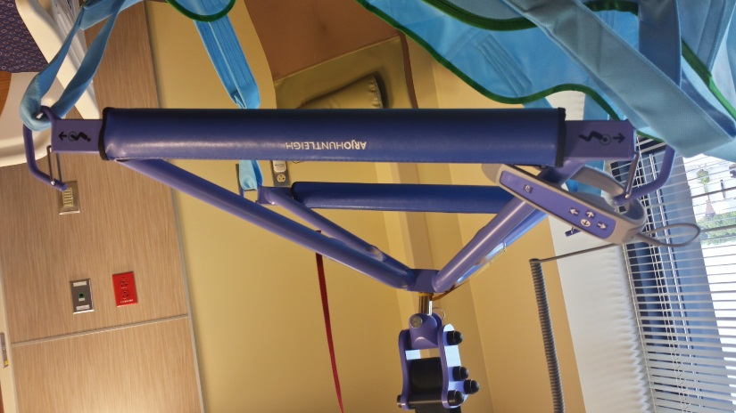
7. Lift Bar / Spreader Bar / Hanger Bar / Lift Bracket / Sling Bar
Hazards
Ceiling lift systems have a wide range of movement vertically. As a result, a portion of a Lifting Bar can be caught underneath or wrapped around an obstacle, creating a tripping hazard for the care taker.
Lifting the lift system while a Lift Bar is snagged can result in excessive strain on the Lift Unit causing mechanical malfunction or a sudden drop/release of a patient.
The Lift Tape Hook at the end of the Lift Tape could be incompatible with the attachment handle eye on a Lifting Bar.
The Lifting Bar Hooks or Pad-eye can be incompatible with certain Safety Pins or Carabineers.
Back
Click here for recommended actions
Main

Slide 18
7. Lift Bar / Spreader Bar / Hanger Bar / Lift Bracket / Sling Bar
Recommendations
Prior to lifting, visually examine the area for lifting clearance; remove any potential obstacles.
Lifting the lift system while a Lift Bar is snagged can result in excessive strain on the Lift Unit, causing mechanical malfunction or sudden drop/release of a patient.
Points of weakness on a lift system are at the attachment points. There are three major attachment points, one between the Lift Tape and the Lift Bar and two at either side of the Lift Bar attached to the Sling.
Develop a checklist to ensure that these three points are inspected prior to the lift operation; ensure the security and the compatibility of the attached components.
Back
Click here for an example checklist
Main

Slide 19
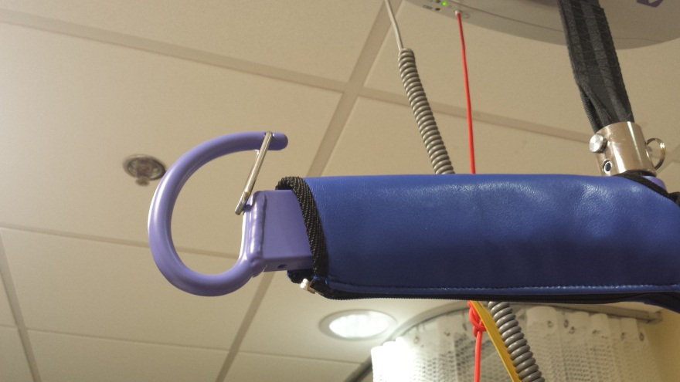
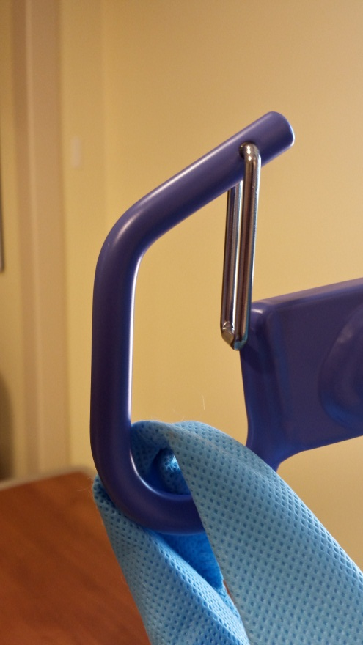
8. Sling Securing Mechanism / Carabineers / Safety Pins / Cotter Pins / Safety Hooks / Sling Hooks
Hazards
Slings are attached with a variety of components to the Lifting Bar such as Carabineers / Safety Pins / Safety Hooks / Sling Hooks. These components are weak points in the lift system. If improperly connected or uninspected for wear, their failure could cause the sudden drop/release of a patient.
The Lifting Bar Hooks or Pad-eye can be incompatible with certain Safety Pins or Carabineers. Incompatibilities in these parts create points of weakness that can fail during a lifting.
Back
Click here for recommended actions
Main

Slide 20
8. Sling Securing Mechanism / Carabineers / Safety Pins / Cotter Pins / Safety Hooks / Sling Hooks
Recommendations
Develop a checklist to ensure that the three points of weakness at the attachment points are inspected prior to the lift operation; ensure the security and compatibility of the attached components.
Visually examine between these three attachment points during the lifting operation to catch any potential slippage or breakage in order to mitigate the risk of a patient fall/release from the lift.
Back
Click here for an example checklist
Main

Slide 21
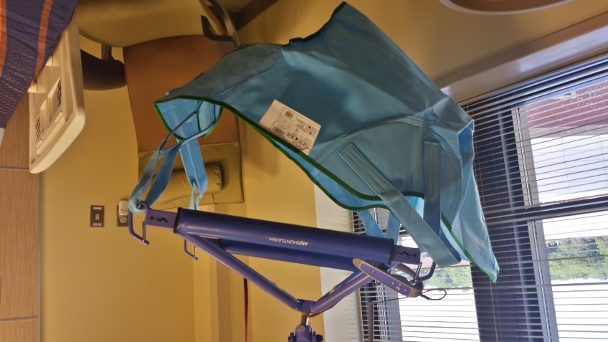
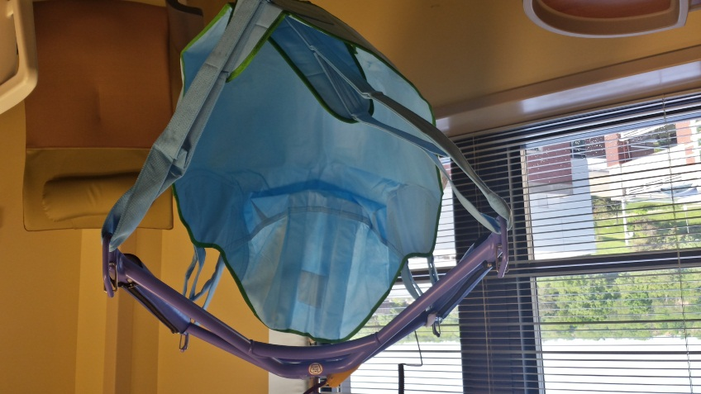
9. Slings
Hazards
Slings show signs of wear, fraying and tearing most commonly at the seams and at the attachment points. If these signs go unnoticed and the Sling is not maintained, repaired or replaced, it can result in the sudden drop of a patient.
Ceiling lift systems have a wide range of movement vertically. As a result, a portion of a Sling can be caught underneath or wrapped around an obstacle creating a tripping hazard for the care taker.
Lifting the lift system while a portion of a Sling is snagged can result in excessive strain on the Lift Unit, causing mechanical malfunction or sudden drop/release of a patient.
Back
Click here for recommended actions
Main

Slide 22
9. Slings
Recommendations
Prior to lifting, visually examine the area for lifting clearance; remove any potential obstacles.
Develop a checklist to visually inspect the Lift Tape and Slings prior to use for rips, tears, or fraying. Pay careful attention to attachment points of the Sling and major seams.
Replacing Lift Tape and Slings prior to them showing any signs of wear on a regular schedule can also mitigate the risk of breakage.
Back
Click here for an example checklist
Main

