Slide 1
Safe Patient Handling Initiative
Army-wide Implementation
COL Myrna Callison
Ms. Kelsey McCoskey
Ms. Carlla Jones
7 December 2011
Unclassified

Slide 2
Briefing Outline
PURPOSE: To provide a Business Case Analysis for the proliferation of the Safe Patient Handling Initiative throughout the Army.
Background
Summary of Costs and Benefits
Implementation Plan
Costs
Benefits
Pilot Project Outcomes
ROI
Next Steps
Carlla Jones/MCHB-CS-RM/410-436-1329/carlla.jones1@us.army.mil
UNCLASSIFIED

Slide 3
Background
Problem Statement: Preventable musculoskeletal disorders (MSDs) among healthcare workers related to patient handling and movement are frequent and expensive in the MEDCOM | Objective: Implementation of a comprehensive SPHP throughout the Army to include a signed MEDCOM policy Maximize patient outcomes through reduction of hospital-acquired pressure ulcers Minimize patient handling-related injuries to patient care providers Minimize staff lost work days related to patient handling injuries
Scope: Mr. Coley directed development of a SPHP implementation plan for all Army Medical Treatment Facilities (MTFs)and calculation of corresponding return-on-investment Core SPHP elements are: (1) ergonomic risk assessment for each clinical unit/area; (2) patient handling equipment (e.g., ceiling lifts, slings); (3) comprehensive equipment / program training and education; (4) facility champions and unit peer leaders; (5) multi-disciplinary facility Safe Patient Handling Committee; (6) Facility ‘Minimal Life’ Policy | Assumptions: Rate of injuries at locations without a SPHP will remain constant Rate of injury underreporting* will remain constant Benefits will begin to accrue in year 2 of initiative implementation at a given location Constraints: MTF renovation priorities and timelines set by US Army Health Facility Planning Agency (USAHFPA) Retrofits will be needed for already renovated MTFs Limited influence for Joint Task Force National Capital Region Medical Region locations
*60% for military and civilian workers
Kelsey McCoskey/MCHB-TS-OER, ERGO/410-436-8864/kelsey.mccoskey@us.army.mil
UNCLASSIFIED
3

Slide 4
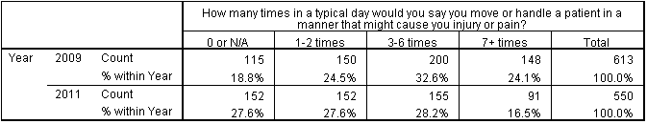
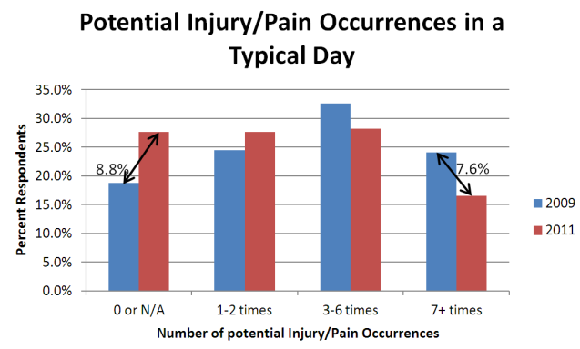
JBLM-Specific Data
Injury rate data from the JBLM pilot project is trending in the right direction (i.e., injury rates).
Evidence of change in culture and usage of patient handling equipment:
Since the JBLM pilot project is still in its infancy, published literature references were used as the basis for decreases in numbers of pressure ulcers.
* = Statistically significant
*
*
Kelsey McCoskey/MCHB-TS-OER, ERGO/410-436-8864/kelsey.mccoskey@us.army.mil
UNCLASSIFIED
4

Slide 5
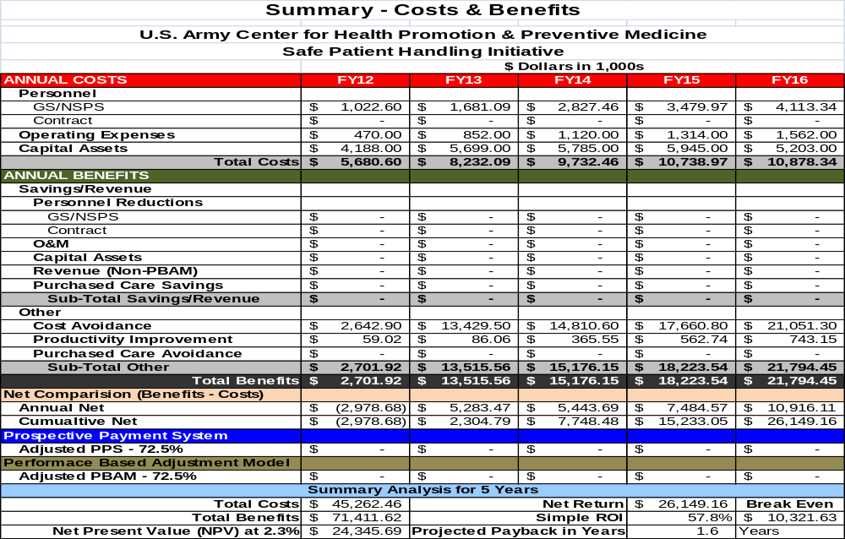
Carlla Jones/MCHB-CS-RM/410-436-1329/carlla.jones1@us.army.mil
UNCLASSIFIED
5

Slide 6
Implementation Plan
Implementation timeline based on USAHFPA schedule for facility renovation and injury rates/prevalence
For locations with Phase I/II renovations, calculations assume .5 implementation of initiative in each phase.
FY12: Madigan AMC (sustainment of pilot project), Brooke AMC, Tripler AMC, Eisenhower AMC, Evans ACH (Phase I)
FY13: Reynolds ACH, Winn ACH (Phase I), Leonard Wood ACH, Blanchfield ACH, Moncreif ACH
FY14: Womack AMC, Evans ACH (Phase II), Martin ACH, Irwin ACH, Keller ACH,
FY15: Darnall AMC, Bayne-Jones ACH, Guthrie ACH, Bassett ACH
FY16: Wm. Beaumont AMC, Winn ACH (Phase II), Ireland ACH, Weed ACH
FY17*: R. Bliss ACH, Fox AHC, Lyster AHC, Munson ACH
FY18*: Camp Humphreys (Korea), Landstuhl (Germany)
*Costs and benefits not included in MEDCOM BCA
Carlla Jones/MCHB-CS-RM/410-436-1329/carlla.jones1@us.army.mil
UNCLASSIFIED
6

Slide 7
Equipment and Facilities Costs
Equipment Lease/Purchase Cost (Capital Asset Expense)
Description of Equipment | Lease or Purchase | Classification | FY12 | FY13 | FY14 | FY15 | FY16
 |  |  | Enter Full Cost under each year. Capital Asset cost are not prorated because of initial investment requirements
Safe Patient Handling Equipment | Purchase | Patient Care | $3,935,000.00 | $5,352,000.00 | $5,486,000.00 | $5,640,000.00 | $4,895,000.00
Computers | Purchase | IM/IT Hardware | $28,000.00 | $36,000.00 | $30,000.00 | $73,000.00 | $67,000.00
Total Capital Equipment Cost Increase |  |  | $3,963,000.00 | $5,388,000.00 | $5,516,000.00 | $5,713,000.00 | $4,962,000.00
Patient handling equipment: ceiling lifts, floor lifts, sit-to-stand lifts, straight track lifts, slings, spare motors, privacy curtains
Equipment costs based on pilot project: $8.5K per room needing coverage
Slings calculated as 5/bed (overhead lifts), 5/lift (sit-to-stand/floor-based lifts)
Number of beds determined by bed/days/month data from M2, FY09 – FY11
Number of room determined from DMLSS data pull, August 2011
MILCON $$ will fund ceiling lifts in all med-surg and ICU areas in renovated/new facilities in coordination with USAHFPA
Computer cost = $3.5K per person
**Note: JIF funding received for Tripler AMC for FY12 – Tripler costs backed out of BCA for FY12.
Carlla Jones/MCHB-CS-RM/410-436-1329/carlla.jones1@us.army.mil
UNCLASSIFIED
7

Slide 8
Equipment and Facilities Costs, cont.
Facility New & Modification Cost (Capital Asset Expense)
Description of Facility | New/ Modification | FY12 | FY13 | FY14 | FY15 | FY16
 |  | Enter Full Cost under each year. Capital Asset cost are not prorated because of initial investment requirements
Additional storage space within each MTF for lifts/slings | Modification | $225,000.00 | $311,000.00 | $269,000.00 | $232,000.00 | $241,000.00
Total Capital Facility Cost Increase |  | $225,000.00 | $311,000.00 | $269,000.00 | $232,000.00 | $241,000.00
Additional storage space needed to store slings, sit-to-stand, floor lifts
Cost of $75K/MTF based on pilot project data
Space usually scavenged from existing (unused) closet/utility areas
Carlla Jones/MCHB-CS-RM/410-436-1329/carlla.jones1@us.army.mil
UNCLASSIFIED
8

Slide 9
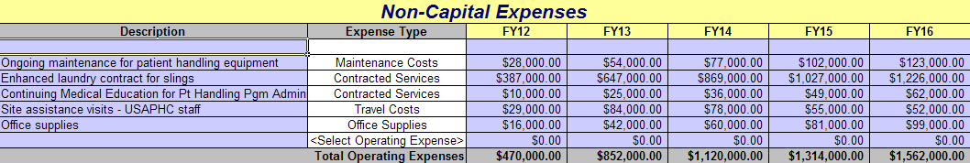
Non-Capital Expenses
Maintenance for patient handling equipment (batteries ,belts, etc.) = 0.5% of equipment costs/per year
Enhanced laundry contract for slings – based on pilot project data = no. of slings purchased * 4.1 = no. of slings needing to be laundered each month * $0.0003
Continuing Medical Education (CMEs) for Patient Handling Program Administrators assumes 30 CMEs required every 2 years = 15 CMEs per year; $1.8K TDY costs + $0.8K registration per FTE per year
Site assistance visits: 5 on-site consults for 2 USAPHC staff per site in year 1 and year 2 of implementation
Office supplies = $2K/FTE
Carlla Jones/MCHB-CS-RM/410-436-1329/carlla.jones1@us.army.mil
UNCLASSIFIED
9

Slide 10
Labor
Description | Grade Level | Total Salary | FY12 | FY13 | FY14 | FY15 | FY16
Safe Patient Handling Program Administrator | 11 | $ 88,493 | 5.00 | 9.00 | 16.00 | 20.00 | 24.00
Safe Patient Handling Program Assistant | 9 | $ 73,139 | 5.00 | 9.00 | 16.00 | 20.00 | 24.00
BioMed Personnel (MTF) | 7 | $ 59,798 | 0.38 | 0.58 | 0.83 | 0.93 | 0.71
Safe Patient Handling Project Manager/Consultant (USAPHC) | 13 | $ 126,130 | 1.52 | 1.52 | 1.52 | 1.52 | 1.52
Total GS Personnel Cost per Year: |  |  | $ 1,022,600 | $ 1,681,088 | $ 2,827,461 | $ 3,479,969 | $ 4,113,341
Safe Patient Handling Program Administrator and Assistant required at each location (as per industry gold standards and pilot project)
Sustainment of Madigan SPHP Pgm Administrator and Assistant included
BioMed Personnel (MTF) needed to:
  Inspect rooms 3 times during equipment installation for infection control (0.25 hrs/room)
  Perform yearly maintenance and load testing for equipment (0.5 hrs/room)
Project Consultant and Project Manager are USAPHC staff to oversee Army-wide implementation
Carlla Jones/MCHB-CS-RM/410-436-1329/carlla.jones1@us.army.mil
UNCLASSIFIED
10

Slide 11
Benefits – O&M
Benefit description | Expense type | Benefit type | FY12 | FY13 | FY14 | FY15 | FY16
Reduction of pressure ulcer cases by 15% | Other | Cost avoidance | $ 1,043,400 | $ 5,272,100 | $ 5,435,200 | $ 5,944,100 | $ 6,777,300
Hospital stay length decreased for new pressure ulcer cases by 1 day for 30% of cases | Other | Cost avoidance | $ 180,500 | $ 946,600 | $ 1,012,700 | $ 1,192,500 | $ 1,411,000
One complication avoided related to immobility for 30% of new pressure ulcer cases | Other | Cost avoidance | $ 1,189,400 | $ 6,236,500 | $ 6,671,800 | $ 7,857,100 | $ 9,296,100
Temporary Total Disability (TTD) costs avoided associate with reduced new patient handling injuries (nurses/techs) | Other | Cost avoidance | $ 191,300 | $ 811,900 | $ 1,409,100 | $ 2,222,600 | $ 2,972,400
Medical costs avoided associated with reduced new patient handling injuries (nurses/techs) | Other | Cost avoidance | $ 38,300 | $ 162,400 | $ 281,800 | $ 444,500 | $ 594,500
Total Benefit Estimate |  |  | $ 2,642,900 | $ 13,429,500 | $ 14,810,600 | $ 17,660,800 | $ 21,051,300
No. of pressure ulcer cases per year determined from linear best fit trend based on M2 data for FY09 - FY11. Average medical care cost per pressure ulcer case (individual) is $39.3K, based on M2 data, FY09 - FY11. Peer-reviewed literature documents the extra days of hospital stay required by patients with pressure ulcers; use linear best fit trend for hospital stays for pressure ulcer cases from M2 data, FY09 - FY11; M2 data used to determine average cost per day of hospital stay = $3.4K/day.
The complications from immobility due to inadequate patient handling can be extensive and expensive - average of $22.4K in hospital costs per complication. Make conservative estimate of 1 complication related to immobility avoided for 30% of new pressure ulcer cases.
Nurse/tech injury data drawn from Defense Civilian Personnel Data System (DCPDS) via Regional BOXi, Sept 2011. Injuries extrapolated forward using linear best fit trend. Assume 60% underreporting of injuries based on averaged reported in Nelson/Baptiste (2004), Weddle (1996) and Brown (2005). Assume 40% of nurse/tech injuries are due to patient handling, based on % of nursing injuries related to patient handling, 2002 - 2005. TTD costs ($20.5K/new injury) and Medical costs ($4.1K/new injury) for FECA cases based on 3-year period, 2002-2005, adjusted for inflation.
Benefits were assumed to begin to accrue 1 year after program initiation at each installation, staggering the benefits based on the overall implementation plan.
Carlla Jones/MCHB-CS-RM/410-436-1329/carlla.jones1@us.army.mil
UNCLASSIFIED
11

Slide 12
Benefits – Productivity Improvements
Bureau of Labor Statistics indicates an average of 5 lost duty days per nurse/tech patient handling injury. Percentage of nurses/techs at MTFs is ~66% nurses and 35% techs. Calculate 66% of lost duty time at nurse (GS-11) rate and 34% at tech (GS-7) rate.
Assume 50% of patient handling injuries result in restricted/light duty; assume initiative reduces light duty time by 25%. Calculate 66% of lost duty time at nurse (GS-11) rate and 34% at tech (GS-7) rate.
Productivity increase - moving patients - assume 25% of patients require 6 moves per day, which require 3 additional personnel @ .25 Hrs per each move at GS-7 rate. Number of patients per day derived by M2 data, FY09 - FY11, average bed days/month.
Benefits were assumed to begin to accrue 1 year after program initiation at each installation, staggering the benefits based on the overall implementation plan.
Carlla Jones/MCHB-CS-RM/410-436-1329/carlla.jones1@us.army.mil
UNCLASSIFIED
12

Slide 13
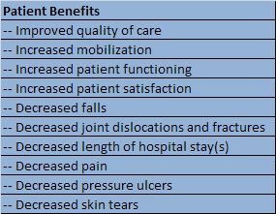
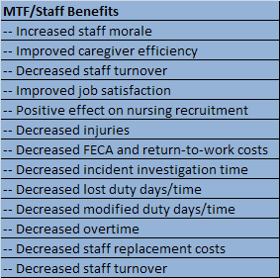
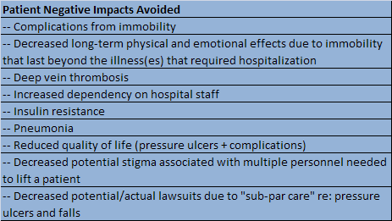
Other Benefits
Carlla Jones/MCHB-CS-RM/410-436-1329/carlla.jones1@us.army.mil
UNCLASSIFIED
13

Slide 14
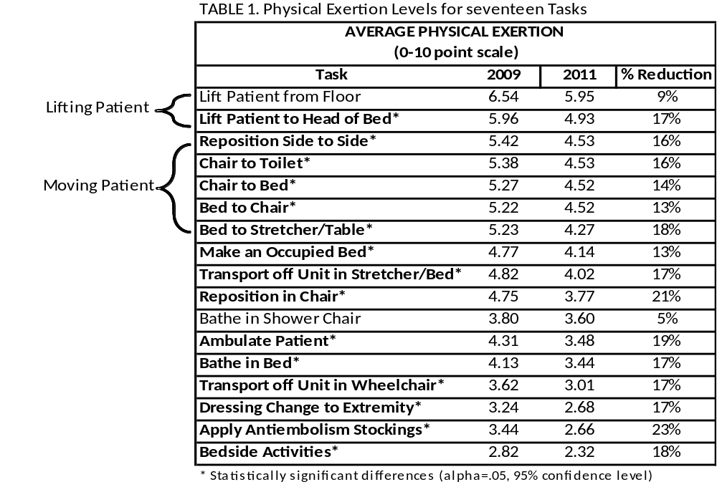
Pilot Project Outcomes
Kelsey McCoskey/MCHB-TS-OER, ERGO/410-436-8864/kelsey.mccoskey@us.army.mil
UNCLASSIFIED
14

Slide 15
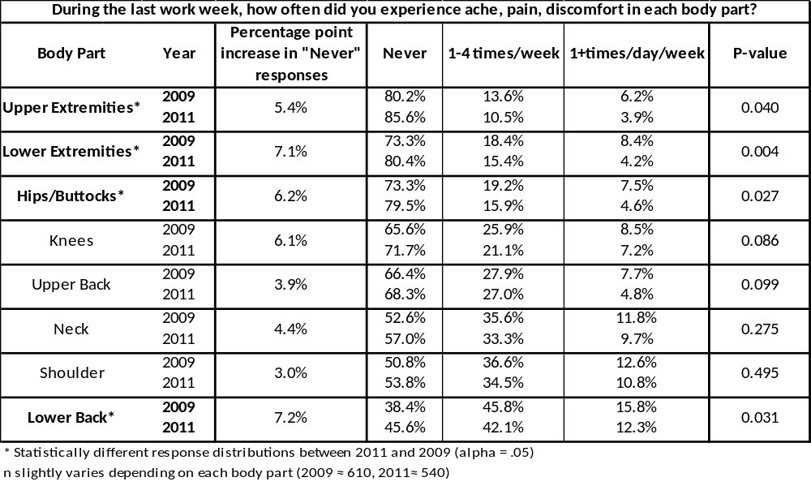
Pilot Project Outcomes
Kelsey McCoskey/MCHB-TS-OER, ERGO/410-436-8864/kelsey.mccoskey@us.army.mil
UNCLASSIFIED
15

Slide 16
ROI
Summary Analysis for 5 Years
Total Costs | $ 45,262.46 | Net Return | $ 26,149.16 | Break Even
Total Benefits | $ 71,411.62 | Simple ROI | 57.8% | $ 10,321.63
Net Present Value (NPV) at 2.3% | $ 24,345.69 | Projected Payback in Years | 1.6 | Years
Carlla Jones/MCHB-CS-RM/410-436-1329/carlla.jones1@us.army.mil
UNCLASSIFIED
16

Slide 17
Safe Patient Handling
Problem / Issue
Discussion
  Preventable musculoskeletal disorders (MSDs) among healthcare workers related to patient handling and movement are frequent and expensive in the MEDCOM
  Mr. Coley directed development of a SPHP implementation plan for all Army Medical Treatment Facilities (MTFs)and calculation of corresponding return-on-investment
  Business Case Analysis of this initiative predicts a Return-On-Investment of 53.1% and a break-even point of 1.9 years.
Recommendation(s)
Additional Information
Request permission to move forward with Army-wide implementation
Because the high investment costs occur in year 1 for equipment, it is anticipated that benefits will accrue rapidly in out years.
APPROVED
DISAPPROVED
COMMENTS
Carlla Jones/MCHB-CS-RM/410-436-1329/carlla.jones1@us.army.mil
UNCLASSIFIED
17

