Slide 1
Safe Patient Handling Program
Ms. Kelsey McCoskey
Unclassified

Slide 2
BRIEFING OUTLINE
Background and Facts
Patient Handling and Movement Assessment
Veteran’s Administration Program
Army Initiative

Slide 3
Hidden Epidemic
Healthcare Workers at Risk
Back injuries are among the top three occupational injuries for every MEDCOM region
(Safety Occupational Health Committee Report, 2008)
Underreporting of injuries in nursing is common since they perceive that back pain is an inevitable part of nursing practice and they are duty bound to work to care for patients.
(Nelson, A., & Baptiste, 2006).
“Unintended consequences of lifting to patients includes shoulder injuries, hip fractures, bruising, loss of dignity during lifting procedures, skin tears, pressure area damage.”
(Baptiste and Nelson, 2006)

Slide 4
Hidden Epidemic –
Healthcare Workers at Risk
During the course of a shift, a nurse typically lifts a cumulative weight of 1.8 tons
Among healthcare personnel, nurses have the highest rate of back pain, with an annual prevalence of 40-50%
Mean nursing age according to ANA is 47 years
A 35 year old, GS 7 Step 5 employee, will receive over $1,600,000 in compensation if they never return to work

Slide 5
Patient Care is High Risk
Rates of nonfatal Injuries & illnesses requiring days away from work - Bureau of Labor Statistics (BLS) 2010
  Bus drivers, transit and intercity 614.6
  Police and sheriff’s patrol officers 504.3
  Nursing Aids, orderlies and attendants 489.4
  Laborers and freight, stock and material movers 430.4
Musculoskeletal Disorders (MSD) accounted for 29% of all workplace injuries and illnesses requiring time away from work.
Five occupations had MSD counts higher than 10,000. Of these, nursing aides, orderlies and attendants had the highest incidence rate of 249 MSD cases per 10,000 full time workers and also had the highest case count.

Slide 6
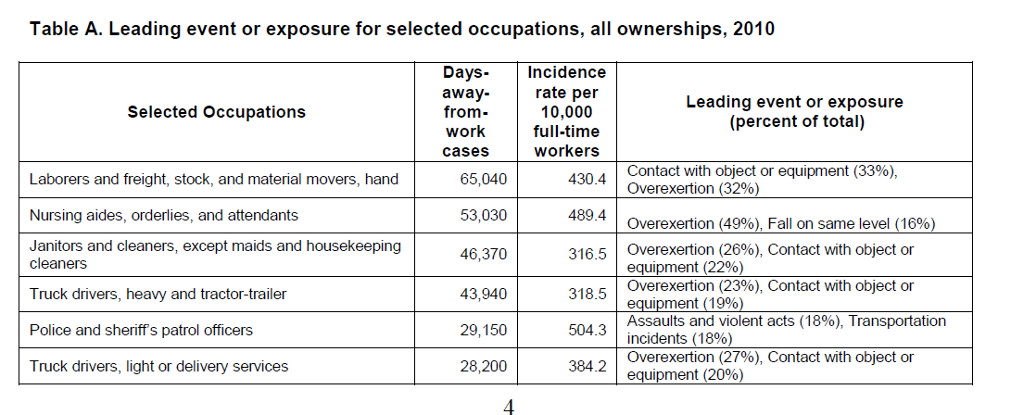
BLS 2010
NONFATAL OCCUPATIONAL INJURIES AND ILLNESSES REQUIRING DAYS AWAY FROM WORK, 2010
Notes:
http://www.bls.gov/news.release/pdf/osh2.pdf

Slide 7
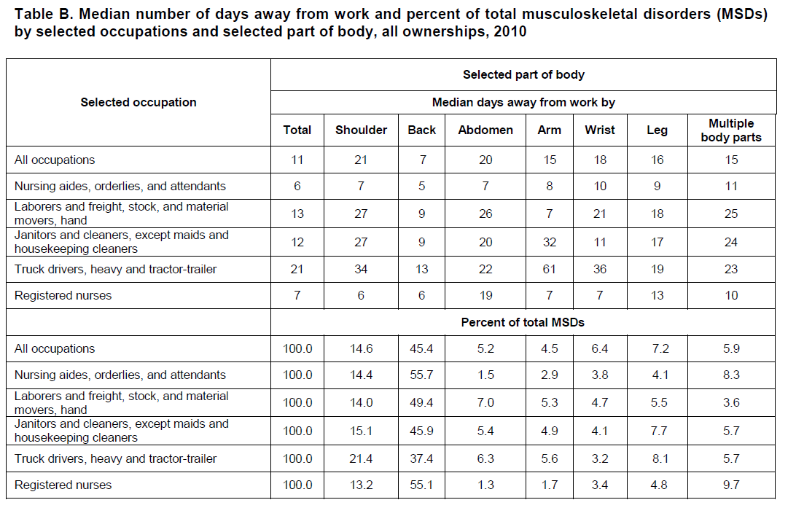
BLS 2010
Notes:
http://www.bls.gov/news.release/pdf/osh2.pdf

Slide 8
Weight Limits for Manual Materials Handling & Patient Handling Activities
NIOSH Lifting Limits
Manual Materials Handling Maximum Permissible Limit (boxes) – 51 lbs.
Patient/Resident Handling Lifting Limit Recommendation – 35 lbs. * (best case scenario for dependent patients not able to assist)
* Waters, T. R. (2007). When is it safe to manually lift a patient? American Journal of Nursing, 107(6), 40-45.

Slide 9
ANA
The 2011 Health and Safety Survey (http://bit.ly/vqEUJ3) shows nursing remains tough on the body, with 80% of nurses reporting they continue to work frequently despite neck, back or shoulder pain caused by the job. Also, 13% of respondents said they had been injured three or more times on the job within a year, compared with 7% in 2001.
The survey, which drew responses from 4,614 RNs, reveals the same top three work environment concerns as in a similar 2001 ANA survey: the acute or chronic effects of stress and overwork (74% of respondents); disabling musculoskeletal injury (62%); and risk of contracting an infectious disease (43%).
http://news.nurse.com/article/20111215/NATIONAL02/112190010/-1/frontpageposted 12/15/11.
USAPHC invited to participate on an ANA working group to develop national standards for Safe Patient Handling. The public comment period on these standards closed 30 November 2012.

Slide 10
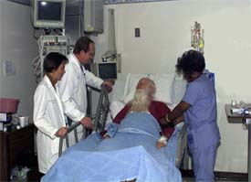
Why are Patient Care Providers at High Risk?
AS A REFERENCEPOINT: WEIGHT OF A LEG
150-lb. Person…about 24 lbs
200-lb. Person…about 31 lbs
250-lb. Person…about 39 lbs
Almost 16% of the total body weight
Chaffin DB, et al., 2006

Slide 11
Obesity Trends* Among U.S. Adults
BRFSS, 1990, 2000, 2010
(*BMI ≥30, or about 30 lbs. overweight for 5’4” person)
1990
2000
2010
No Data <10% 10%–14% 15%–19% 20%–24% 25%–29% ≥30%

Slide 12
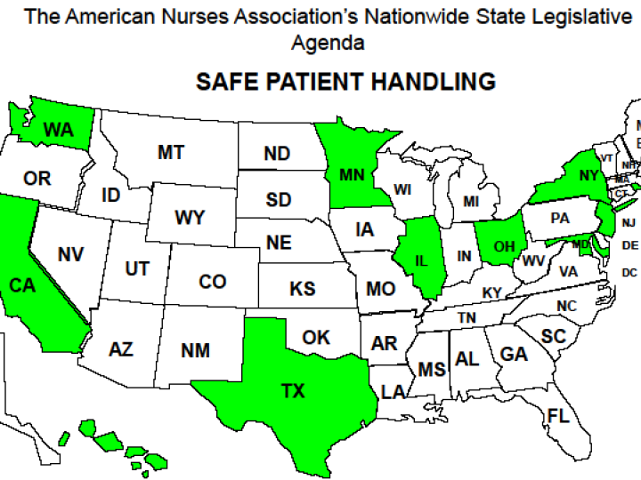
December 2011
10 states enacted legislation/adopted regulation. http://www.nursingworld.org/search.aspx?SearchPhrase=map

Slide 13
ISO Standard Draft
An International Organization for Standardization (ISO) standard (Technical Report (TR) 12296) has been written by a working group of specialists from all over the world who developed this document over a period of 4 years.
The final call for comments was closed in January 2012. Comments were received from countries all over the world and were integrated in the document.
The final document was published on 1 June 2012.
  http://www.iso.org/iso/iso_catalogue/catalogue_tc/catalogue_detail.htm?csnumber=51310
  Summary of ISO standard developed by manufacturer: http://www.arjohuntleigh.com/Admin/files/20120617152601.pdf

Slide 14
ADA
ADA: Access to Medical Care for Individuals with Mobility Disabilities, July 2010
http://www.ada.gov/medcare_mobility_ta/medcare_ta.htm
Is it ok to examine a patient who uses a w/c in the w/c because they cannot get onto the exam table? Generally No
  Talks about portable lifts and ceiling mounted lifts
  ADA sets requirements for new building and alterations to buildings
  Pertains to clinic settings as well

Slide 15
Patient Handling & Movement Assessment (PHAMA)
The 2010 edition of the Facility Guidelines Institute Guidelines for Design and Construction of Health Care Facilities introduces a requirement for project applicants to conduct a patient handling and movement assessment (PHAMA) as part of the sequence of pre-design functional and space programming processes for new construction and renovation projects.
Further, the 2010 Guidelines requires applicants to revise that PHAMA as new information becomes available throughout project design, construction, and commissioning.
PHAMA (two distinct yet interdependent phases)
  Phase 1. Patient handling needs assessment
    functions to identify ‘appropriate’ patient handling and moving equipment for each area in which patient handling and movement occurs
  Phase 2. Determination of Space and Structural design considerations for incorporation of patient handling equipment
Notes:
Patient Handling and Movement Assessment (PHAMA) into the guidelines for 2010. This means that in every state that adopts these Guidelines, a PHAMA will be mandated every time an organization decides to construct a new healthcare facility. Many states/organizations also look to this guideline during renovations.

Slide 16
PHAMA continued
Guidance on appropriate lift coverage for specific clinical areas is provided in the Facility Guidelines Institute, April 2010 Patient Handling and Movement Assessments: A White Paper Appendix I.
As of 1 January 2011, the Joint Commission has adopted the 2010 FGI Guidelines for Design and Construction of Health Care Facilities for design criteria for new construction as well as alterations and renovations.

Slide 17
CLINICAL UNIT/AREA | CL ‘SYSTEM’ Minimal Patient Coverage | CL ‘TRACK’ Minimal Room Coverage ** | PREFERRED TRACK CONFIGURATION
Medical/Surgical Unit | 50 – 100% * | 100% | Traverse
Post-Surgical Unit Provide one supine sling and hanger bar system for unit. | 50 – 100% * | 100% | Traverse
Rehab Unit Consider installing straight track down hallway for ambulating patients. Provide one supine sling and hanger bar system for unit. | 50 – 100% * (If unit is primarily neuro rehab, provide a minimum of 70% coverage) (For new construction or rooms large enough for ambulation w/in rooms, provide 100% coverage) | 100% | Traverse
MICU | 100% | 100% | Traverse
SICU | 100% | 100% | Traverse
CCU | 50% | 50% | Traverse or straight
ICU (Combined MICU/SICU/CCU) | 100% | 100% | Traverse
Nursing Home/Longterm Care | 70 – 100% * (Less coverage may be provided for primarily dementia units) | 100% | Traverse (into bathroom)
Hemodialysis | 50% - 100% * | 50% | Straight or Traverse CL coverage is needed over areas where lateral transfers of patients from stretchers to dialysis beds occur. One straight track over several bays in a row would be appropriate.
Radiology (X-ray, CT, etc.) Overhead/ceiling lift system must be compatible with the ceiling-mounted radiological equipment. | 50% | 100% | Traverse or straight
MRI | 100% | 100% | Straight track located in adjacent MRI patient transfer area
Nuclear Medicine | 50% | 50%
Procedure areas (GI, Cystoscopy, etc.) | 100% | 100% | Traverse or straight positioned as needed
Cath Lab | 100% | 100% | Traverse or Straight
PACU | 100% | 100% | Straight Track (if possible, extend over all beds in a row using one lift system per row)
OR | 100% | 100% | Traverse
Physical Therapy Clinics | 100% | 100% | Preferred design – Rehab clinic design is best when an all-encompassing traverse system covers the entire area and 2 or more motors can be used simultaneously (on the parallel bars and at any two treatment tables). Alternate design – Install straight track over parallel bars. Install traverse track system covering treatment tables and activity areas.
Spinal Cord Injury | 100% | 100% | Traverse into bathroom
Outpatient SCI Clinic Exam/Treatment Rooms | 100% | 100% | Traverse
Outpatient/Primary Care Clinics | Depending on patient population, one or more regular &/or one expanded capacity/bariatric lift |  | Traverse
Emergency Dept/ Urgent Care Exam Rooms | 50 – 100% * | 100% | Preferred design - Traverse over multiple bays in a row or in private rooms Alternate design- Straight track over several bays in a row or in private rooms
 | Depending on patient population, one regular or one expanded capacity/bariatric lift under canopy in ambulance bay |  | Traverse
Mental Health/Psychiatric Patient Care Areas | Ceiling lifts shall not be installed in mental health units with the potential for actively suicidal patients. These statements do not apply to dementia care units or gero-psychiatry units that do not treat actively suicidal patient and may need ceiling lifts.
Geri-psych | 50 – 100% | 50 – 100% | Straight or Traverse
Dental | Depending on patient population, one regular &/or one expanded capacity/bariatric lift | 50% | Straight or Traverse
Morgue Expanded capacity lift w/ minimum weight capacity of 600 lbs. or greater depending on patient population characteristics. Include Supine Lift Frame in purchase. | 100% | 100% | Traverse or Straight Lift system should be able to assist in inserting & extracting trays into cooler as well as lifting & moving bodies into & w/in autopsy suite.
Nurse Training Area | One |  | Straight
CLINICAL UNIT/AREA | CL ‘SYSTEM’ Minimal Patient Coverage | CL ‘TRACK’ Minimal Room Coverage ** | PREFERRED TRACK CONFIGURATION
Medical/Surgical Unit | 50 – 100% * | 100% | Traverse
Post-Surgical Unit Provide one supine sling and hanger bar system for unit. | 50 – 100% * | 100% | Traverse
Rehab Unit Consider installing straight track down hallway for ambulating patients. Provide one supine sling and hanger bar system for unit. | 50 – 100% * (If unit is primarily neuro rehab, provide a minimum of 70% coverage) (For new construction or rooms large enough for ambulation w/in rooms, provide 100% coverage) | 100% | Traverse
MICU | 100% | 100% | Traverse
SICU | 100% | 100% | Traverse
CCU | 50% | 50% | Traverse or straight
ICU (Combined MICU/SICU/CCU) | 100% | 100% | Traverse
Nursing Home/Longterm Care | 70 – 100% * (Less coverage may be provided for primarily dementia units) | 100% | Traverse (into bathroom)
Hemodialysis | 50% - 100% * | 50% | Straight or Traverse CL coverage is needed over areas where lateral transfers of patients from stretchers to dialysis beds occur. One straight track over several bays in a row would be appropriate.
Table 1. Ceiling Lift (CL) Coverage and Track Configuration Recommendations by Clinical Unit/Area
Notes:
.

Slide 18
Radiology (X-ray, CT, etc.) Overhead/ceiling lift system must be compatible with the ceiling-mounted radiological equipment. | 50% | 100% | Traverse or straight
MRI | 100% | 100% | Straight track located in adjacent MRI patient transfer area
Nuclear Medicine | 50% | 50%
Procedure areas (GI, Cystoscopy, etc.) | 100% | 100% | Traverse or straight positioned as needed
Cath Lab | 100% | 100% | Traverse or Straight
PACU | 100% | 100% | Straight Track (if possible, extend over all beds in a row using one lift system per row)
OR | 100% | 100% | Traverse
Physical Therapy Clinics | 100% | 100% | Preferred design – Rehab clinic design is best when an all-encompassing traverse system covers the entire area and 2 or more motors can be used simultaneously (on the parallel bars and at any two treatment tables). Alternate design – Install straight track over parallel bars. Install traverse track system covering treatment tables and activity areas.
Spinal Cord Injury | 100% | 100% | Traverse into bathroom
Outpatient SCI Clinic Exam/Treatment Rooms | 100% | 100% | Traverse

Slide 19
Outpatient/Primary Care Clinics | Depending on patient population, one or more regular &/or one expanded capacity/bariatric lift |  | Traverse
Emergency Dept/ Urgent Care Exam Rooms | 50 – 100% * | 100% | Preferred design - Traverse over multiple bays in a row or in private rooms Alternate design- Straight track over several bays in a row or in private rooms
Ambulance Bay | Depending on patient population, one regular or one expanded capacity/bariatric lift under canopy in ambulance bay |  | Traverse
Mental Health/Psychiatric Patient Care Areas | Ceiling lifts shall not be installed in mental health units with the potential for actively suicidal patients. These statements do not apply to dementia care units or gero-psychiatry units that do not treat actively suicidal patient and may need ceiling lifts.
Geri-psych | 50 – 100% | 50 – 100% | Straight or Traverse
Dental | Depending on patient population, one regular &/or one expanded capacity/bariatric lift | 50% | Straight or Traverse
Morgue Expanded capacity lift w/ minimum weight capacity of 600 lbs. or greater depending on patient population characteristics. Include Supine Lift Frame in purchase. | 100% | 100% | Traverse or Straight Lift system should be able to assist in inserting & extracting trays into cooler as well as lifting & moving bodies into & w/in autopsy suite.
Nurse Training Area | One |  | Straight

Slide 20
Veterans Administration
Safe Patient Handling Program
The VA Patient Safety Center of Inquiry has been a leader in researching and developing Safe Patient Handling Programs
  Intensive multi-year study conducted by the VA found implementing a SPHP:
    30% decrease in # of injuries
    70% decrease in modified duty days
    18% decrease in lost time injuries
    ROI - 4.1 years
VA Directive released 28 June 2010 stating:
  “It is VHA policy that a SPH Program to protect caregivers and patients from injuries due to patient handling and movement must be established and maintained in all VHA facilities and that new construction and renovation projects must incorporate appropriate and necessary patient handling and moving equipment at all VHA facilities”

Slide 21
Army Initiative
The US Army Public Health Command (Prov) Ergonomics Program collaborated with the VA Patient Safety Center of Inquiry.
2009 USAPHC given go ahead and support from OTSG and MEDCOM CoS to begin a pilot program at MAMC.
The “DoD Overview of Military Health Systems Principals of World Class Healthcare” include:
  Install ceiling lifts in all inpatient rooms
  Institute an integrated and facility wide lift program
The Army Safe Patient Handling Program follows the basic program elements set out by the VA.
2012 Joint Incentive Fund proposal approved and funded to implement comprehensive program at TAMC.

Slide 22
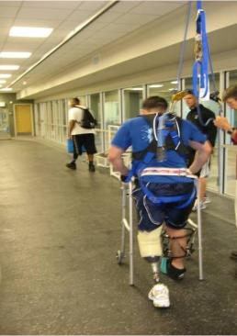
Army Initiative
Program elements:
  Ergonomic site assessment
  Training on Safe Patient Handling Program
  and equipment
  FTE Site Coordinator and assistant
  Unit peer leaders
  Equipment fair and selection
  Equipment installation
  Ongoing data collection

Slide 23
Program Elements
MTF Leadership and Unit Peer Leader Education
  Command briefing
  All staff SPH awareness training (CEU)
  Selection Site Coordinator
  Unit Peer Leaders training
Unit Peer Leader
  Ideally one per shift
  Staff nurse who acts as the local unit expert on the program and equipment and is a liaison to the facility safe patient handling coordinator.
  VA study found the unit peer leaders to be an integral part of a successful program.
On-site Ergonomic Assessment
  Census patterns and trends
  Detailed assessment of current status of
  facility with recommendations.
  Baseline data
    transfer types, population, equipment, use unit/staff specific demographics, focus groups, staff surveys, injury data review
Notes:
The first two program elements are leadership support and unit peer leader selection and education. All staff in the hospital have received training on what safe patient handling is and what the program consists of. Each unit has a unit peer leader, ideally one per shift, the unit peer leader is a staff nurse who acts as the local unit expert on the program and equipment and is a liaison to the facility safe patient handling coordinator. The VA study found the unit peer leaders to be an integral part of a successful program.
The on-site ergonomic assessment was performed by the USAPHC ergonomics program with assistance from the VA. A comprehensive overview of each are of the hospital was performed. Focus groups with nursing personnel at all levels were conducted. An inventory of all available equipment was taken and storage concerns were discussed. This assessment provided a detailed report of what equipment was recommended for the facility.

Slide 24
Program Elements
Patient Handling Equipment
  Equipment fair with staff input
  Equipment installation
  Training
  Ensure maintenance
Safe Patient Handling Program Administrator
  Essential to initiation of a program that requires so much coordination between program areas, buy-in and change of culture for staff.
Safe Patient Handling Policy
  Facility policy (to be in effect after all equipment is in place and training complete)
  Specified plan for future training (i.e., new staff orientation)
  Standardized operating procedures for business processes such as equipment usage, patient handling assessment criteria, and ongoing roles and responsibilities for designated staff (i.e., unit peer leaders)
Notes:
There are a variety of types of patient handling equipment. Ceiling lifts are the gold standard of equipment because they are always accessible. Research has found that if equipment is not easily accessible and easy to use staff are not likely to use it. A variety of concerns were considered and detailed meetings with engineering and maintenance personnel were conducted to ensure that any structural issues were identified. Other types of equipment will also be included for example, a floor based lift in the ER to assist with getting patients out of cars and a system of air assisted lateral transfer devices (like the one shown here) which will travel with a patient from the time they come into the ER as they travel throughout the hospital.

Slide 25
MAMC equipment
All aspects of the SPH Program are fully operational
Pending funding request for Cath Lab and Mother Baby units.
All equipment has been installed
  100% H-track ceiling lift coverage: ICU-E , ICU-W, Intermediate Care/Stepdown, 3 Medical/Surgical units, SCU, PCU, PACU
  Inpatient PT: 4 ambulation tracks
  Outpatient PT: over parallel bars, cardio room, treatment area
  Morgue: 1 bariatric H-track lift covers entire room
  Cardiac Cath: over 1 table in surgical suite
  Pediatrics: 1 lift over 2 beds
  Radiology:
CT: 2
Holding: 1 lift over 3 beds
MRI Holding: (outside)1
X-Ray Rooms: 4
  OR Holding: 3 lifts over 8 beds
  Training Room: 1
Notes:
Phase I
2S= 20/20
ICU-E= 10/10
ICU-W= 10/10
PCU= 4/4
6N= 13/32
6S= 13/32
7N= 14/32
2S= intermediate care/stepdown
PCU= Progressive Care Unit (ICU stepdown) ICU-E= surgical ICU ICU-W = medical/cardiac ICU 6S = med/surg/observation 6N= med/surg (more med) 7N= med/surg (more surg)
four ambulation tracks being installed (2S, 6S, 6N, and 7N; each one 23 feet long H-track configuration)
All Phase I equipment has been installed
64 ceiling lifts, 4 ambulation tracks
Variety of floor based equipment and air assisted lateral transfer devices
Phase II contract awarded.
Additional 64 ceiling lifts to complete medical/surgical areas, 1 pediatric room, 4 pediatric ICU beds, morgue, Physical Therapy and PACU

Slide 26
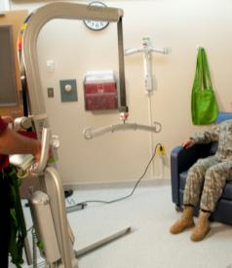
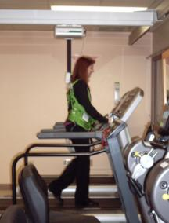
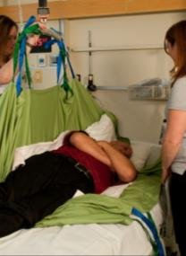
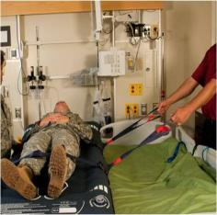
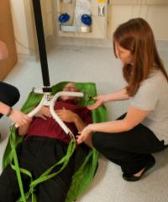
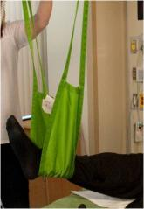
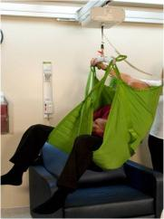
Safe Patient Handling Equipment
UNCLASSIFIED
Notes:
USAPHC photos taken by USAPHC photographer at Madigan Health System
There are a variety of types of patient handling equipment. Ceiling lifts are the gold standard of equipment because they are always accessible. Research has found that if equipment is not easily accessible and easy to use staff are not likely to use it. A variety of concerns were considered and detailed meetings with engineering and maintenance personnel were conducted to ensure that any structural issues were identified. Other types of equipment will also be included for example, a floor based lift in the ER to assist with getting patients out of cars and a system of air assisted lateral transfer devices (like the one shown here) which will travel with a patient from the time they come into the ER as they travel throughout the hospial.

Slide 27
Good for Staff, Good for Patients
Safe patient handling equipment can and should be used beyond a typical ‘bed to chair’ or ‘bed to stretcher’ transfer.
  Early mobilization
  Fall prevention
  Prevention of pressure ulcers
  Rehabilitation

Slide 28
DATA REVIEW

Slide 29
How many times in a day do you move or handle a patient in a manner that might cause you injury or pain?
Notes:
-- Compared to 2009, the number of times that a respondent felt that they handled a patient that might cause injury or pain has decreased.
--However, there was a slight increase in the distribution of respondents that felt they might get injured handling a patient in February of 2012.
February 2012 results are likely not a start of future increases in pain or injury handling a patient, but like a sign of stabilizing trends. It is likely that no matter what intervention or prevention to injury techniques are implemented, a percentage of workers are going to believe that handling a patient might cause them injury or pain. This may be related to the way the question is worded, such that it may not be clear to the respondent whether they should be considering the availability of equipment or not.

Slide 30
Chart includes units where ceiling lifts were installed at 100%: 2S, ICU E, ICU W, PCU/SCU, PACU 6N, 6S,7N as well as radiology (not 100%)
Perceived risk of injury scale is 0=none to 10=maximum
Notes:
From 2009 to February 2012, there was a constant reduction in the perceived risk of injury it took survey respondents to perform all seventeen specified patient handling tasks.
Consistent throughout all surveys, bedside activities, dressing change to extremity, and applying antiembolism stockings were the tasks that were least likely to cause an injury for the survey respondents.
Tasks that involved lifting and moving patients consistently proved to be the tasks survey respondents felt they were most likely to cause them an injury.
Transferring a patient from a chair to bed and transferring a patient from a bed to stretcher/table had the largest reduction in magnitude on the 0 to 10 risk of injury scale from 2009 to February 2012.
Dressing change to extremity, however, had the largest percent reduction on the 0 to 10 risk of injury scale from 2009 to February 2012.
It is apparent that results from table on physical exertion are very similar to results from the average risk of injury graph, illustrating that respondents felt that an increase in physical exertion meant and increase in the risk of injury to a similar degree.

Slide 31
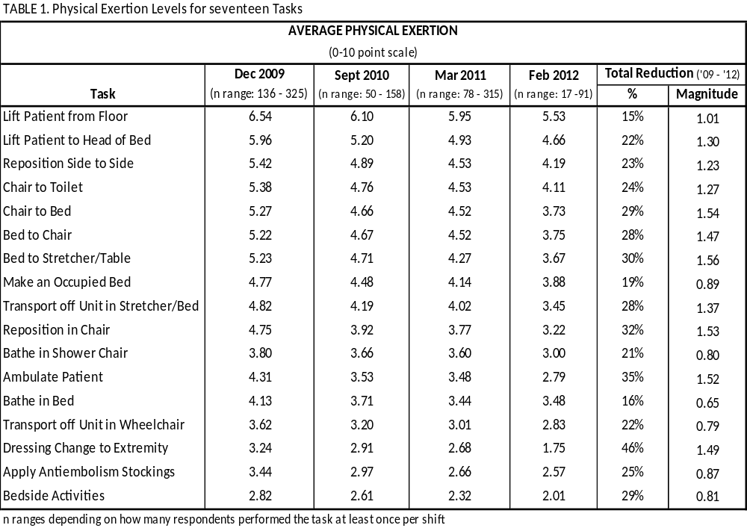
Pilot Project Outcomes
UNCLASSIFIED
Notes:
This chart only includes the units that received Ceiling lifts: 2S, ICU E, ICU W, PCU/SCU, PACU, 6S, 6N, 7N, and Radiology.
From 2009 to February 2012, there was a constant reduction amount of physical exertion it took survey respondents to perform all specified patient handling tasks, excluding bathe in bed.
However, it would be expected that this reduction in physical exertion for each task start to become very minimal, as every task that a survey respondent performs involves physical exertion to some degree. The scale also has a minimum of 0.
Transferring a patient from a chair to bed, repositioning patient in chair, and transferring a patient from a bed to stretcher/table had the largest reduction in magnitude on the 0 to 10 risk of injury scale from 2009 to February 2012.
Dressing change to extremity, however, had the largest percent reduction on the 0 to 10 risk of injury scale from 2009 to February 2012.
Tasks that involved lifting and moving patients consistently proved to be the tasks that caused survey respondents to use the most physical exertion to perform the task.
Consistent throughout all surveys, bedside activities, dressing change to extremity, and applying antiembolism stockings were the tasks that were required the least amount of physical exertion to perform.

Slide 32
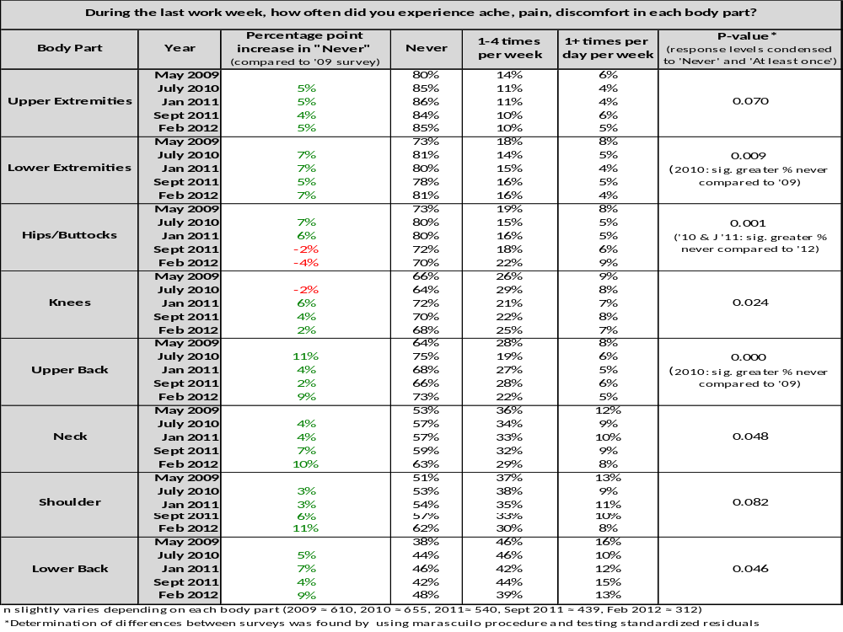
Notes:
All body regions, excluding hips/buttocks, had an increased percentage of respondents who did not experienced ache, pain, or discomfort since the start of the MSD study in 2009.
In many of the body regions, the percentage of respondents who felt they never experienced ache, pain, or discomfort was similar, indicating that a 100% response distribution of never experiencing ache, pain, or discomfort is not obtainable and that some respondents will always experience ache, pain, or discomfort in the body regions.
Lower back, shoulders, and neck are the body parts that cause the most ache, pain, and discomfort in survey respondents.
Upper and lower extremities are the body parts that respondents feel they experienced the least frequent ache, pain, or discomfort.

Slide 33
During the last work week how often did you experience ache, pain, discomfort in each body part?
Notes:
These bar graphs represent the data shown in the table on the previous slide.
All body regions, excluding hips/buttocks, had an increased percentage of respondents who did not experienced ache, pain, or discomfort since the start of the MSD study in 2009.
In many of the body regions, the percentage of respondents who felt they never experienced ache, pain, or discomfort was similar, indicating that a 100% response distribution of never experiencing ache, pain, or discomfort is not obtainable and that some respondents will always experience ache, pain, or discomfort in the body regions.
Lower back, shoulders, and neck are the body parts that cause the most ache, pain, and discomfort in survey respondents.
Upper and lower extremities are the body parts that respondents feel they experienced the least frequent ache, pain, or discomfort.

Slide 34
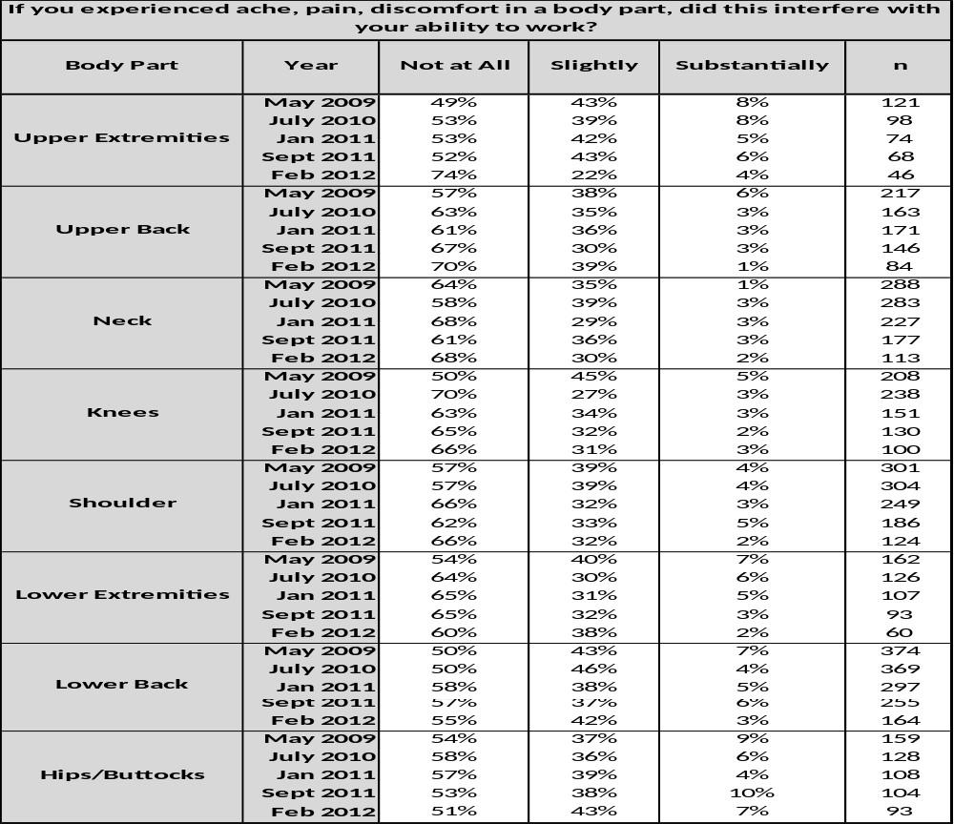
If you experienced ache, pain, discomfort in a body part, did this interfere with your ability to work?
Chart includes units where ceiling lifts were installed as part of phase I at 100%: 2S, ICU E, ICU W, PCU and at 50%: 6N, 6S,7N
Notes:
Ache, pain, and discomfort in the lower extremities, lower back, or hips/buttocks interfered the most in respondent’s ability to work.
Approximately forty to fifty percent of the respondents felt that an ache, pain, or discomfort in these lower extremities, lower back, or hips/buttocks interfered with their ability to work.
Almost all body regions had an increase in the percentage of respondents answering never to causing interference from 2009 through February 2012, indicating that fewer respondents felt that an ache, pain, or discomfort in a specific body region interfered with their ability to work.
Additionally, only a very small proportion of respondents, especially in February of 2012, felt that an ache, pain, or discomfort substantially interfered with their ability to work.
The response distribution of hips/buttocks between the four survey periods was very similar, indicating that there was little or no change in perception through the survey periods on how much an ache, pain, or discomfort interfered with their ability to work.
Only 25% of respondents felt that an ache, pain, or discomfort in their upper extremities interfered with their ability to work. However, in the three previous surveys approximately 50% of the respondents felt that an ache, pain, or discomfort in their upper extremities interfered with their ability to work. This 25% increase in ache, pain, or discomfort not affecting their ability to work was not found in any other body region.

Slide 35
Use of Ceiling Lifts
Notes:
Chart 1: This graph only includes the units that received Ceiling lifts: 2S, ICU E, ICU W, PICU/SCU, PACU, 6S, 6N, 7N, and Radiology.
After installation of the ceiling lift(s) (after 2008), the ceiling lifts were being used at least once per day by about 50% or more of the survey respondents. Two years after the first survey was implemented post-installation, the use of the ceiling lift is still increasing.
Chart 2:This graph is reflective of the results shown in the ceiling lift use chart above, but the labels and x-axis are switched. Again, this graph only includes the units that received Ceiling lifts: 2S, ICU E, ICU W, PICU/SCU, PACU, 6S, 6N, 7N, and Radiology.
Results of the χ² test (p = .000) indicate that the percent of respondents who use ceiling lifts was significantly greater in Feb 2012 and Sept 2011 compared to 2008 and 2010.
Overall, there is a steady increase from one survey to the next in the percent of respondents who use the ceiling lift. By the February 2012 survey, 70% of the respondents are using the ceiling lift at least once per day.

Slide 36
SUMMARY
Comprehensive Safe Patient Handling Program meets Joint Commission Guidelines and follows the program put forth by the Facility Guidelines Institute.
Patient handling equipment should be included anywhere patients are manually handled.

Slide 37
Questions?
POC:
Kelsey L. McCoskey MS, OTR/L
Ergonomist, CPE
Certified Safe Patient Handling Professional, CSPHP
Kelsey.McCoskey@us.army.mil
US Army Public Health Command
(410) 436-8864

