Slide 1
Stories from the Field:
From good to disastrous
Tony Hilton DrPH, RN, MSN, FNP, CRRN
Marie Martin PhD

Slide 2
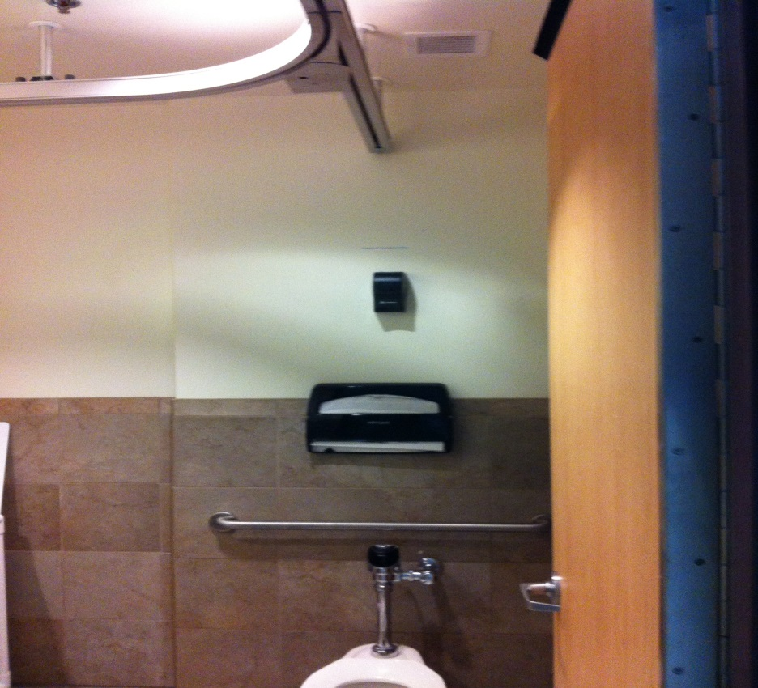
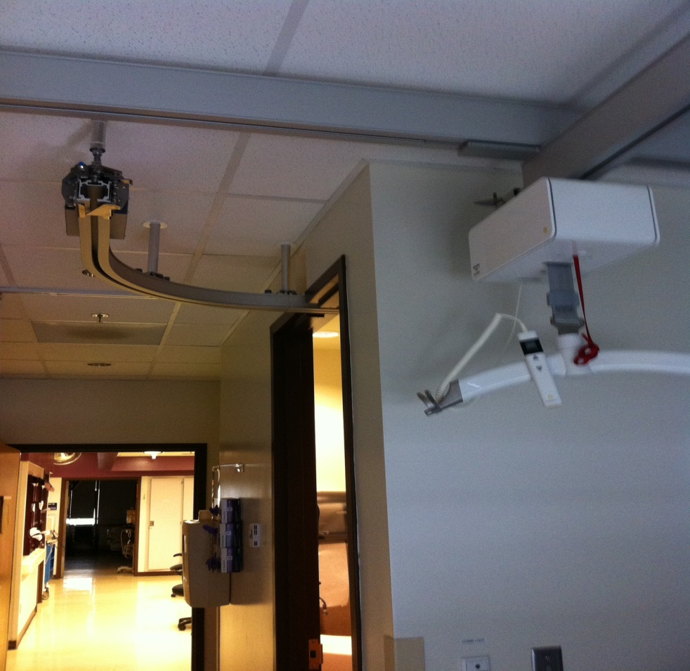
What we can do well access to shower and toilet, maximum lifting heights

Slide 3
What we don’t do well recurrent themes from Facility Champions.
Hi,
The main problem, nursing was left out of some major decision making. This oversight has really cost the staff and facility heart break for those who care. The new unit is Polytrauma-Mostly TBI patients who are forgetful and unsteady.

Slide 4
What we don’t do well
Unintended consequences and poor communication
The railing around the 2nd floor balcony as you step off the elevator is about waist level. Patients (or visitors)could climb up and jump off or bump into it and fall over
The fire doors are accordion designed and automated to close. Even though I was told they close slowly, I see patient safety as a problem. TBI patients can be very unsteady and mentally challenged as well; not to mention elderly visitors.

Slide 5
What we don’t do well inadequate communication
A staircase is across from the “climbing wall” in the same area as the children’s play area. Open for children to easily climb.
The climbing wall for patient rehab is close to children’s play area with a large light attracting attention to it
Sharps containers installed in patient rooms in bad location and infection control problem.
A new company of lifts were chosen which brings another long list of issues-training, safety and time to train staff when they float, lack of continuity, etc.
In short, there needs to be someone from the frontline, patient safety and SPHM.

Slide 6
What we don’t do well
Costly errors
I had three lifts installed in 12 ft ceilings that apparently the COR and the installer agreed was ok. This was a project where the contractor hired ARJO to install the lifts. Plus the lifts were installed on the opposite side of the room from the exam tables. I was not consulted. And now we are seeking funds to move and lower the lifts. I do not have photos. There needs to be a better review of the architect’s work also. J

Slide 7
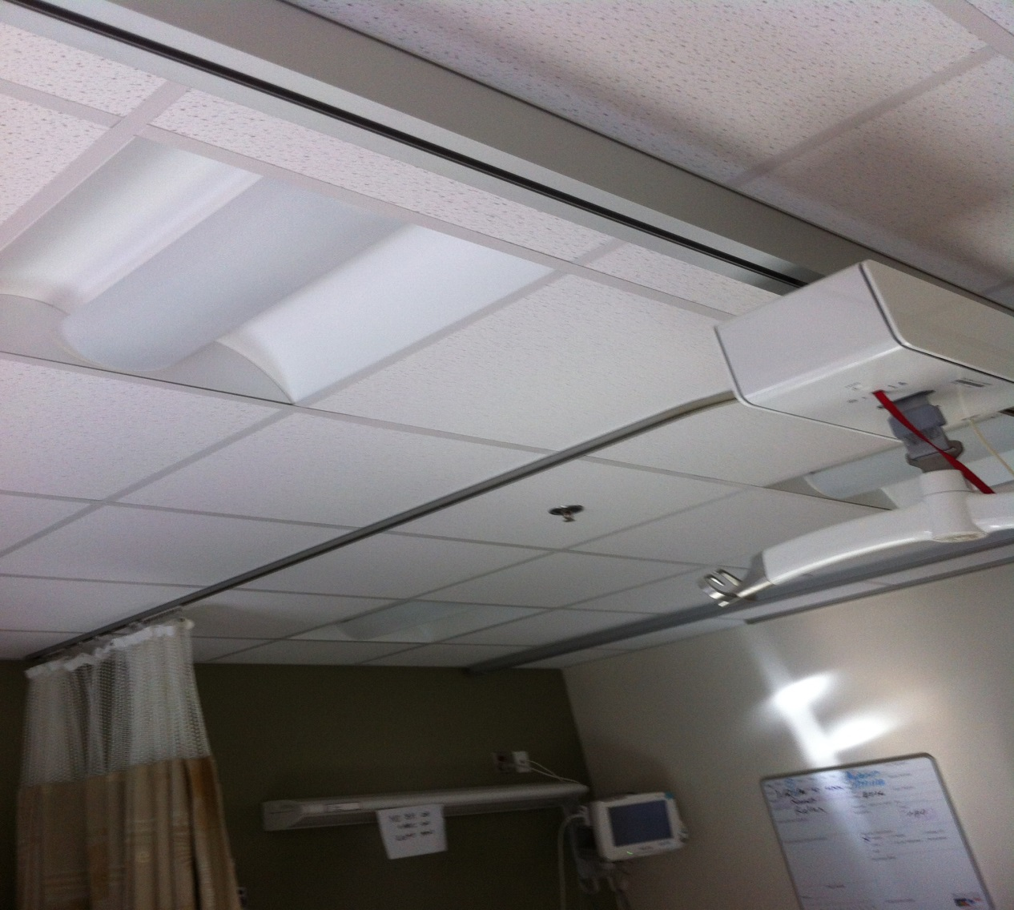
What don’t do so well
Integrating privacy curtains into ceiling lift designs

Slide 8
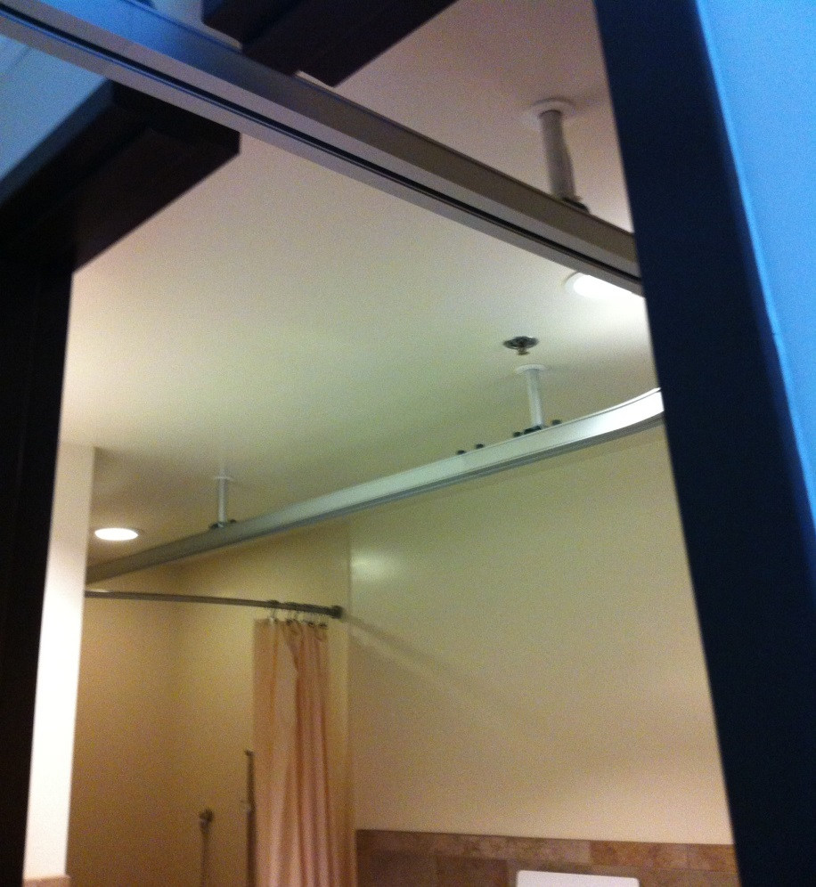

What don’t do so well
Over toilet OK unable to get into shower with curtain rod barrier

Slide 9
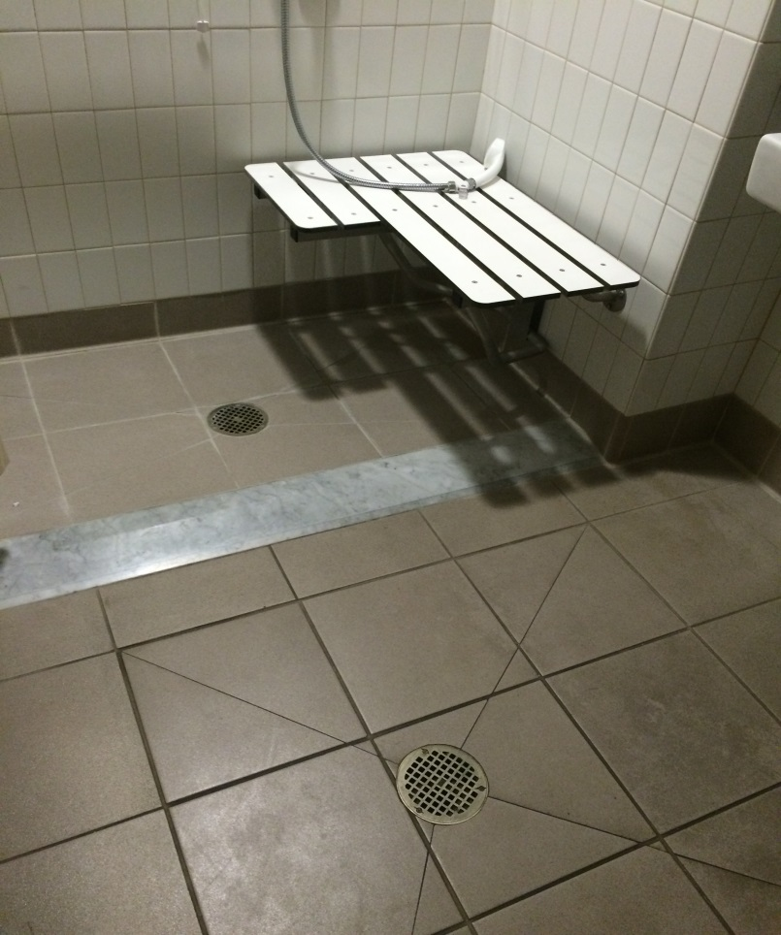
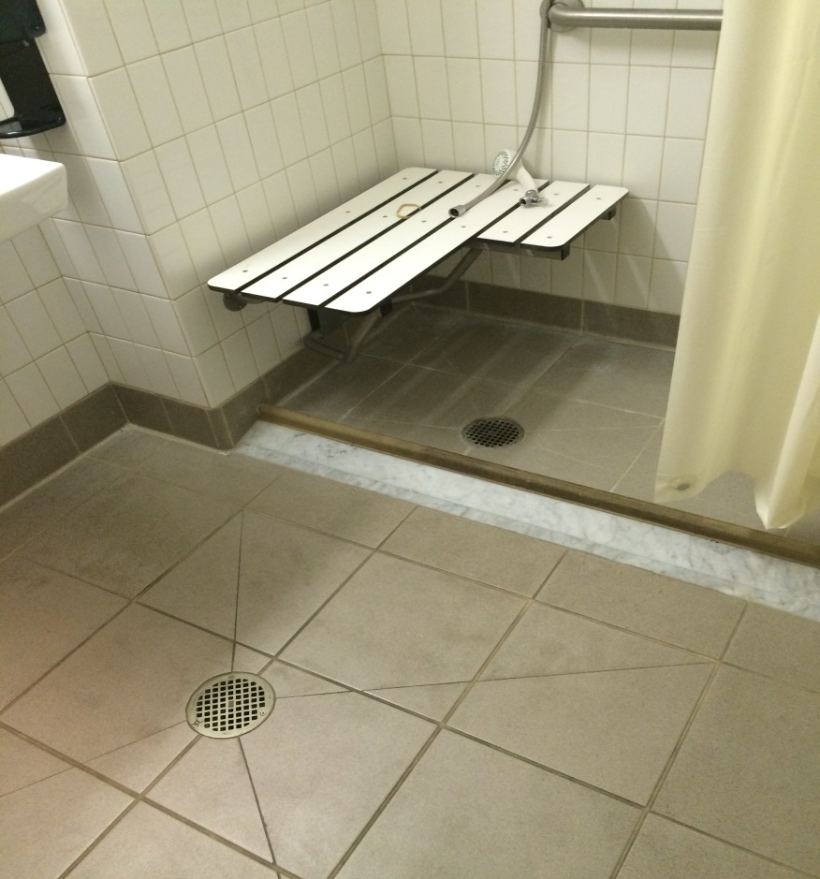
What don’t do so well
Raised shower floor with huge water spills in bathroom

Slide 10
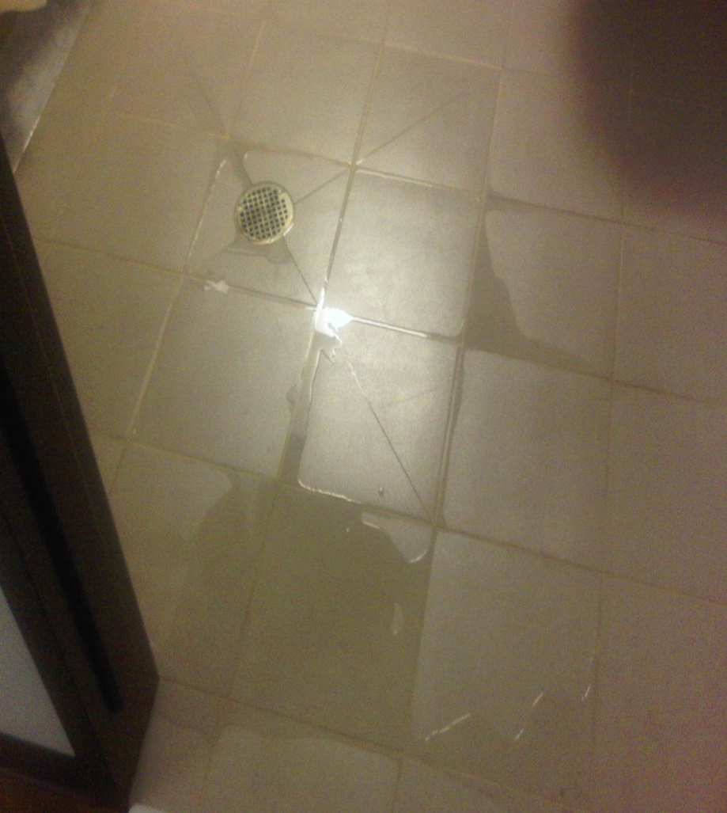
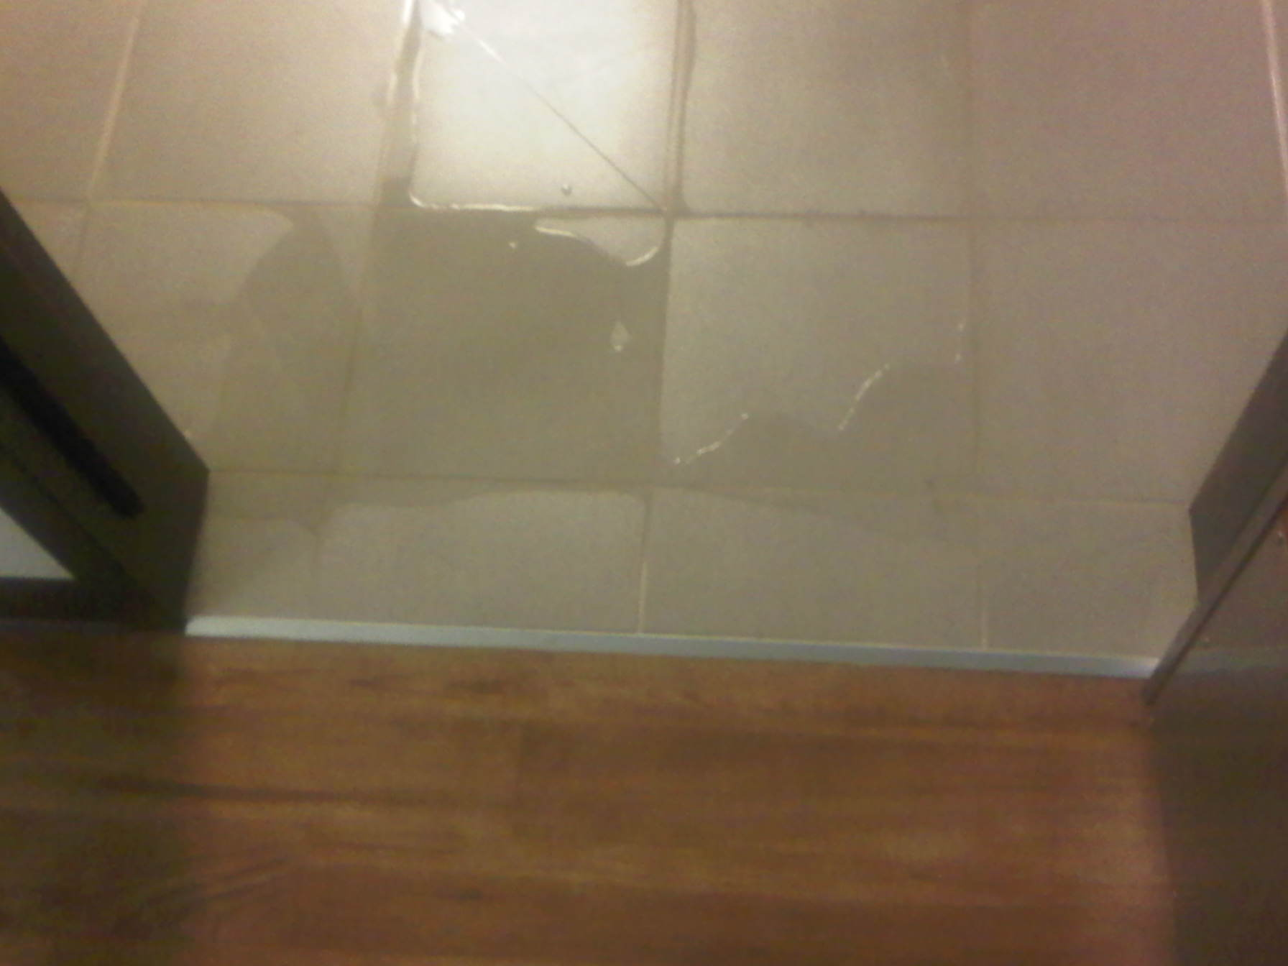
What don’t do so well
Water spills in bathroom with overflow in patient rooms

Slide 11
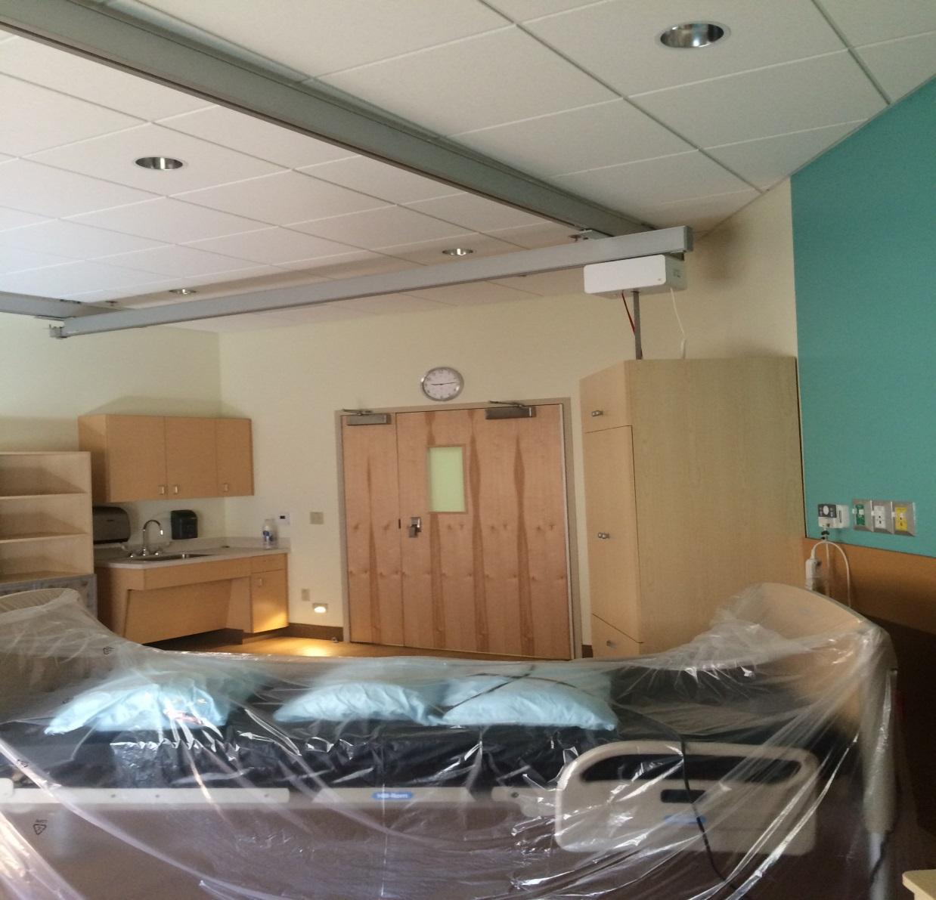
What we don’t do well
Bariatric room lift partial coverage over bed

Slide 12
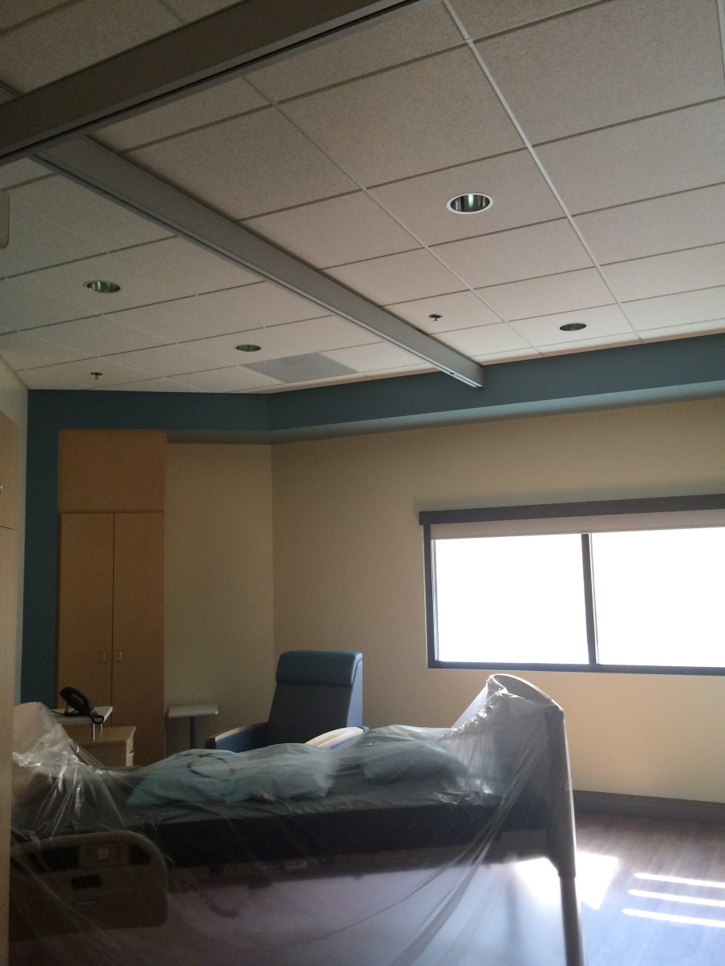
What we don’t do well
Another view overhead lift does not fit functional patient needs

Slide 13
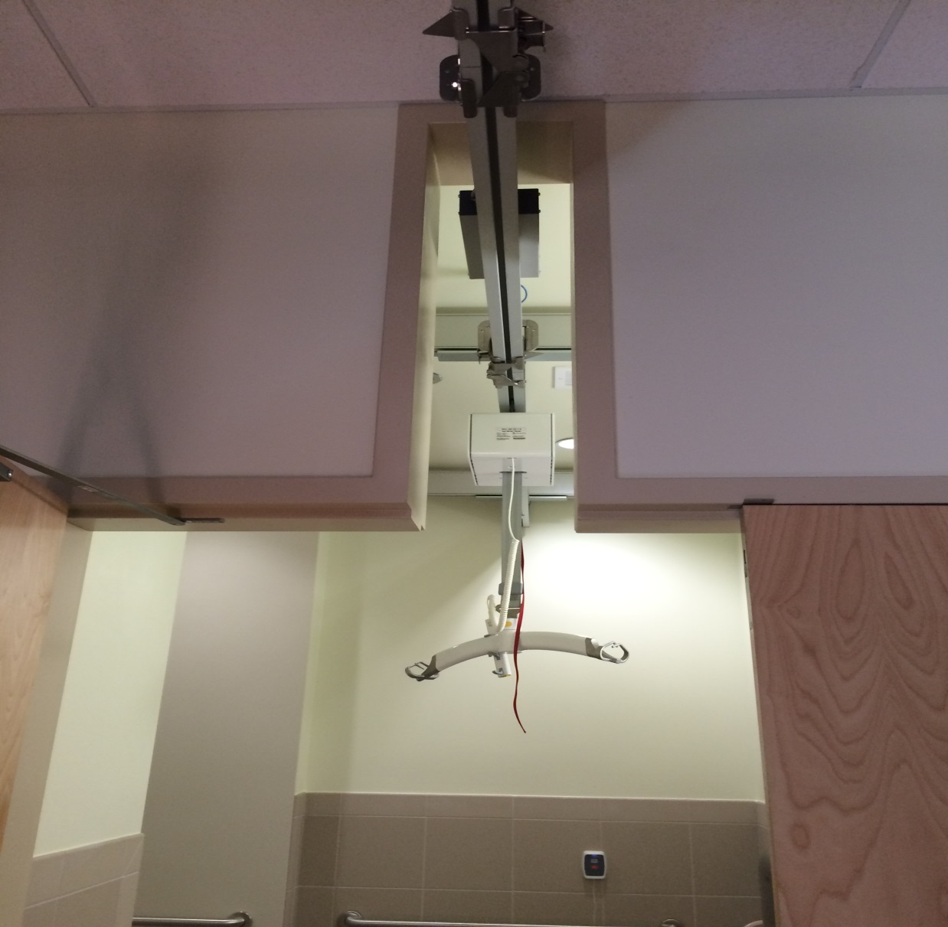
What we don’t do well limited entryway of motor

Slide 14
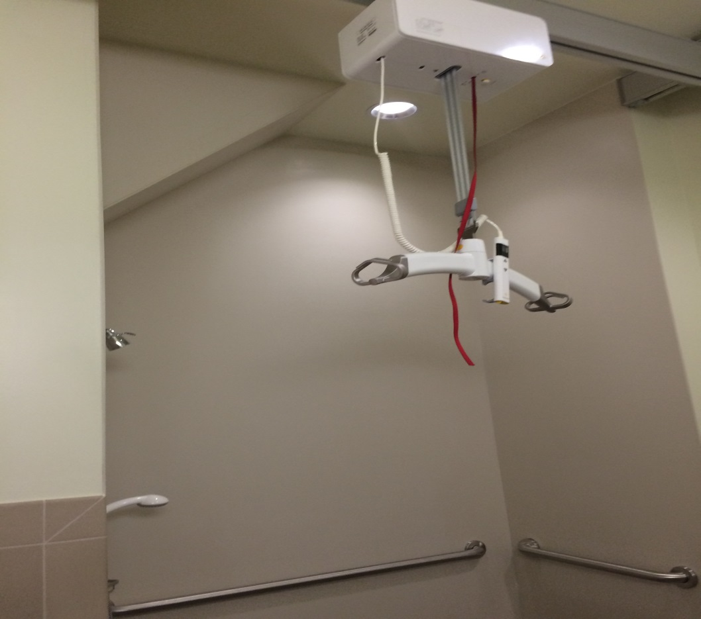
What we don’t do well
Showering outside the shower due to structural barriers

Slide 15

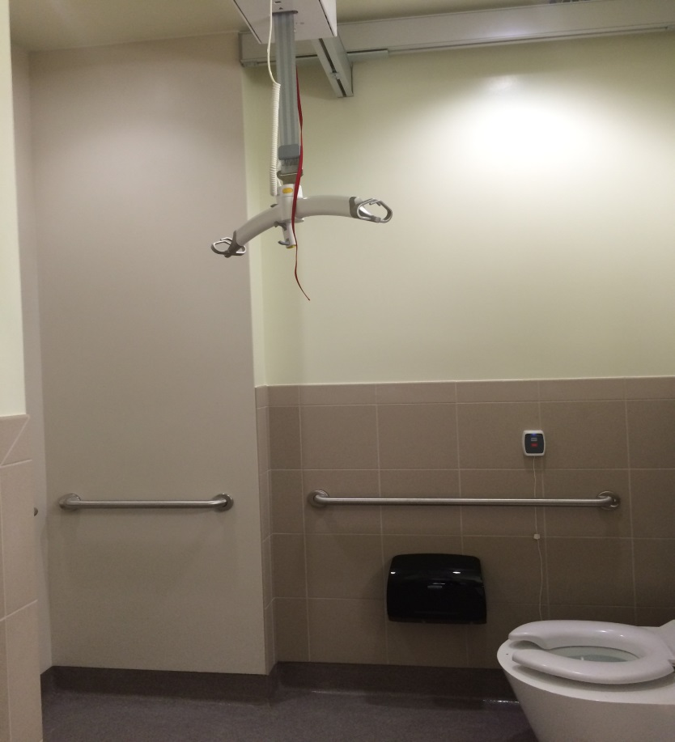
What we don’t do well
Taking a shower outside the shower ???

Slide 16
More stories to share
What actually happened
  Design carried out from architects office
What should have occurred
  SPHM FC and Guldmann should be involved in layout prior to drawing phase
Outcome
  Design did not meet desired function
  End users suffer from mistakes

Slide 17
What actually happened
Substructure installed based on plans
What should have occurred
  Substructure should be installed to as-built
Outcome
  Areas lost full coverage of ceiling lifts

Slide 18
What actually happened
  No liason person and communication
What should have occurred
Liason person to check daily on progress and issues and let installers now at what point contractors are carrying out critical work that will have an effect on patient lift rails
Outcome:
Ceilings installed before Guldmann installers arrived resulting in lost flush mounts.
Electrical contractor failed to install J-boxes.
Door company had little no knowledge of what they were trying to achieve.

Slide 19
What actually happened
  2nd phase install: substructure then patient lift with no internal walls in place.
  3rd month interval between substructure and rail install.
What should have occurred
More attention to design and the fact the system remains symmetrical
Outcome
Lifts now do not follow lines. Hinders use in some areas.

Slide 20
What we don’t do well more recurrent themes
Had two acute medical floors completely remodeled and they installed the showers 2-3 inches off of the ground. Patients who require SPH equipment or are very unsteady are unable to use because they cannot get up into the shower.
Failure to communicate construction needs with SPHC lead to 2 moveable ceiling lifts in a 10 bed house with spa that would require staff to manually move the ceiling lift from room to room; not practical. Also led to door jams not being cut into enough to allow for ceiling lift to pass through doorway while on track
Not taking space into consideration when looking at bariatric rooms, furniture, and equipment that will be needed to be used.

Slide 21
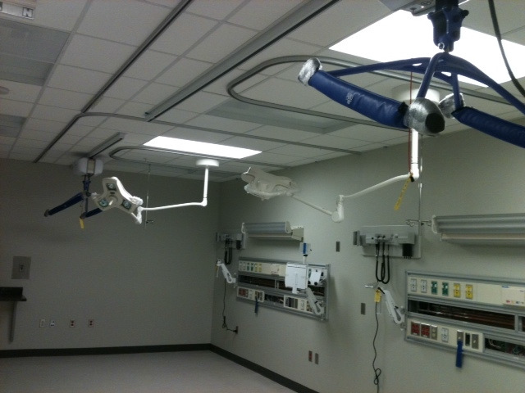
What we don’t do well single track at foot of bed

Slide 22
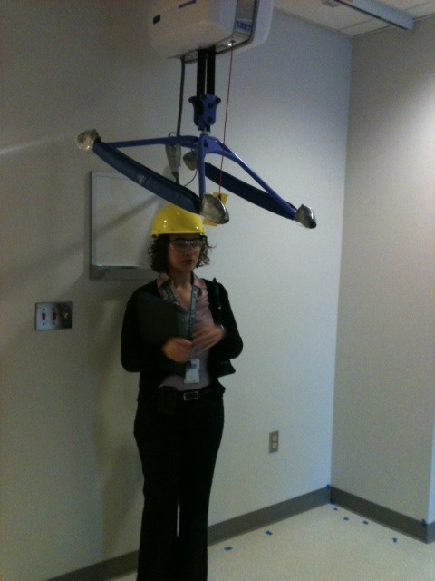
What we don’t do well
Brand new hospital with 100% incorrect installations still unresolved

Slide 23
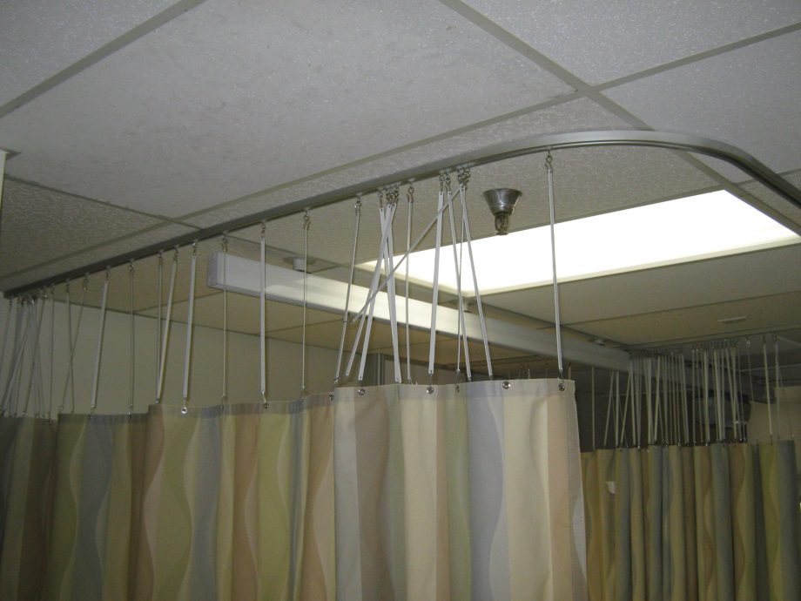
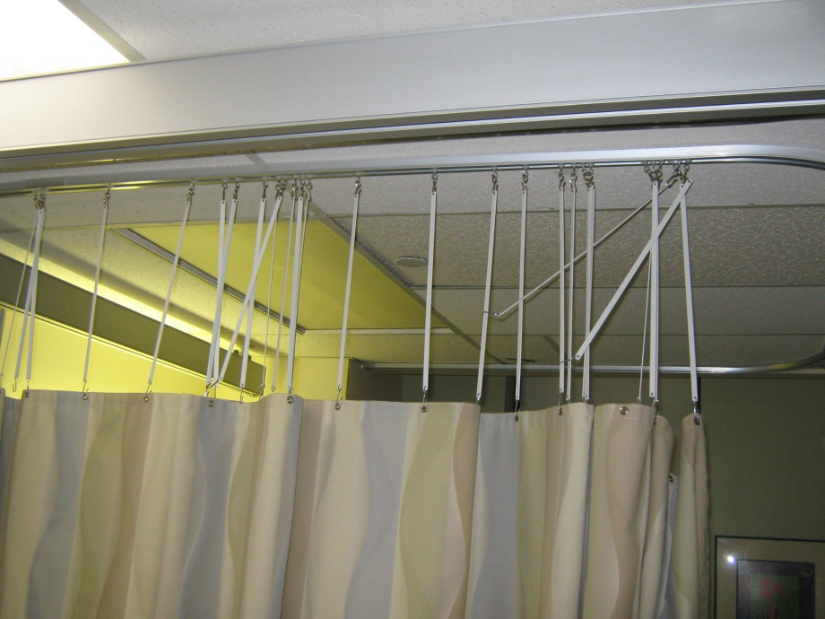
What we don’t do well more privacy curtain barriers

Slide 24
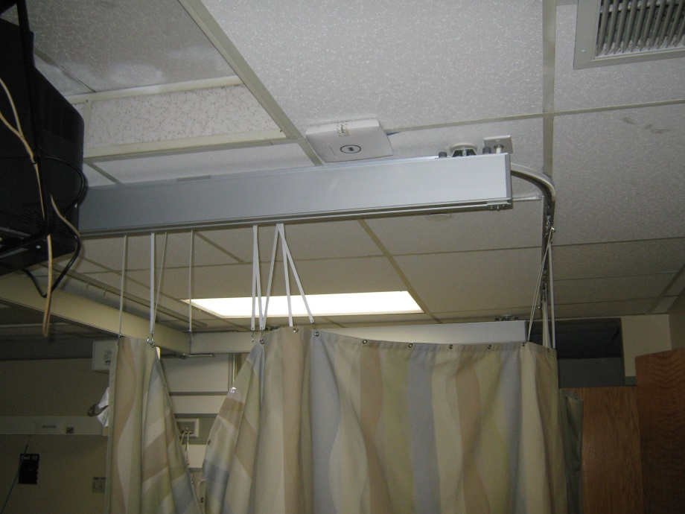
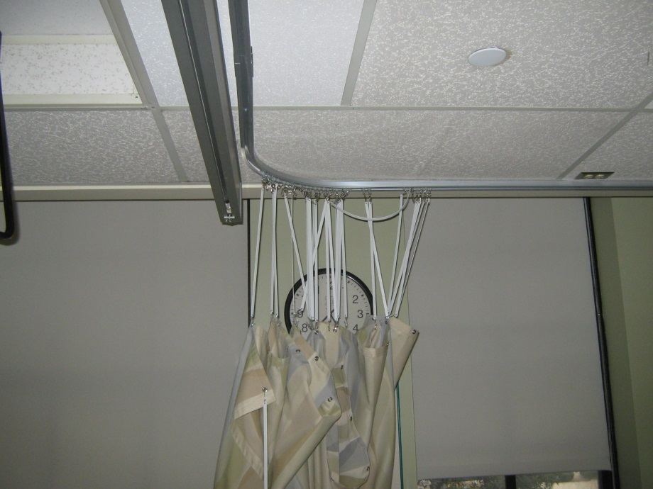
What we don’t do well more privacy curtain barriers

Slide 25
Better coordination/communication between COR, Safe Patient Handling Coordinator and clinical users +from beginning to end of the project.

