Slide 1

VHA Office of Community Care
Network RFP Updates
March 2, 2017
Gain access to Webinar: 10:30 am – 11 EST
VA Presentation: 11am – 11:30 EST

Slide 2
History and Engagement: Timeline
RFP Background
Site visits and Industry Day
Q1 FY16
Q2 FY16
Draft PWS and Industry Day
DRAFT RFP
Q3 FY16
Q1 FY17
*RFP Released on FedBizOpps
Pre-Proposal Conference and Questions from Offerors
Q2 FY17
Q2 FY17
Answers to Questions and Amendments to be Posted
Proposals Due
April 28, 2017

Slide 3
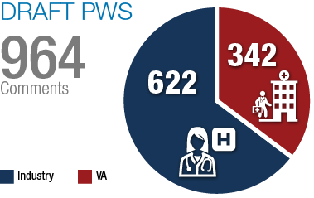
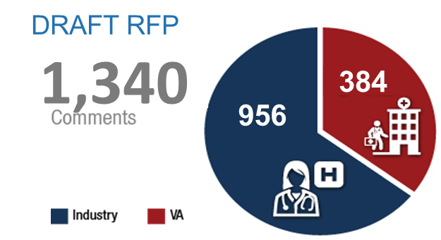

Engaging VA and Industry
~ 3,104
Total Comments and Questions
Feb 2016 Draft PWS
April 2016 Draft RFP
~800
Response to Draft PWS / RFP
Drafts were posted in February 2016 (PWS) and April 2016 (RFP)
February feedback was considered prior to VA issuing the April version
Questions and comments received and addressed from Dec RFP posting
Industry
Jan 2017 RFP & Pre-Proposal Conference

Slide 4
Proposed Changes Based on Comments and Questions
RFP | Description of Proposed Changes Made
Data and Attachments | Refreshing and expanding data in existing and new attachments to help offerors better understand scope and prepare proposals Dental volumes by station, Unique Veterans by rurality, Tier 2 call center volume projections, Zip and Claims level data (de-identified of Veteran identifiable information)
Referral and Authorization | Providing answers to ~70 related questions and adjusting requirement for more clarity and understanding
Pharmacy Network Adequacy | Adopting recommended CMS distance standards for pharmacy network locations
Optional Requirements | Adding an optional scheduling requirement, answered many questions and clarified language in the RFP for Case Management, Care Coordination and Disease Management

Slide 5
Proposed Changes Based on Comments and Questions
RFP | Description of Changes Made
Pricing/Claims & Invoicing | Clarifying claims and invoicing information and processes needed for submissions including flexibility for highly rural or hard to obtain providers/specialties Adding a Contract Line Item (CLIN) specific for Maryland HSCRS Hospital pricing Improving Home Infusion pricing based on Industry recommendation
Claims Auditing | Including requirements to improve claims auditing and recoupment of overpayments
Minor Changes | Clarifying and adjusting requirements related to Technology, Contract Clauses, Network Adequacy, Definitions, Customer Service, Benefits and High Performing Networks

Slide 6
Timeline Update (all dates 2017)
Mid-March
  Posting of Answers and Amendment
End-March
  Industry Day for open discussion and further clarification on RFP
Early April
  Opportunity for final questions from industry
Mid April
  Final Responses/Clarifications posted
April 28
  Proposal due

