Slide 1

Community Care Network
Industry Day
April 4, 2017

Slide 2
Introduction
  Veterans Health Administration (VHA)
  Denver Acquisition & Logistic Center (DALC)
  Points of Contact
    Contracting is the sole point of contact for this procurement
    Email: laura.arscott@va.gov or david.little@va.gov
  Contracting Staff
    David Little, Contracting Officer
    Laura Arscott, Alternate Contracting Officer

Slide 3
Agenda
9:00AM – 9:20AM | Introductions and welcome Dr. Yehia Deputy Under Secretary for Health Community Care (DUSH)
9:20AM – 9:30AM | Ground rules for the day
9:30AM – 10:45AM | Care in the Community discussion themes of key amendment / changes
10:45AM – 11:00AM | Break
11:05AM – 12:15PM | Questions from industry
12:15PM – 1:15PM | Lunch
1:15PM – 2:30PM | Questions from industry
2:45PM – 3:00PM | Closing

Slide 4
General Themes for Amendments
Modifications
  Respond to industry questions and requests
  Ensure consistency of:
    Definitions
    Terms
    Schedule of Services and Deliverables with PWS
  General editing and hyperlink corrections

Slide 5
SF 1449 and Important Dates
  Proposals are due by 5:00 PM MT, April 28, 2017
  Reponses will be posted April, 17, 2017
  Questions are due by close of business, April 6, 2017
  Acknowledge amendments
  Sign offer – complete boxes 30a – 30c

Slide 6
Schedule of Services
  Additions/Revisions
    CLIN XXX5 Seasonal Influenza vaccination.
    CLIN XX14AC Eyeglass Lens (progressive, bifocal and trifocal, per lens) using
    CLIN XXX8 Home Infusion Therapy
    CLIN XX11 Administrative Services
    CLIN XX12 Medical Administrative Management
    CLIN 1016 Maryland Health Services Cost Review Commission
    CLIN XX17 Agreed Upon Procedures

Slide 7
Ordering/Invoicing
  Approved Referral/Task Order communicated to the contractor through Health Information Exchange (HIE) or VA’s Data Access Service (DAS) (mandatory requirement) (B.14 Section 1)
  Clarification - Approved Referral (Task Order)
  Clarification - Medical Administrative Management Ordering
  Clarification - Invoicing requirements and expectations
  Changed in Amendment A00009

Slide 8
SOC/SSAE 18 Reporting
  Addition(s):
    Engage an unaffiliated external auditing firm to conduct a Service Organization Controls (SOC) 1, Type 2 and SOC 2, Type 2 Reports (Section 2.7)
      Initial reports must cover a minimum of nine (9) months from contact award
      Deviations to the initial report minimum must be approved by VA
      Subsequent Prime and Subcontractor Reports must always cover a minimum of 12 months
      Bridge letters are required for any gaps between the end date of the period covered by the reports and the end of VA’s fiscal year
      New Deliverables and Clarified due dates
        SOC 2, Type 2 – Prime Report
        SOC 2, Type 2 – Subcontractor Report
Notes:
Provide Key Highlights of the change
Do not provide the entire amendment language – limited to 2 to 3 slides
Do not explain why but just what it is
Provide information on associated attachment whether it changed or if it was added
Be prepared to present slides and field industry questions during the Q&A

Slide 9
Provider Networks
Provider Networks
  Addition(s): (Section 3.2)
    Only VA providers have delegated ordering official authority
    Approved referral required for VA providers ordering pharmacy services
Out-of-Network Providers (Section 3.3)
  Addition(s) - Non-network providers notifications must include a reminder to submit supporting medical documentation with the claim
Credentialing Requirements
  Addition(s) - Rehabilitation facilities: (Section 3.7.1)
    Must maintain accreditation with Commission on Accreditation of Rehabilitation Facilities (CARF)
    CARF is not required for facilities with a Joint Commission accreditation

Slide 10
CCN Health Benefit Package
CCN Healthcare Services
  Addition(s) - Chronic Dialysis Services (section 4.1 and 9.7)
    Veterans identified as transplant candidates should be directed to the referring VAMC and include appropriate transplant medical documentation
  Clarification(s) – (section 4.1.1)
    In vitro fertilization and emergency services are covered
    Ambulatory Services modified to require ambulance services to always be referred directly to VA for payment consideration

Slide 11
Referral and Prior Authorization
Notification of Emergency Care
  Addition(s) – VA determines eligibility criteria and the authority under which eligible services will be paid (Section 7.1)
Referrals Processes
  Clarification(s) – Processes for services from Ancillary providers
    Table 9 - Referral Processes and Actions (Section 7.2)
    Table 10 - Process for Transmitting Referrals from a CCN Provider to VA (Section 7.3)
  Addition(s) - Table 11a – Processes and Clarifications for Transmitting Referrals from a CCN Provider to VA for Behavioral Health (Section 7.3)

Slide 12
Scheduling of Appointments
  Addition(s):
    Contractor must report no shows to VA (Section 8.0)
    Requirements in 8.0 do not apply to 11.1 (Scheduling and Comprehensive Care Coordination optional task)

Slide 13
Medical Documentation
Medical Documentation and Escalation Process
  Addition(s) – CCN providers must submit urgent follow-up medical documentation within 24 hours of notification (Section 9.5)

Slide 14
Appointment Scheduling and Comprehensive Care Coordination
  Allows for VAMC Level of Customization
    At VA facility
    Contractor facility
    Or combination of both
  Appointment Scheduling and Comprehensive Care Coordination Implementation Plan timeframes: (Section 11.1)
    Contractor site:
      Urban – Fully operational no later than 120 days after optional task is exercised
      Rural – Fully operational no later than 120 days after optional task is exercised
      Highly Rural – Fully operational no later than 160 days after optional task is exercised
    VA Facility:
      Urban – fully operational no later than 90 days after optional task is exercised
      Rural – Fully operational no later than 90 days after optional task is exercised
      Highly Rural – Fully operational no later than 160 days after optional task exercised
  Approved referrals and relevant medical documentation to be transmitted via VA’s Community Care Provider Portal (Section 11.0)
    VA and contractor to collaborate on the use of other systems and technologies to support these tasks as they become available
Notes:
Provide Key Highlights of the change
Do not provide the entire amendment language – limited to 2 to 3 slides
Do not explain why but just what it is
Provide information on associated attachment whether it changed or if it was added
Be prepared to present slides and field industry questions during the Q&A

Slide 15
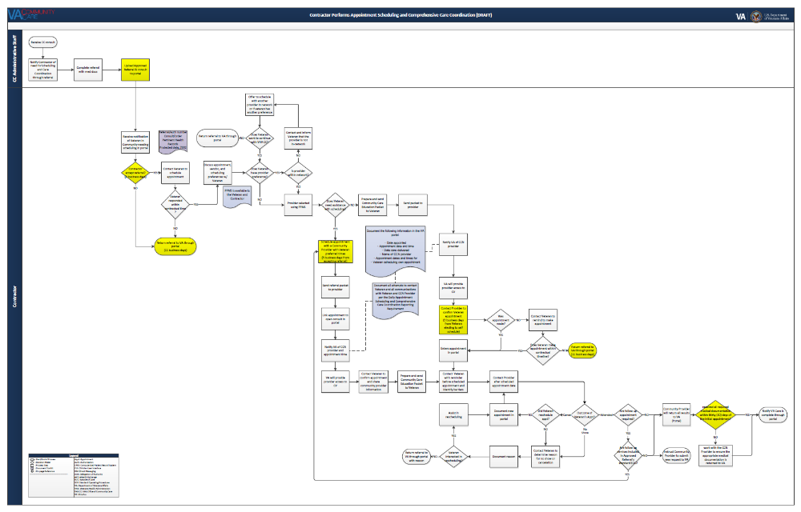
Appointment Scheduling and Comprehensive Care Coordination

Slide 16
Appointment Scheduling and Comprehensive Care Coordination
Modified optional task
  Appointment Scheduling and Comprehensive Care Coordination Plan
    Scheduling Components: (Section 11.1)
      Supports self-scheduling
      Includes a quality assurance component (performance and quality measures, staffing (e.g., capabilities, minimum qualifications, attrition, location, specialization based upon complexity of cases))
      Ensures
        First appointment is scheduled within five (5) business days from acceptance of Approved Referral (QASP performance object 17)
        First appointment is completed within thirty (30) days of the Care Indicated Date, unless an appointment or provider whose first available appointment is outside of those requirements is requested
        Unscheduled appointments are returned to VA with eleven (11) days from acceptance
      Ensures the geographic accessibility requirements in Sections 3.1 are met
      Notifies VA of the CCN Provider (to allow VA to establish provider access to the Veteran’s EHR)
      Sends confirmation notification to Veteran
Notes:
Provide Key Highlights of the change
Do not provide the entire amendment language – limited to 2 to 3 slides
Do not explain why but just what it is
Provide information on associated attachment whether it changed or if it was added
Be prepared to present slides and field industry questions during the Q&A

Slide 17
Appointment Scheduling and Comprehensive Care Coordination
  Appointment Scheduling and Comprehensive Care Coordination Plan (Continued)
    Comprehensive Care Coordination Components: (Section 11.1.3)
      Obtains appointment dates and times for Veteran scheduled appointments
      Identifies barriers impacting Veterans from attending appointments
      Requires follow-up to ensure appointment was kept, and ascertain any supplemental requirements
      Provides discharge planning liaison support to VA
      Confirms VA receipt of medical documentation within thirty (30) days of the initial appointment and at the completion of Episode of Care from the CCN Provider
        Works with the provider to obtain missing medical documentation (This is outside the escalation process in Section 9.5.)
      Contacts Veterans to determine and document reasons for cancellation or no show
      Reschedules and documents new appointment details
      Assists Veterans in scheduling approved additional care
Notes:
Provide Key Highlights of the change
Do not provide the entire amendment language – limited to 2 to 3 slides
Do not explain why but just what it is
Provide information on associated attachment whether it changed or if it was added
Be prepared to present slides and field industry questions during the Q&A

Slide 18
Appointment Scheduling and Comprehensive Care Coordination
  Appointment Scheduling and Comprehensive Care Coordination Plan (Continued)
    Comprehensive Care Coordination Components: (Continued)
      Administers a discharge planning program for Veterans under this task:
        Discharge Planning Plan to include the program design for managing inpatient discharges to VA for approval thirty (30) days prior to execution
        Establishes Discharge Planning Liaison positions to facilitate the transfer of information from the Contractor to VA
          Discharge Planning Liaisons are not required to be co-located in VAMCs; however, specific contact information for each Discharge Planning Liaison must be provided
        Transferring Veterans to VA in accordance with the “VHA Directive 1094 January 11, 2017 Inter-Facility Transfer Policy” or its replacement directive https://www.va.gov/vhapublications
  Addition(s) –
    Attachment - AH Appointment Scheduling and Comprehensive Care Coordination Estimated Volumes (Section 11.1.4)
    Deliverables (Section 11.1.4, 11.2, 11.3, 11.4 and 20.4)
Notes:
Provide Key Highlights of the change
Do not provide the entire amendment language – limited to 2 to 3 slides
Do not explain why but just what it is
Provide information on associated attachment whether it changed or if it was added
Be prepared to present slides and field industry questions during the Q&A

Slide 19
Claims Processing and Adjudication
Claims Submission and Processing Timeframes
  Addition(s): (Section 12.4)
    Term ‘adjudicate’ includes the expectation payment is issued within thirty (30) days
    Contractor:
      Confirms the actual date of receipt is entered in the ICN
      Applies all required claims aging and inventory controls to all claims
      Counts the actual date of receipt as day one
      Process all “other than clean” claims within 45 days of receipt
      Claims adjustment (Positive and Negative)
Service Connected Disability Healthcare Services
  Addition(s) - “Whenever the Contractor is aware of potential Third Party liability, e.g., Workman’s Compensation, automobile insurance liability insurance, etc., through the normal course of business, the contractor will notify the COR in writing of such potential Third Party liability within 30 days of identifying the event.” (Section 12.7.1)

Slide 20
IPERA
VA has determined Care in the Community as a program susceptible to significant improper payments
  Addition(s) (Section 12.14)
    Ensure VA is invoiced in accordance with the contract pricing and payments guidelines and only for services authorized through an Approved Referral
    Maintain accurate accounting of payments and Standard Episodes of Care and make those documents available to VA or another Federal Partners
    Cooperate and provide any records to ensure compliance with healthcare invoicing / medical claims processing requirements
    Aggregate data using the format found in Attachment U Rev 2 Data Specification
    Use a third-party AICPA auditor to conduct audits and provide quarterly reports IAW OMB Circular A-123, Appendix C
    Submit rebuttals of audit error findings to the auditor and VA
    Repay VA for the projection of overpayments
    Refer to Section 20.4 for additional deliverables
  Clarification – Incentives/Disincentives (IDF 5)

Slide 21
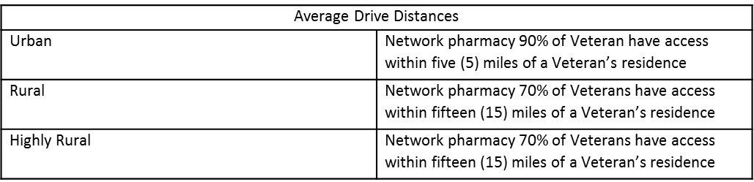
Pharmacy
Urgent/Emergent Prescriptions
  Modification(s) Fax continuation of treatment prescriptions to VA Pharmacy, vice CMOP (section 15.1)
    Table 12 Network Pharmacy Minimum Access Standards (section 15.2)
  Addition(s) - Contractor must offer a National Formulary alternative when medication from the VA Urgent/Emergent National Formulary is not acceptable (Section 15.1)
Routine/Maintenance Prescriptions
  Addition(s) - VA to provide SEOC listing of approved vaccinations and CPT/billing codes that will be reimbursed without further authorization from VA (Section 15.3)

Slide 22
Durable Medical Equipment
Urgent/Emergent Prescriptions for DME and Medical Devices
  Addition(s) (Section 16.1)
    CCN providers assess cost effectiveness of a rental option for an urgent/emergent DME/Medical Devices
    Rental period limited to 30 days
    CCN providers submit long term need of urgent/emergent DME/Medical Device to VA for fulfillment
Eyeglasses
  Addition(s) – Numerous additional lenses were added to the list of lenses that require a review and approval by VA (Section 16.3)

Slide 23
Technology
Contractor System Access
  Addition(s) - Application Programming Interfaces (API) access for future use (Section 18.3)
VA System Integration Requirements
  Addition(s) – VA’s intent to collaborate with contractor to identify and adopt future, more sophisticated technologies (Section 18.4)
Contractor Portal
  Addition(s) - Access to real-time pharmacy dispensing data from the Contractor’s PBM to prevent medication errors and maintain clear communication with network providers and patients (Section 18.8)

Slide 24
Technology (cont)
VA Community Care Provider Portal
  Clarification - Scheduling and comprehensive care coordination (Section 11 and 18.7)
    Where option(s) are exercised, the Contractor will use the VA Community Care Provider Portal to:
      Receive Referral and Authorization details from the VA
      Access the Veterans’ electronic health record
      Facilitate workflow tracking
      Record CCN Provider assignment and communicate back to the VA
      Record appointment date/times and communicate back to the VA
      Request additional details from the VA
      Submit records/documentation to the VA

Slide 25
Data Analytics
Data Repository and Data Repository Relational Database Schema
  Modification(s) - Standardize and finalize the report format and schema changed to within 30 days of award (Section 19.2)
Interactive Dashboard
  Clarification(s) - “The Contractor must always make available, in accordance with the Schedule of Deliverables, prior business day data update by 9AM ET, interactive dashboard to include all performance standards in the QASP” (Section 19.3)
Data Integrity
  Addition(s) - “A data integrity issue is identified when an ETL thru DAS is rejected at the receiving VA database. VA will notify the Contractor of the ETL failure when it is noted by VA staff which will normally be the next business day. VA reserves the right to identify issues of physical or logical properties. ETL’s to VA DAS that are rejected for non-compliance with the VA provided specification must be corrected within two business days of notification by VA. Any other data integrity issue identified by VA must be corrected within 30 days of observation and notification of the Contractor by VA.” (Section 19.5)

Slide 26
Contract Clauses
Guaranteed Minimum satisfied by payments to CLIN XX11
Region | Minimum per Option Period
1 | $ 1,930,000
2 | $ 5,190,000
3 | $ 5,610,000
4 | $ 7,110,000

Slide 27
Attachments – Section D – Revisions
  Attachment A Rev 1 VA enrollees by County and Closest SC Site FY15Q4
    Provides size of enrolled population
  Attachment BA Rev 1 and 2 QASP Appendix 1 CCN Performance Requirements Summary
    Clarified performance Standard language
    Clarified performance objectives (How/Steps)
    Added new performance objectives for scheduling and comprehensive care coordination (PO 17- PO 23)
  Attachment E Summary Demand Data
    Provides demand levels
  Attachment F Rev 1 Projected Active Veterans
    Provides potential population to be served
  Attachment H Rev 1 Eligibility Verification and Enrollment Data Exchange
    Deleted requirement for Veterans Choice Card Reporting Formats
  Attachment T Rev 2 and 3 Incentive Plan
    Clarified IDF5 from payment rules to IPERA and calculation
    Clarified IDF6 calculations
  Attachment TA Rev 1 and 2 Incentives Disincentives Factor Summary
    Clarified IDF4 logic
    Clarified IDF5 logic
  Attachment U Rev 1 and 2 Data Specification
    Addresses some requests for clarification
  Attachment W Rev 1 Update with Scheduling Care Coordination
    Provides insight to level of effort for database

Slide 28
Attachments – Section D – Additions
  Attachment X Dental Volumes
  Attachment Y Tier 2 Call Volume Estimate
  Attachment Z Station Category of Care provider Zip Unique
  Attachment AA Uniques by Rurality by Station FY15
  Attachment AB Pharmacy 14 Day Fills FY15
  Attachment AC No Shows FY15 CHOICE Only
  Attachment AD Dialysis Rurality Uniques Visits BDOC by Zip
  Attachment AE VA National Formulary January 2017
  Attachment AF Home Infusion by Station FY15
  Attachment AG FY15 Urgent vs Emergent Care
  Attachment AH Appointment Scheduling and Comprehensive Care Coordination Estimated Volumes

Slide 29
Instructions to Offerors
  E.2 VAAR 852.273-70 Late Offers (JAN 2003) renumbered to Section E.3
  E.3 VAAR 852.273-74 Award Without Exchanges (JAN 2003) renumbered to Section E.4
  E.2.4 Deleted and Replaced to accommodate the following:
    The font for the Technical Volume shall be in Times New Roman type with a minimum 10 point font. There are no restrictions for the font size or style for the Business Volume.
  E.2.7.3 Price Proposal revised to add:
    Specific to CLIN XXX8 - Offerors shall submit a Microsoft Excel file containing proposed prices for Home Infusion Therapy services for current CPT or HCPCS services that do not currently have a Medicare reimbursement rate. Provide a default reimbursement rate (%) for any Home Infusion Therapy in which a reimbursement rate may not have been established

Slide 30
Instructions to Offerors (Continued)
  E.2.7.3 Price Proposal revised to add (Continued):
    Offerors may instruct any proposed subcontractors who desire to submit sealed pricing to clearly identify the prime offeror by name to allow VA contracting to associate the subcontractor's package with the correct prime offeror. Sealed packages from subcontractors shall use the same delivery location and date for receipt of offers.
  E.2.7.3.1 was revised to delete the 4th bullet and replace with:
    As an addendum to the narrative description, submit documentation that demonstrates adequate financial resources. Sufficient documentation may include irrevocable letters of credit or available cash balances for the offeror in the amounts of $100,000,000.00. The addendum does not count against the page limitation for the price proposal narrative description.

Slide 31
Instructions to Offerors (Continued)
  E.2.7.5 Past Performance revised to delete the paragraphs after (b) and replaced with revised instructions for the Past Performance Data Sheet
  E.2.8.1 revised to delete the first bullet and replaced with:
    Specific approach for developing and maintaining a high performing network as described in the requirements. Please include in this approach the number of current providers within network by county and each specialty, by Addendum to the technical proposal in Excel format. Submit an Excel file that contains the current provider data. Hard copy is not requested
  E.2.8.2 second bullet was revised to delete sub-bullet “care coordination follow-up” and “performance management”. A new final sub-bullet was added as “operational quality and reporting”
  E.2.8.2, third bullet was revised to delete “to include how the security requirements apply to its approach”; fourth bullet was revised to add “(B.16, 2.8.1 Transition Plan)” and “(B.16, 2.8.2 Transition Out)” references.

Slide 32
Evaluation
  E.5, Addendum to VAAR 852.273-73 Evaluation Factors, (c)(4) was revised to
    Updated all CLIN weights for evaluation purposes. CLIN XXX8 was also removed from the total evaluated price.
  E.5 Solicitation Attachment 1 – Past Performance Data Sheet was deleted and replace with “Solicitation Attachment 1 – Past Performance Data Sheet Rev 1”
  E.17 52.212-3 Offerors Representations and Certifications – Commercial Items (OCT 2016) was deleted and replaced with 52.212-3 Offerors Representations and Certifications – Commercial Items (JAN 2017)

Slide 33
THANK YOU
  Questions due April 6, 2017 close of business
    VA will use its discretion in considering questions submitted after this date
  Proposals due April 28, 2017, 5:00 PM Mountain Time
Contact information: laura.arscott@va.gov or david.little@va.gov
Please continue to watch FBO.gov for amendments.

