Slide 1
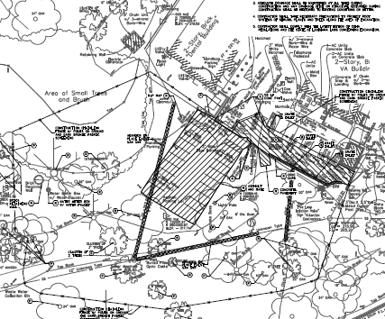
PHASE A: Maintain 1-Way thru traffic behind Bldg 6 Mon – Fri, 6:00AM – 5:00PM
Dental
Clinic
Construction
Fence
Bldg 6
PHASE A

Slide 2
PHASE B: Work in this area can happen before Phase A starts or once Phase A completes
Dental
Clinic
Construction
Fence
Bldg 6
PHASE B
PHASE B: Must facilitate turn-around access/flow for Dental Clinic traffic,
OR be worked to be performed during Phase A but only on weekends or
after hours and not impact Dental Clinic Access

