Slide 1
ATTACHMENT 04

Slide 2
Keokuk National Cemetery Columbarium Project
by Higdem, Ryan L.

Slide 3
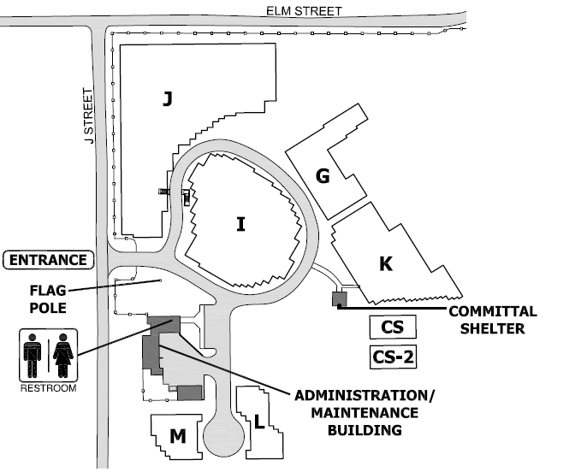
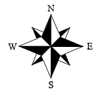
KNC Western Portion – Proposed Columbarium Orientation Map
NOTES:
Columbarium located in unutilized area at KNC
No current future development plans for proposed site
Currently illustrated layout assumes 2 columbarium rows of 250 niches
  25 x 5 double sided
  Estimate 35’ length each
Height relative to other KNC sections can be taken into consideration as backfilling the area will be required
  Backfilling similar to what was done in sections L & M
  Sight lines to sections CS & CS-2 can be left unobstructed
Can be made accessible from loop around section I and from front parking lot with sidewalk
Proposed Columbarium Section

Slide 4
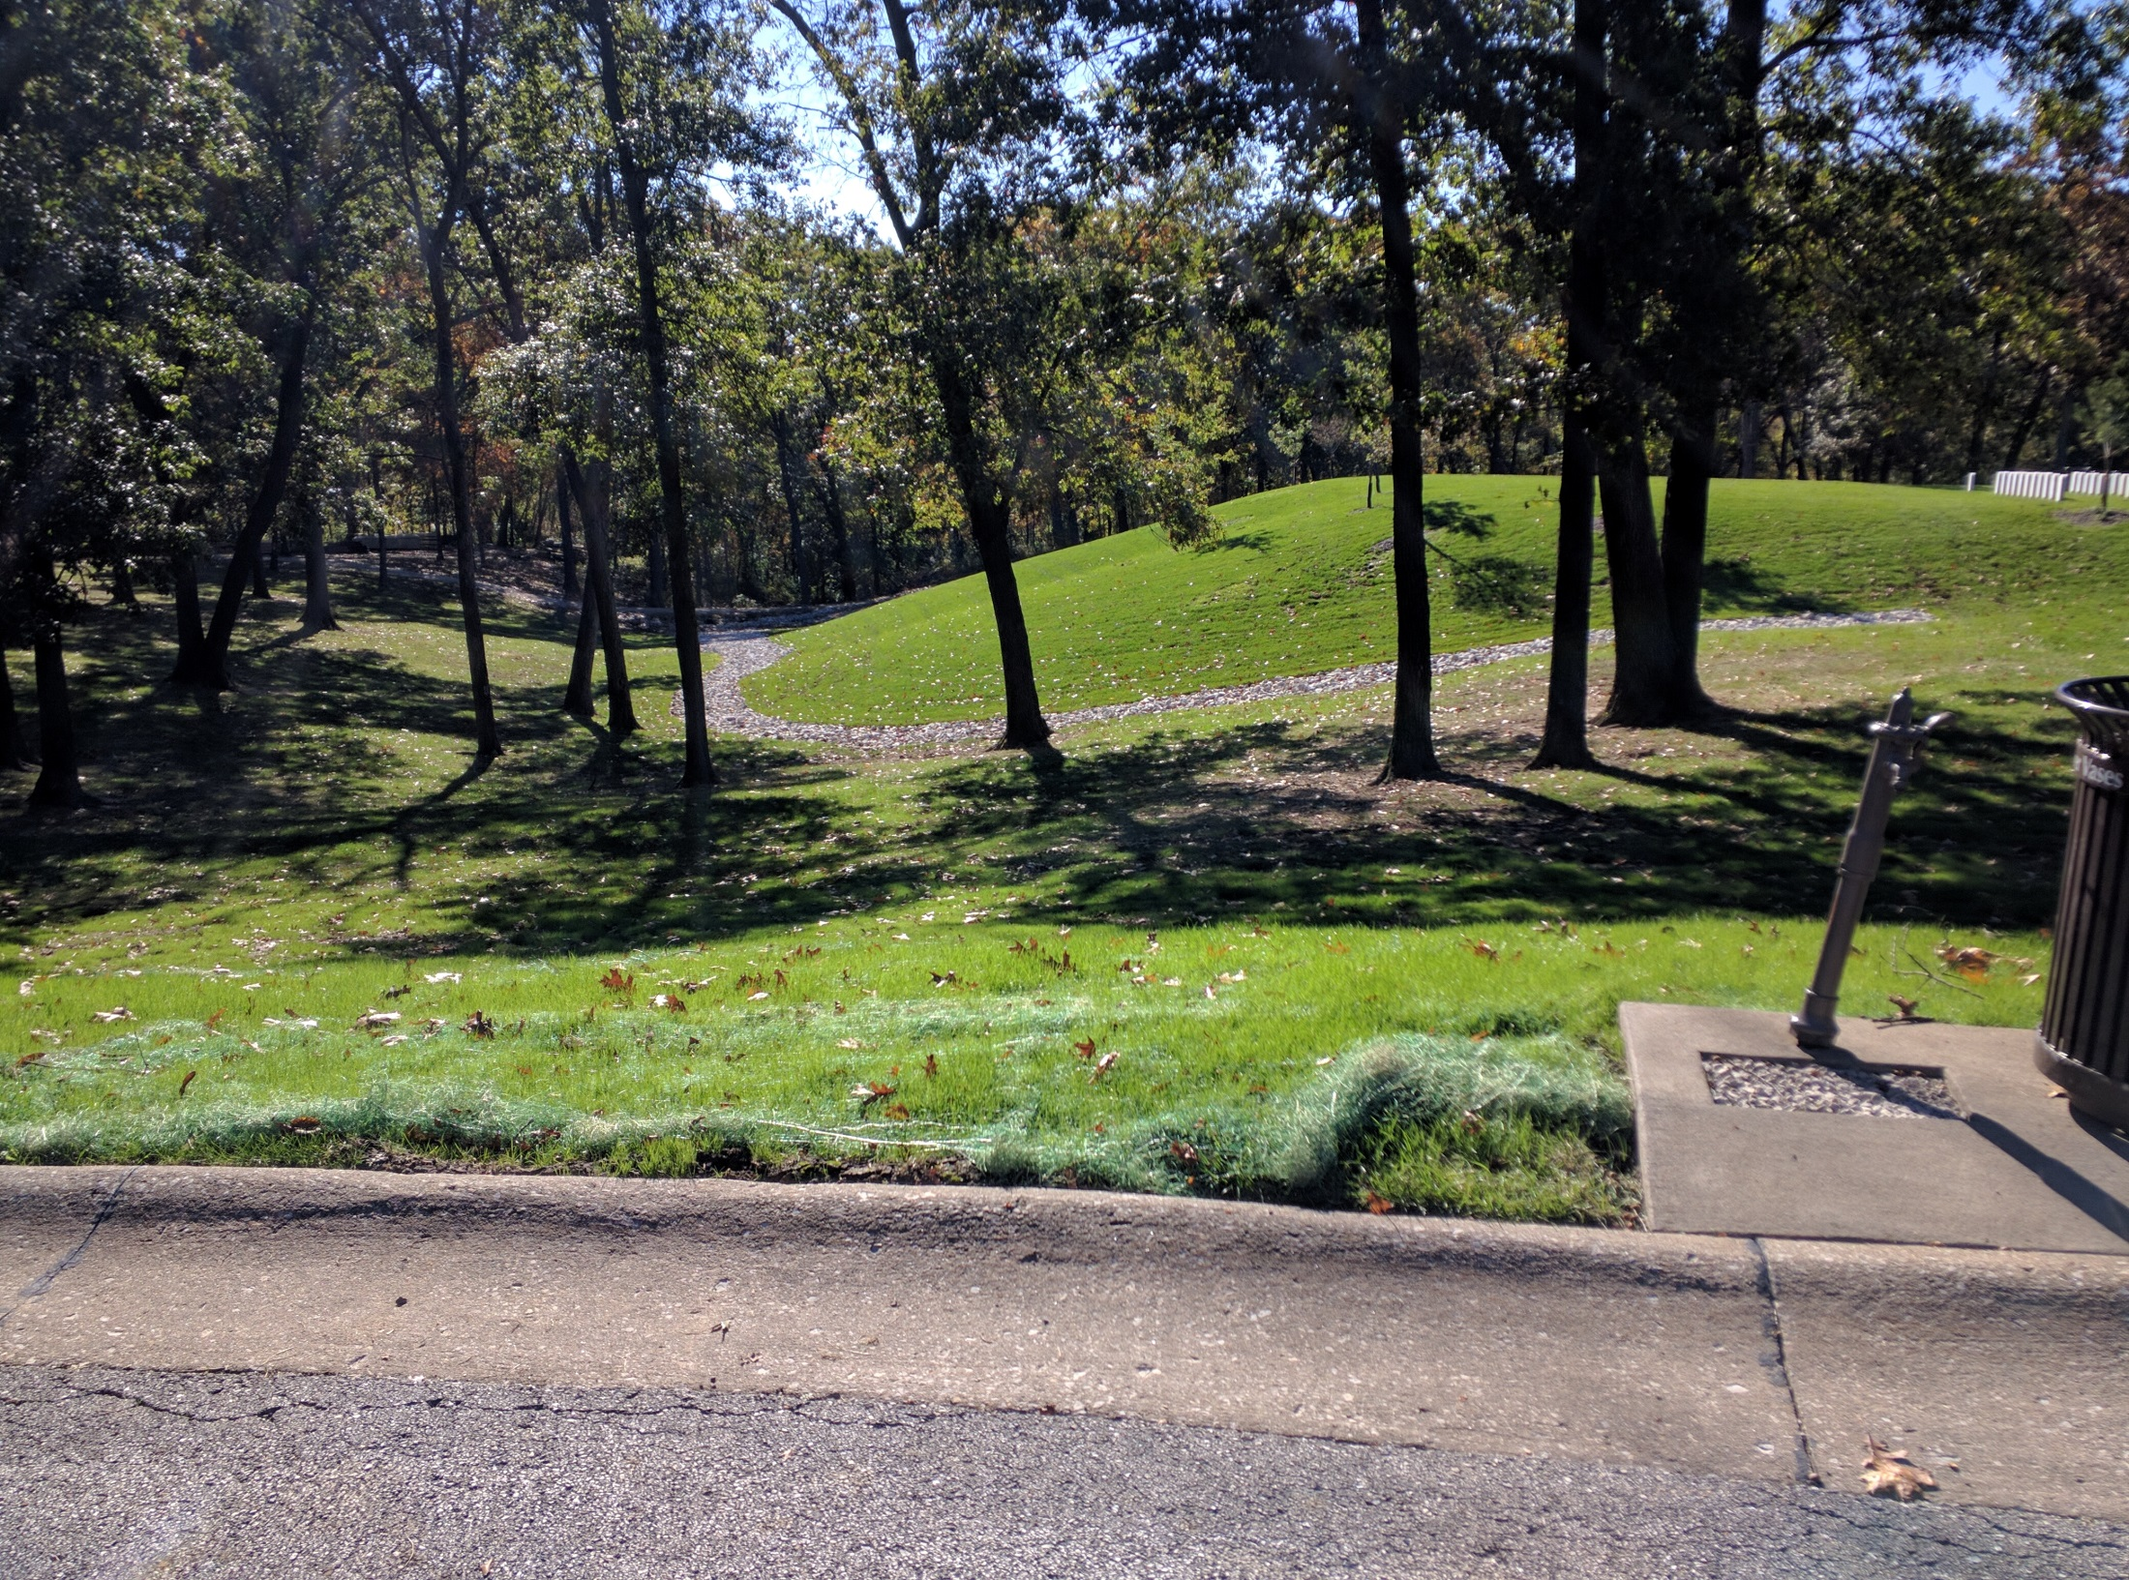

Slide 5
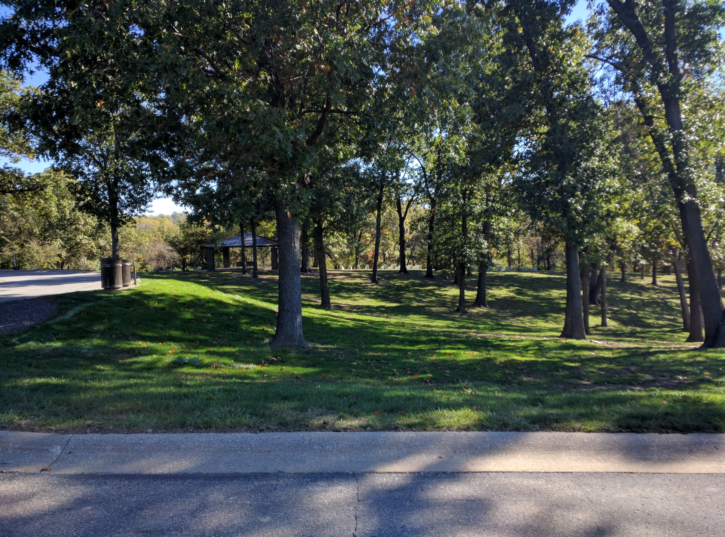

Slide 6
