Slide 1

Department of Veterans Affairs
Network Contracting Office (NCO) 21
Parking Counter System, Parking Structure #1
Pre-Bid Conference / Site Visit May 11, 2017

Slide 2
Expand Emergency Department
Facilities – Project No: 640-396
PRE-BID CONFERENCE
SOLICITATION NUMBER: VA261-17-B-0375
Parking Counter System, Parking Structure #1
Project No: 640-17-104
PROJECT LOCATION: VA, Palo Alto California.
Please Sign In

Slide 3
Expand Emergency Department
Facilities – WELCOME
Agenda
Introductions
Contracting Procedures
Contract Officer: Ferdee Gawaran
Project Overview by Contracting Officer Representative (COR): Nick Rustia
Site Walk: Immediately after presentation

Slide 4
Expand Emergency Department
Facilities – Project No: 640-396
This acquisition is 100% Total Service Disabled Veteran Owned Small Business (SDVOSB) set aside in accordance with Public Law 109-461.
Acquisition method using FAR Part 14, Sealed Bidding.
I will be your point of contact for this project.

Slide 5
Contact Info
My email, phone, and fax contact information is as follows,
With a preference for email for electronic ease and confirmation:
Email: ferdinand.gawaran@va.gov
Phone: (925) 372-2314
Fax: (925) 372-2220
My Official / USPS mailing address is as follows:
Department of Veterans Affairs
Network Contracting Office (NCO 21)
Bldg. AB7, Room AB736
150 Muir Road
Martinez, CA 94553

Slide 6
RFI’s
Any issues, concerns, questions, or Requests for Information (RFIs), even if they are answered here today, should be forwarded to the Contracting Officer (CO), in writing, preferably by email. This process confirms an official written record of RFI.
However, please note that the last day to submit RFIs is NLT COB
May 22, 2017.
The Solicitation shall be accessed, FREE at the FBO website:
WWW.FBO.GOV

Slide 7
STANDARD FORM 1442
All Bidders are to fully complete blocks 14 through 20 of SF 1442 and unsigned bids will be rejected.
The back of the Standard Form 1442 is critical. You must acknowledge ALL Amendments, type or print both the name and the title of the person authorized to sign the offer, and, then, that same person must date and sign the offer.
Please note that Bids must be received by a specific time, on a specific day, and at a specific place.
NO ELECTRONIC BIDS

Slide 8
Instructions to Bidders
Bidders are required to be registered with WWW.SAM.GOV, and WWW.VETBIZ.GOV
Public bid opening is scheduled for 2:00PM Local Time, June 6, 2017.
150 Muir Road, Building AB7, Room AB736, MARTINEZ, CA 94553
All bidders must provide evidence of Service disabled veteran owned small business (SDVOSB) from vetbiz.GOV (CVe) with bid.
All prime contractors must provide evidence of a contractor's license with bid.
The winning bidder must be determined as "responsible" by the Contracting Officer in accordance with FAR Part 9 and the resultant contract will be awarded as Firm Fixed Price (FFP).

Slide 9
SCOPE OF WORK
GENERAL SOW:
  The contractor shall provide all the necessary design services, materials, tools, equipment, and labor to procure and install a parking counter system for Parking Structure #1 (PS1). The parking counter system for PS1 shall be identical in design, signage, equipment, functionality, and operation as the system installed in Parking Structure #2 (PS2). The parking counter system for PS1 shall be able to fully integrate, communicate, and connect with the system in PS2.
  The COR will discuss further.

Slide 10
BASIS FOR CONTRACT AWARD
The Government will award a contract resulting from this solicitation to the responsive, responsible lowest bidder whose bid conforms to the IFB solicitation (FAR Part 14).
Project magnitude is between $500,000.00 and
$1 Million (See SF 1442, Block 10)

Slide 11
BID BONDS, GUARANTEE, AND BIDDING MATERIAL
This section discusses bonding, failure to furnish a bid guarantee in the proper form and amount, by the time set for opening of bids, may be cause for rejection of the bid.
The bidder shall furnish a bid guarantee in the form of a firm commitment, e.g., bid bond supported by good and sufficient surety or sureties acceptable to the Government, postal money order, certified check, cashier's check, irrevocable letter of credit, or, under Treasury Department regulations, certain bonds or notes of the United States. Ref FAR 52.228-1.

Slide 12
GENERAL CONDITIONS
This solicitation contains applicable clauses by reference.
These are required by law and regulation.
The period of performance will be 150 calendar days after receipt of the Notice To Proceed (NTP) (see FAR 52.211-10).

Slide 13
QUESTIONS?
CONTRACTING QUESTIONS?
This concludes my formal remarks. Are there any questions? In particular, if you have any areas of concern or confusion pertaining to the submittal requirements, you need to let us know now.

Slide 14
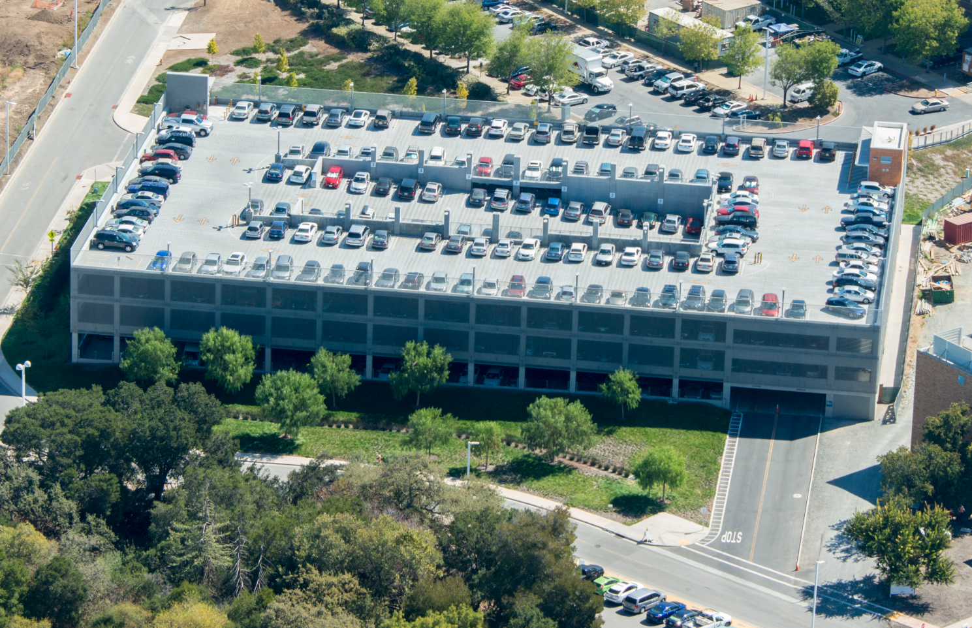
Parking Counter System
Similar in operation and functionality as counter system in Parking Structure #2 (PS-2)
2 level-by-level detailed display signs at both entrances
2 monument signs with building identification and total number of spaces available at both entrances

Slide 15
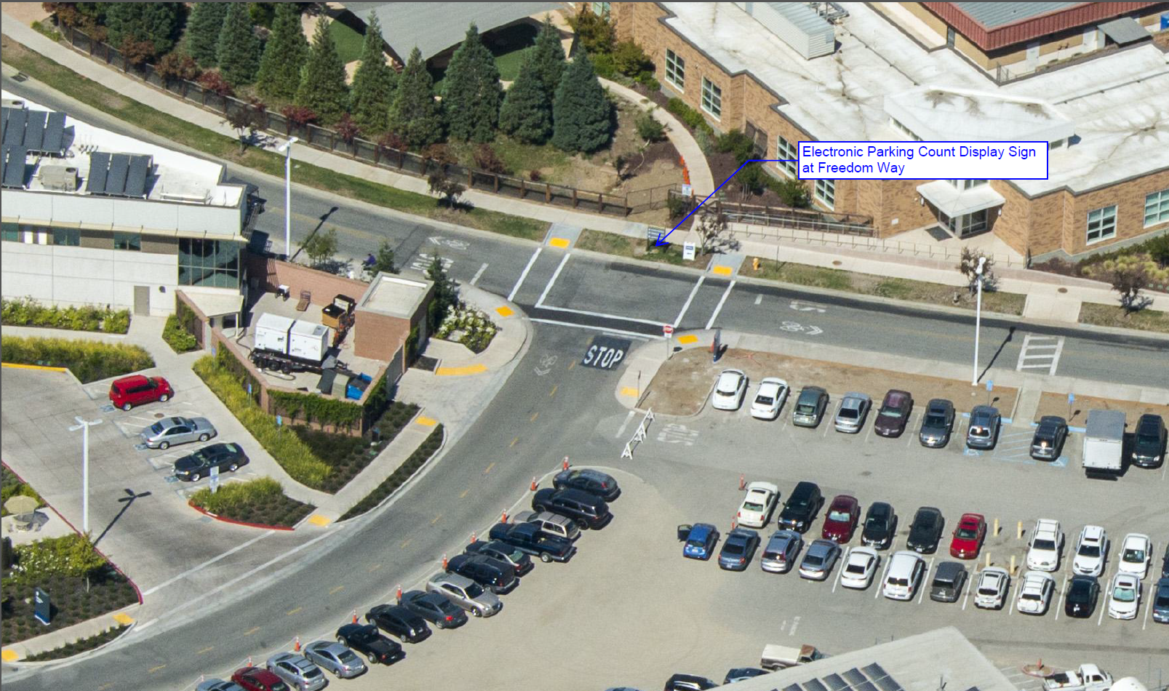
Electronic Display Sign at Freedom Way
Electronic display sign will show the total number of spaces available at PS-1 and PS-2

Slide 16
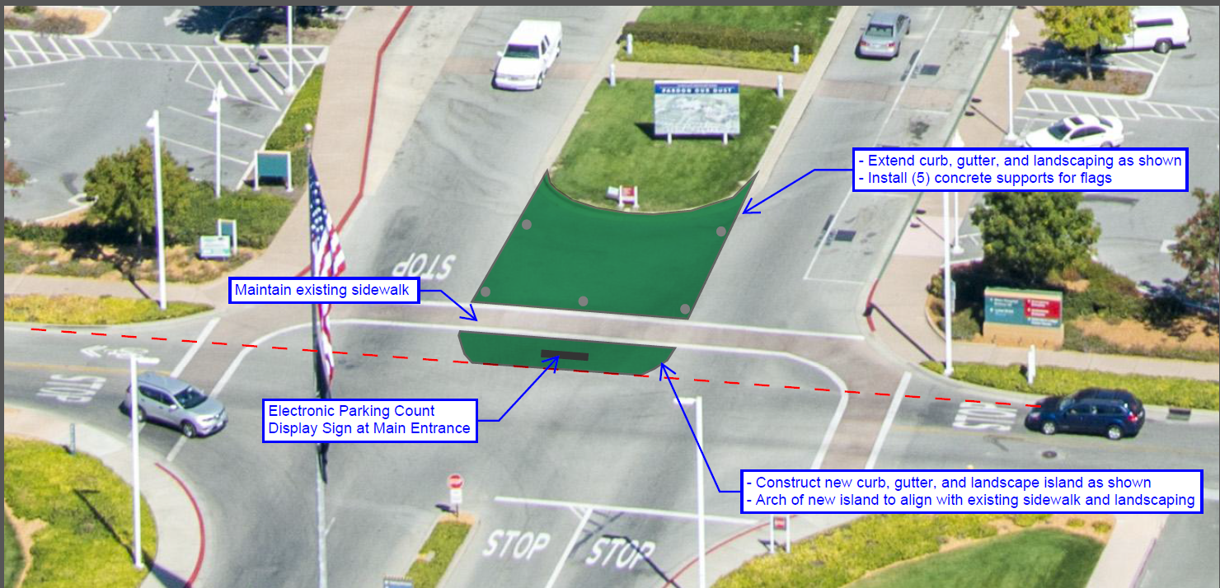
Electronic Display Sign at Main Campus Entrance
Extend curb, gutter, and landscaping
New curb, gutter, and landscape island
Electronic display sign will show the total number of spaces available at PS-1 and PS-2

Slide 17
SOW Amendments
Installation of concrete pads for all monument signs listed in the SOW
Restoration of roadways, sidewalks, landscaping, curbs, gutters, etc. to match existing conditions after work is completed. This shall include any re-striping of crosswalks and road displays that are impacted during work.
X-ray concrete prior to mounting and installation of counter system equipment, devices, and materials.

Slide 18
Questions
Please submit all questions via RFIs to the Contracting Officer

