Slide 1
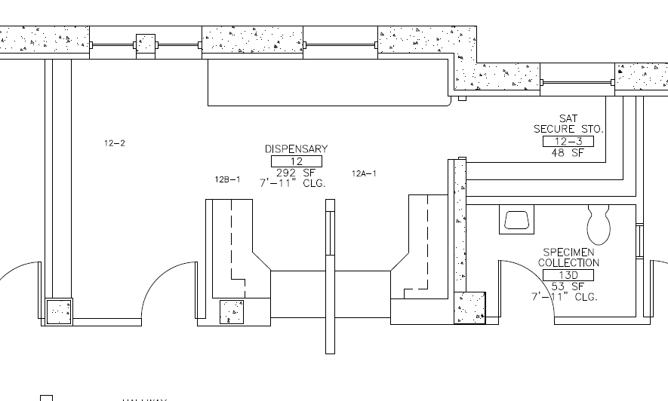
Building #1 – Ground Floor

Slide 2
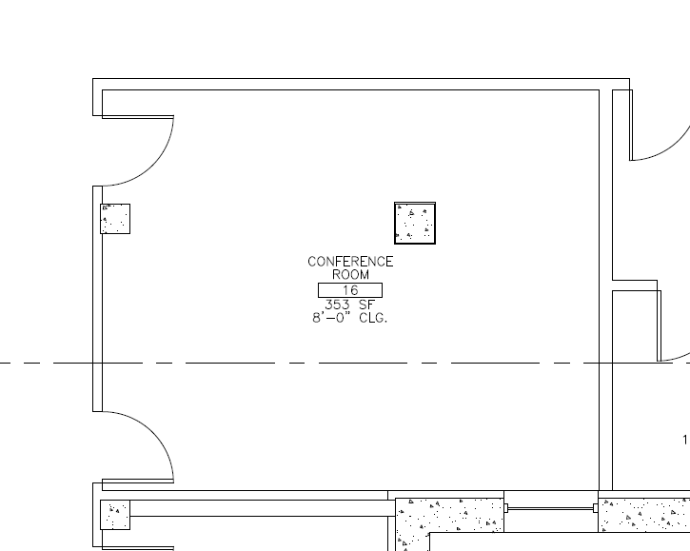
Building #1 – Ground Floor

Slide 3
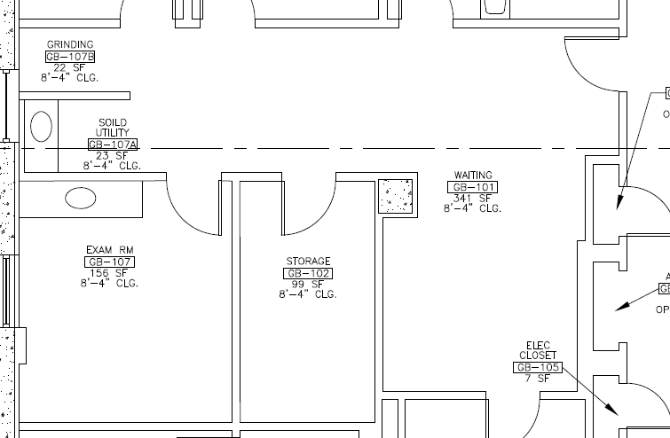
Building #200 – Ground Floor

Slide 4
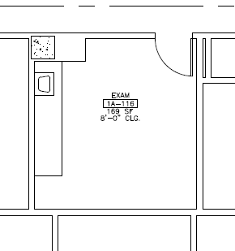
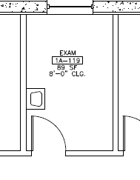
Building #200 – First Floor

Slide 5
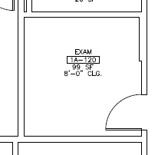
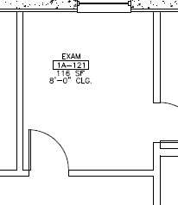
Building #200 – First Floor

Slide 6
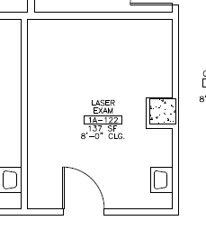
Building #200 – First Floor

Slide 7
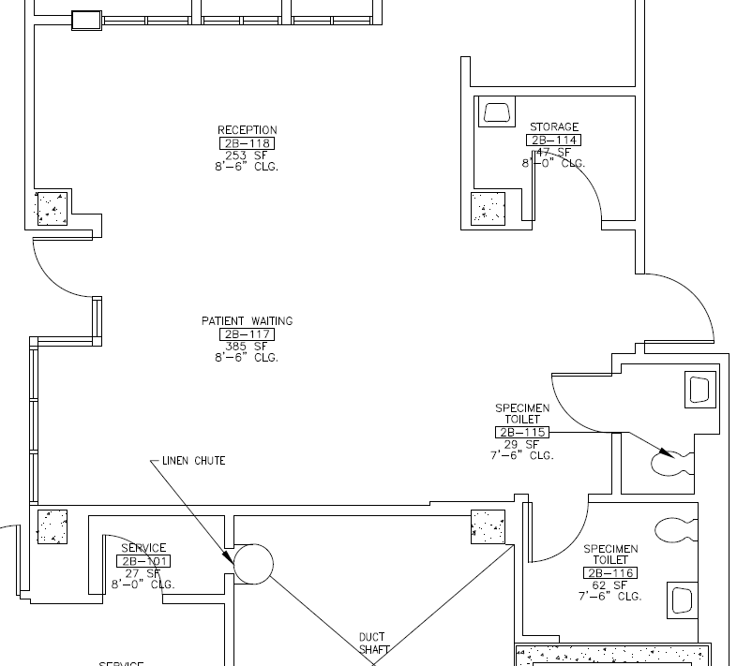
Building #200 – Second Floor

Slide 8
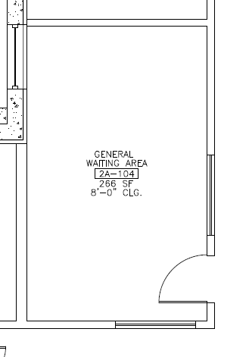
Building #200 – Second Floor

Slide 9
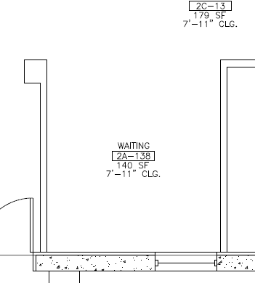
Building #200 – Second Floor

Slide 10
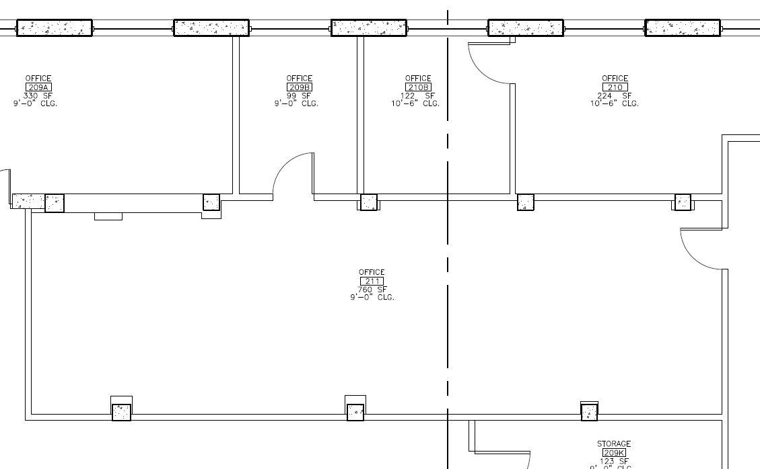
Building 6 - Room 209B and 211

