Slide 1
ELECTRICAL SITE DEVELOPMENT
636A8-12-002
IOWA CITY VA HEALTHCARE SYSTEM
SOLICITATION:
VA-263-11B-0372

Slide 2
Bid due date: June 15, 2012 @ 2:00 p.m.
  Addressed to the Contracting Officer at the address listed.
  Cost Estimate: $1,000,000.00 and $2,000,000.00
  100% Service Disabled Veteran Owned Small Business
  Iowa Sales Tax Exempt
  Bid Bond required along with bid
  Awarded contractor to submit performance and payment bond
  Total of 5 bid items with 2-5 are alternates (in order of priority)

Slide 3
SOLE SOURCE PRODUCTS
FIRE ALARM – SIMPLEX –
ACCESS CONTROL – LENEL PIV
ELECTRICAL METERING – POWER LOGIC
HVAC CONTROLS – JOHNSON CONTROLS - METASYS

Slide 4
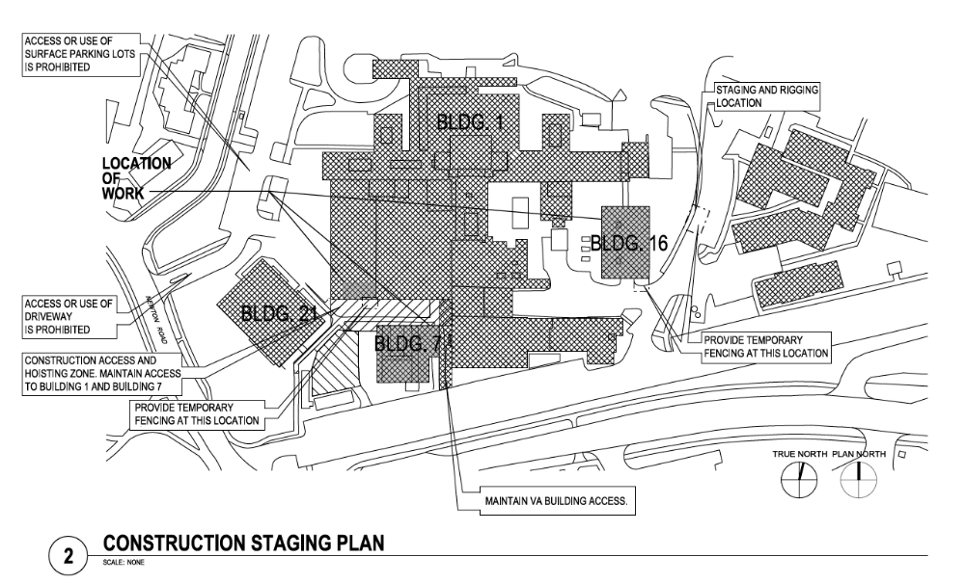
ELECTRICAL SITE DEVELOPMENT

Slide 5
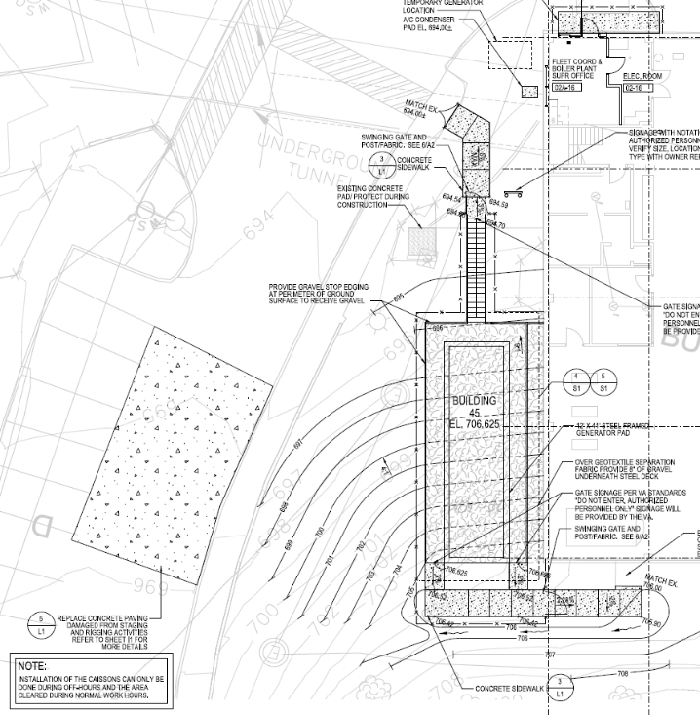
CAISSONS FOR GENERATOR ENCLOSURE
CAISSONS CAN ONLY BE INSTALLED DURING OFF HOURS. EQUIPMENT MUST BE OUT OF DRIVEWAY DURING NORMAL WORK HOURS OF 7:00 AM TILL 5:00 PM MONDAY THRU FRIDAY. WORK WITH PROJECT MANAGER FOR LOCATION OF EQUIPMENT WHEN NOT IN USE.

Slide 6
RENOVATION OF MES
CONTRACTOR RESPONSIBLE FOR PROVIDING PORTABLE GENERATORS FOR:
  GDPH – BW116
  ESS – “COURTYARD”
  ATS 1 (MDP) – BUILDING 16
  CONTRACTOR RESPONSIBLE FOR RENTAL AND FUEL COSTS FOR ALL PORTABLE GENERATORS REQUIRED DURING CONSTRUCTION

Slide 7
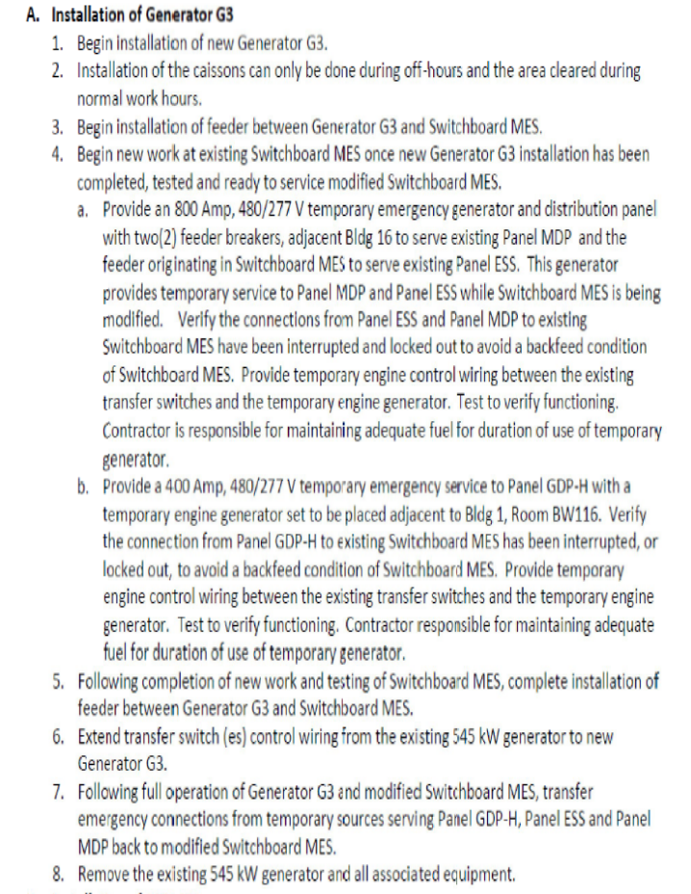
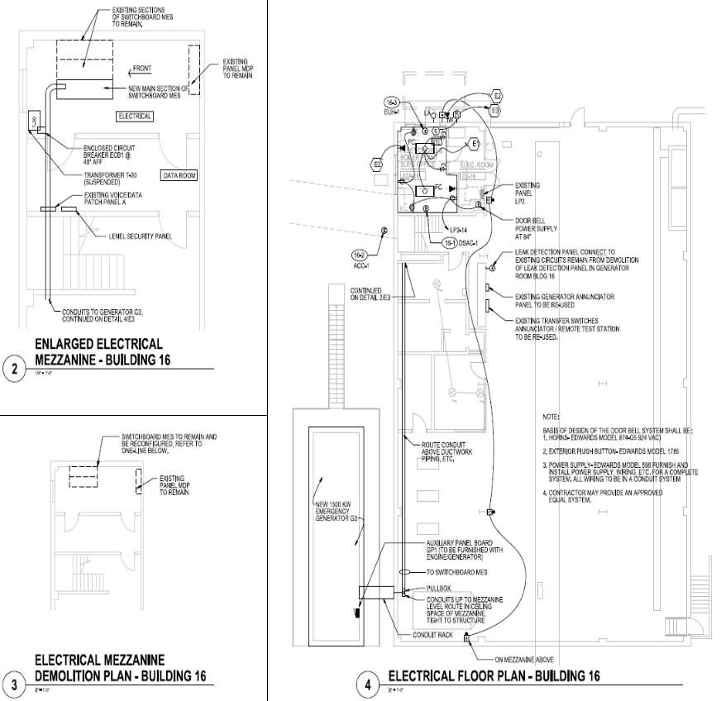
PHASING OF ELECTRICAL INSTALLATIONS:

Slide 8
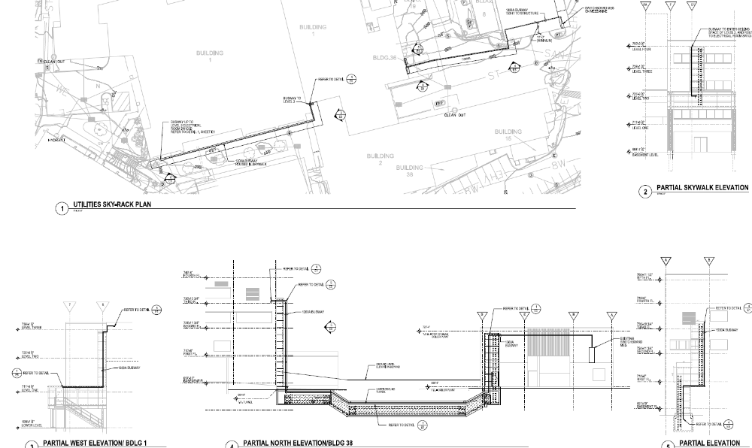
INSTALLATION OF GDP-OR

Slide 9
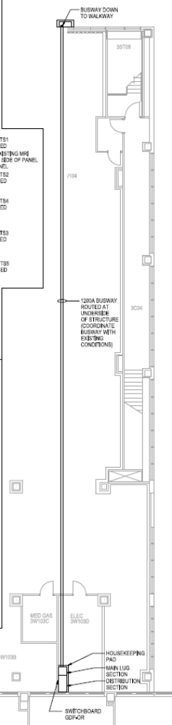
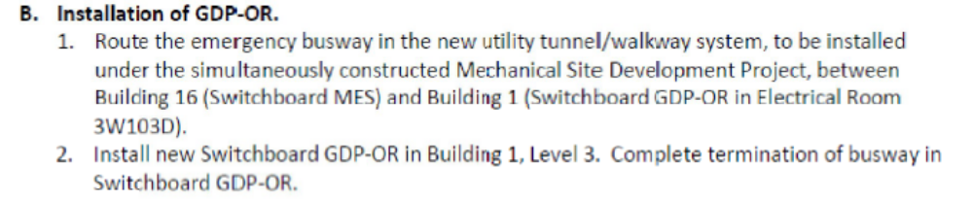
INSTALLATION OF GDP-OR

Slide 10
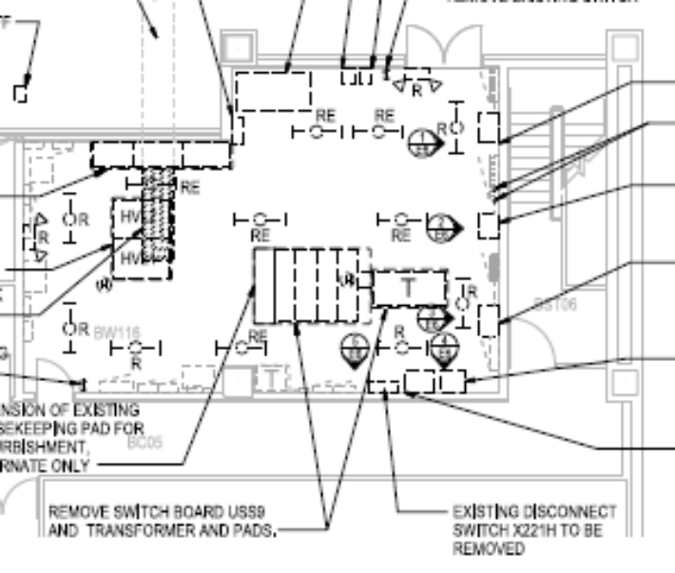
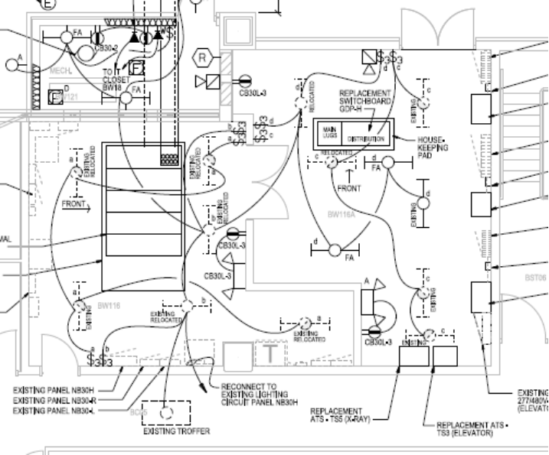
REPLACEMENT OF GDPH & USS9 – BW116
EXISTING BW116
NEW BW116 & BW116A

Slide 11
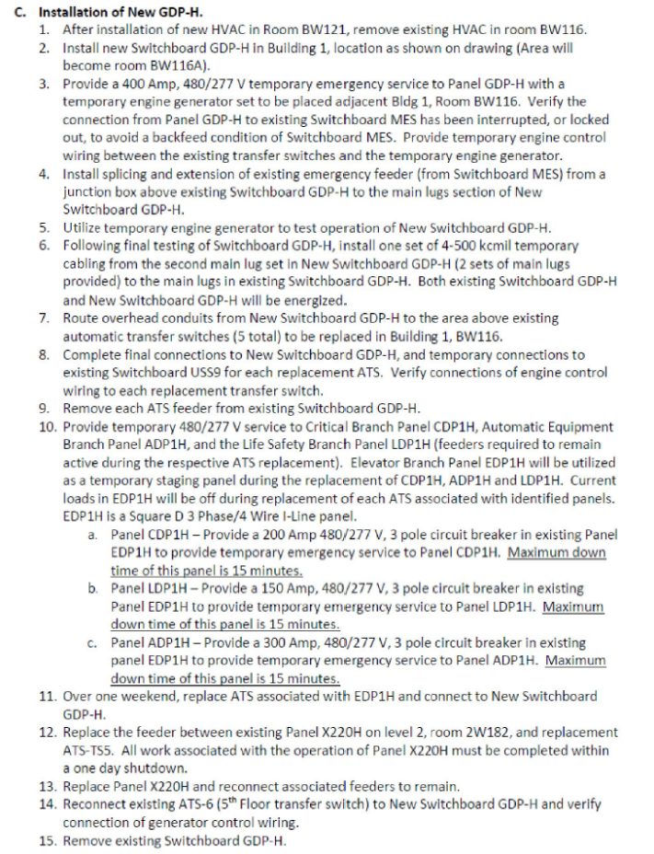
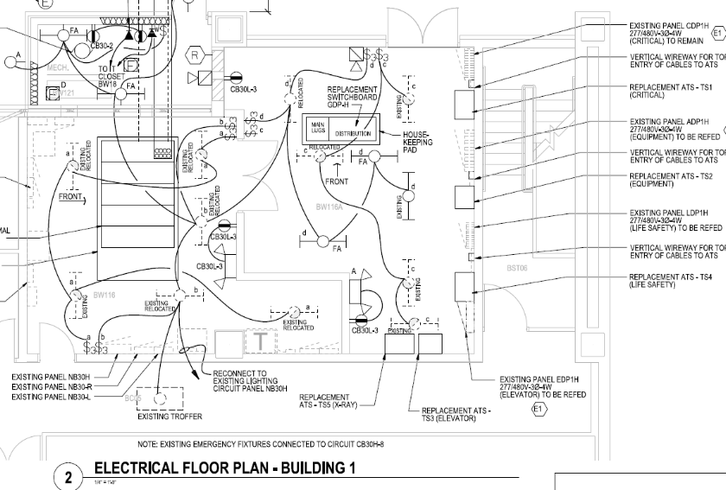
INSTALLATION OF NEW GDPH & ATS’s

Slide 12
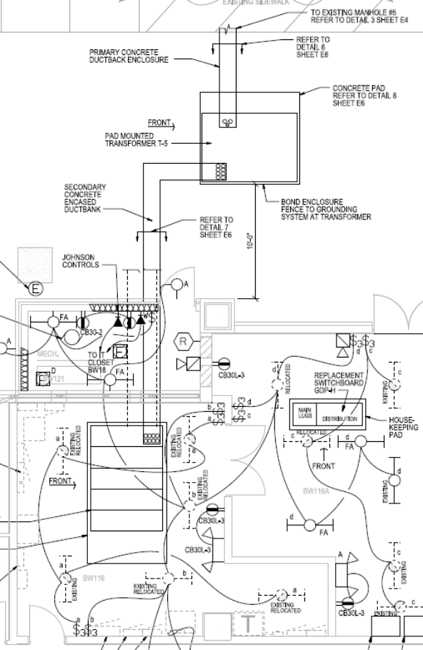
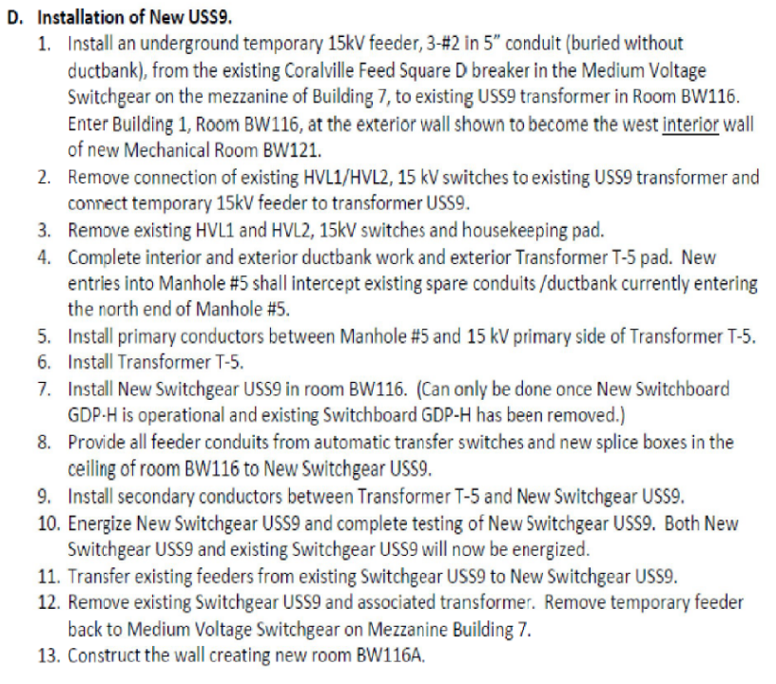
INSTALLATION OF NEW USS9

Slide 13
TRAINING ON POWER LOGIC
Contractor to furnish factory instruction at the SqD LaVergne, TN manufacturing facility to provide complete SqD Power Logic to ION upgrade training for VAMC personnel. (see section 26 23 00.2.12.E.)
All air fares, lodging, meals, transportation to/from airports, training materials, etc.
Week long (5 day) training program for 5 VAMC personnel

Slide 14
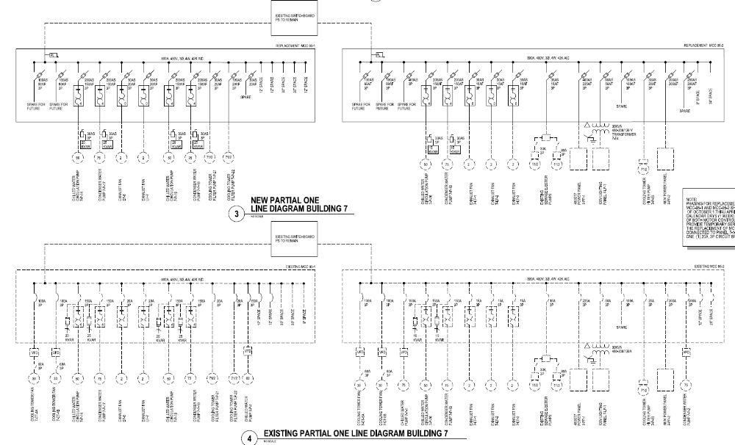
REPLACEMENT OF MCC 95-1 & 95-2 – OCT 1 TO APRIL 1 (MAXIMUM 7 DAYS DOWN)

Slide 15
QUESTIONS?
QUESTIONS WILL NOT BE ANSWERED DURING THE WALK THROUGH
QUESTIONS ARISING DURING THE WALK THROUGH SHOULD BE WRITTEN DOWN AND SENT TO THE CONTRACTING OFFICER AT felecia.beamen@va.gov
ALL QUESTIONS (RFI’s) WILL BE ACCEPTED UP TO TUESDAY, JUNE 5, 2012 AT 2:00 P.M.
ALL SUB-CONTRACTORS MUST SUBMIT RFI’s THROUGH THE PRIME CONTRACTOR
ALL RESPONSES TO QUESTIONS WILL BE POSTED ON www.FBO.Gov

