Slide 1
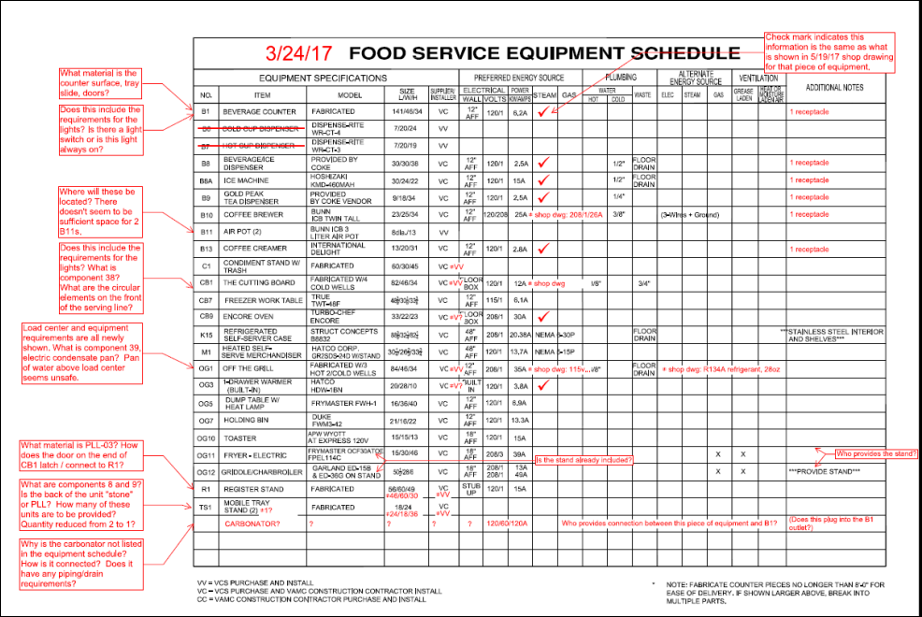
Info provided on shop drawing
There is a light switch to control light under tray slide
The airpots are located directly in front of the brewer
Yes, the 12A load includes the lights. There is no component 38. The circular elements are fan guards.
A new shop drawing is being provided to match the electrical design of the project, along with the removal of the electric condensate pan which is not needed since there’s a floor sink.
PLL-03 will be updated on the new shop dwg. The swing gate does not connect to R1.
VCS will provide stand for OG12. OG11 doesn’t require a stand.
8 & 9 are casters. The back is plastic laminate. Qty = 1
Yes it does. Coke will install.
The carbonator utility requirements are shown on B1. Coke will install.

