Slide 1
Install Proximity Card Devices –
Pharmacy, OI&T, and Boiler Plant
VA Sierra Nevada Health Care System
July 05, 2017
COR:
Jon Emis
jonathon.emis@va.gov
(775) 789-6685
COR: J. Emis
Project #: 654-18-801
Dwg Title:
Title Sheet
Project Location:
VA Sierra Nevada Health Care System
975 Kirman Avenue
Reno, NV 89502
Date: 07/05/2017
Sheet #: A001

Slide 2
Door Access Control System General Notes
  Standards and Codes: All door access control work shall be installed in accordance with the National Electric Code (NEC).
  General Requirements: Include all labor, materials, equipment, tools, transportation, storage costs, training, insurance, temporary protection, permits, inspections, taxes, and all necessary and related items required to provide a complete and operational door access control system as shown on the contract drawings and described in the specifications. Information shown on the drawings is diagrammatic. Field verify all dimensions, locations, and layout. Review all drawings and adjust all work to meet the requirements or conditions shown.
  Raceway: All door access control cabling shall be routed in conduit. See drawings for conduit rough-in for each door configuration. All raceway shall be run perpendicular to building grid lines. Raceway shall be installed so that the following minimum clear distances are maintained from sources of electro-magnetic interference (EMI): 6” clear from power cables, 12” clear from fluorescent lighting, and 36” clear from transformers and motors. Furnish access doors to provide reasonable access for the installation of the access control cabling.
  Concrete Coring and Sawcutting: The contractor shall locate reinforcing steel and conduits in existing concrete walls, floors, and beams prior to core drilling or sawcutting. Current X-ray and pachometer detection equipment shall be utilized. The contractor shall notify the COR at least 48 hours prior to coring and/or sawcutting. The contractor shall repair any items damaged.
  Firestopping: All firestopping assemblies shall be UL listed and shall meet or exceed the rating of the wall or floor being penetrated.
  Cabling and Terminations: See drawings and specifications for cable type and quantity of each.
  Examination of Site: Before submitting a proposal, the contractor shall examine the site and become familiar with the existing conditions and limitations. No extras will be allowed because of the contractor’s misunderstanding of the amount of work involved or lack of knowledge of any site conditions which may affect the work. Any apparent variance of the drawings or specifications from the existing conditions at the site shall be called to the attention of the COR before submitting a proposal.
  Fire Alarm Connection: For all doors with a magnetic lock, these doors shall be connected to the facility fire alarm system. If there is a fire alarm, power needs to be dropped to these doors to allow for safe egress.
  Guarantee: The complete access control system, and all portions thereof, shall be guaranteed to be free from defects in workmanship and materials for a minimum period of one (1) year from date of final acceptance. Promptly remedy such defects and any subsequent damage caused by the defects or repair thereof at no expense to the VA.
COR: J. Emis
Project #: 654-18-801
Dwg Title:
General Notes
Project Location:
VA Sierra Nevada Health Care System
975 Kirman Avenue
Reno, NV 89502
Date: 07/05/2017
Sheet #: A002

Slide 3
Door Security Single Line General Notes
  The door access control system shall match and be compatible with the existing access control system installed at the Reno VA. The current door access control system is manufactured by Lenel with card readers manufactured by HID Global.
  Not all devices and cabling are shown in the single line diagram. Submit shop drawings for approval including point-to-point wiring and panel block diagrams showing all devices and required cabling.
  Submit layout drawing for approval of the equipment mounted in the Hoffman security enclosures including security panels, add-in boards, power supplies, battery chargers, fuses, relays, batteries, network outlets, electrical outlets, cable management wireways, overhead gutters, etc.
  Submit cut sheets for approval of all security equipment including but not limited to security panels, add-in boards, relays, power supplies, batteries, cabling, request-to-exits, door contacts, card readers, electric strikes, push buttons, contactless sensors, etc.
  Submit battery calculations for approval. Batteries shall back up the entire system for a minimum of 2 hours.
  All security cable is to be routed in conduit.
Door Security Single Line Sheet (A004) Notes
  Door access control panel including controllers, reader interface modules, I/O modules, power supplies, batteries, relays, etc. All equipment to be mounted in 30” wide x 36” high lockable Hoffman enclosures. See plans for location of security panels. See detail for general layout of access control equipment inside Hoffman enclosures.
  Door access system controller with 2-door reader module (Lenel LNL-2220). Provide network connection to VA LAN via CAT 6 drops.
  2-door Reader Interface Module (Lenel LNL-1320). Provide qty of 2-reader modules to accommodate all doors. Do not exceed qty (7) 2-reader boards per LNL-2220 System Controller (16 card reader doors total per security panel).
  16-input Control Module (Lenel LNL-1100). Provide qty of 16-input control modules to accommodate all inputs.
  16-output Control Module (Lenel LNL-1200). Provide qty of 16-output control modules to accommodate all outputs.
  Install separate DIN mounted relays to activate 24V power to devices including locks, request-to-exits, local alarms, etc. Do not run 24V power through relays mounted on system controller boards, reader modules, and output modules.
  Power supplies/battery chargers/relays. Install power supplies in Hoffman enclosures. Provide 120VAC connection to each power supply. Provide batteries to backup all power supplies. The contractor shall perform calculations to determine the number of batteries required to backup each power supply. In the case of a power failure, the batteries shall provide a minimum of 2 hours of continuous backup.
  Install interface between fire alarm system and security system for all fire-rated doors. In case of fire alarm, all interior doors should fail closed but allow for safe egress.
  Request-to-Exit (REX) Motion Detector (Bosch DS160 or approved equal).
  Remote push button to manually unlock area door (Securitron PB3-ER).
  Magnetic Door Contacts (GE/Sentrol 1078 or approved equal).
  Contactless Smart Card Reader (HID Global RP40).
  Electric Strike (Von Duprin 6000 Series or approved equal).
COR: J. Emis
Project #: 654-18-801
Dwg Title:
Single Line Notes
Project Location:
VA Sierra Nevada Health Care System
975 Kirman Avenue
Reno, NV 89502
Date: 07/05/2017
Sheet #: A003

Slide 4
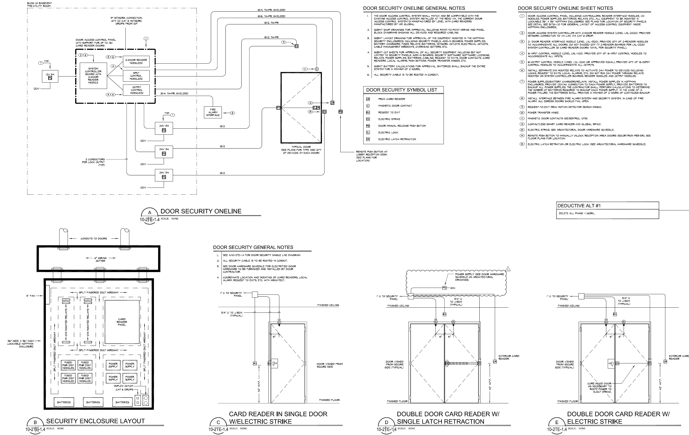
10
COR: J. Emis
Project #: 654-18-801
Dwg Title:
Door Security Single Line
Project Location:
VA Sierra Nevada Health Care System
975 Kirman Avenue
Reno, NV 89502
Date: 07/05/2017
Sheet #: A004

Slide 5
30” WIDE X 36” HIGH LOCKABLE HOFFMAN ENCLOSURE
COR: J. Emis
Project #: 654-18-801
Dwg Title:
Security Enclosure Layout
Project Location:
VA Sierra Nevada Health Care System
975 Kirman Avenue
Reno, NV 89502
Date: 07/05/2017
Sheet #: A005

Slide 6
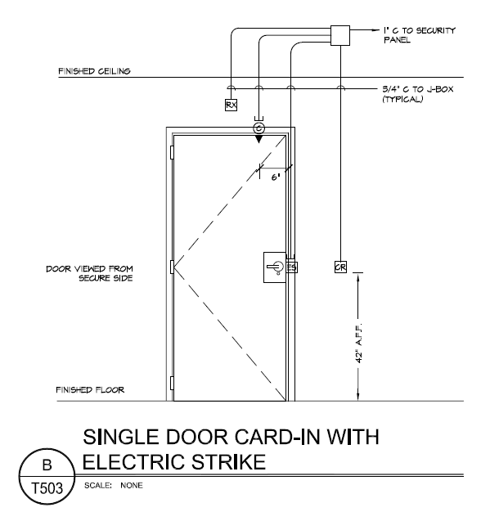
Single Door
COR: J. Emis
Project #: 654-18-801
Dwg Title:
Single Door
Project Location:
VA Sierra Nevada Health Care System
975 Kirman Avenue
Reno, NV 89502
Date: 07/05/2017
Sheet #: A006

Slide 7
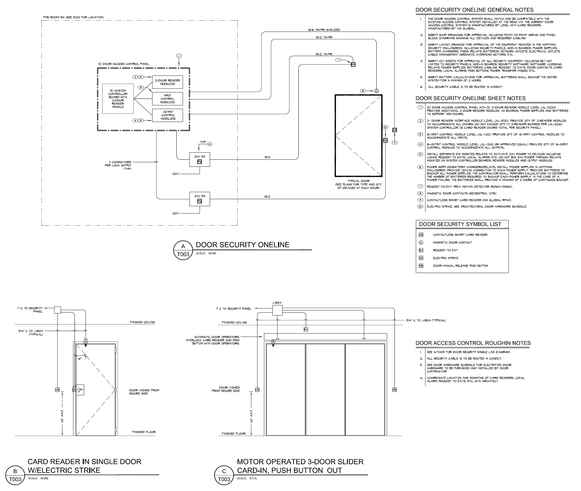
Double Doors, Manual
COR: J. Emis
Project #: 654-18-801
Dwg Title:
Double Doors, Manual
Project Location:
VA Sierra Nevada Health Care System
975 Kirman Avenue
Reno, NV 89502
Date: 07/05/2017
Sheet #: A007

