Slide 1
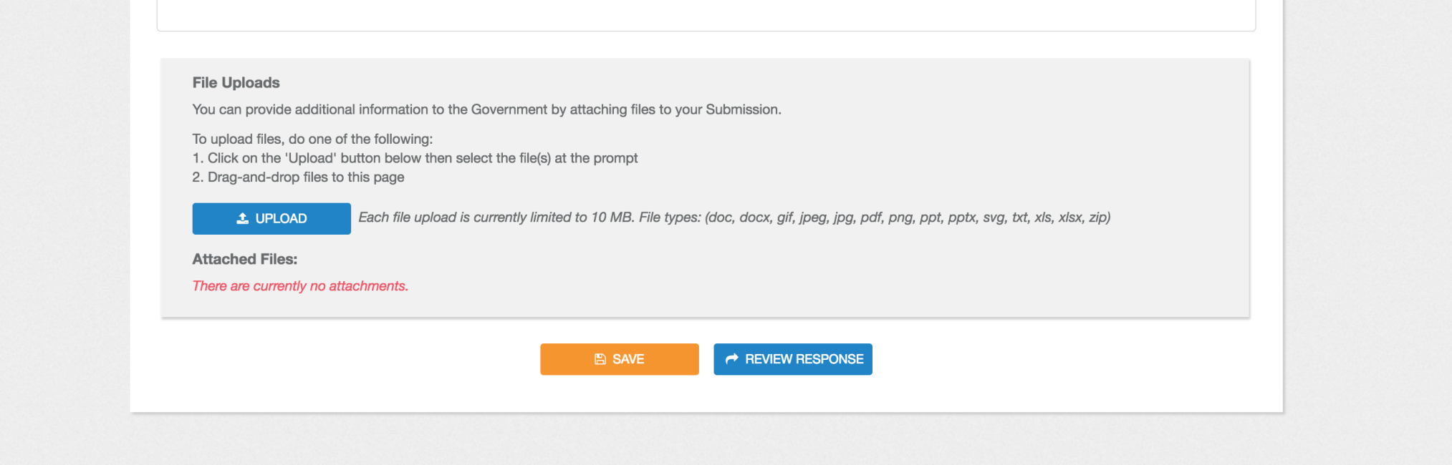
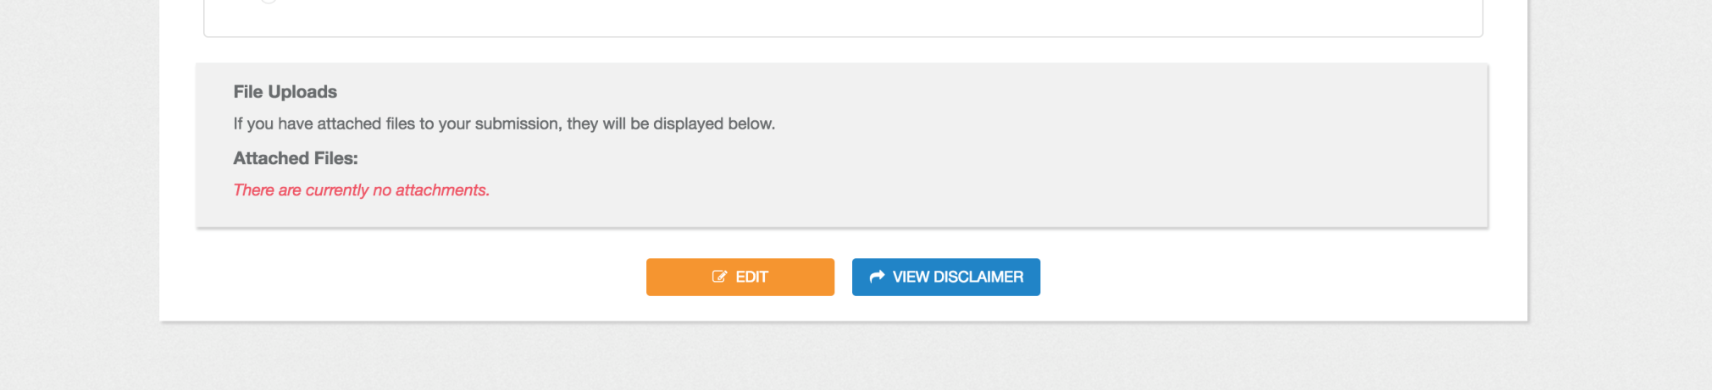
To save your input press “SAVE”. You can return and continue later.
Once you return and are ready to continue, press “EDIT”.

