Slide 1
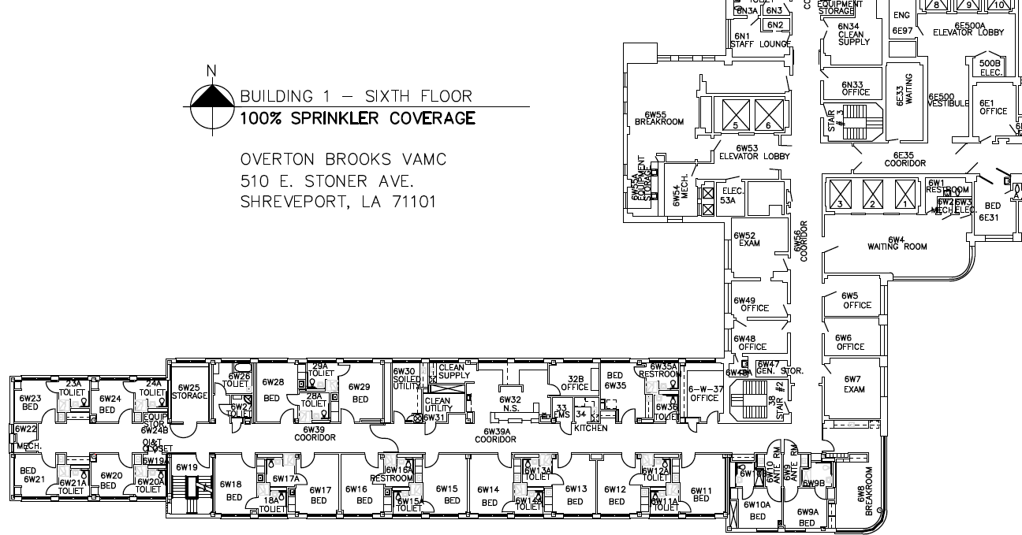
ATTACHMENT A: Renovate Inpatient Wards 6W, 7W & 8W (Page 1 of 3)
6th Floor = Approximately 11,000 GSF

Slide 2
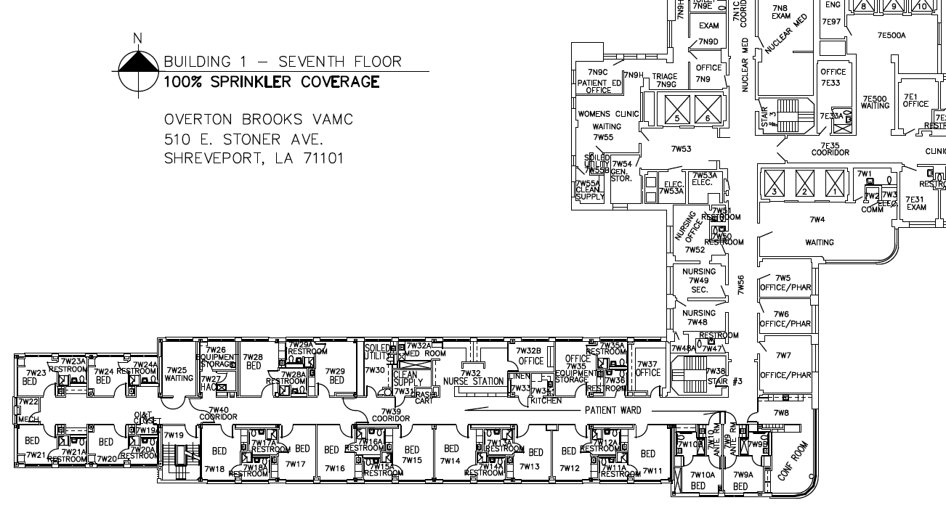
ATTACHMENT A: Renovate Inpatient Wards 6W, 7W & 8W (Page 2 of 3)
7th Floor = Approximately 9,000 GSF

Slide 3
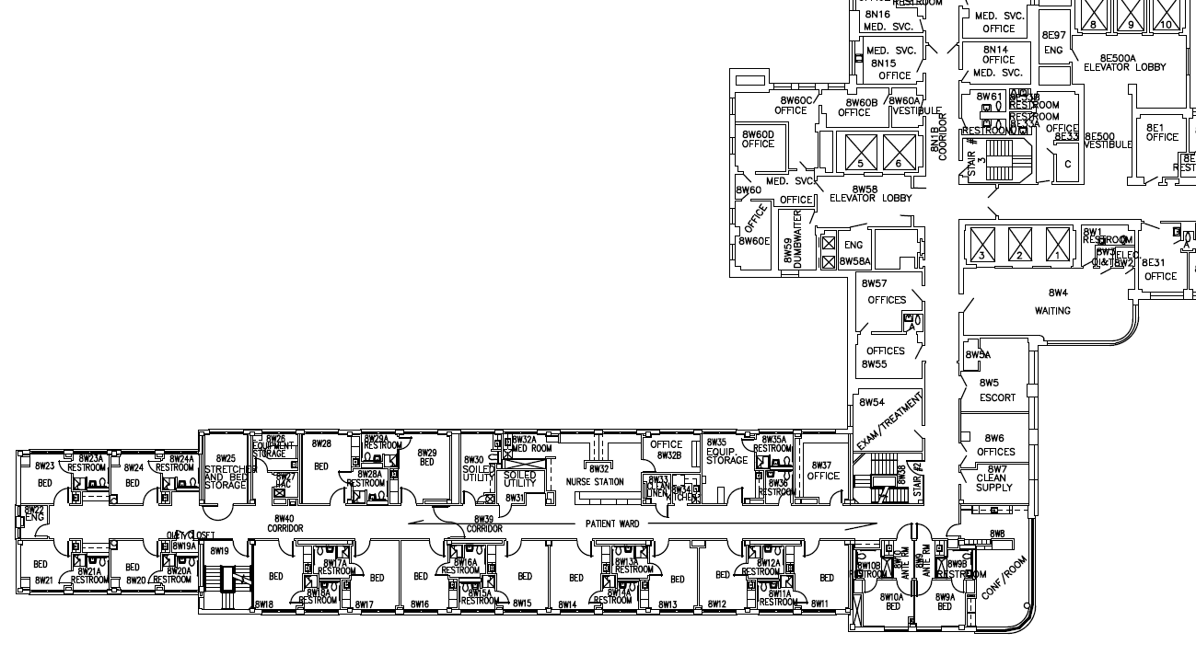
ATTACHMENT A: Renovate Inpatient Wards 6W, 7W & 8W (Page 3 of 3)
8th Floor = Approximately 11,000 GSF

