Slide 1
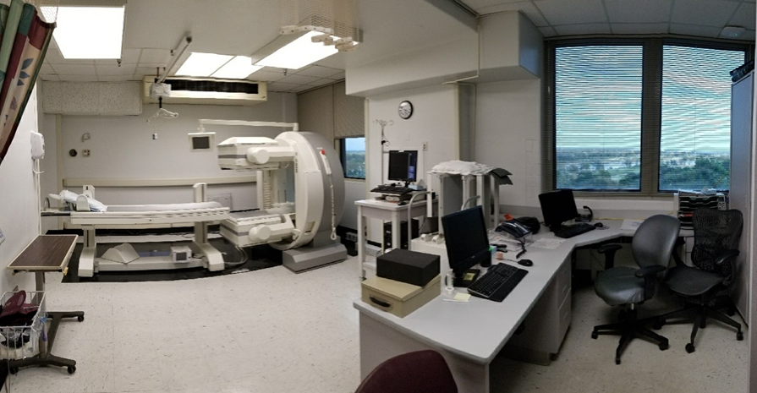
PROJECT 667-18-118
SITE PREPARATION FOR NEW NUCLEAR MED CAMERA – 7N4

Slide 2
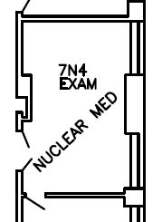
PROJECT 667-18-118
SITE PREPARATION FOR NEW NUCLEAR MED CAMERA – 7N4
Approximately 24.5’ x 16.5’
Contractor to verify existing dimensions & conditions

Slide 3
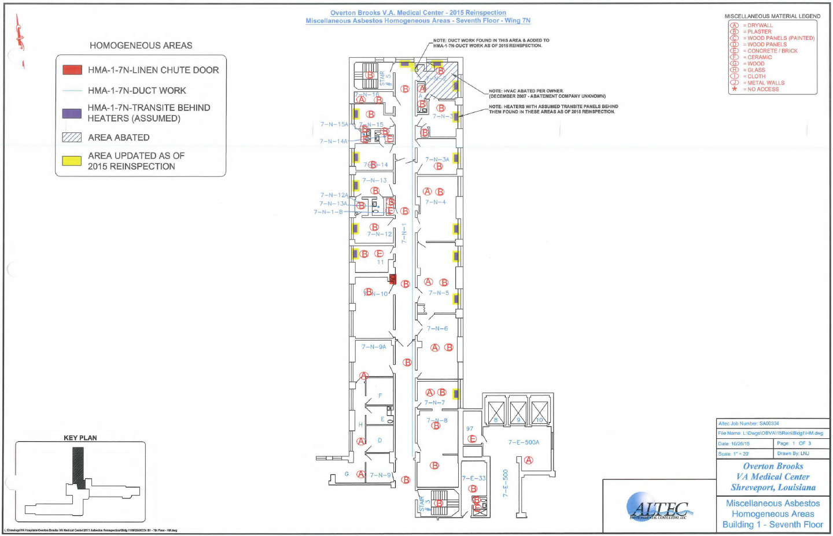
ABATE ASBESTOS

Slide 4
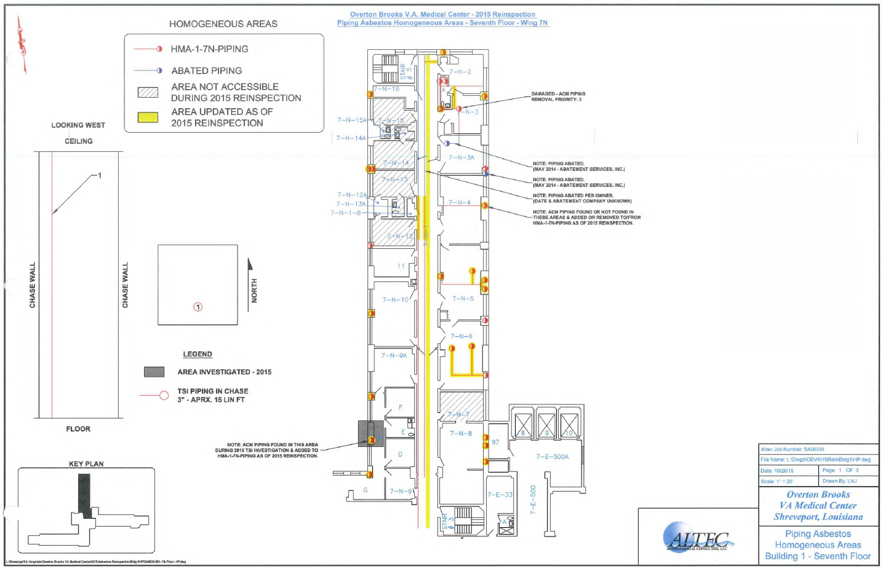
ABATE ASBESTOS

Slide 5
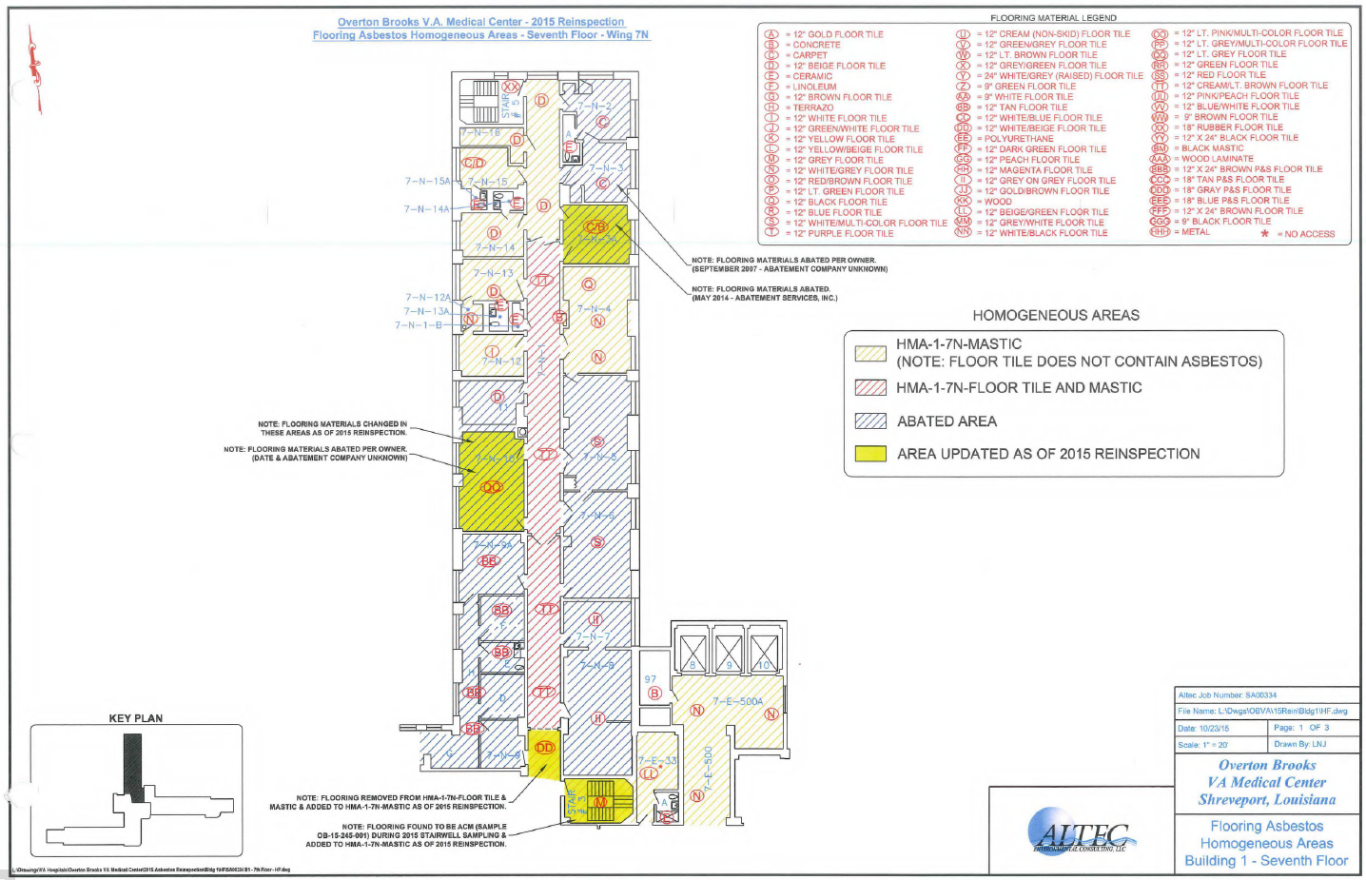
FLOORING ASBESTOS ABATEMENT IS NOT REQUIRED

