Slide 1
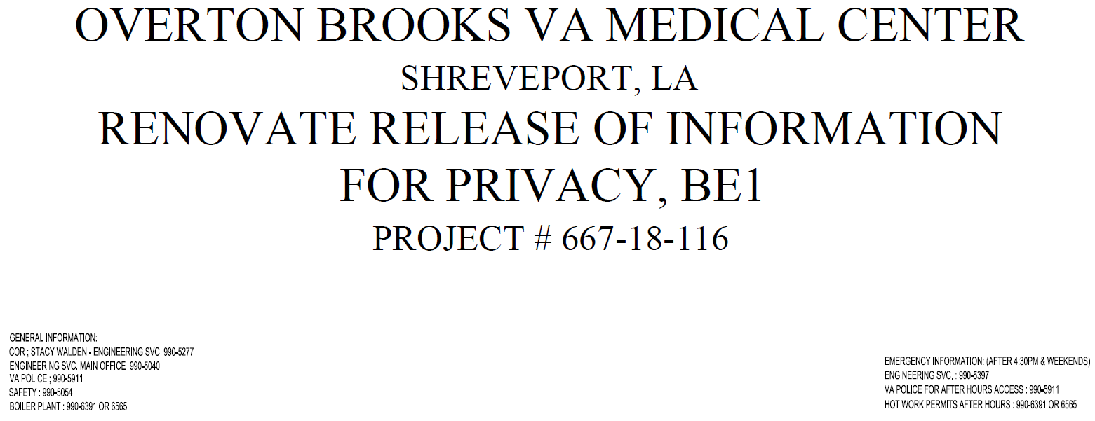
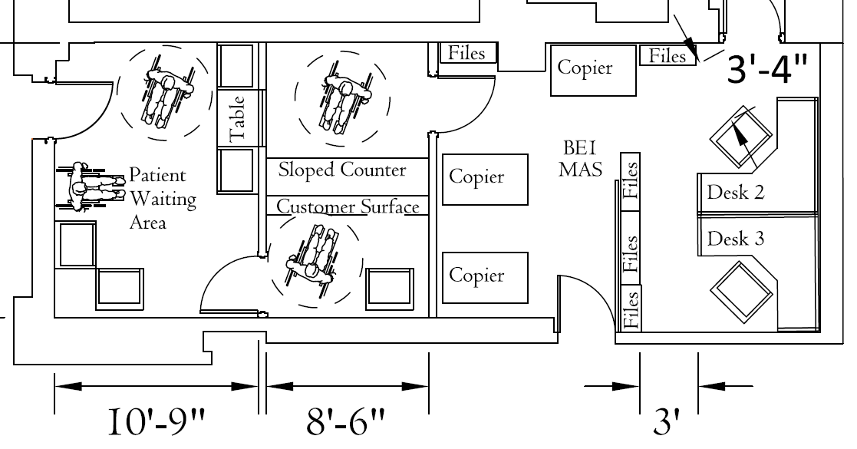
Title Sheet (Sheet 1 of 11)

Slide 2
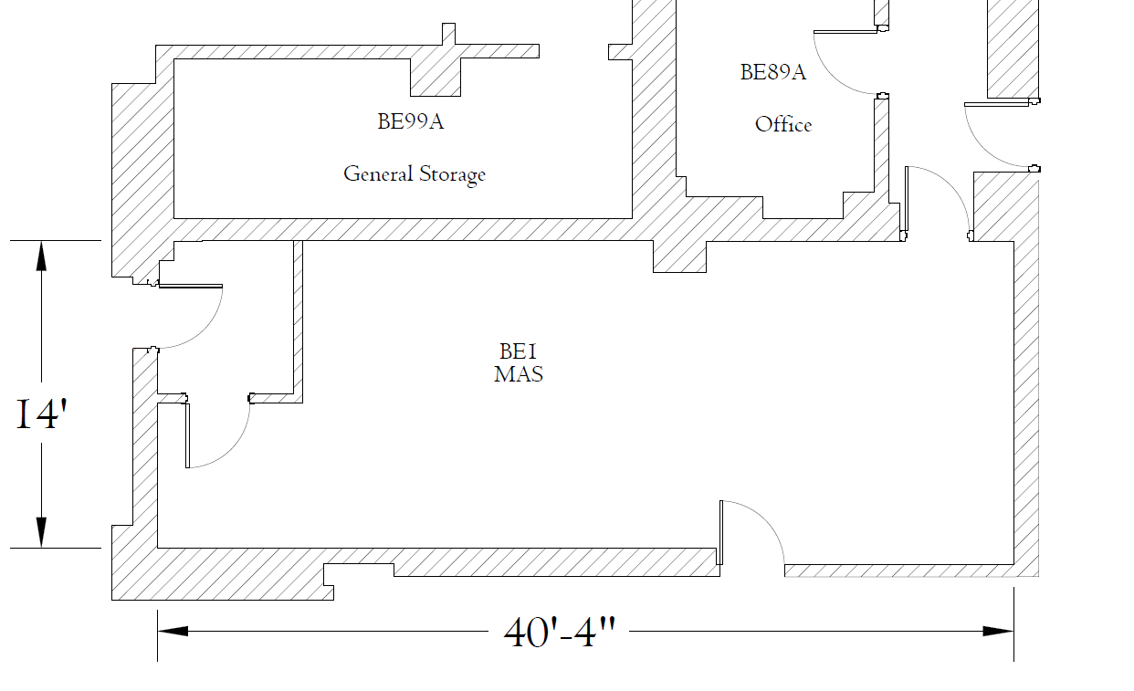
NOTE: Dimensions, shape of room/space & area are approximate & Contractor must field verify all measurements
Construction Area & Limits (Sheet 2 of 11)

Slide 3
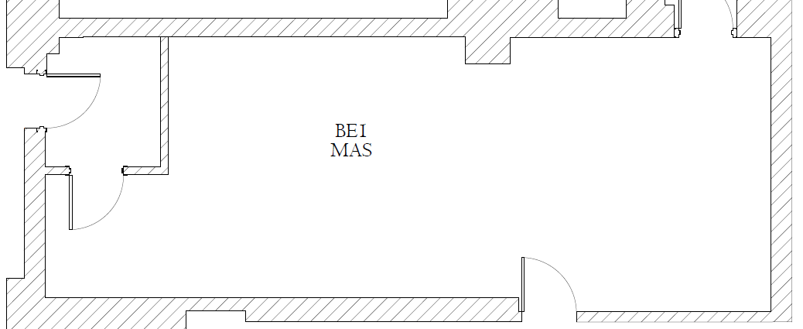

1
2
2
1
3
Abate & remove flooring (mastic contains asbestos) & prepare for new flooring installation
Remove wall
Remove door
GENERAL DEMO NOTES: Coordinated all items w/COR
NOTE: Where terrazzo wall base exist, demo wall/floor intersection sufficiently to be floated (filled in) horizontally and vertically (90 degree angle) to support and allow for proper installation of the new LVT flooring and 6” wall base.
Remove Wall Mold where no longer active or needed. Repair wall.
Demo outlet, receptacles, etc. no longer required. Repair wall & provide new blank stainless steel cover plate.
Ref SOW
Architectural Demo Plan (Sheet 3 of 11)

Slide 4
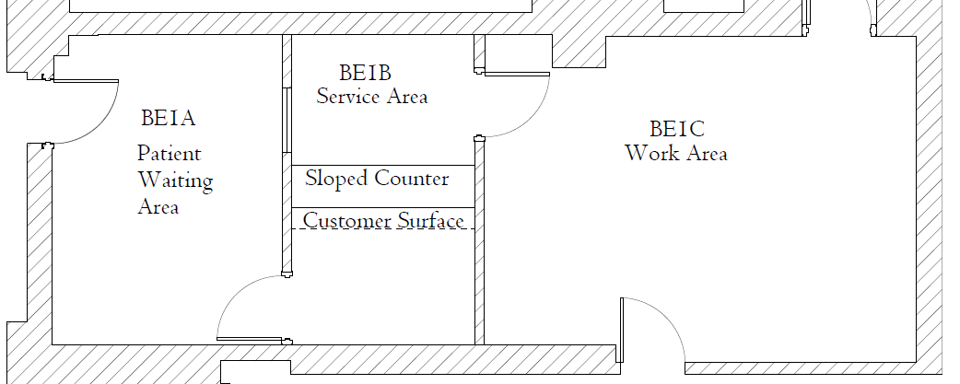
1
5
4
6
3
6
6
2
2
6
5
New Items of Work, Contractor to provide and install (Refer to SOW for more details):
Modify existing wood door with a ½ Door Vision Kit
Construct new wall w/sound proof insulation – extend wall to deck above
Construct new Service Counter (Ref SOW)
Install new sliding glass window w/acoustical performance (Ref LIDCO 260 System)
Install new 36” wide solid core wood door with door hardware (coordinate w/COR)
Install new LVT flooring & 6” rubber wall base. Corners shall be pre-formed.
Architectural Plan (Sheet 6 of 11)

Slide 5
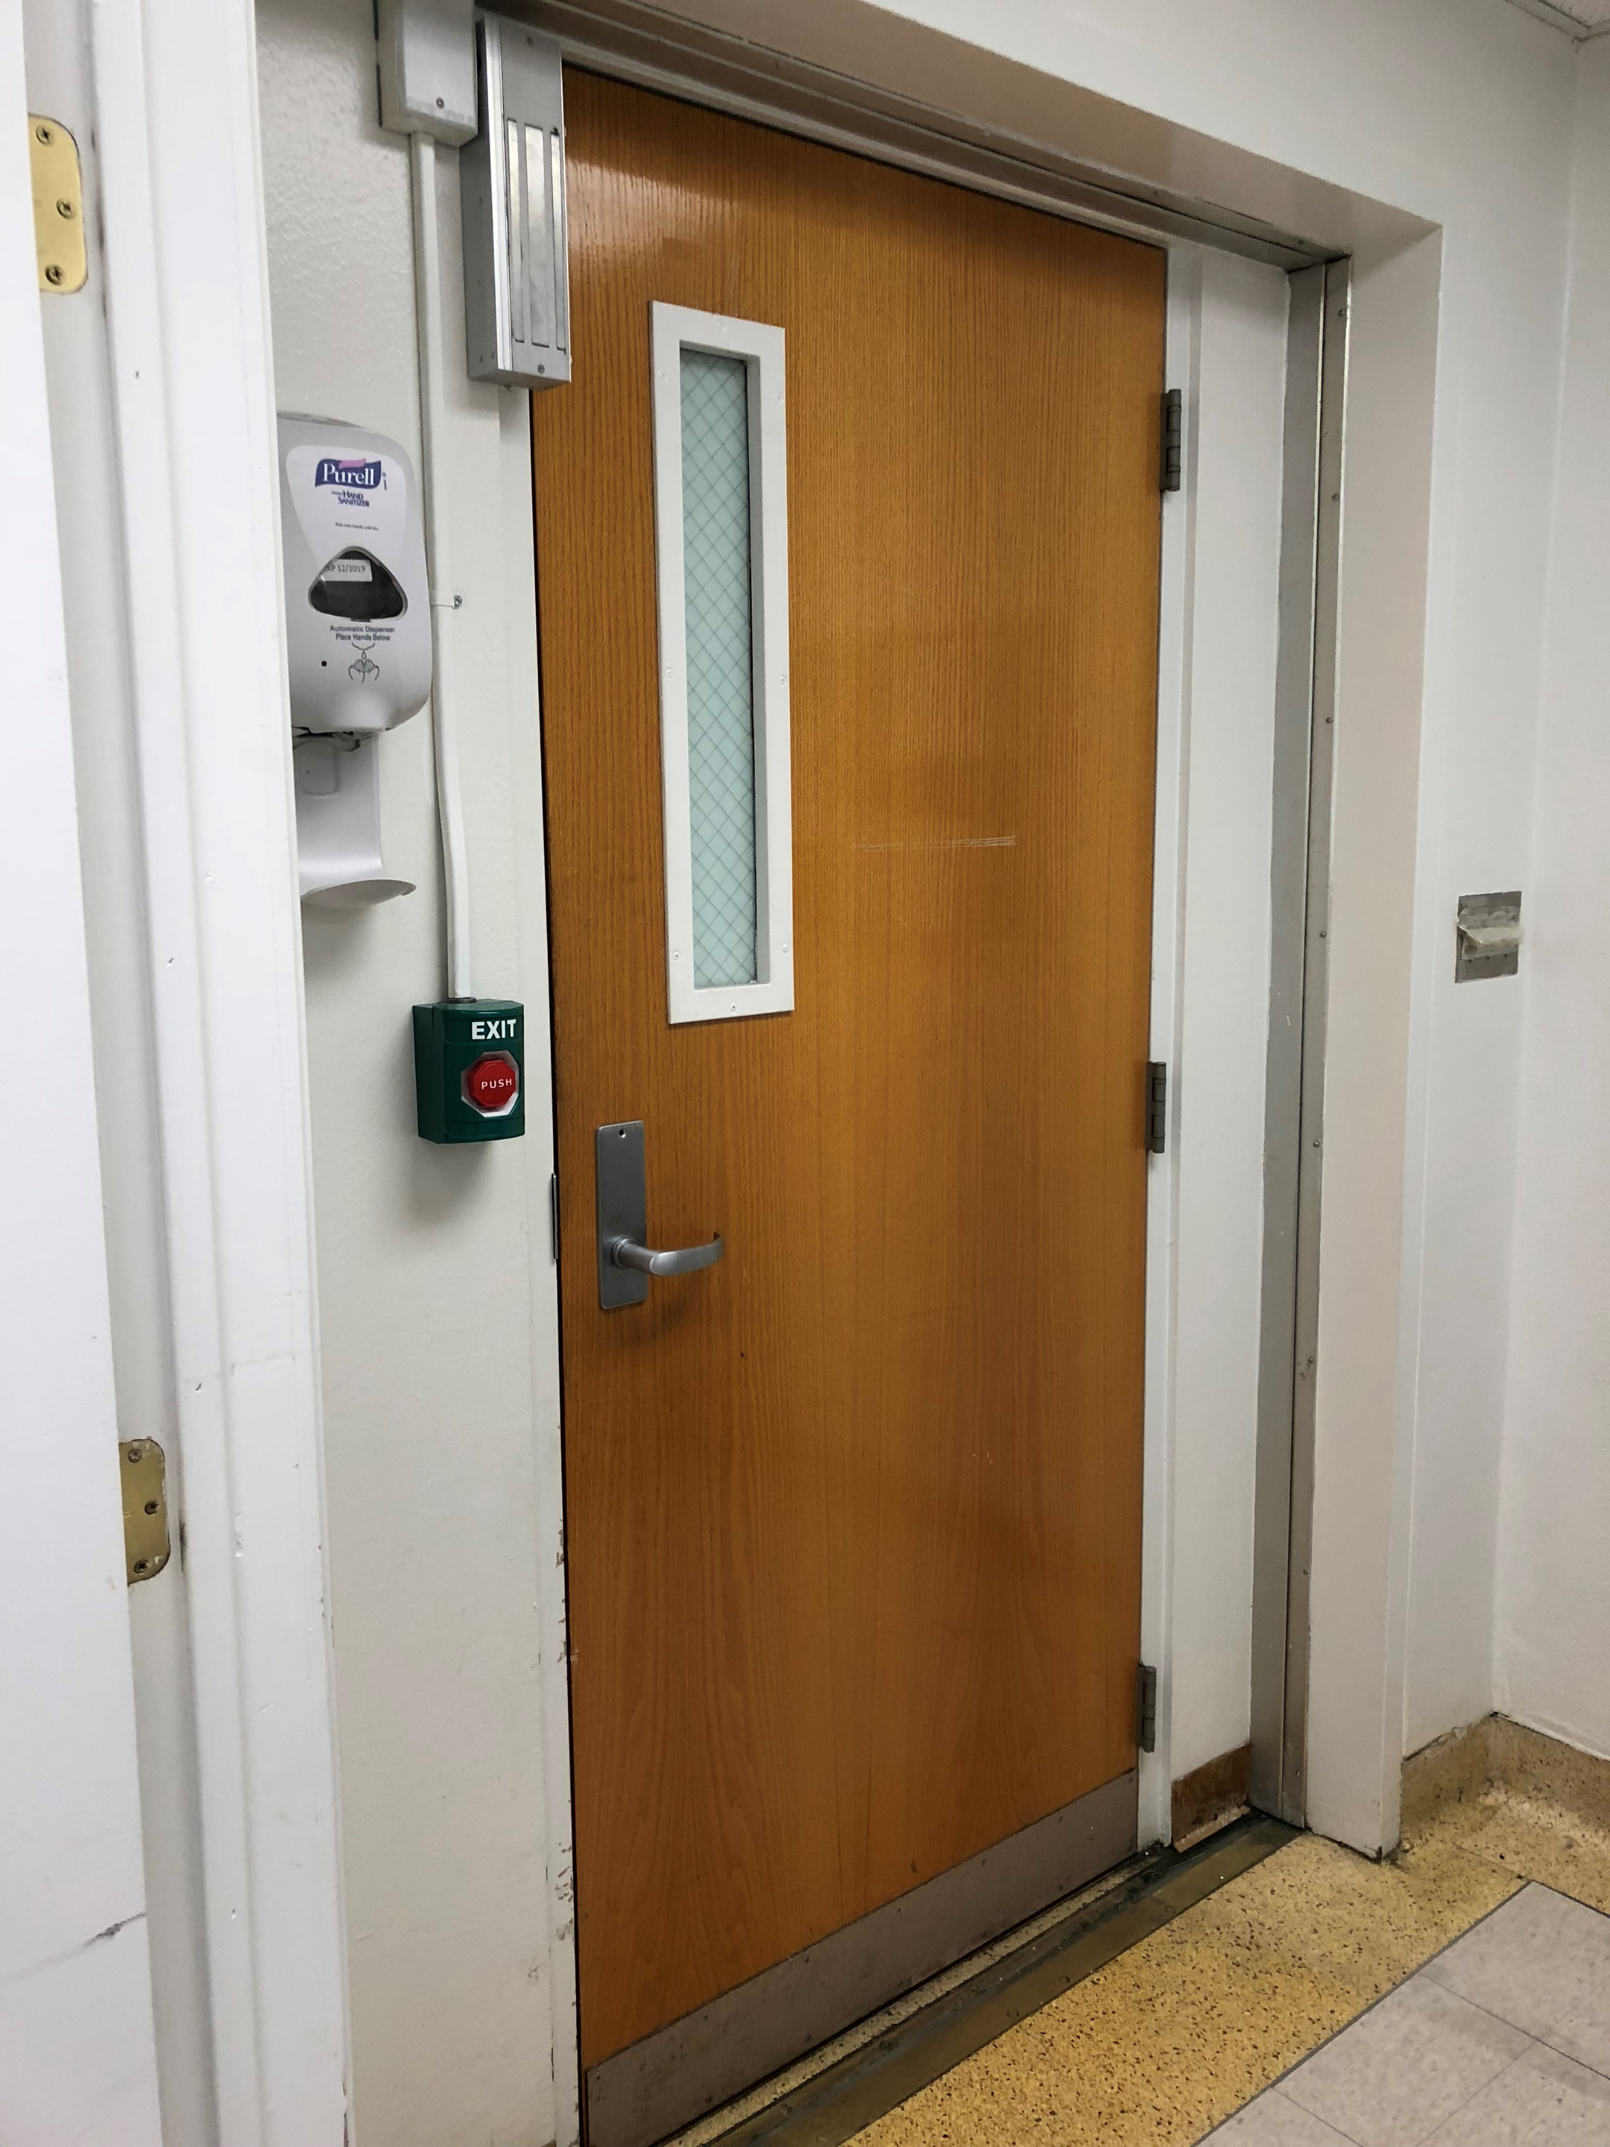
Modify existing wood door with a new ½ Door Vision Kit
(Ref Lidco 261 Sliding Window System Product Data)
GENERAL NEW WORK NOTES:
- Coordinated all items w/COR
Repair walls as needed. All walls, existing & new, shall be newly textured & painted.
Provide all new outlet covers, electrical & data covers and wall mold for items to remain
Reference Submittals Section in SOW for Finishes for this project.
Architectural Plan (Sheet 5 of 11)

Slide 6
W
W
LEGEND:
Existing 2’x4’ Light Fixture
Existing Sprinkler Head
Existing Supply Diffuser
Existing Return Grille
Existing WiFi Device
Existing Mirror
W
Existing Ceiling Plan (Sheet 6 of 11)

Slide 7
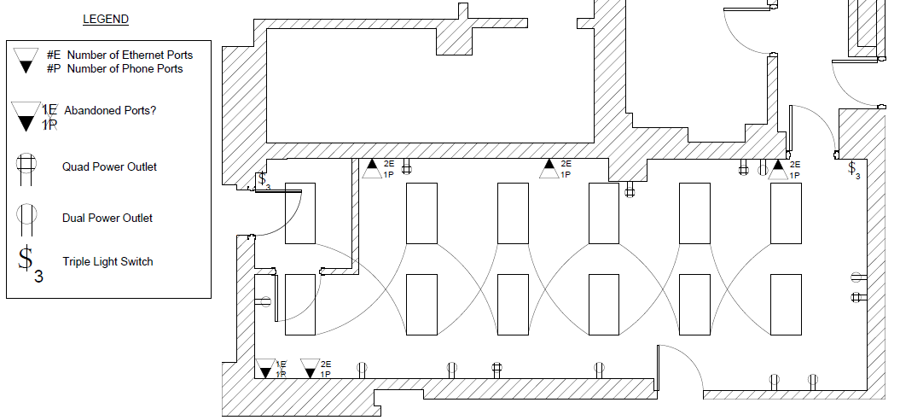
PROVIDED FOR REFERENCE ONLY: Contractor to verify all exact locations & quantities.
Existing Electrical & Data (Sheet 7 of 11)

Slide 8
Lighting Demo Plan (X – Remove & Salvage Item to be Re-used)
W
X
X
W
X
X
New Lighting Plan (R – Replaced Salvaged Item)
W
R
R
W
R
R
Lighting Plan (Sheet 8 of 11)

Slide 9
Ceiling System Demo Plan
W
W
X
Remove Ceiling Tile & Grid as necessary
New Ceiling Plan (Typical)
TYPICAL: Finished ceiling shall be modified and adjusted to account for all ceiling changes & new walls.
W
W
New wall floor to deck above with unfaced batt insulation for sound proofing.
Ceiling Plan (Sheet 9 of 11)

Slide 10
Sprinkler Head Demo Plan (X – Remove Item)
X
W
W
X
New Sprinkler Head Plan (N – New Item)
N
N
W
W
N
N
Sprinkler Head Plans (Sheet 10 of 11)

Slide 11
Existing Supply & Return Plan
W
W
230 CFM
230 CFM
230 CFM
690 CFM
New Supply & Return Plan (N – New Grille/Diffuser, New Duct, New Damper)
W
W
180 CFM
150 CFM
180 CFM
180 CFM
N
N
N
180 CFM
150 CFM
360 CFM
Mechanical Plan (Sheet 11 of 11)

