Slide 1
Department of Veterans Affairs
VHA Procurement and Logistics Office
Equipment lifecycle management
program executive office
SAC/VHA Industry Engagement Day
Presentation for
Vendor Community
Presented By
Jack DuFon
January 24, 2018

Slide 2
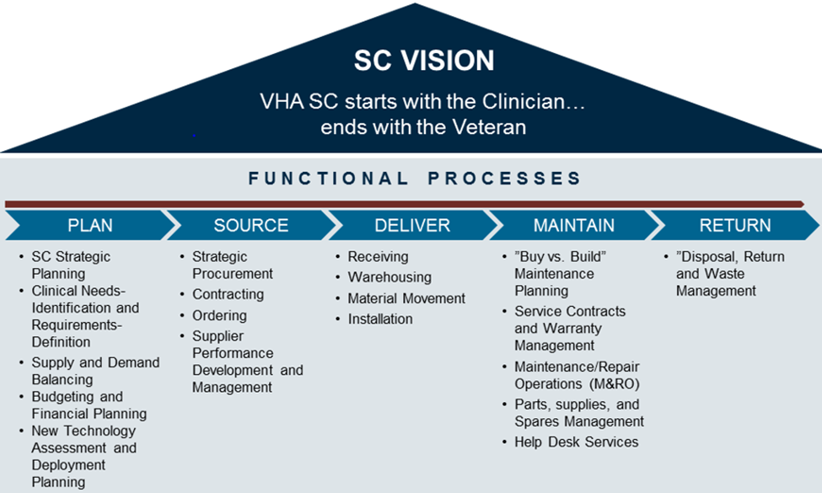
VHA is moving to a new supply chain operating model that focuses on total life cycle costs for all equipment

Slide 3
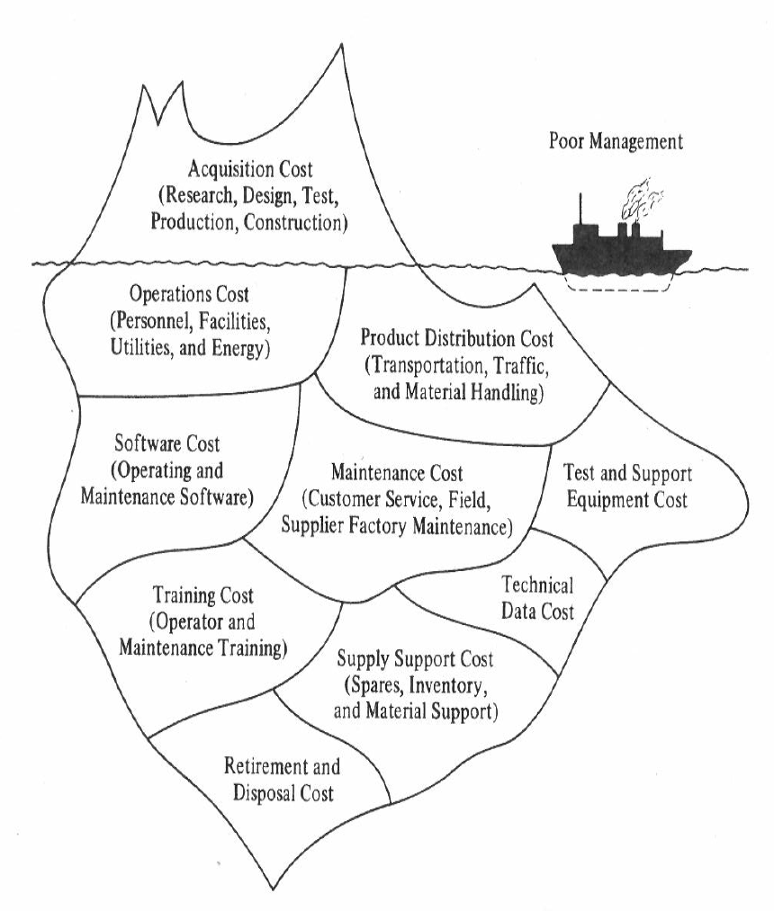
VHA seeks to partner with the vendor community to identify opportunities for efficiencies within the supply chain
Total Life Cycle Cost Analysis
ELCM Opportunities
Scope
  VHA equipment inventory
    Major categories
      High Tech Medical (HTME)
      Non HTME
  Est. 30% of total FY costs spent above the surface
    Equipment replacements
    Based on 10 year replacement cycle
  Est. 70% of total FY costs spent below the surface
    Includes maintainers, support contracts, repair / operating materials, etc.
ELCM done right
  Linear Accelerator methodology/logic
    Appropriate amount / configuration of equipment based on clinical need
    May be able to use existing equipment more effectively, may not need all the “bells & whistles”
  Enterprise risk
    Detroit’s TVs
      Bought using EOFY funds before supported system purchased; Found to be incompatible

Slide 4
The clinical sourcing strategy is informed by enterprise data and is multi-faceted when direct clinical input is required
Clinically Driven Sourcing Approach
Clinically driven sourcing begins with an analysis of historically inventory data
When a single manufacturer emerges as the predominant market share holder for all VHA facilities within a given requirement, that manufacturer is targeted for contracts
When no single manufacturer emerges as an obvious choice for a national contract, the PEO has several methods of gauging clinical preference
  Conducting Clinical IPTs
  Consulting a clinical representative in the PEO, or others with strong backgrounds in medical equipment (i.e. biomedical engineers)
  Engaging with Clinical Program Chiefs
The PEO has processes in place to monitor and assess the availability of new technology within the clinical portfolio, including the push and pull approaches
The pull approach designates key clinical opinion leaders to solicit input from front-line doctors
The push approach involves periodic market research by the clinical team at the PEO to monitor new and developing technologies
  When market research indicates that a newly available technology may be superior to what the VA uses, the clinical team then consults with front-line clinical staff to determine if it warrants deviating from the data driven approach

Slide 5
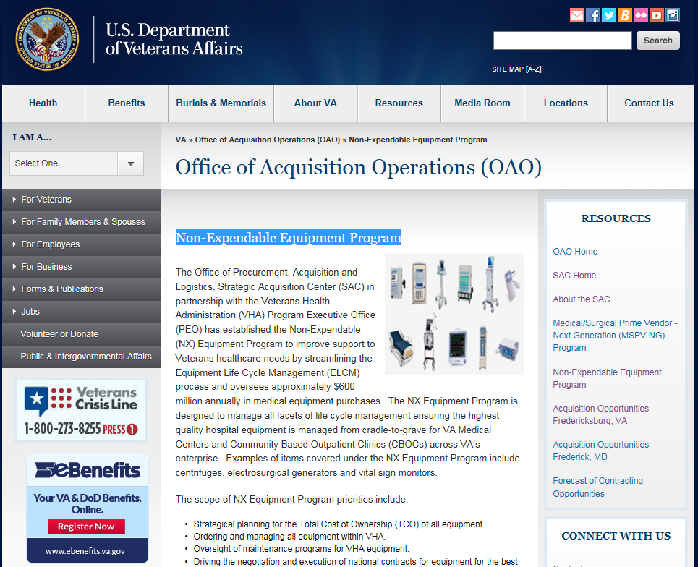
Non-Expendable Equipment Program
https://www.va.gov/officeofacquisitionoperations/sac/nxEquipment.asp

